Slide 1
WileyPLUS is an online learning platform that helps students do better in their course. Student who consistently use WileyPLUS throughout the semester earn higher grades in the course.
Learn by doing practice questions, homework, and assessments.
Save $$$, with the online interactive eTextbook.
Personalize your learning experience with ORION adaptive practice. Know what you don’t know before it’s too late.

Slide 2

Getting Started
With WileyPLUS
Class Test
Register — in minutes!
Get Help — when you need it!

Slide 3
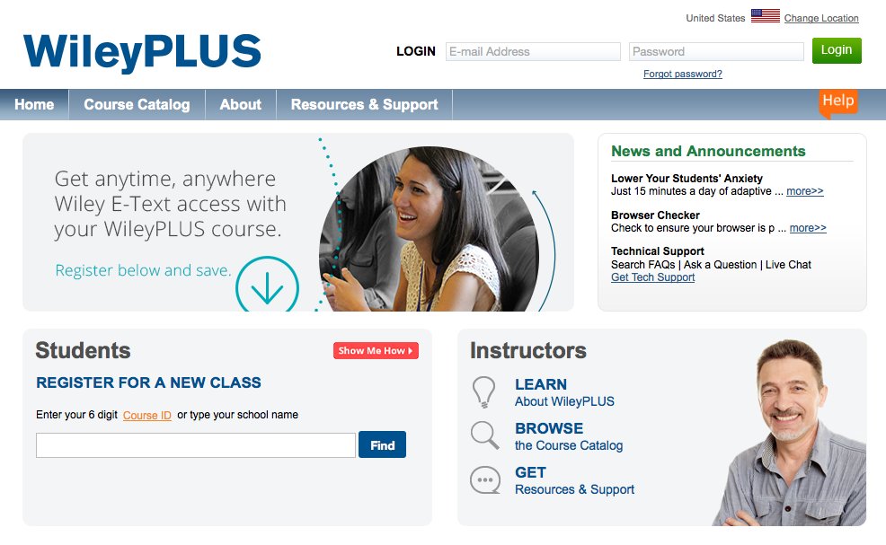
Go to www.wileyplus.com.
Notes:
Open your browser and go to www.wileyplus.com. If at anytime you need help using WileyPLUS, click “Show Me How” or “Help” and you will be guided through the process. “Help” is available when using WileyPLUS to show you exactly what you need to do if you are ever stuck or don’t understand what it is you need to do within the application.

Slide 4

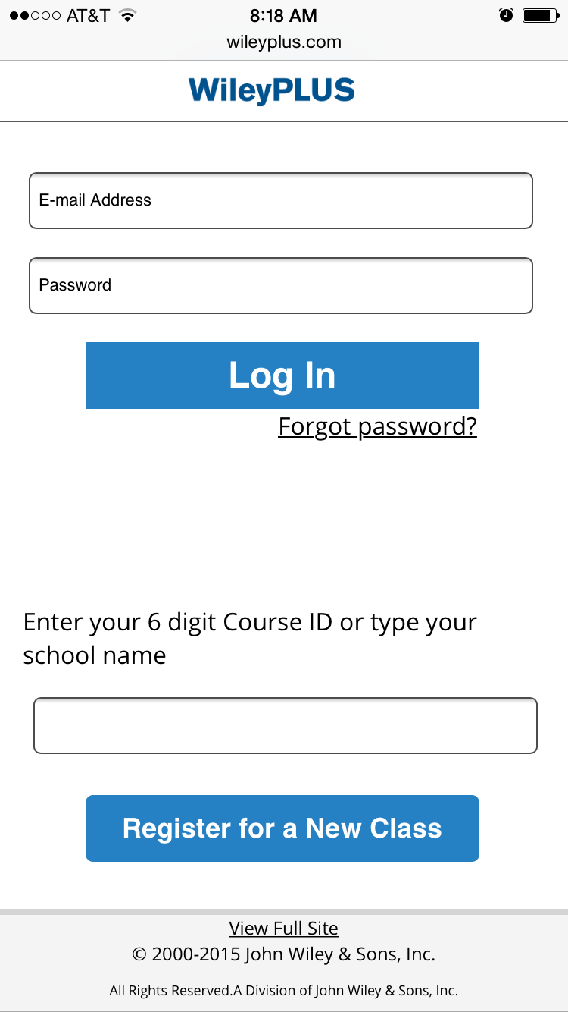
Or register via mobile
Notes:
WileyPLUS now supports mobile registration. Simply go to wileyplus.com on your device and follow the prompts.

Slide 5
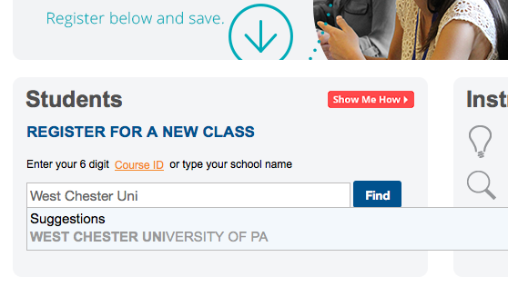
Course ID
If your instructor has provided you with a WileyPLUS Course ID, enter it into the space provided.
Don’t have the Course ID?
Simply start typing in your school name and select it when it appears.
Notes:
Looking at the lower left-hand corner you see a box labeled for Students. There are two ways to register for your class. The first is if your professor has provided you with a six-digit course ID. If you don’t have the course ID, the process is super simple. Start typing the name of your school into the space provided. Your school name will appear in a drop-down menu. When you find your school select it, and click the “Find” button.

Slide 6
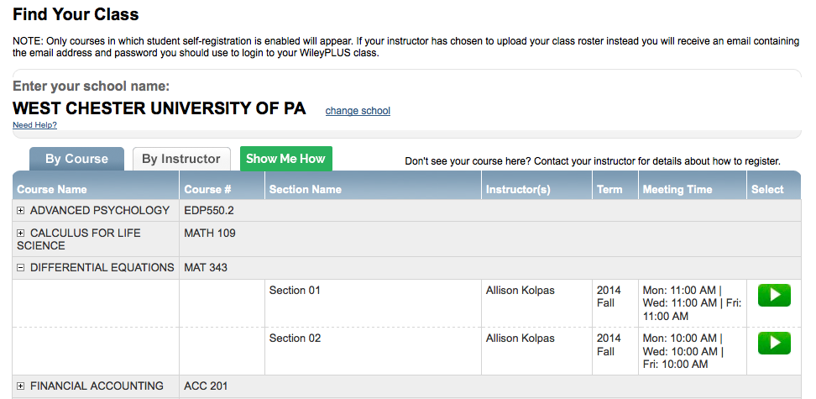
Find Your Class
Click the “+” next to the Course Name to reveal course sections. Once you have located your class and section, click the green button with the arrow to proceed.
POWER TIP:
The default search is “By Course,” but you can also search for your instructor’s name by clicking on the tab “By Instructor.”
Notes:
You now will see all of the classes at your school in which WileyPLUS is being used. You need to find your class. The local course name and course number are listed, so it should be very easy to locate your class. If you want to search by professor, you can do that as well—whatever works for you! Okay, so you found your class, now you need to find and select you class section. Again—this is really easy. Next to your class or instructor name (depending on how you searched) there is a plus symbol. Click the symbol and the various class sections will appear below. Locate your section and then click the arrow in the green box to the right of the class meeting time.

Slide 7
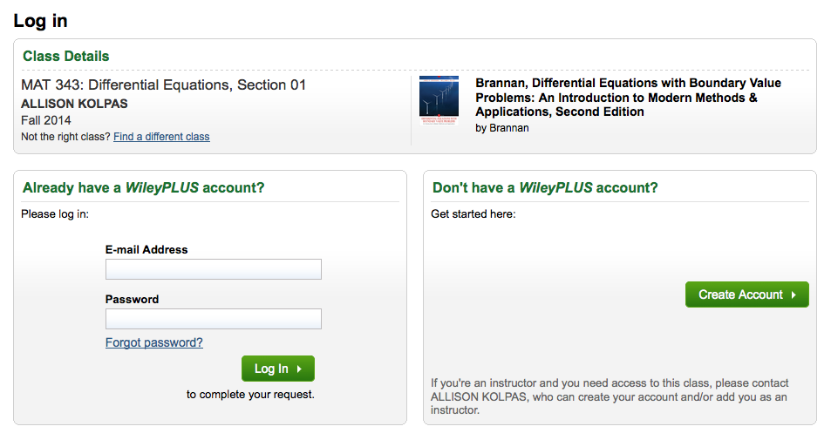
Log In
If you used WileyPLUS in the past, simply enter your E-mail Address and Password.
If this is your first time using WileyPLUS, click “Create Account.”
Notes:
Awesome! Now you’re ready to log in to WileyPLUS. If you used WileyPLUS in a different class, simply enter your email address and the password you created for the previous class. Congratulations! You can move on to the next step.
If this is your first time using WileyPLUS you will need to create an account—no big deal. Click “Create Account” in the box located in on the right side of the screen.

Slide 8

Class Test of WileyPLUS
Your instructor is class testing WileyPLUS, You will NOT need to purchase access to WileyPLUS Anton, Calculus, 11e.
*if you are using WileyPLUS for another course you will need to follow those directions for purchasing.

Slide 9

Need Help?
For any questions, please do not contact your instructor and use these helpful resources below:
  Visit our help section: 2 minute tutorials & More! www.wileyplus.com/go/studentfdoc
  Tech support: FAQs and live chat! www.wileyplus.com/support
Notes:
Need Help?
For any questions, please do not contact your instructor and use these helpful resources below:
Visit our help section: 2 minute tutorials & More! www.wileyplus.com/go/studentfdoc
Tech support: FAQs and live chat! www.wileyplus.com/support

Slide 10
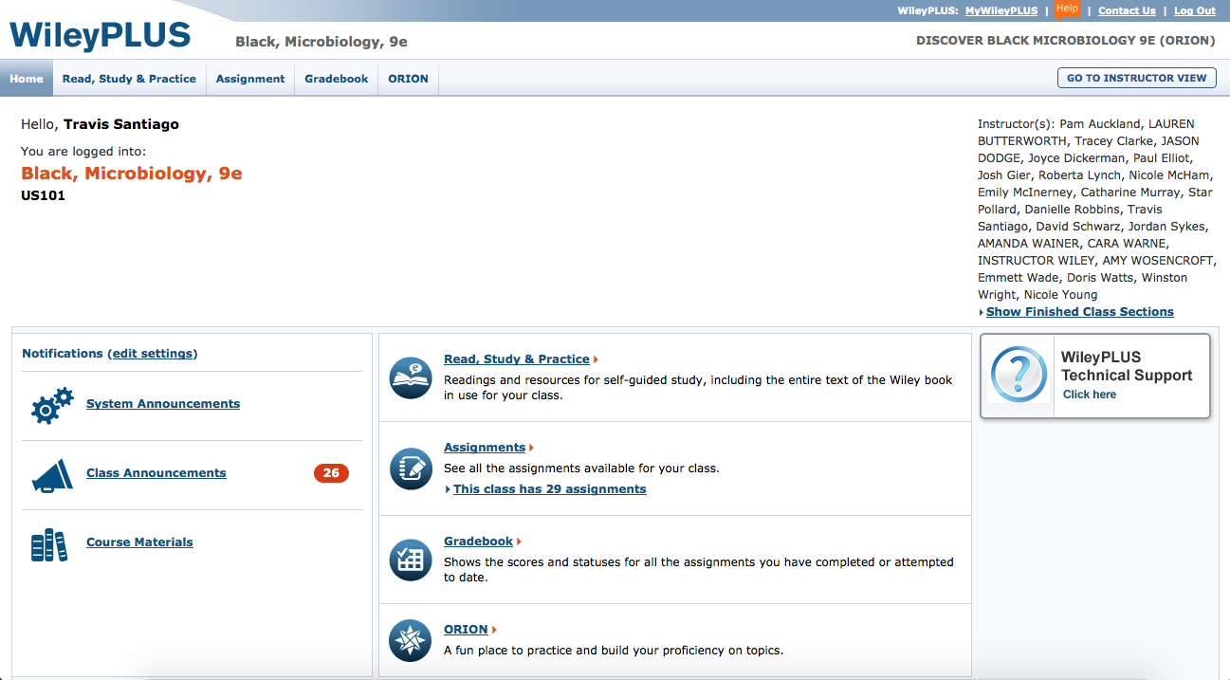
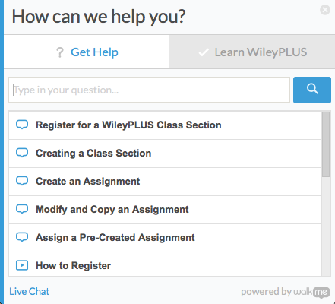
Help Powered by WalkMe

Slide 11
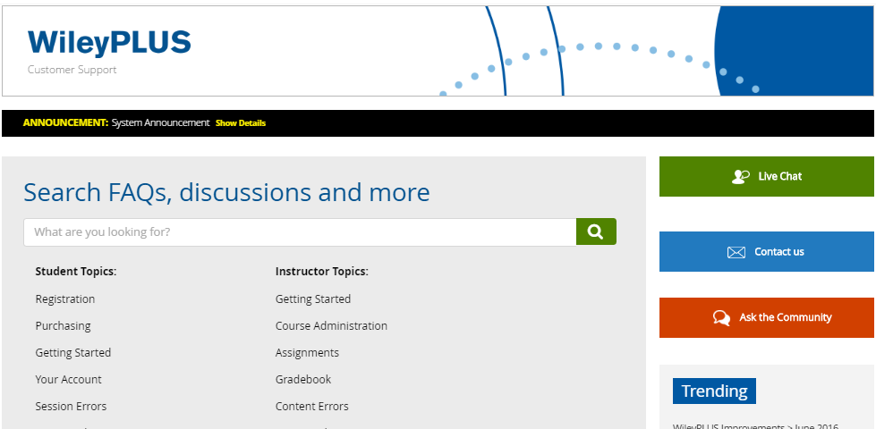
Technical Support
At wileyplus.com/support, you can search the knowledge base, live chat, and send a message to the WileyPLUS support team.
Notes:
Sometimes things don’t always go as planned. We do everything we can to ensure your WileyPLUS experience is excellent, but if you do encounter a problem, tech support is just a click away. You can access FAQs and other support directly from your Home screen, or at wileyplus.com. Live chat and messaging is the best way to connect with us one-on-one. Also, ask your instructor if there is a WileyPLUS Student Partner available for the class. Student Partners are just like you, except they are trained to help you out face-to-face. We’re always looking for new Student Partners, so if you would like to join the team, simply ask your instructor to recommend you. Student Partners are paid $200, receive a blurb for their resume, and students receive a certificate.

Slide 12
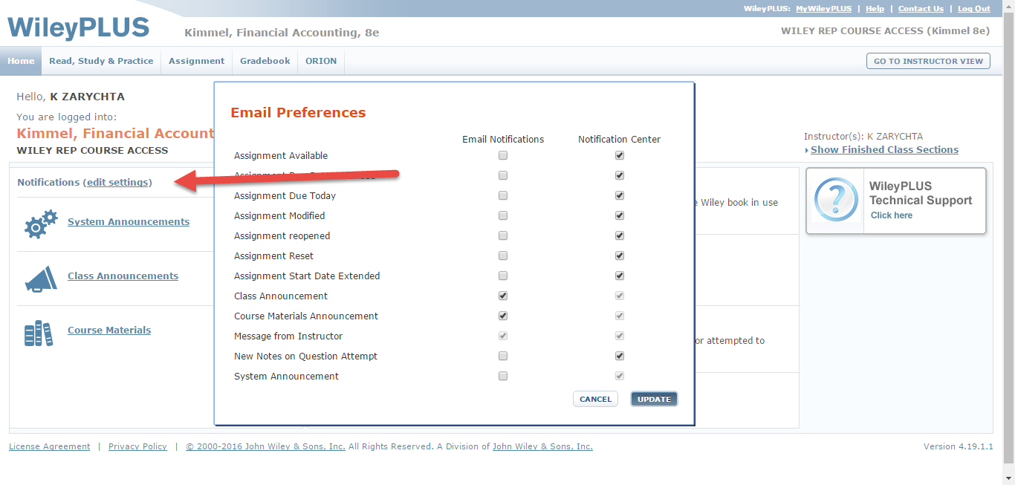
Student Home Page – Set Your Notifications

Slide 13

WileyPLUS with ORION
* Use Orion as a Pre-Cal refresher

Slide 14
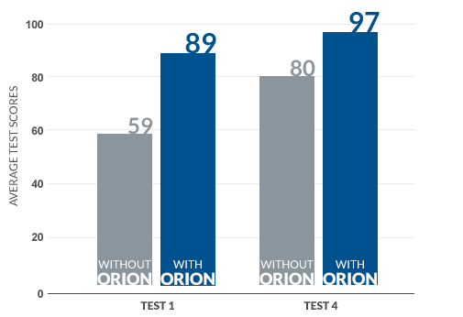
Students using ORION perform better on exams

Slide 15
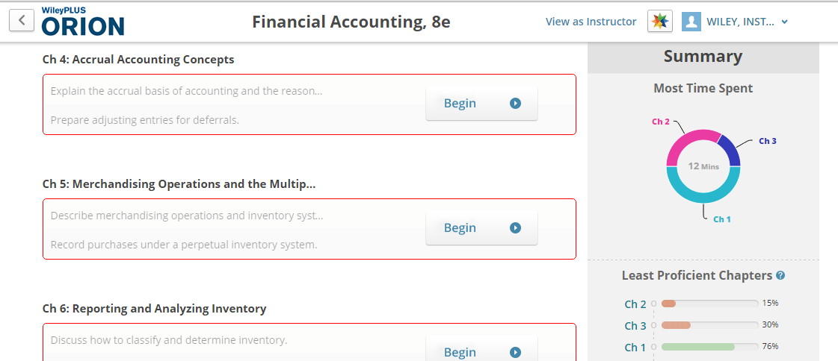
ORION Student Dashboard
Pick a chapter and click begin to start question-based diagnostic to determine your baseline level of understanding.

Slide 16
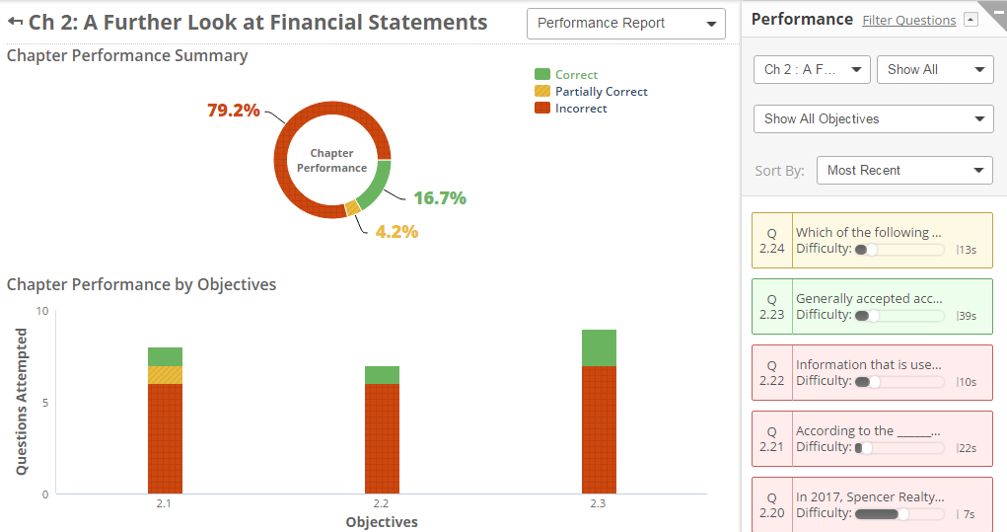
Performance Report
Review your question, learning objective, and chapter performance.

Slide 17
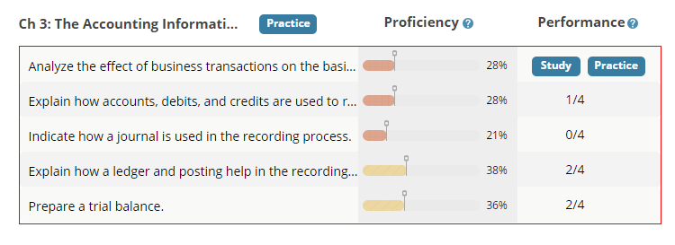
Study & Practice
Identify what you know, and study what you don’t know. You can practice at the chapter level to increase your overall proficiency

Slide 18
First Day of Class
Thank You!
We look forward to hearing about your WileyPLUS experience. Best of luck in this and all of your courses!

