Slide 1
PowerPoint Presentation to accompany
Educational Psychology
6th Edition
by John W. Santrock
© 2018 McGraw-Hill Higher Education. All rights reserved.

Slide 2
CHAPTER 1
Educational Psychology:
A Tool for Effective Teaching

Slide 3
Learning Goals
Describe some basic ideas about the field of educational psychology.
Identify the attitudes and skills of an effective teacher.
Discuss why research is important to effective teaching, and how educational psychologists and teachers can conduct and evaluate research.

Slide 4
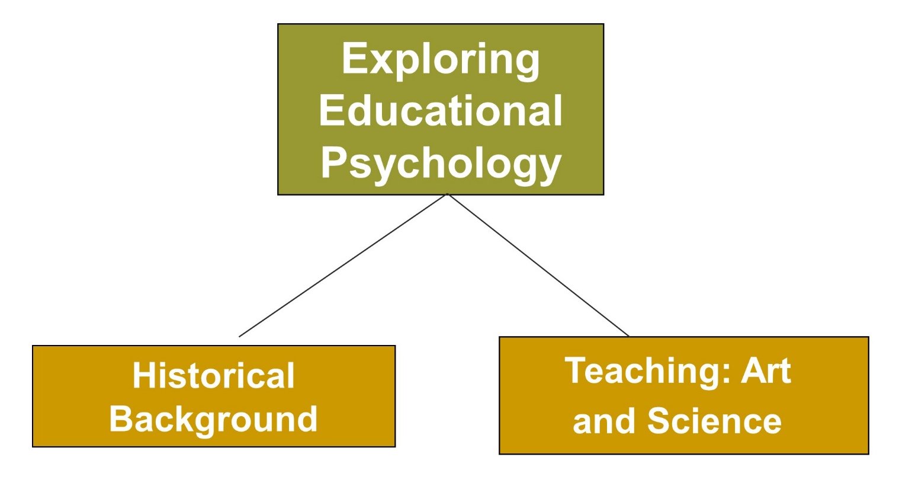
Educational Psychology:
A Tool for Effective Teaching, 1
Jump to long description

Slide 5
Connecting with Teachers
Effective teachers
  Emphasize how to learn, rather than what to learn
  Teach students how to read with genuine comprehension, shape an idea, master difficult material, and use writing to clarify thinking
  Include students in the process of teaching and learning (Metzger, 1996)

Slide 6
Educational Psychology
A branch of psychology that specializes in understanding
teaching and learning in educational settings

Slide 7
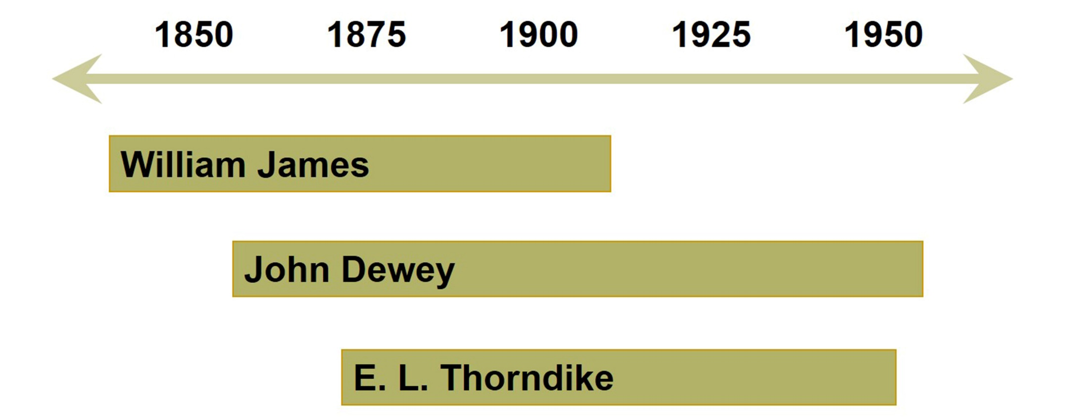
Historical Background of Educational Psychology
Jump to long description

Slide 8
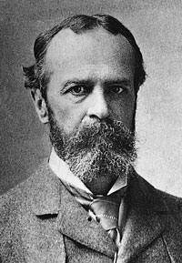
William James (1842 to 1910)
Emphasized the importance of observing teaching
and learning in the classroom for improving education
Recommended that lessons must be started just beyond a child’s level of knowledge and understanding to stretch the child’s mind

Slide 9
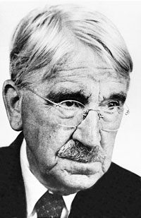
John Dewey (1859 to 1952)
Viewed the child as an active learner
Emphasized the child’s adaptation to the environment
Pushed for competent education for all children
Established the first major educational psychology lab in the U.S.

Slide 10
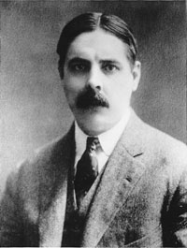
E. L. Thorndike (1874 to 1949)
Initiated an emphasis on assessment and measurement
of learning
Promoted the idea that educational psychology must have a scientific base and that measurement should be a central focus

Slide 11
Educational Psychology’s Historical Background
Leta Hollingworth (1916) - First to use the term gifted to describe students who scored exceptionally high on IQ tests
George Sanchez (1932) - Researcher who demonstrated that intelligence tests were culturally biased against minority children
Mamie and Kenneth Clark (1939) - Pioneering researchers who studied African American children’s self-conceptions and identity

Slide 12
Behavioral Approach
B. F. Skinner (1938)
  Defined psychology as the science of observable behavior and controlling conditions
  In the 1950s, the concept of programmed learning was developed
    Involved reinforcement after a series of steps until the student reached a learning goal

Slide 13
The Cognitive Revolution
Bloom’s taxonomy of cognitive skills (1950s)
Includes
  Remembering
  Comprehending
  Synthesizing
  Evaluating
Cognitive psychology (1980s)
Includes
  Memory
  Thinking
  Reasoning

Slide 14
Teaching: Art and Science, 1
How is teaching both art and science?

Slide 15
Teaching: Art and Science, 2
Science and the art of experienced practice play an important role in a teacher’s success
  Educational psychology draws its knowledge from
    Broader theory and research in psychology
    Theory and research created and conducted by educational psychologists and a teacher’s personal experiences
  Teaching remains an art
    Teaching sometimes must depart from scientific recipes, requiring improvisation and spontaneity

Slide 16
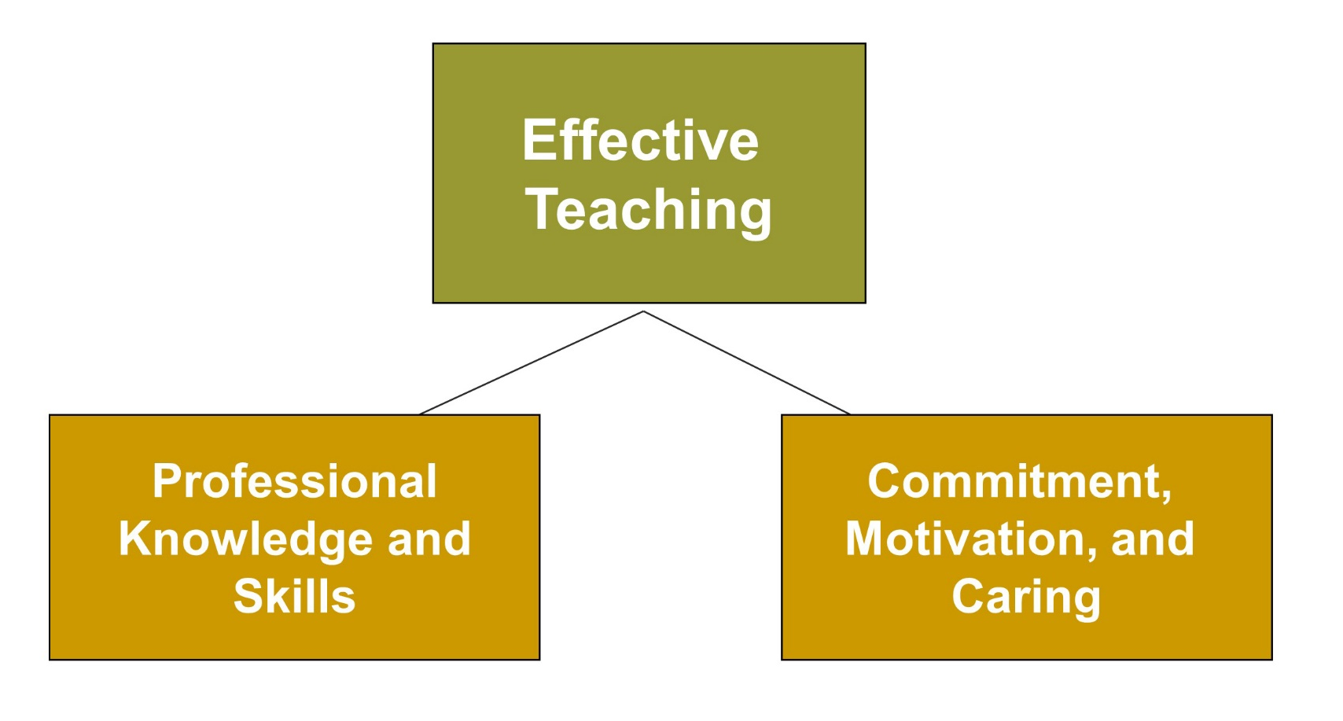
Educational Psychology: A Tool for Effective Teaching, 2
Jump to long description

Slide 17

Reflection and Observation
Reflection:
What were the characteristics of the most effective teachers in your educational experience?
Notes:
This slide accompanies the video segment, Observing Effective Teaching, on the McGraw-Hill DVD Teaching Stories: A Video Collection for Educational Psychology.

Slide 18
Effective Teaching
Professional Knowledge and Skills, 1
Effective Teachers:
  Exhibit subject-matter competence
  Implement appropriate instructional strategies
  Model and communicate good critical thinking skills
  Set high goals for themselves and students and organize plans for reaching those goals
  Create developmentally appropriate instructional materials and activities
  Manage classrooms for optimal learning

Slide 19
Effective Teaching
Professional Knowledge and Skills, 2
Effective Teachers:
  Use effective strategies to promote students’ motivation to learn
  Communicate well with students and parents
  Pay more than lip service to individual variations
  Work effectively with students from culturally diverse backgrounds
  Have good assessment knowledge and skills
  Integrate technology into the curriculum

Slide 20
Effective Teaching
Commitment, Motivation, and Caring
Effective Teachers:
  Have a good attitude
  Care about students
  Invest time and effort
  Have confidence in their own self-efficacy
  Bring a positive attitude and enthusiasm to the classroom

Slide 21
Characteristics of Best Teachers
CHARACTERISTICS OF BEST TEACHERS
Characteristics | % Total
Have a sense of humor | 79.2
Make the class interesting | 73.7
Have knowledge of their subjects | 70.1
Explain things clearly | 66.2
Spend time to help students | 65.8
Are fair to their students | 61.8
Treat students like adults | 54.4
Relate well to students | 54.2
Are considerate of students’ feelings | 51.9
Don’t show favoritism toward students | 46.6

Slide 22
Characteristics of Worst Teachers
CHARACTERISTICS OF WORST TEACHERS
Characteristics | % Total
Are dull/have a boring class | 79.6
Don’t explain things clearly | 63.2
Show favoritism toward students | 52.7
Have a poor attitude | 49.8
Expect too much from students | 49.1
Don’t relate to students | 46.2
Give too much homework | 44.2
Are too strict | 40.6
Don’t give help/individual attention | 40.5
Lack control | 39.9

Slide 23
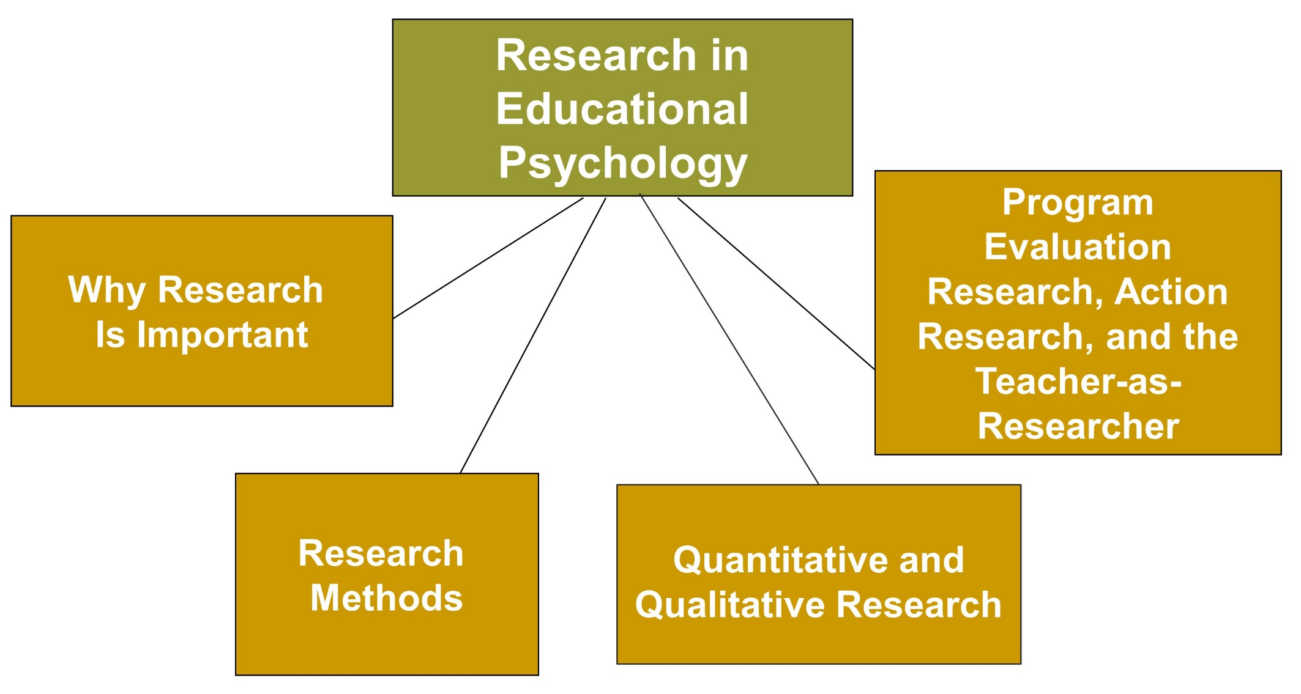
Educational Psychology:
A Tool for Effective Teaching, 3
Jump to long description

Slide 24
Why Research Is Important
  Research
  Provides you with valid information about the best way to teach children
  Allows you to be objective about knowledge you get from personal experience
  Allows you to make sense of experts who don’t always agree on the “best way” to educate students

Slide 25
Research Methods, 1
Descriptive Research
  Observations
    Laboratory
    Naturalistic observation
    Participant observation
  Interviews and questionnaires
  Standardized tests

Slide 26
Research Methods, 2
Descriptive Research
  Physiological Measures
  Case Studies
  Ethnographic Studies
  Focus Groups
  Personal Journals and Diaries

Slide 27
Research Methods, 3
Correlational Research
Measures the strength of a relationship between two variables
Does NOT equal causation
Experimental Research
Cause versus effect
Independent variables versus dependent variables
Only truly reliable method of establishing cause and effect
Experimental groups versus control groups
Random assignment

Slide 28
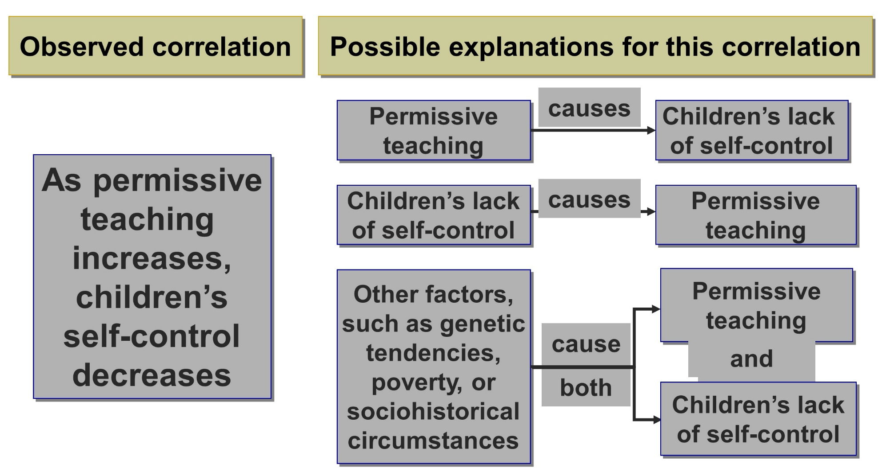
Possible Explanations for Correlational Data
Jump to long description

Slide 29
Experimental Research, 1
    Independent variable: The manipulated, influential, and experimental factor
    Dependent variable: The factor that is measured in an experiment
    Control group: In an experiment, a group whose experience is treated in every way like the experimental group except for the manipulated factor
    Experimental group: The group whose
    experience is manipulated
    Random assignment: The assignment of participants
    to experimental and control groups by chance

Slide 30
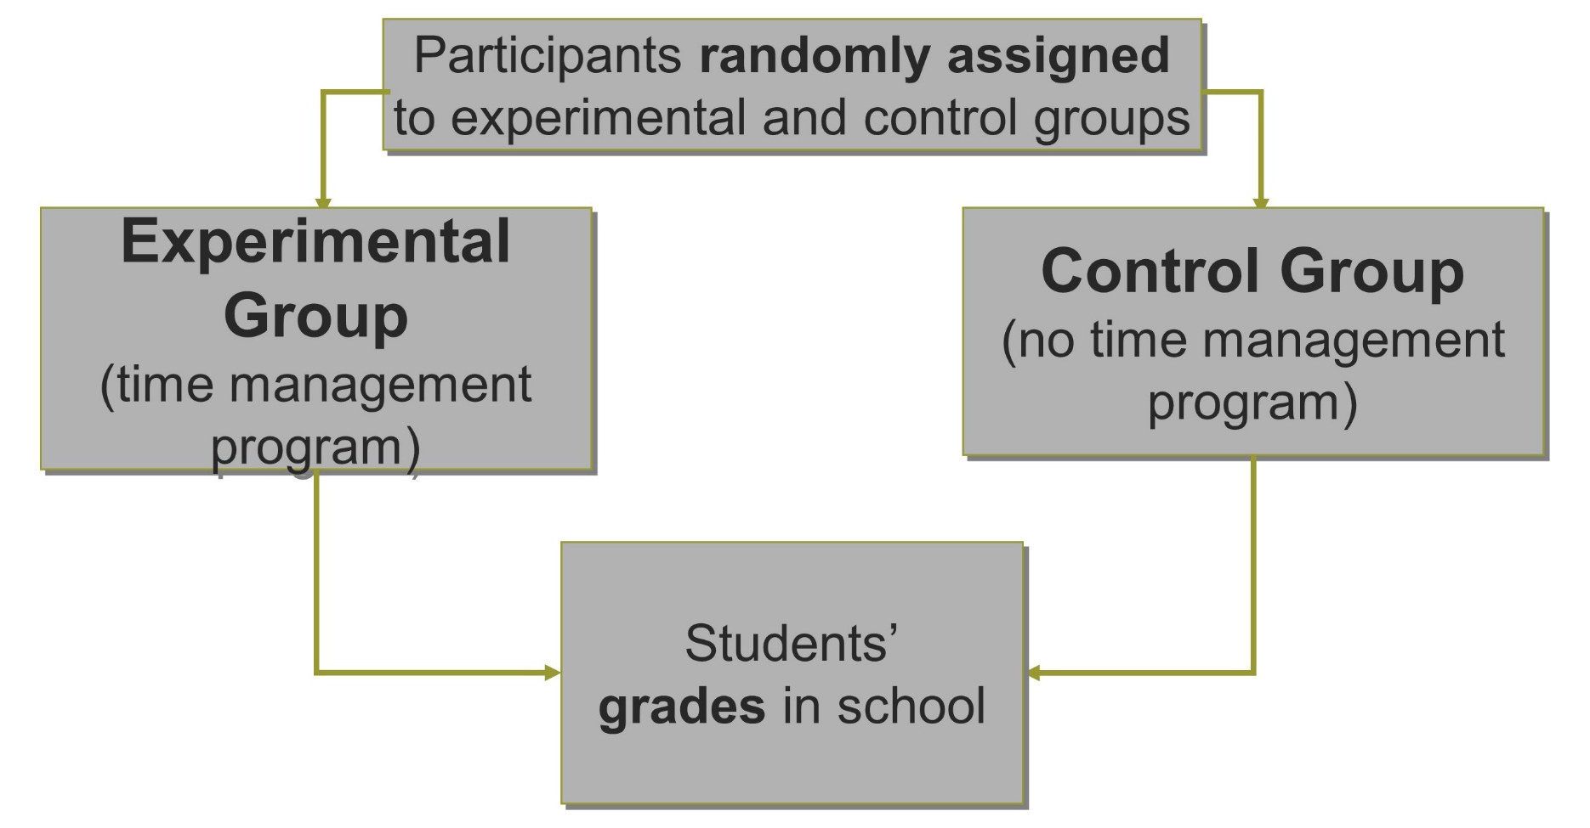
Experimental Research, 2
A study of the effects of time management on students’ grades

Slide 31
Program Evaluation, Action Research, and Teacher-as-Researcher
Program Evaluation: Designed to make decisions about the effectiveness of a particular program
Action Research: Used to solve a
particular classroom or
school problem
Teacher-as-Researcher: Teachers
conduct their own studies to
improve their teaching practices

Slide 32
Quantitative and Qualitative Research
Quantitative Research
  Uses numerical calculations to discover information about a topic and includes experimental and correlational research designs
Qualitative Research
  Information gathered using descriptive methods and includes interviews, case studies, and ethnographic studies
Mixed Methods Research
  Blends different research designs and/or methods

Slide 33
Enter the Debate
Should teachers conduct research using their students as subjects?
YES
NO
Notes:
During a slideshow, text may be written on the slides in the yes/no boxes, and then saved for later reference.

Slide 34
Classroom Connections: Crack the Case—The Classroom Decision, 1
What issues would need to be considered in conducting such a study?
What type of research would be most appropriate?
Why?
If she compared the two different curricula and their outcomes, what would the independent variable be?
Notes:
This case is on page 25 of the text.

Slide 35
Classroom Connections: Crack the Case—The Classroom Decision, 2
If she decides to conduct an experimental study in which she compared the two different curricula and their outcomes, what would the dependent variable be?
How should Ms. Huang go about conducting her study?
Notes:
This case is on page 25 of the text.

Slide 36
Appendix of Image for Long Descriptions

Slide 37
Educational Psychology:
A Tool for Effective Teaching, 1 Long Description
This figure contains a flowchart with three boxes. The first box reads exploring educational psychology. This box has two line below it pointing to the next two boxes. Out of these, the box on the left reads historical background, and the box on the right reads teaching. Art and science.
Jump back to slide containing original image

Slide 38
Historical Background of Educational Psychology Long Description
This slide illustrates the historical background of educational psychology.
This timeline, from the left to the right, lists the years 1850, 1875, 1900, 1925, and 1950.
Names of the three major pioneers, William James, John Dewey, and E. L. Thorndike, are added in three text boxes below the timeline.
William James is associated from the year 1842 to 1910. John Dewey is associated from the year 1859 to 1952. E. L. Thorndike is associated from the year 1874 to 1949.
This slide illustrates the historical background of educational psychology. Three major pioneers namely William James, John Dewey, and E. L. Thorndike are considered in this image as they are said to have created and shaped the field of educational psychology.
The timeline moves from the left to the right and lists the years 1850, 1875, 1900, 1925, and 1950.
William James covers the timeline from 1842 to 1910. John Dewey covers the timeline from 1859 to 1952. E. L. Thorndike covers the timeline from 1874 to 1949.
Jump back to slide containing original image

Slide 39
Educational Psychology: A Tool for Effective Teaching, 2 Long Description
This figure contains a flowchart with three boxes. The box at the top reads effective teaching. This box has two lines that connect it to the two boxes below it. The box on the left reads professional knowledge and skills, and the box on the right reads commitment, motivation, and caring.
Jump back to slide containing original image

Slide 40
Educational Psychology:
A Tool for Effective Teaching, 3 Long Description
This slide illustrates the use of research in education psychology with the help of a flowchart. The flowchart has five boxes. The box at the top reads research in education psychology. Four lines connect this box to the four boxes below it. From the left, these boxes read why research is important, research methods, quantitative and qualitative research, and program evaluation research, action research, and the teacher-as-researcher.
Jump back to slide containing original image

Slide 41
Possible Explanations for Correlational Data Long Description
This slide illustrates possible explanations for correlation data. There are two header boxes next to each other with related boxes under each of them with explanations.
The title of the first box reads observed correlation. The box under this reads as permissive teaching increases, children’s self-control decreases.
The title of the second box reads possible explanations for this correlation.
The content in the first set of boxes under this reads permissive teaching causes children’s lack of self-control.
The content in the second set of boxes reads children’s lack of self-control causes permissive teaching.
The content in the third set of boxes reads other factors, such as genetic tendencies, poverty, or sociohistorical circumstances cause both permissive teaching and children’s lack of self-control.
Jump back to slide containing original image

