Slide 1
CHAPTER 2
Cognitive and Language Development
© 2018 McGraw-Hill Higher Education. All rights reserved.

Slide 2
Learning Goals
Define development and explain the main processes, periods, and issues in development, as well as links between development and education.
Discuss the development of the brain and compare the cognitive developmental theories of Jean Piaget and Lev Vygotsky.
Identify the key features of language, biological and environmental influences on language, and the typical growth of the child’s language.

Slide 3
Connecting with Teachers
Donene Polson’s classroom reflects Vygotsky’s emphasis on the importance of collaboration among a community of learners
Students, teachers, and parents work as a community to help students learn
  Many students tell Donene that experiences in her classroom contributed to their development and learning

Slide 4
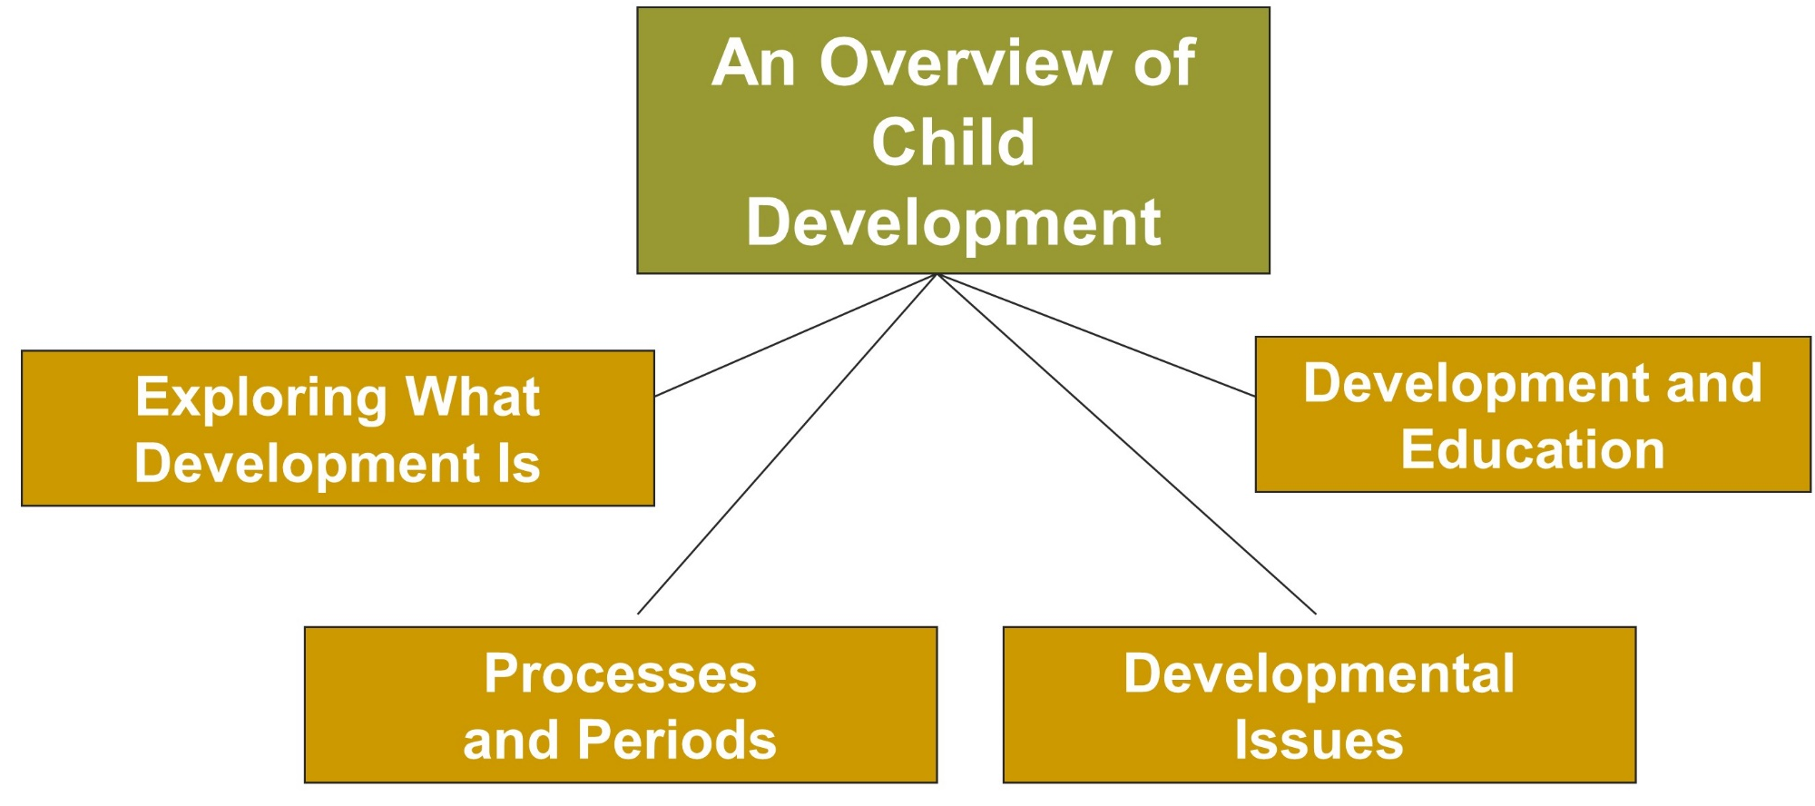
Cognitive and Language Development, 1
Jump to long description

Slide 5
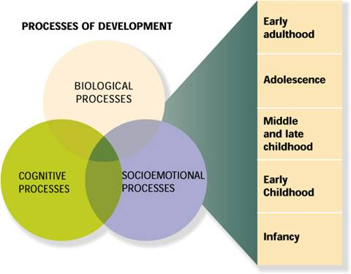
An Overview of Child Development
Development: The pattern of biological, cognitive, and socioemotional changes that begins at conception and continues through the life span
Jump to long description

Slide 6
Developmental Processes, 1
Biological processes and genetic inheritance
  Development of the brain
  Gains in height and weight
  Changes in motor skills
  Puberty’s hormonal changes
Cognitive processes
  Changes in the child’s thinking
  Intelligence
  Language acquisition

Slide 7
Developmental Processes, 2
Socioemotional processes
  Changes in the child’s relationships
  with other people
  Changes in emotions
  Changes in personality

Slide 8
Biological, Cognitive, and Socioemotional Processes
Processes are intertwined; a child’s smile as a response to a parent’s touch depends on ….
  Biological processes (physical nature of touch and responsiveness to it)
  Cognitive processes (ability to understand intention)
  Socioemotional processes (smile reflects positive feeling and connects the child with others)

Slide 9
Two Emerging Fields That Explore Connections across Processes
Developmental cognitive neuroscience
  Explores links between development, cognitive processes, and the brain
Developmental social neuroscience
  Examines connections between socioemotional processes, development, and the brain

Slide 10
Periods of Development, 1
Infancy - From birth to 18 to 24 months
  Activities include language development, symbolic thought, sensorimotor coordination, and social learning
  Time of extreme dependence on adults
Early childhood - Extends from the end of infancy to about 5 years (preschool years)
  Children become more self-sufficient, develop school readiness skills, and spend time with peers
  Early childhood ends at 1st grade

Slide 11
Periods of Development, 2
Middle and late childhood - Extends from about 6 to 11 years (elementary school years)
  Children master the fundamental skills of reading, writing, and math
  Self-control increases; children interact with a wider social world
Adolescence - Begins around ages 10 to 12 and ends in the late teens
  Rapid physical changes (height, weight, and sexual functions), desire for independence and identity, and development of abstract reasoning skills

Slide 12
Developmental Issues
Nature-Nurture Issue
Continuity-Discontinuity Issue
Early-Later Experience Issue
Notes:
1. Nature-nurture issue - Whether development is primarily influenced by nature (biological inheritance) or nurture (environmental experiences)
2. Continuity-discontinuity issue - Extent to which development involves gradual, cumulative change (continuity) or distinct stages (discontinuity)
3. Early-later experience issue - Degree to which early experiences (especially those in infancy) or later experiences are the key determinants of the child’s development

Slide 13
Development and Education
Developmentally appropriate teaching practices
  Teaching at a level that is
  not too difficult and stressful nor too easy and boring
Splintered development
  Student development may
  be uneven across domains
  (student might be strong in math but poor in writing)

Slide 14
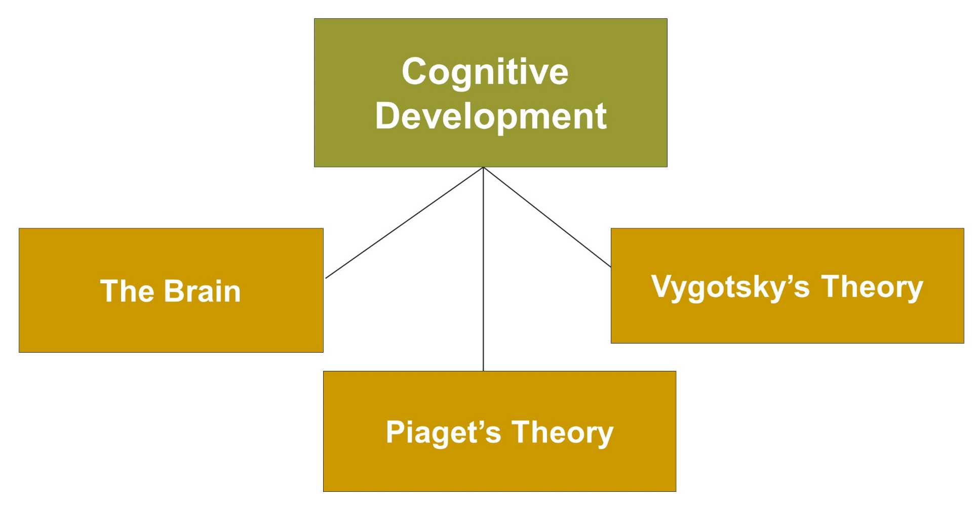
Cognitive and Language Development, 2
Jump to long description

Slide 15
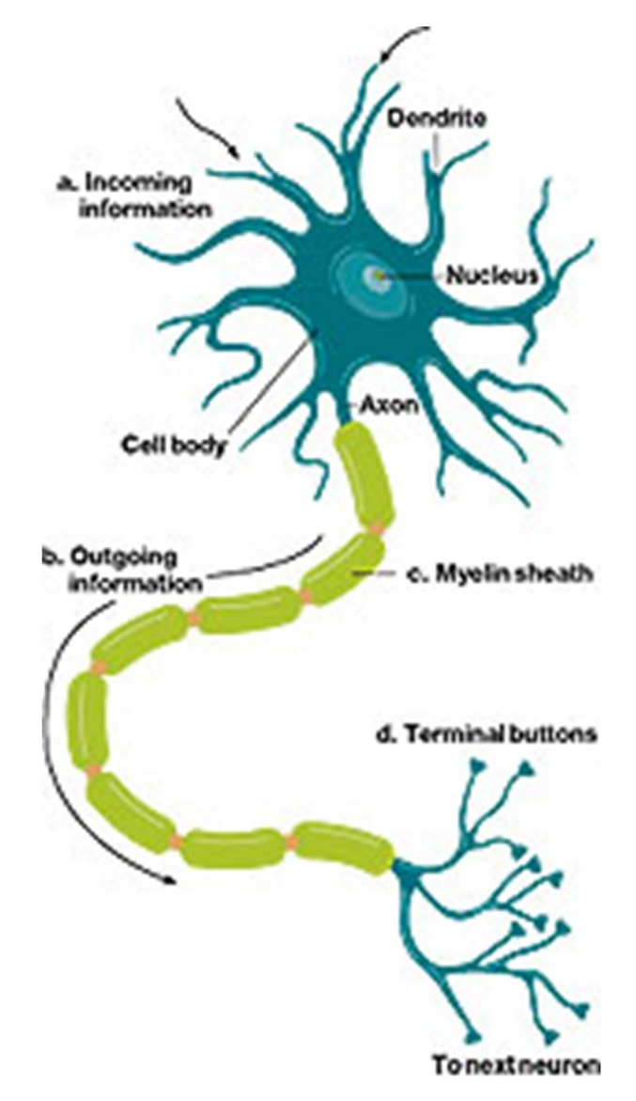
Myelination
Increases the speed at which information travels through the nervous system
Jump to long description
Notes:
1. The number and size of the brain’s nerve endings continue to grow at least into adolescence.
2. Children will have difficulty focusing and maintaining attention in early childhood. Attention will improve during elementary school years.
3. Synaptic connections show dramatic growth in visual, auditory, and prefrontal cortex areas (areas critical for learning, memory, and reasoning).
4. Connections that are used are strengthened; unused connections disappear (“pruned”).

Slide 16
Brain Development in Middle and Late Childhood
Total brain volume stabilizes
Brain pathways and circuitry in prefrontal cortex continue to increase
Advances in prefrontal cortex are linked to child’s improved attention, reasoning, and cognitive control

Slide 17
Brain Development in Adolescence
Adolescents have fewer, more selective, more effective connections between neurons than they did as children
Activities adolescents choose to engage in or not engage in influence neural connections (which will be strengthened and which will disappear)

Slide 18
Brain and Children’s Education
Role of early and later experiences
Dramatic changes in synaptic connections
Prefrontal cortex development into adolescence
Cognitive control challenges in adolescence
Brain functioning along specific pathways and integration of function

Slide 19
Piaget’s Cognitive Processes
Schemas | Actions or mental representations that organize knowledge
Assimilation | Incorporating new information into existing schemas
Accommodation | Adjusting existing schemas to fit new information and experiences
Organization | Grouping isolated behaviors and thoughts into a higher-order system
Equilibration | Explains a shift from one stage to the next as children try to resolve conflict to reach a balance
Notes:
Equilibration - Mechanism by which children shift from one stage of thought to the next
The shift occurs as children experience cognitive conflict (disequilibrium) in trying to understand the world.
Eventually, children resolve their conflict and reach a balance (equilibrium) of thought.

Slide 20
Figure 2.9 - The Four Piagetian Stages of Cognitive Development
SENSORIMOTOR STAGE
PREOPERATIONAL STAGE
CONCRETE OPERATIONAL STAGE
FORMAL OPERATIONAL STAGE
The infant constructs an understanding of the world by coordinating sensory experiences with physical actions. An infant progresses from reflexive, instinctual action at birth to the beginning of symbolic thought toward the end of the stage.
The child begins to represent the world with words and images. These words and images reflect increased symbolic thinking and go beyond the connection of sensory information and physical action.
The child can now reason logically about concrete events and classify objects into different sets.
The adolescent reasons in more abstract, idealistic, and logical ways.
Birth to 2 Years of Age
2 to 7 Years of Age
7 to 11 Years of Age
11 Years of Age Through Adulthood

Slide 21
Piaget’s Preoperational Stage
Symbolic Function Substage
Symbolic function: Child gains ability to represent mentally an object that is not present
Limitation
  Egocentrism - Inability to distinguish between one’s own perspective and someone else’s perspective
Notes:
Preoperational stage is the second Piagetian stage.
Lasts approximately from 2 to 7 years of age
Can be subdivided into two substages: (a) symbolic function and (b) intuitive thought
Symbolic function substage - Occurs between 2 and 4 years of age

Slide 22
Piaget’s Preoperational Stage
Intuitive Thought Substage
Intuitive Thought involves primitive reasoning
Centration: Focuses attention on one characteristic to the exclusion of others
  Lack of Conservation: Idea that some characteristics of an object stay the same even when the object might change in appearance
Notes:
Intuitive thought substage - Second substage of Piaget’s preoperational thought
Begins at about 4 years of age and lasts until about 7 years of age.
A child begins to use primitive reasoning and wants to know the answers to all sorts of questions.

Slide 23
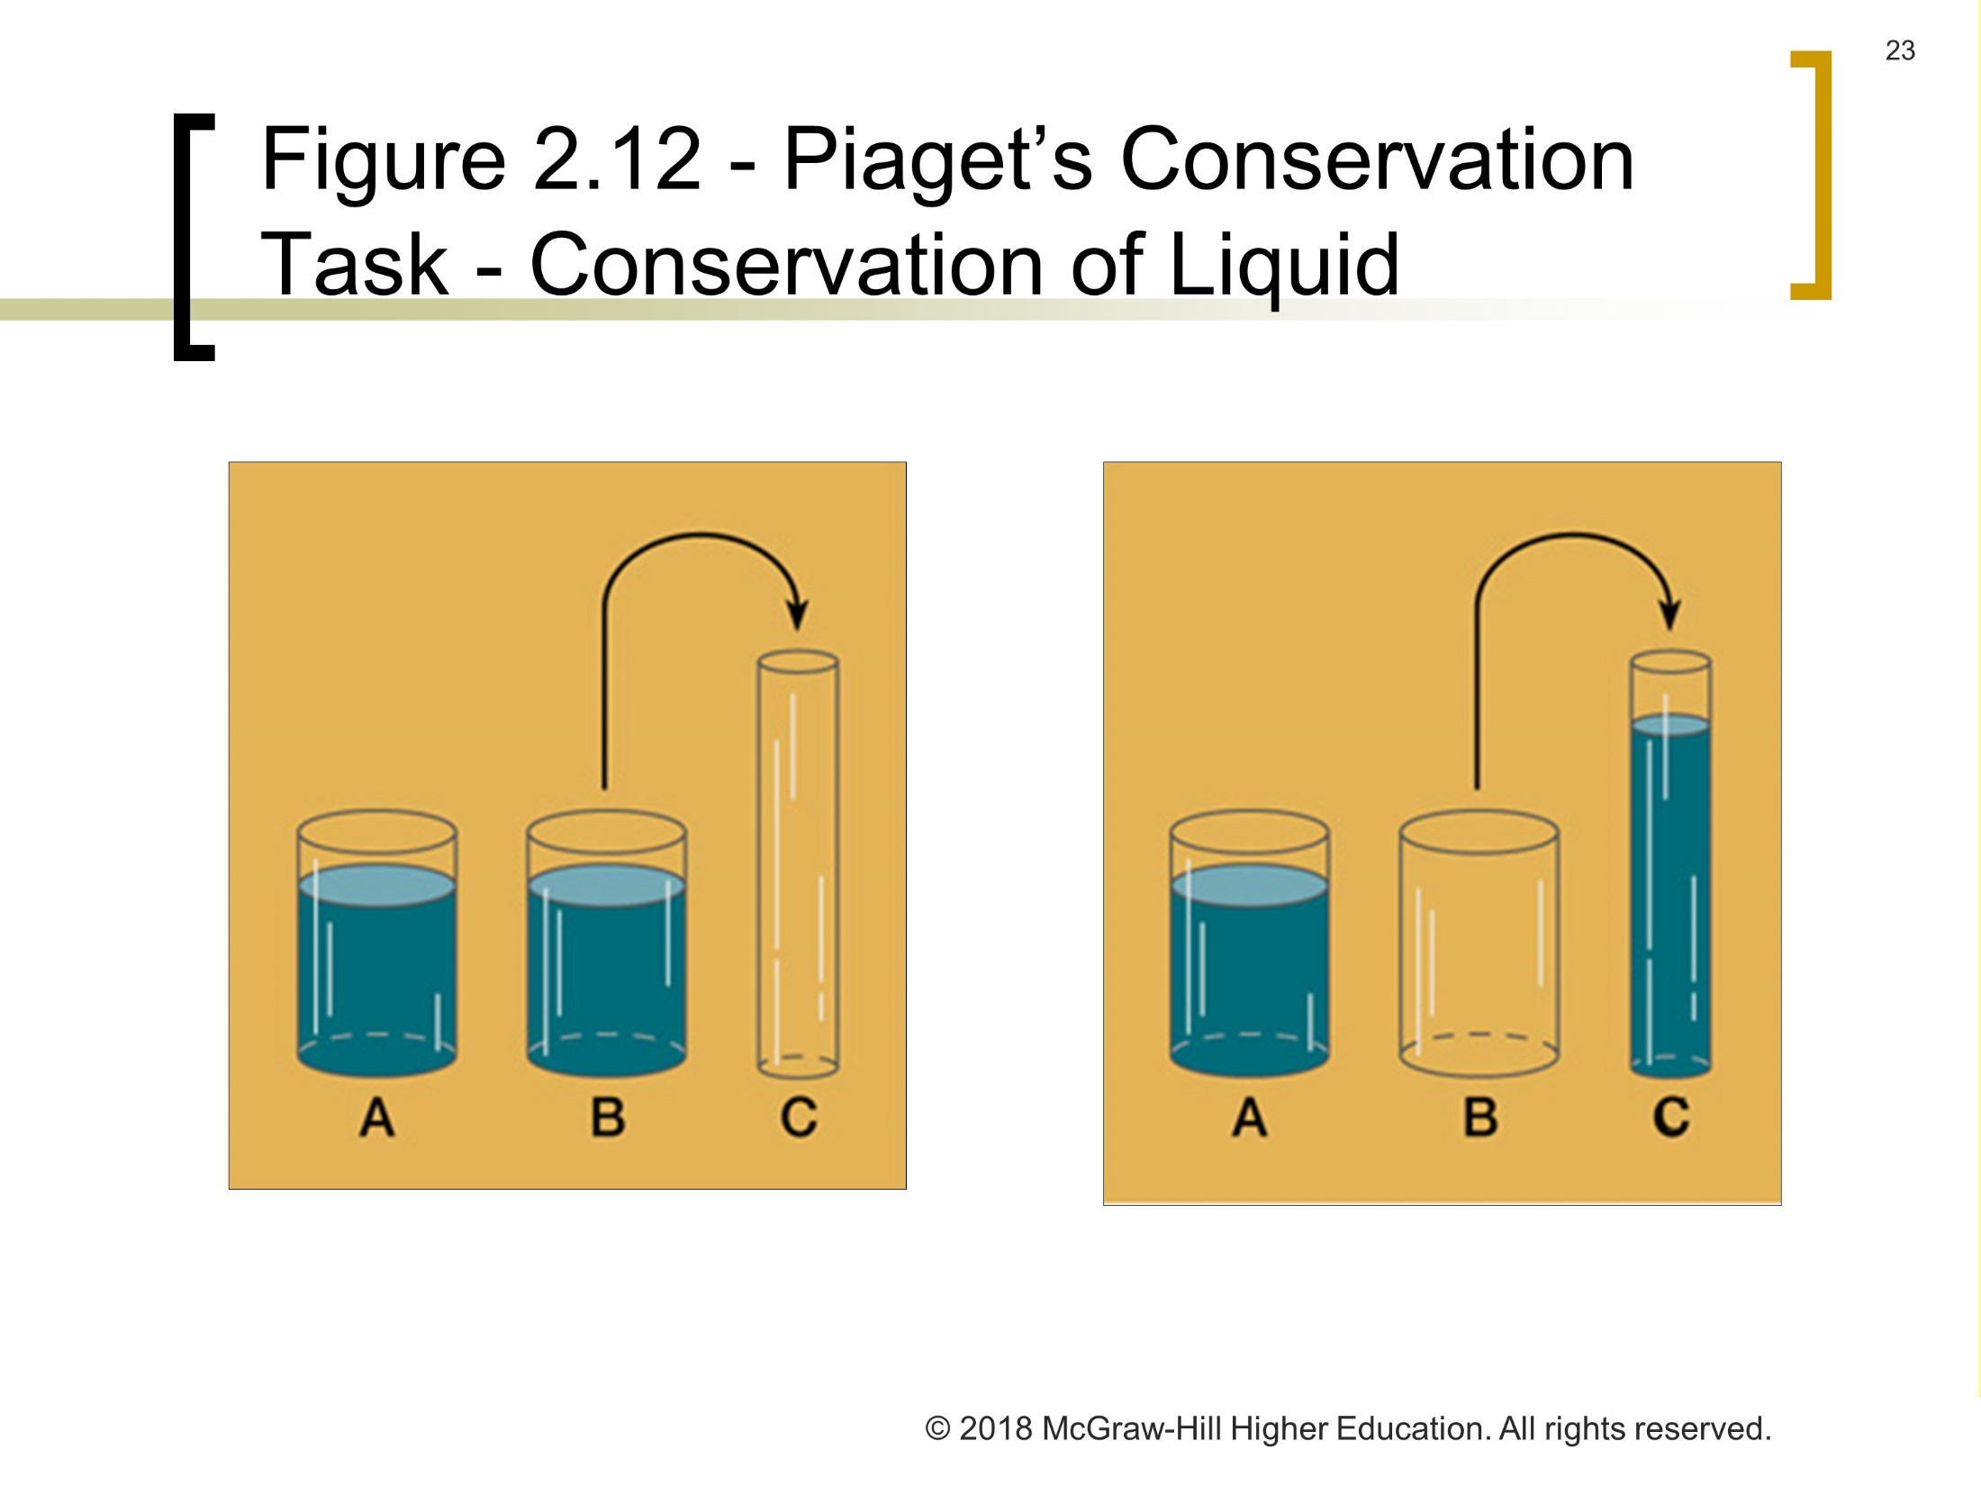
Figure 2.12 - Piaget’s Conservation Task - Conservation of Liquid
Jump to long description
Notes:
Piaget’s thoughts:
Preoperational stage of thinking - Child fails conservation of liquid task.
Concrete operational stage of thinking - Child passes conservation of liquid task.
Children show considerable variation in conservation skill attainment.

Slide 24
Piaget’s Concrete Operational Stage
Logical reasoning replaces intuitive reasoning, but only in concrete situations.
Conservation | The idea that some characteristics of an object stay the same even though the object might change in appearance
Classification | Coordinate several characteristics rather than focus on a single property of an object
Seriation | Stimuli is ordered along some quantitative dimension
Transitivity | Ability to reason about and logically combine relationships If A>B and B>C, then A>C
Notes:
Third Piagetian stage of cognitive development
Lasts from about 7 to 11 years of age
Concrete operational thought involves using operations.
Operations are mental representations that are reversible.

Slide 25
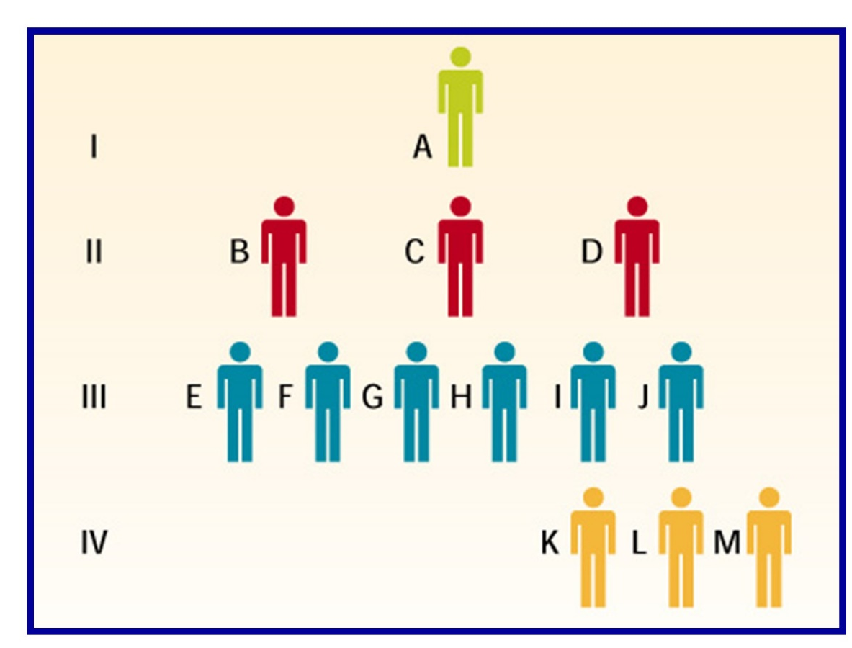
Figure 2.13 - Classification
When shown a family tree of four generations, the concrete operational child can classify
the members vertically,
horizontally, and obliquely.

Slide 26
Piaget’s Formal Operational Stage
Hypothetical-deductive reasoning: Adolescents can develop hypotheses about ways to solve problems and systematically reach a conclusion
Adolescent egocentrism - Heightened self-consciousness and a sense of personal uniqueness
Notes:
Piaget’s fourth and final cognitive stage
Individuals move beyond reasoning only about concrete experiences.

Slide 27
Best Practices and Strategies: Working with Formal Operational Thinkers
Realize many adolescents are not fully formal operational thinkers
Propose a problem and invite students to form hypotheses about possible solutions
Present a problem and suggest several ways it might be approached
Develop projects and investigations for students to carry out
Encourage students to create hierarchical outlines when writing papers

Slide 28
Criticisms of Piaget’s Theory
Estimates of children’s competence: Some cognitive abilities emerge earlier, others later
Stages: Thought to be unitary structures
  Some concrete operational concepts do not appear at same time
Training children to reason at a higher level: Piaget argued that training is ineffective unless the child is at a maturational transition point
Culture and education: Stronger influence on a child’s development than Piaget envisioned

Slide 29
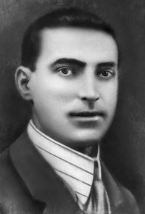
Vygotsky’s Theory
Zone of proximal development: Range of tasks that are too difficult for a child to master alone
Can be learned with guidance and assistance of adults or more skilled children
Scaffolding: Teacher adjusts the level of support as performance varies
Language and thought:
  Develop independently of each other and then merge
  Have external or social origins

Slide 30
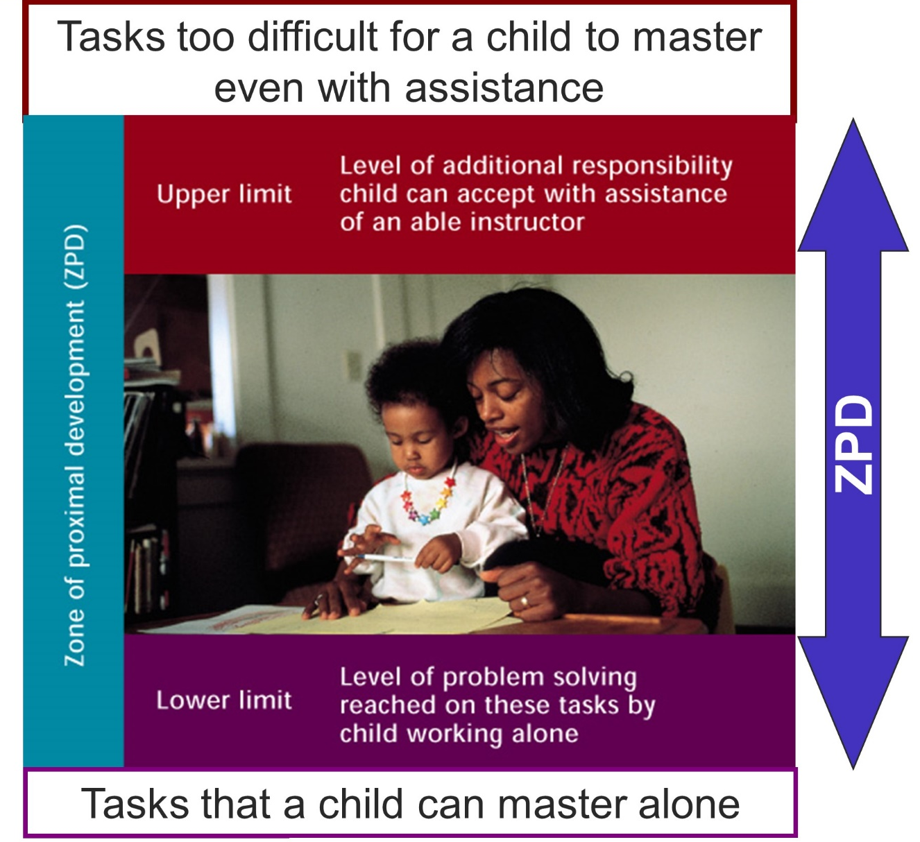
Figure 2.14 - Vygotsky’s Zone of Proximal Development
Jump to long description

Slide 31
Comparison: Piaget’s and Vygotsky’s Theories
Piaget and Vygotsky’s theories
  Both are constructivist
  Vygotsky’s social constructivist approach emphasizes the social contexts of learning and the construction of knowledge through social interaction
  Piaget focuses on the individual; Vygotsky focuses on collaboration, social interaction, and sociocultural activity

Slide 32
Criticism of Vygotsky’s Theory
Not specific enough about age-related changes
Did not adequately describe how changes in socioemotional capabilities contribute to cognitive development
Overemphasized the role of language in thinking
Emphasis on collaboration and guidance had potential pitfalls

Slide 33
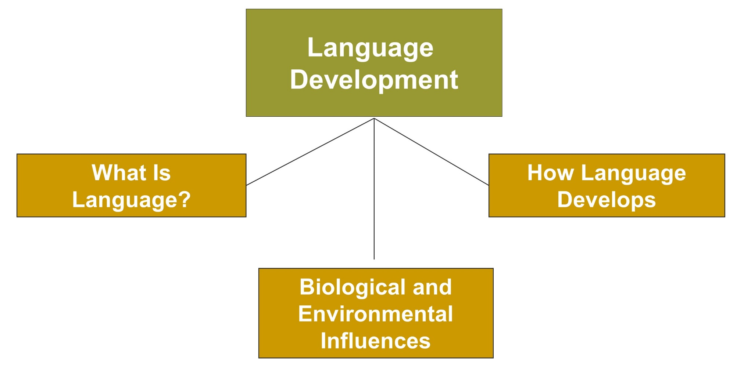
Cognitive and Language Development, 3
Jump to long description

Slide 34
Language
Form of communication, spoken, written, or signed, that is based on a system of symbols
Phonology
Sound system of a language
Morphology
Units of meaning involved in word formation
Syntax
Ways for combining words into phrases/sentences
Semantics
Meaning of words and sentences
Pragmatics
Appropriate use of language in different contexts

Slide 35
Biological and Environmental Influences
Children are neither exclusively
biological linguists
nor
social architects of language.
Interactionists emphasize the contribution of both biology and experience in language development
Notes:
Children are biologically prepared to learn language as they and their caregivers interact.

Slide 36
How Language Develops
Infancy
Babbling occurs in the middle of the 1st year
Infants utter their first words at about 10 to 13 months
Infants begin to string two words together at about 18 to 24 months
Notes:
Key developmental milestones in language development - Infancy

Slide 37
How Language Develops
Adolescence
Increased sophistication in use of words
Greater understanding of metaphors, satire, and adult literary works
Better writers than children are

Slide 38
Appendix of Image for Long Descriptions

Slide 39
Cognitive and Language Development, 1 Long Description
This exhibit contains a flowchart that depicts cognitive and language development. There is a box at the top that is labeled an overview of child development. It has four boxes branching out of it. Starting from the left, the first box is labeled exploring what development is, the second box is labeled processes and periods, the third box is labeled developmental issues, and the fourth box is labeled development and education.
Jump back to slide containing original image

Slide 40
An Overview of Child Development Long Description
This exhibit illustrates the processes of child development. It includes both the periods of development as well as the processes of development. The periods of development are infancy, early childhood, middle and late childhood, adolescence, and early adulthood. The periods of development are a result of the processes of development. The processes of development include biological, cognitive, and socioemotional processes.
Jump back to slide containing original image

Slide 41
Cognitive and Language Development, 2 Long Description
This exhibit contains a flowchart that depicts the essence of cognitive development. There is a box at the top that is labeled cognitive development. The box has three other boxes branching out of it. Starting from the left, the first box is labeled the brain, the second box is labeled Piaget’s theory, and the third box is labeled Vygotsky’s theory.
Jump back to slide containing original image

Slide 42
Myelination Long Description
The image shows a myelinated neuron. The myelinated neuron consists of dendrite, nucleus, axon, cell body, myelin sheath, and terminal buttons. The image shows that the incoming information is transferred through the nervous system to the next neuron.
Jump back to slide containing original image

Slide 43
Figure 2.12 - Piaget’s Conservation Task - Conservation of Liquid Long Description
The figure illustrates Piaget’s conservation task. It depicts two identical beakers that are labeled A and B. It also depicts a third cylindrical beaker that is labeled C. In the first figure, liquid is poured from B into C, which is taller and thinner than A and B. The second figure shows that beaker B is empty and beaker C is full.
The figure illustrates Piaget’s conservation task. It depicts two identical beakers that are labeled A and B. It also depicts a third cylindrical beaker that is labeled C. In the first figure, liquid is poured from B into C, which is taller and thinner than A and B. The second figure shows that beaker B is empty and beaker C is full.
Jump back to slide containing original image

Slide 44
Figure 2.14 - Vygotsky’s Zone of Proximal Development Long Description
The figure illustrates Vygotsky’s zone of proximal development. It shows a lower limit and an upper limit. The upper limit refers to the level of additional responsibility that a child can accept with the assistance of an able instructor. This includes the tasks that are too difficult for a child to master even with assistance. The lower limit refers to the level of problem solving that is reached on tasks when the child is working alone. This involves tasks that a child can master alone.
Jump back to slide containing original image

Slide 45
Cognitive and Language Development, 3 Long Description
The figure illustrates 3 aspects of language development. There is a large rectangular box labeled language development. It is divided into three small rectangular boxes. Starting from the left, they are labeled what is language, biological and environmental influences, and how language develops.
Jump back to slide containing original image

