Slide 1
CHAPTER 3
Social Contexts and Socioemotional Development
© 2018 McGraw-Hill Higher Education. All rights reserved.

Slide 2
Learning Goals
Describe two contemporary perspectives on socioemotional development: Bronfenbrenner’s ecological theory and Erikson’s life-span development theory.
Discuss how the social contexts of families, peers, and schools are linked with socioemotional development.
Explain these aspects of children’s socioemotional development: self-esteem, identity, moral development, and emotional development.

Slide 3
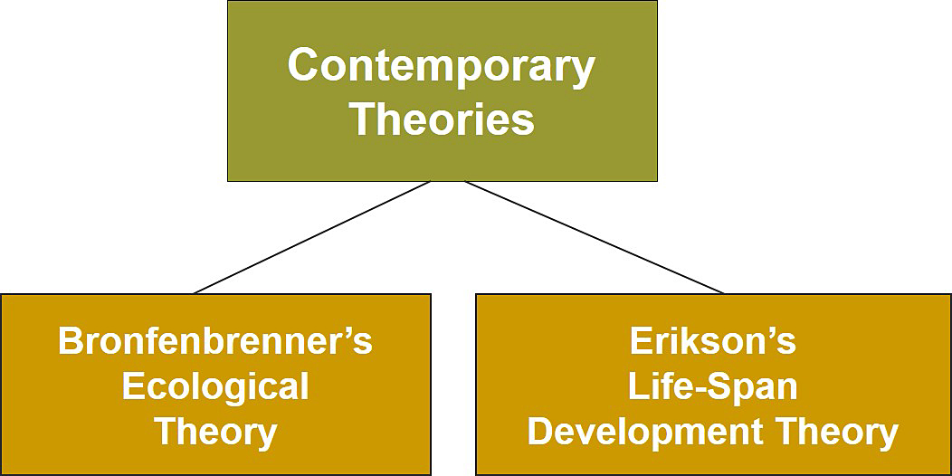
Social Contexts and Socioemotional Development, 1
Jump to long description

Slide 4
Connecting with Teachers
Keren Abra, a 5th-grade teacher in San Francisco, is concerned about the socioemotional context of her students’ lives
  She helped Julie, a quiet student in her class, understand that she is a good student and is loved and that adults could be consistent and responsible
Ms. Abra and Julie’s parents are concerned about her and want to help her become successful in the classroom

Slide 5
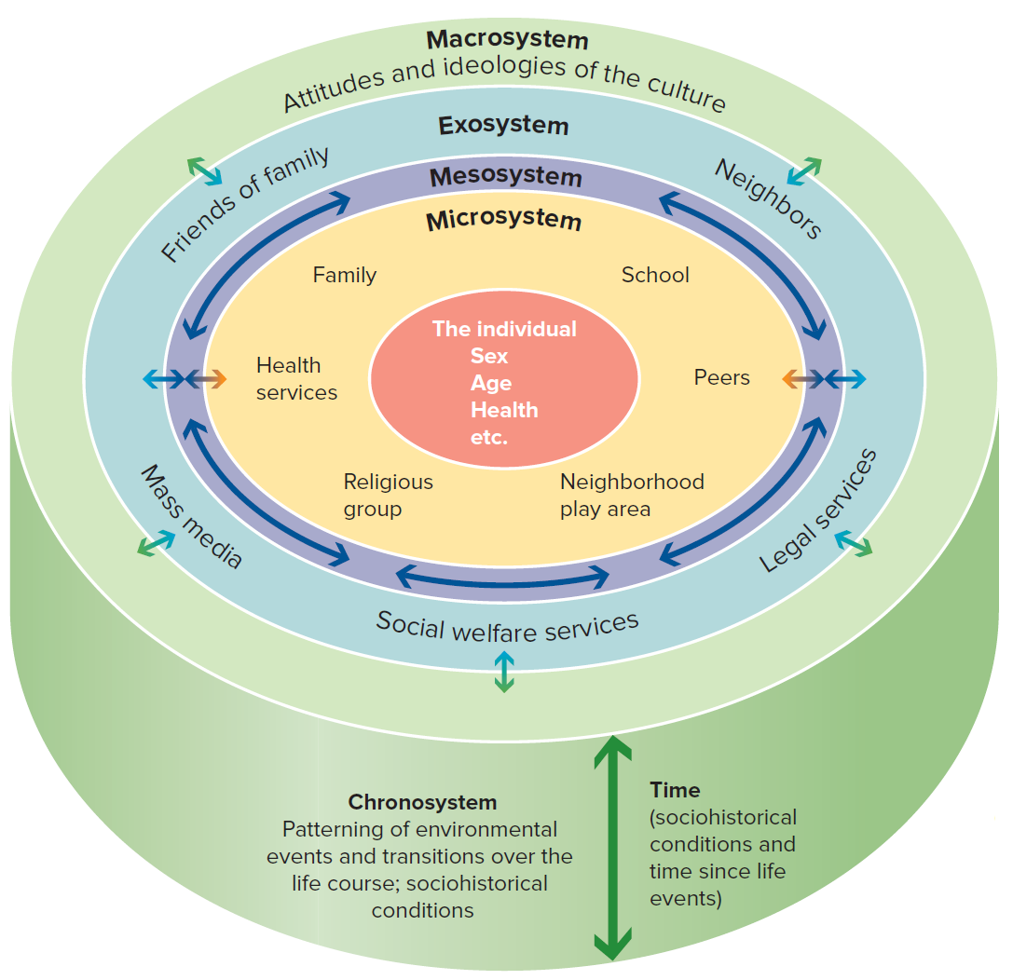
Bronfenbrenner’s Ecological Theory, 1
Bronfenbrenner’s theory focuses on the social contexts in which children live and the people who influence their development
Jump to long description

Slide 6
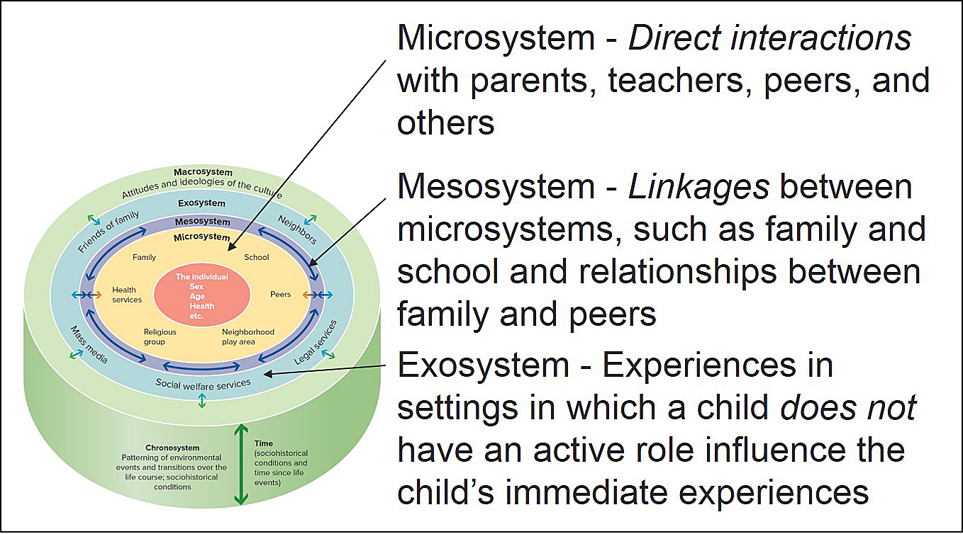
Bronfenbrenner’s Ecological Theory, 2
Jump to long description

Slide 7
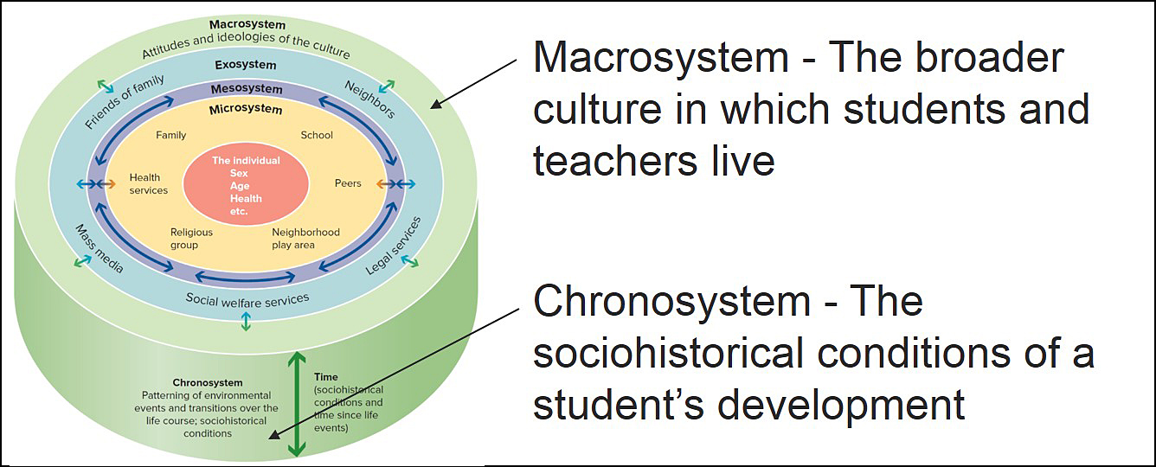
Bronfenbrenner’s Ecological Theory, 3
Jump to long description

Slide 8
Bronfenbrenner’s Ecological Theory
Theory into Practice, 1
Sid’s father left his family years ago and provides no support for them. Sid and his three siblings live with their mother in a public housing project for low-income families. They receive public assistance in the form of reduced rent as well as money to live on and are included in a food program. Sid and his siblings receive free school lunches and do not have to pay the standard book rental fee. In addition, they receive free medical care when ill or injured, but Sid’s mother considers the care they receive to be substandard. Recently, she contacted legal aid about obtaining child support from her children’s father.
Q.1: What aspects of Sid’s microsystem are discussed in the example? Explain
Q.2: What aspects of Sid’s exosystem are discussed in the example? Explain
Notes:
A1: Family, school, and health services
A2: Social services, and legal services

Slide 9
Bronfenbrenner’s Ecological Theory
Theory into Practice, 2
Sid’s father left his family years ago and provides no support for them. Sid and his three siblings live with their mother in a public housing project for low-income families. They receive public assistance in the form of reduced rent as well as money to live on and are included in a food program. Sid and his siblings receive free school lunches and do not have to pay the standard book rental fee. In addition, they receive free medical care when ill or injured, but Sid’s mother considers the care they receive to be substandard. Recently, she contacted legal aid about obtaining child support from her children’s father.
Q.3: How is the mesosystem currently operating for Sid? Explain
Notes:
A1: Family, school, health services
A2: Social services, legal services

Slide 10
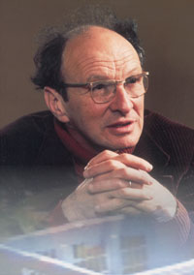
Bronfenbrenner’s Theory in the Classroom
Think about children as embedded in several environmental systems and influences
Pay attention to connections between schools and families
Recognize the importance of community, culture, and socioeconomic status in the child’s development
Notes:
Bronfenbrenner’s theory - One of the few theoretical frameworks for systematically examining social contexts on both micro and macro levels.
The theory bridges the gap between behavioral theories that focus on small settings and anthropological theories that analyze larger settings.

Slide 11
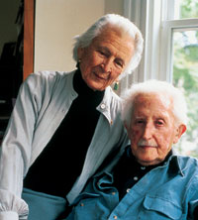
Erikson’s Life-Span Development Theory
Development proceeds in stages
Each stage is characterized by a developmental task that confronts individuals with a crisis
Stages reflect the motivation of the individual

Slide 12
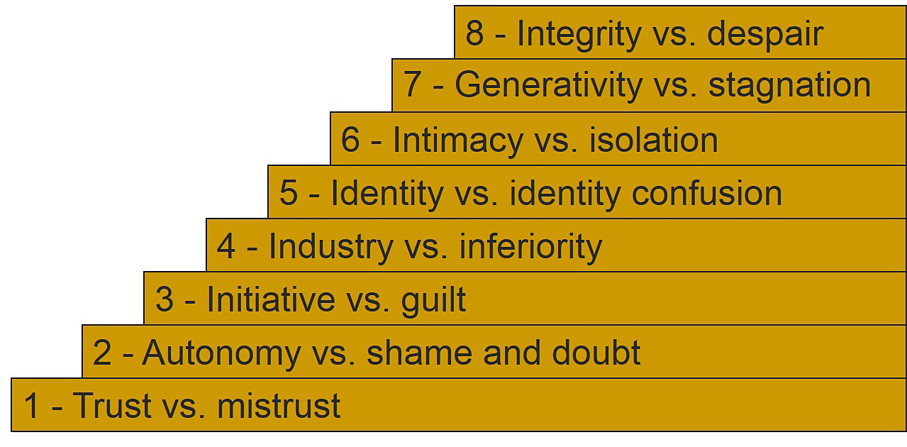
Erik Erikson’s Eight Stages of Human Development
Jump to long description

Slide 13
Erikson’s Human Development Stages, 1
1 - Trust versus mistrust 0 to 1 years | Trust is developed through warm, nurturing caregiving
2 - Autonomy versus shame and doubt 1 to 3 years | Independence is fostered by support and encouragement
3 - Initiative versus guilt 3 to 5 years | Exploring and accepting challenges require behavior that involves initiative

Slide 14
Erikson’s Human Development Stages, 2
4 - Industry versus inferiority 6 years to puberty | Mastery of knowledge and intellectual skills
5 - Identity versus identity confusion Adolescence | Exploration of different paths must be encouraged to attain a healthy identity
6 - Intimacy versus isolation Early adult years | Formation of positive, close relationships with others is essential

Slide 15
Erikson’s Human Development Stages, 3
7 - Generativity versus stagnation Middle adulthood | Generativity - Transmitting something positive to the next generation
8 - Integrity versus despair Late adulthood | Life review and retrospective evaluation of one’s past

Slide 16
Strategies for Erikson’s Stages of Development
Initiative
  Encourage social play
  Have children assume responsibility
  Structure assignments for success
Industry
  Nourish motivation for mastery
  Be tolerant of honest mistakes
Identity
  Recognize that identity is multidimensional
  Encourage independent thinking
  Stimulate students to examine different perspectives

Slide 17
Evaluating Erikson’s Theory
Strength
  View of human development as lifelong rather than being restricted only to childhood
Criticisms
  Stages are too rigid
  Key concepts (identity, intimacy, and independence) are important issues throughout our lives
  Theory has not been scientifically documented

Slide 18
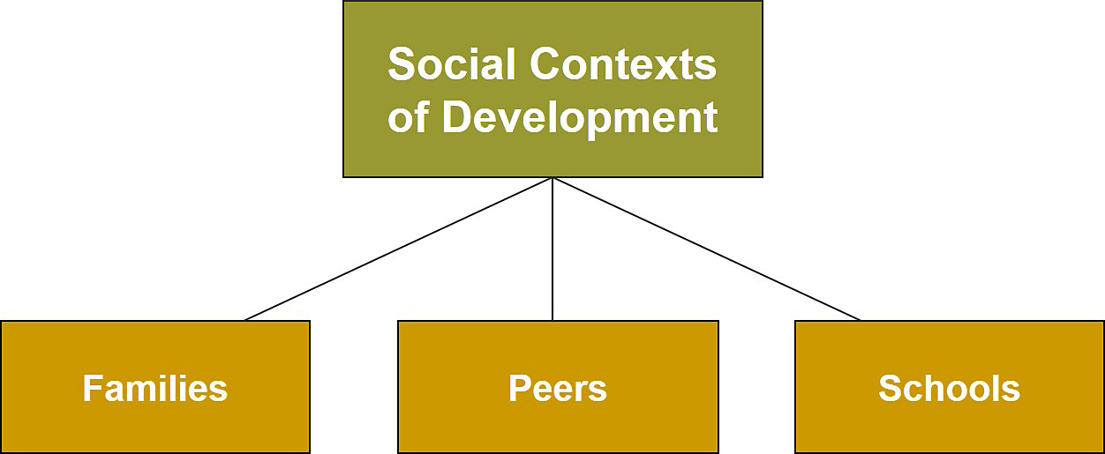
Social Contexts and Socioemotional Development, 2
Jump to long description

Slide 19
Baumrind’s Parenting Styles
Neglectful Parents are uninvolved. Children have poor self-control, don’t handle independence well, and have low achievement motivation. | Authoritarian Parents are restrictive and punitive. Children tend to be socially incompetent, anxious, and exhibit poor communication skills.
Indulgent Parents are highly involved but set few restrictions. Children have poor self-control. | Authoritative Parents are nurturing and supportive, yet set limits. Children are self-reliant, get along with peers, and have high self-esteem.
Notes:
Researchers have found that in some ethnic groups, some aspects of the authoritarian style may be associated with more positive child outcomes than Baumrind predicted.

Slide 20
The Changing Family
Working parents
  Nature of parents’ work matters
Children in divorced families
  The quality of parental relationships, experiences during the predivorce period, use of support systems, type of custody, socioeconomic status, and quality schooling all affect children
  Elementary school children did best when the parenting and the school environment were authoritative.
Children in stepfamilies
  Show more adjustment problems than children in intact families, especially during adolescence
Notes:
The United States has a higher percentage of single-parent families than any other industrialized country.
Today, about 1 in every 4 children in the United States has been part of a stepfamily by age 18.

Slide 21
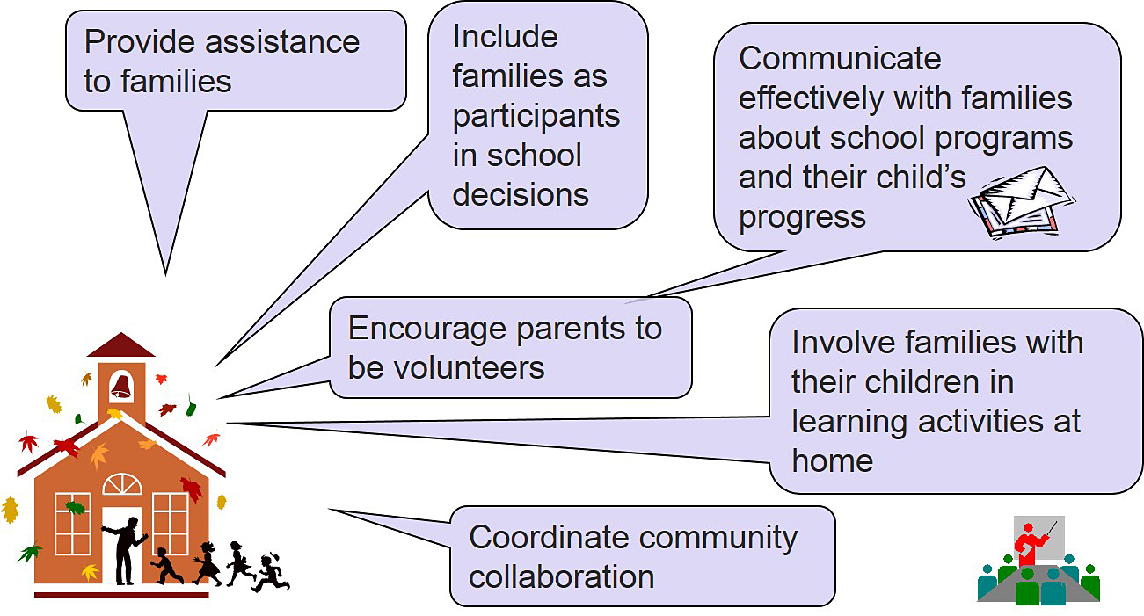
School-Family Linkages
Jump to long description
Notes:
Parents influence children’s in-school achievement.
Parents can also make decisions about children’s out-of-school activities.

Slide 22
Peer Statuses, 1
Rejected
Infrequently nominated as a best friend and often actively disliked by peers
Popular
Frequently nominated as a best friend and rarely disliked by peers
Neglected
Infrequently
nominated as
a “best friend” and not disliked by peers
Notes:
Rejected children have more serious adjustment problems than neglected children.

Slide 23
Peer Statuses, 2
Average
Receive both positive and negative peer nominations
Controversial
Frequently
nominated as
“best friend” and
often disliked
by peers

Slide 24

Friendships
Reflect: What is a friend?
Quality of friendships affects outcomes
Notes:
Friendships influence children’s attitude toward school and how successful they are in the classroom.
During a slideshow, text may be written on the slide in the white box, and then saved for later reference.

Slide 25
Early Childhood and Elementary School
Developmentally appropriate education
The Montessori approach
Controversy in early childhood
education
  Academic versus child-centered
Early childhood education for children from low-income families
Notes:
The early childhood setting is a protected environment.
Young children interact with one or two teachers (usually female) and interact with peers in dyads or small groups.
Developmentally appropriate education emphasizes the importance of creating settings that encourage children to be active learners and reflect children’s interests and capabilities.
Controversy in early childhood education - Child-centered, constructivist approach versus academic, direct instruction approach.

Slide 26
Schooling of Adolescents
Transition to middle or junior high school
  Stressful owing to developmental changes
  Top-dog phenomenon
  Academic challenges
Carnegie Foundation (1989) recommendations
Improving America’s high schools
  Raise expectations for all students
  Encourage student participation in extracurricular activities
  Improve dropout rates
Notes:
The Carnegie Foundation (1989) recommendations: The nation should develop smaller “communities” or “houses” to lessen the impersonal nature of large middle schools, have lower student-to-counselor ratios (10–1), involve parents and community leaders in schools, develop new curricula, have teachers team teach, boost students’ health and fitness, and help students who need public health care get it.

Slide 27
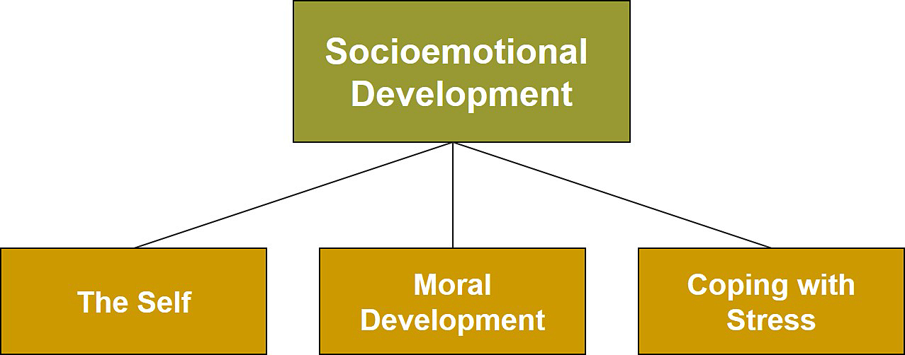
Social Contexts and Socioemotional Development, 3
Jump to long description

Slide 28
Self-Esteem
Self-esteem: An individual’s overall view of himself or herself
Also referred to as self-worth, or self-image

Slide 29
Improving Children’s Self-Esteem
Identify causes of low self-esteem and areas of competence important to the self
Provide emotional support and social approval
Help children achieve
Develop coping skills
Notes:
Self-esteem changes as children develop.
Variations in self-esteem are related to many aspects of development and can vary across different domains (academic, athletic, physical appearance, and social skills).

Slide 30
Marcia’s Four Statuses of Identity, 1
Identity diffusion occurs when individuals have not yet experienced a crisis or made any commitments
Identity foreclosure occurs when individuals have made a commitment but have not yet experienced a crisis
Notes:
Marcia analyzed Erikson’s concept of identity.
Marcia concluded that it is important to distinguish between exploration (examining meaningful alternative identities) and commitment (showing personal investment in an identity and staying with whatever that identity implies).
Identity Diffusion - An individual has not experienced identity crisis or made any commitment.
Identity Foreclosure - An individual has made a commitment, but has not yet experienced identity crisis.
Identity Moratorium - An individual is in identity crisis, but commitments are absent or vaguely defined.
Identity Achievement - An individual has undergone identity crisis and has made a commitment.

Slide 31
Marcia’s Four Statuses of Identity, 2
Identity moratorium occurs when individuals are in the midst of a crisis, but their commitments are either absent or only vaguely defined
Identity achievement occurs when individuals have undergone a crisis and have made a commitment
Notes:
Marcia analyzed Erikson’s concept of identity.
Marcia concluded that it is important to distinguish between exploration (examining meaningful alternative identities) and commitment (showing personal investment in an identity and staying with whatever that identity implies).
Identity Diffusion - An individual has not experienced identity crisis or made any commitment.
Identity Foreclosure - An individual has made a commitment, but has not yet experienced identity crisis.
Identity Moratorium - An individual is in identity crisis, but commitments are absent or vaguely defined.
Identity Achievement - An individual has undergone identity crisis and has made a commitment.

Slide 32
Ethnic Identity
“Ethnic identity is an enduring aspect of the self that includes a sense of membership in an ethnic group, along with the attitudes and feeling related to that membership”
Positive ethnic identity is related to positive outcomes for ethnic minority adolescents

Slide 33
Kohlberg’s Levels of Moral Development
Preconventional
reasoning
Moral reasoning is controlled by external rewards and punishments.
Conventional
reasoning
Internal standards are imposed by others.
Postconventional
reasoning
Morality is internal and not based on external standards.
Notes:
Moral development concerns rules and conventions about just interactions between people.

Slide 34
Care Perspective versus Justice Perspective
Justice perspective focuses on rights of individuals
Care perspective emphasizes relationships and concern for others
Notes:
Two areas of criticism for Kohlberg’s theory:
Idea that moral thoughts do not always predict moral behavior
Kohlberg’s theory places too much emphasis on moral thinking and not enough on moral behavior.
Kohlberg’s theory is too individualistic.
Carol Gilligan (1982, 1998) distinguishes between the justice perspective and the care perspective.

Slide 35

Reflection and Observation
Reflection:
Recall a cheating incident. What factors influenced the decision to cheat?
Notes:
A 2006 survey found that 60% of secondary school students said they had cheated on a test and 1/3 of the students reported they had plagiarized information from the Internet during the past year.
This slide accompanies the video segment, Cheating and Moral Reasoning, on the McGraw-Hill DVD Teaching Stories: A Video Collection for Educational Psychology.

Slide 36
Enter the Debate
Should teachers teach students values/morality?
YES
NO
Notes:
During a slideshow, text may be written on the slides in the yes/no boxes, and then saved for later reference.

Slide 37
Moral Education, 1
Hidden curriculum
School personnel serve as models of ethical behavior.
Classroom rules and peer relationships transmit positive and negative attitudes to
students.
Character education
Schools take a direct approach to teaching moral literacy and design an environment that rewards proper behavior.
Notes:
Moral education is hotly debated in educational circles.

Slide 38
Moral Education, 2
Values clarification
Schools design programs that allow students to
clarify their own values and understand the values of others.
Cognitive moral education
Schools base programs on the belief that students should learn to value things such as democracy and justice as moral reasoning develops.

Slide 39
Moral Education, 3
Service learning
Schools encourage students to be involved in the community by becoming a tutor, helping the elderly, volunteering in hospitals or day care, etc.
Notes:
Service learning - Promotes social responsibility and service to the community

Slide 40
Classroom Connections: Crack the Case: The Case of the Fight, 1
What are the issues in this case?
At what stage of moral development would you expect these boys to be, based on the information you have? What predictions can you make regarding each boy’s sense of self and emotional development?
What can you say about the boys’ mothers?
Notes:
This case is on page 108 of the text.

Slide 41
Classroom Connections: Crack the Case: The Case of the Fight, 2
What do you think about the punishment that Luke received? How would you have handled this situation?
What impact do you think this will have on the boys’ future relationship? What impact will it have on their attitudes toward school?
Notes:
This case is on page 108 of the text.

Slide 42
Strategies for Coping with Stress
Reassure children
Encourage children to talk
Protect from re-exposure to stress
Help children make sense of what happened
Notes:
As children age, they more accurately appraise a stressful situation and determine how much control they have over it.
Older children generate more coping alternatives to stressful conditions and use more cognitive coping strategies.

Slide 43
Appendix of Image for Long Descriptions

Slide 44
Social Contexts and Socioemotional Development, 1 Long Description
This slide illustrates contemporary theories with the help of a flowchart. The flowchart has three text boxes and lists the two contemporary theories of socioemotional development. A textbox at the top reads contemporary theories. Two lines emerge from this textbox connecting it to two textboxes below it. From the left, the textboxes read Bronfenbrenner’s ecological theory and Erikson’s life-span development theory.
Jump back to slide containing original image

Slide 45
Bronfenbrenner’s Ecological Theory, 1 Long Description
This figure illustrates a diagram of Bronfenbrenner’s ecological theory of development. It is in the form of a circle with different sized rings within it. Starting from the outermost ring of the circle and moving towards the central ring, the first ring represents the macrosystem, which represents the attitudes and ideologies of the culture.
The next ring represents the exosystem, which includes friends of families, neighbors, mass media, social welfare services, and legal services.
The next ring represents the mesosystem, which involves linkages between microsystems.
The next ring represents the microsystem, which represents the family, school, peers, neighborhood play areas, religious groups, and health services.
The innermost ring or the center of the circle represents the individual and characteristics such as sex, age, health, and more.
Jump back to slide containing original image

Slide 46
Bronfenbrenner’s Ecological Theory, 2 Long Description
This figure illustrates Bronfenbrenner’s ecological theory of development. It is in the form of a circle with different sized rings within it. Starting from the outermost ring of the circle and moving towards the central ring, the first ring represents the macrosystem, which represents the attitudes and ideologies of the culture.
The next ring represents the exosystem, which includes friends of family, neighbors, mass media, social welfare services, and legal services.
The next ring represents the mesosystem, which involves linkages between microsystems.
The next ring represents the microsystem, which represents the family, school, peers, neighborhood play area, religious group, and health services.
The innermost ring or the center of the circle represents the individual and characteristics such as sex, age, health, etc.
The base of the circle represents the chronosystem, which involves patterning of environmental events and transitions over the life course and sociohistorical conditions. The height of the base represents time, which involves the sociohistorical conditions and time since life events.
Jump back to slide containing original image

Slide 47
Bronfenbrenner’s Ecological Theory, 3 Long Description
This figure illustrates Bronfenbrenner’s ecological theory of development. It is in the form of a circle with different sized rings within it. Starting from the outermost ring of the circle and moving towards the central ring, the first ring represents the macrosystem, which represents the attitudes and ideologies of the culture.
The next ring represents the exosystem, which includes friends of family, neighbors, mass media, social welfare services, and legal services.
The next ring represents the mesosystem, which involves linkages between microsystems.
The next ring represents the microsystem, which represents the family, school, peers, neighborhood play area, religious group, and health services.
The innermost ring or the center of the circle represents the individual and characteristics such as sex, age, health, etc.
The base of the circle represents the chronosystem, which involves patterning of environmental events and transitions over the life course and sociohistorical conditions. The height of the base represents time, which involves the sociohistorical conditions and time since life events.
There is a textbox next to the diagram, which has two points. The first point reads macrosystem refers to the broader culture in which students and teachers live. The second point reads chronosystem refers to the sociohistorical conditions of a student’s development.
Jump back to slide containing original image

Slide 48
Erik Erikson’s Eight Stages of Human Development Long Description
This slide illustrates Erik Erikson’s eight stages of human development. The first stage is trust versus mistrust. The second stage is autonomy versus shame and doubt. The third stage is initiative versus guilt. The fourth stage is industry versus inferiority. The fifth stage is identity versus identity confusion. The sixth stage is intimacy versus isolation. The seventh stage is generativity versus stagnation. The eighth stage is integrity versus despair.
Jump back to slide containing original image

Slide 49
Social Contexts and Socioemotional Development, 2 Long Description
This slide illustrates the social contexts of development with the help of a flowchart. The flowchart has four text boxes and lists the social contexts of development. A textbox at the top reads social contexts of development. Three lines emerge from this textbox and connects it to the three textboxes below it. From the left, the textboxes read families, peers, and schools.
Jump back to slide containing original image

Slide 50
School-Family Linkages Long Description
This slide illustrates the strategies for forging school-family linkages. Six points have been listed in this slide, and each point is contained in a speech bubble.
In a clock-wise manner of appearance, the content in the first bubble reads provide assistance to families.
The content in the second bubble reads include families as participants in school decisions.
The content in the third bubble reads communicate effectively with families about school programs and their child’s progress.
The content in the fourth bubble reads encourage parents to be volunteers.
The content in the fifth bubble reads involve families with their children in learning activities at home.
The content in the sixth bubble reads coordinate community collaboration.
Jump back to slide containing original image

Slide 51
Social Contexts and Socioemotional Development, 3 Long Description
This slide illustrates the social contexts and socioemotional development with the help of a flowchart. The flowchart has four text boxes and lists the socioemotional development. A textbox at the top reads socioemotional development. Three lines emerge from this textbox and connects it to the three textboxes below it. From the left, the textboxes read the self, moral development, and coping with stress.
Jump back to slide containing original image

