Slide 1
CHAPTER 4
Individual Variations
© 2018 McGraw-Hill Higher Education. All rights reserved.

Slide 2
Learning Goals
Discuss what intelligence is, how it is measured, theories of multiple intelligences, the neuroscience of intelligence, and some controversies and issues about its use by educators
Describe learning and thinking styles
Characterize the nature of personality and temperament

Slide 3
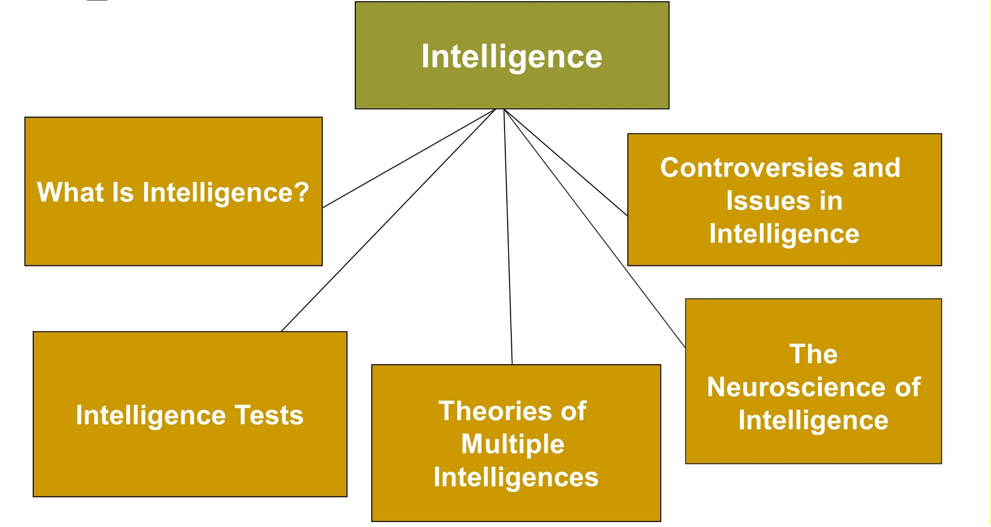
Individual Variations
Jump to long description

Slide 4
Connecting with Teachers
Shiffy Landa, a first-grade teacher in St. Louis, Missouri, uses Howard Gardner’s multiple-intelligences approach in her classroom
  It is the best way to reach children because they have many different kinds of abilities
  She doesn’t stand in front of the room and lecture her students
  She acts as a facilitator
  Her students work in cooperative learning groups to develop their interpersonal intelligences
  She educates her students’ parents with parent education classes

Slide 5
Intelligence
Intelligence: Problem-solving skills and the ability to adapt to and learn from life’s everyday experiences

Slide 6
Binet Intelligence Tests
Mental Age (MA)
An individual’s level of mental development relative to others
Intelligence Quotient (IQ)
Person’s mental age divided by chronological age (CA), multiplied by 100
Normal Distribution
A symmetrical distribution
Majority of scores fall in the middle of the possible range of scores
Few scores appear in the extremes
Notes:
ED: we need to insert a space between “mental” and “age” in the equation, but you can’t click inside it
Intelligence Quotient (IQ) - A person’s mental age divided by their chronological age (CA), multiplied by 100. (MA/CA 100)

Slide 7
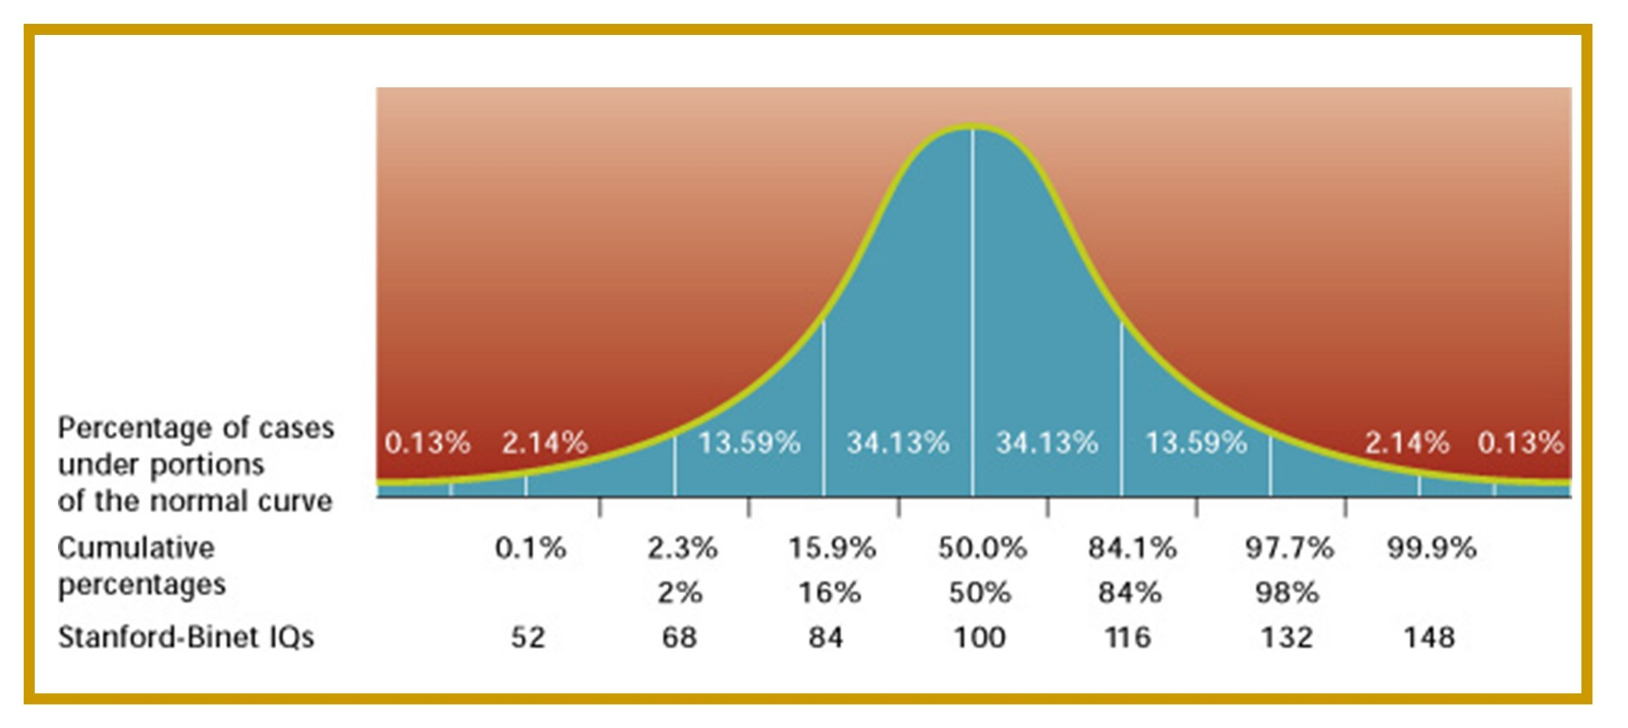
Figure 4.1 - The Normal Curve and Stanford-Binet IQ Scores
Jump to long description
Notes:
The normal distribution is symmetrical, with a majority of the scores falling in the middle of the possible range of scores and a few appearing toward the extremes of the range.

Slide 8
The Wechsler Scales
WPPSI-IV | Wechsler Preschool and Primary Scale of Intelligence (2 years 6 months to 7 years 3 months)
WISC-V | Wechsler Intelligence Scale for Children(ages 6 to 16)
WAIS-IV | Wechsler Adult Intelligence Scale

Slide 9
Group Intelligence Tests
Advantage
  More convenient and economical
Disadvantages
  Examiner cannot:
    Establish rapport
    Determine student’s level of anxiety
  Student:
    Might not understand instructions
    Might be distracted by other students

Slide 10
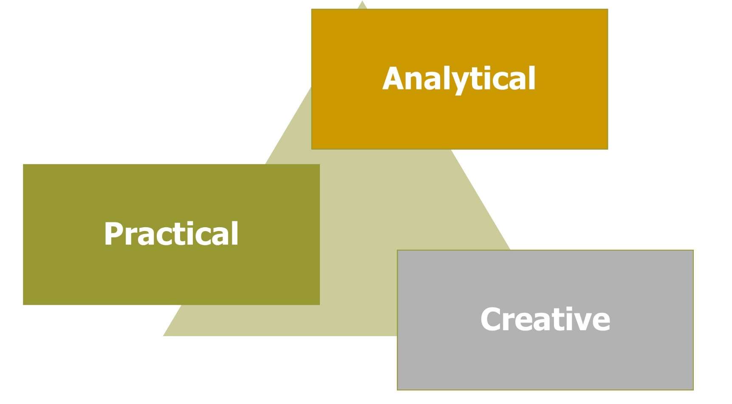
Sternberg’s Triarchic Theory of Intelligence
Jump to long description
Notes:
Students with different triarchic patterns look different in school.
Sternberg said few tasks are purely analytic, creative, or practical. Most tasks require some combination of these skills.
Wisdom is linked to both practical and academic intelligence.

Slide 11
Sternberg’s Triarchic Theory
Into Practice, 1
Cindy always does very well on both standardized and classroom tests and gets good grades in school. However, she does not write original stories well nor would anyone say that she has much common sense.
Q: In what form of intelligence is Cindy high? Explain.
Notes:
A: Analytic intelligence
Cindy has the ability to do the things most likely measured by tests—analyze, judge, evaluate, compare, and contrast.

Slide 12
Sternberg’s Triarchic Theory
Into Practice, 2
Trent does not do well on standardized tests. His grades are not very high. However, Trent is very imaginative and a wonderful storyteller. Trent’s classmates beg him to read his stories to the class. Trent hopes to be a novelist one day. However, he often turns in work that does not conform to teacher expectations or directions.
Q: In what form of intelligence is Trent high? Explain.
Notes:
A: Creative intelligence
Trent is imaginative and creative. He often does not conform.

Slide 13
Sternberg’s Triarchic Theory
Into Practice, 3
Ken doesn’t do very well in school. However, he is very popular with his peers and has excellent leadership skills.
Q: In what form of intelligence is Ken high? Explain.
Notes:
A: Practical intelligence
Ken functions very well in day-to-day life, but struggles with the demands of school.

Slide 14
Gardner’s Eight Frames of Mind
Verbal
Mathematical
Spatial
Bodily-kinesthetic
Musical
Intrapersonal
Interpersonal
Naturalist
Notes:
Gardner argues there are many specific types of intelligence, or frames of mind.
Verbal - Ability to think in words and use language to express meaning
Mathematical - Ability to carry out mathematical operations
Spatial - Ability to think three-dimensionally
Bodily-kinesthetic - Ability to manipulate objects and be physically adept
Musical - Sensitivity to pitch, melody, rhythm, and tone
Intrapersonal - Ability to understand oneself and effectively direct one’s life
Interpersonal - Ability to understand and effectively interact with others
Naturalist - Ability to observe patterns in nature and understand natural and human-made systems

Slide 15
Gardner’s Eight Frames of Mind
Theory into Practice, 1
  Carrie loves to read and write stories.
Q: Which of Gardner's eight frames of mind is she displaying when she engages in these activities? Explain.
Notes:
A: Verbal skills

Slide 16
Gardner’s Eight Frames of Mind
Theory into Practice, 2
Jane is an excellent athlete, excelling at soccer, basketball, and baseball.
Q: Which of Gardner's eight frames of mind is Jane displaying when she engages in these activities? Explain.
Notes:
A: Bodily-kinesthetic skills

Slide 17
Gardner’s Eight Frames of Mind
Theory into Practice, 3
Steve loves to play the piano, trumpet, and drums and is quite good at all of them.
Q: Which of Gardner's eight frames of mind is Steve displaying when he engages in these activities? Explain.
Notes:
A: Musical skills and bodily-kinesthetic skills

Slide 18
Gardner’s Eight Frames of Mind
Theory into Practice, 4
Tanesha is a good friend. People often open up to her and tell her things they would not share with other people. She never betrays their trust.
Q: Which of Gardner's eight frames of mind is Tanesha displaying when she engages in these activities? Explain.
Notes:
A: Interpersonal skills

Slide 19
Emotional Intelligence
According to Salovey and Mayer (1990), emotional intelligence is the ability to:
  Perceive and express emotion accurately and adaptively
  Understand emotion and emotional knowledge
  Use feelings to facilitate thought
  Manage emotions in oneself and others

Slide 20
Enter the Debate
Should schools use intelligence tests for placement purposes?
YES
NO
More convenient and economical
Notes:
During a slideshow, text may be written on the slides in the yes/no boxes, and then saved for later reference.

Slide 21
The Neuroscience of Intelligence
Interest in the neuroscience of intelligence has increased
Questions include:
  Is having a bigger brain linked to higher intelligence?
  Is intelligence located in certain brain regions?
  Is the speed at which the brain processes information linked to intelligence?

Slide 22
Between-Class Ability Grouping or Tracking
Advantages
Narrows the range of skill in a group of students
Prevents less-able students from "holding back" more talented students
Disadvantages
Stigmatizes students who are consigned to low-track classes
May have less-experienced teachers, fewer resources, and lower expectations
Segregates students by socioeconomic status and ethnicity
Notes:
Nongraded (cross-age) programs - Variation of between-class ability grouping
Students are grouped by their ability in particular subjects, regardless of their age or grade level

Slide 23
Within-Class Ability Grouping
Involves placing students in two or three groups within a class according to their ability or achievement
Notes:
Within-class grouping is more common in elementary than in secondary school.

Slide 24
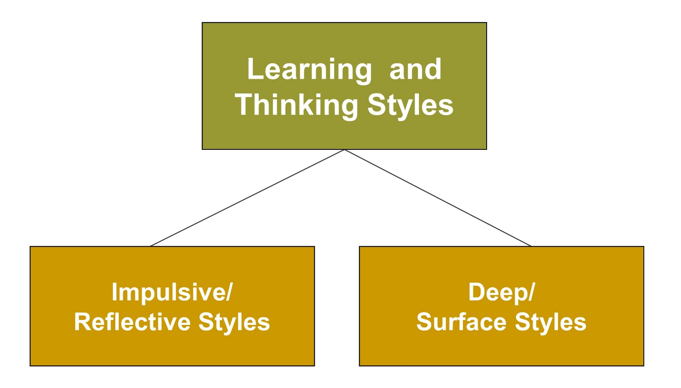
Learning and Thinking Styles
Jump to long description
Notes:
Intelligence refers to ability.
Learning and thinking styles are preferred ways to use one’s abilities.
None of us has a single learning and thinking style; we have a profile of many styles.

Slide 25
Reflective versus Impulsive Thinking Styles
Reflective students surpass impulsive
students at:
  Remembering structured information
  Reading comprehension
  Problem solving and decision making
  Goal setting
  Setting high standards for performance
Notes:
Impulsive/reflective styles are also referred to as conceptual tempo.
This dichotomy involves a student’s tendency to act quickly and impulsively or to take more time to respond and reflect on the accuracy of an answer.

Slide 26
Deep versus Surface Learning Styles
Deep Learners
Surface Learners
Actively construct knowledge
Give meaning to material
Are self-motivated
Are passive learners
Fail to tie information to a larger framework
Focus on external rewards
Notes:
Deep/surface styles involve how students approach learning materials.

Slide 27
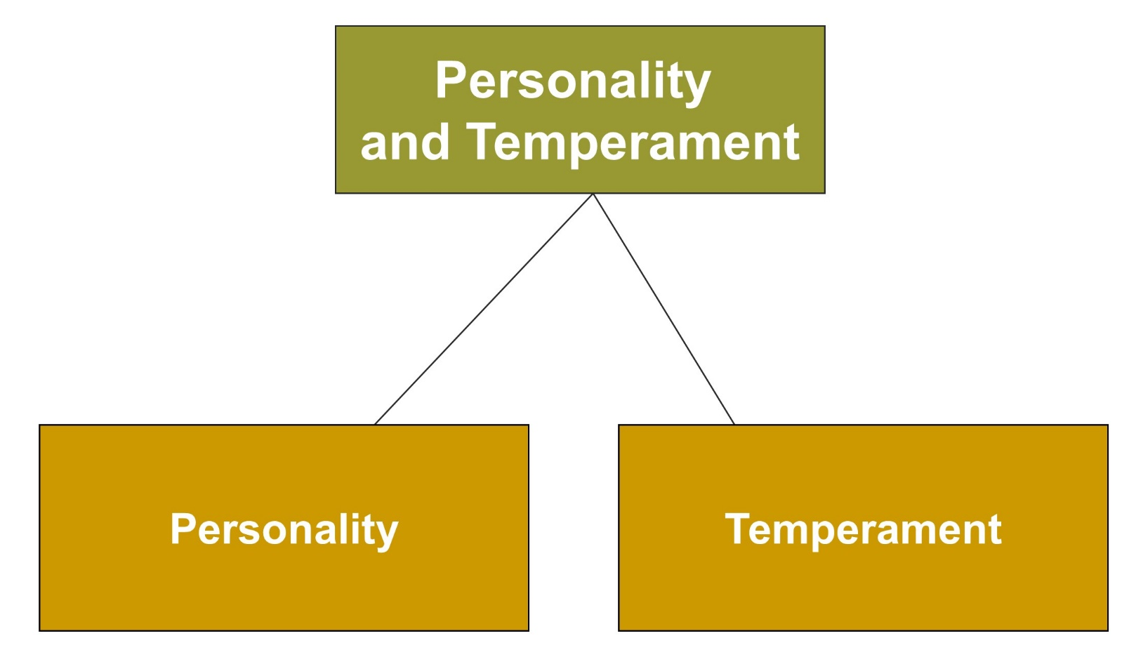
Personality and Temperament
Jump to long description

Slide 28
Personality versus Temperament
Personality: The distinctive thoughts, emotions, and behaviors that characterize the way an individual adapts to the world
Temperament: A person’s behavioral style and characteristic way of responding

Slide 29
The “Big Five” Personality Factors
Openness
Imaginative or practical
Interested in variety or routine
Independent or conforming
Conscientiousness
Organized or disorganized
Careful or careless
Disciplined or impulsive
Extraversion
Sociable or retiring
Fun-loving or somber
Affectionate or reserved
          Agreeableness
          Softhearted or ruthless
          Trusting or suspicious
          Helpful or uncooperative
Neuroticism (emotional stability)
Calm or anxious
Secure or insecure
Self-satisfied or self-pitying
Notes:
OCEAN - The “Big Five” Personality Factors
Openness
Conscientiousness
Extraversion
Agreeableness
Neuroticism

Slide 30
Person-Situation Interaction Theory
  The best way to characterize an individual’s personality is not only in terms of personal traits or characteristics, but also in terms of the situation involved
Notes:
Students choose to be in some situations and avoid others.

Slide 31
Children’s Temperament
Easy child
Positive mood
Establishes regular routines in infancy
Adapts easily to new experiences
Difficult child
Reacts negatively and cries frequently
Irregular daily routines
Slow to accept change
Slow-to-warm-up child
Low activity level
Somewhat negative
Low intensity of mood
Notes:
Classification system proposed by Alexander Chess and Stella Thomas (Chess & Thomas, 1977; Thomas & Chess, 1991)
In a longitudinal study, Chess and Thomas found 40% of children could be classified as easy, 10% as difficult, and 15% as slow to warm up. Thirty-five percent did not fit any of the three patterns.

Slide 32
Rothbart and Bates’ Temperament Dimensions
Extraversion/surgency
  Includes approach, pleasure, activity, smiling, and laughter
Negative affectivity
  Includes fear, frustration, sadness, and discomfort
Effortful control (self-regulation)
  Study revealed effortful control was a strong predictor of academic success skills in kindergarten children from low-income families
Notes:
Mary Rothbart and John Bates - Three broad dimensions represent what researchers have found to characterize the structure of temperament.
Goodness of fit - Match between an individual’s temperament and the environmental demands of the person

Slide 33
Classroom Connections: Crack the Case: Workshops, 1
What are the issues in this case?
To what extent should teachers adapt their instruction to the strengths, learning styles, and personalities of their students? Why?
What will you do in your classroom to accommodate individual differences such as students’ strengths, learning styles, and personalities?
Notes:
This case is on page 145 of the text.

Slide 34
Classroom Connections: Crack the Case—Workshops, 2
What other individual differences do you think you might have to accommodate? How will you do this?
On which theory is Ms. Jacobson basing her comments regarding Joe and Martha?
Notes:
This case is on page 145 of the text.

Slide 35
Appendix of Image for Long Descriptions

Slide 36
Individual Variations Long Description
The figure illustrates five points under the topic intelligence. There is a rectangular box labeled intelligence. It is divided into five rectangular boxes. Starting from the left in an anti-clockwise direction, the boxes are labeled what is intelligence, intelligence tests, theories of multiple intelligences, the neuroscience of intelligence, and controversies and issues in intelligence.
Jump back to slide containing original image

Slide 37
Figure 4.1 - The Normal Curve and Stanford-Binet IQ Scores Long Description
This is a graph that illustrates the normal curve and Stanford-Binet IQ Scores. The graph shows that most of the population falls in the middle range of scores. Extremely high and extremely low scores are rare. More than two-thirds of the scores fall between 84 and 116. Only about 1 in 50 individuals has an IQ of more than 132, and only about 1 in 50 individuals has an IQ of less than 68.
Jump back to slide containing original image

Slide 38
Sternberg’s Triarchic Theory of Intelligence Long Description
This figure illustrates Sternberg’s triarchic theory of intelligence. There is a triangle on which three rectangular boxes are placed. The box at the top is labeled analytical, the box at the bottom left is labeled practical, and the box at the bottom right is labeled creative.
Jump back to slide containing original image

Slide 39
Learning and Thinking Styles Long Description
This figure illustrates learning and thinking styles. There is a large rectangular box labeled learning and thinking styles. It is divided into two small rectangular boxes. Starting from the left, the boxes read impulsive or reflective styles and deep or surface styles.
Jump back to slide containing original image

Slide 40
Personality and Temperament Long Description
This figure shows the two topics under personality and temperament. There is a large rectangular box with two small rectangular boxes emerging out of it. The large box is labeled personality and temperament. Out of the two small boxes, the box on the left is labeled personality and the box on the right is labeled temperament.
Jump back to slide containing original image

