Slide 1
CHAPTER 5
Sociocultural Diversity
© 2018 McGraw-Hill Higher Education. All rights reserved.

Slide 2
Learning Goals
Discuss how variations in culture, socioeconomic status, and ethnic background need to be taken into account in educating children.
Describe some ways to promote multicultural education.
Explain various facets of gender, including similarities and differences in boys and girls; discuss gender issues in teaching.

Slide 3
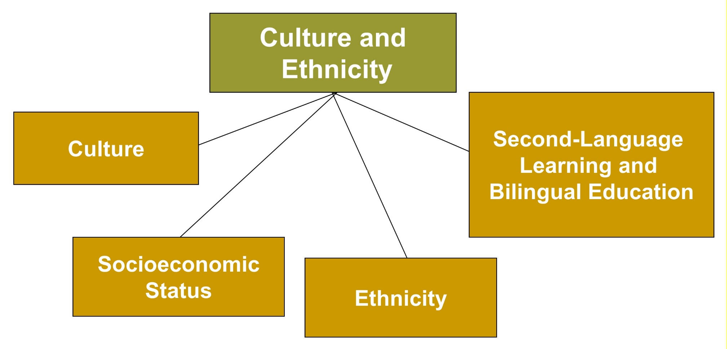
Sociocultural Diversity, 1
Jump to long description

Slide 4
Connecting with Teachers
Margaret Longworth, a high school Teacher of the Year, currently teaches at the middle school level in St. Lucie, Florida.
  When considering sociocultural diversity, she believes it is important to make schools “user friendly” for parents.
  She meets with parents at Haitian churches.
  She talks to parents about special education classes, gifted classes, language programs, and scholarships.
  She encourages parents to keep their children in school.
  She establishes important parent-school-church connections.

Slide 5
Culture
Culture refers to the behavior patterns, beliefs, and all other products of a particular group of people that are passed on from generation to generation.
Cross-cultural studies
  Provide information about the degree
  to which people are similar
  Elucidate behaviors specific to certain cultures

Slide 6
Individualism versus Collectivism
Individualism
Gives priority to personal goals
Values feeling good and personal distinction
Fosters independence
Collectivism
Values group and personal goals are subordinated
Encourages interdependence of group members
Supports harmonious relationships
Notes:
Four values that reflect parents’ beliefs in individualistic cultures for children’s effective development of autonomy are: (1) personal choice, (2) intrinsic motivation, (3) self-esteem, and (4) self-maximization (achieving one’s full potential).
Three values that reflect parents’ beliefs in collectivistic cultures are: (1) connectedness to the family and other close relationships, (2) orientation to the larger group, and (3) respect and obedience.

Slide 7
Socioeconomic Status
Socioeconomic status (SES): The grouping of people with similar occupational, educational, and economic characteristics
Educating students from low-SES backgrounds requires strategies that address issues such as discipline, motivation, parent involvement, mentoring, and the untapped knowledge these students can access.

Slide 8
Children in Poverty
Of the 21.1% of U.S. children who live in poverty, African American and Latino families with children have especially high rates of poverty (more than 30 percent).
Notes:
As compared to non-Latino White children, ethnic minority children are more likely to experience persistent poverty over many years and live in isolated poor neighborhoods with minimal social supports and threats to positive development.

Slide 9
Ethnicity
Ethnicity refers to a shared pattern of characteristics such as cultural heritage, nationality, race, religion, and language.
For children of color, educational
segregation is still a reality that affects school experiences.
Notes:
Almost one-third of African American and Latino students attend schools where 90% or more of the students are from minority groups, typically their own minority group.
The schools of students from ethnic minority backgrounds have fewer resources than the schools of largely non-Latino white backgrounds.

Slide 10
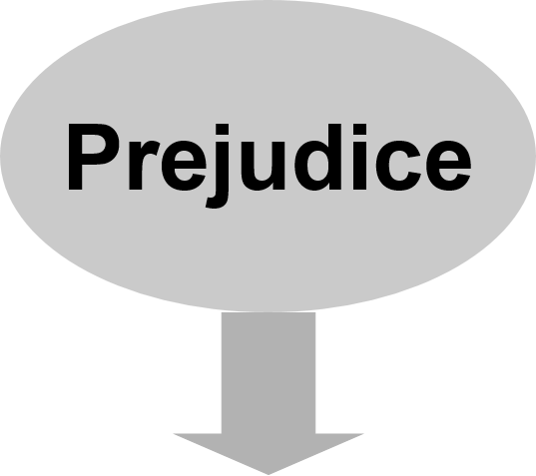
Prejudice
An unjustified negative attitude toward an individual because of the individual’s membership in a group
Jump to long description

Slide 11
English as a Second Language
Bilingual education programs teach English to students whose native language is not English.
  Instruction is primarily in English (Dual-language approach).
Notes:
Bilingualism, the ability to speak two languages, has a positive effect on children’s cognitive development. Children fluent in two languages perform better than students who are fluent in only one language on tests of control of attention, concept formation, analytical reasoning, cognitive flexibility, and cognitive complexity.

Slide 12
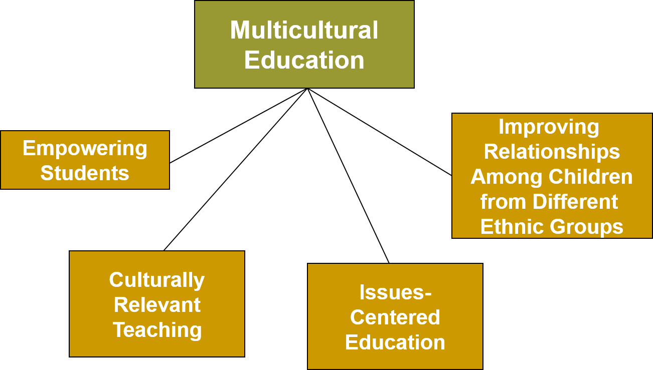
Sociocultural Diversity, 2
Jump to long description

Slide 13
The Multicultural Classroom
High expectations for all students
Curriculum presents diverse cultural perspectives
Instructional materials represent diverse backgrounds and experiences
Hidden curriculum reflects positive aspects of diversity
Counseling program challenges students to dream and provides strategies to reach those dreams
Notes:
The goal of multicultural education is equal educational opportunity for all students. This includes closing the gap in academic achievement between mainstream students and students from underrepresented groups.

Slide 14
Multicultural Education and Social Justice
Social justice - One of the core values in multicultural education
The core components are:
  Prejudice reduction - Activities teachers can implement in the classroom to eliminate negative and stereotypical views of others
  Equity pedagogy - Modifications to the teaching process to incorporate materials and learning strategies appropriate to both boys and girls and to various ethnic groups

Slide 15
Empowering Students
Empowerment: Providing people with intellectual and coping skills to succeed and make this a more just world
Notes:
Empowerment - Providing people with the intellectual and coping skills to succeed and make this a more just world
Funds of knowledge approach - Teachers should visit students’ homes to develop social relationships with their students’ family members. Teachers should learn more about their cultural and ethnic background and incorporate this knowledge into their teaching.

Slide 16
Issues-Centered Education
Students are taught to systematically examine issues that involve equity and social justice.
Students clarify their values and examine alternatives and consequences for their stance on an issue.
Is closely related to moral education

Slide 17
Improving Relations among Children from Different Ethnic Groups
The jigsaw classroom
Positive personal contact with others from different cultural backgrounds
Perspective taking
Technology connections with students around the world
Reducing bias
Increasing tolerance
Developing school and community as a team
Notes:
Technology connections: New advances in telecommunication has made it possible for students around the world to communicate. These global technology projects can reduce American students’ ethnocentric beliefs.

Slide 18

Reflection and Observation
Reflection:
What experiences have you had with students different from yourself?
Notes:
This slide accompanies the video segment, Integrating Diversity into the High School Curriculum, on the McGraw-Hill DVD Teaching Stories: A Video Collection for Educational Psychology.

Slide 19
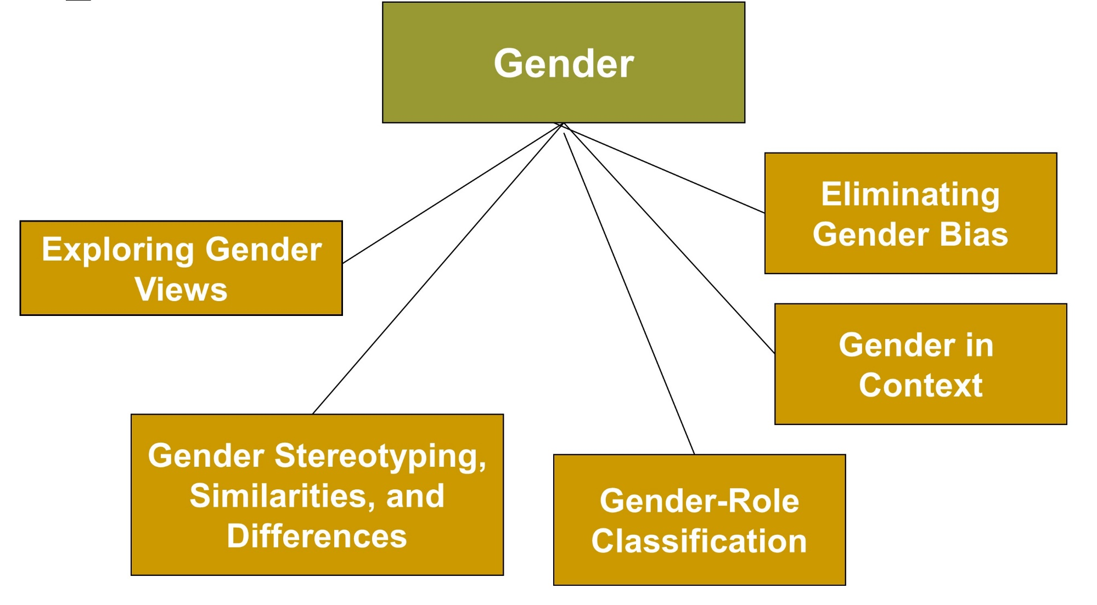
Sociocultural Diversity, 3
Jump to long description

Slide 20
Gender
Gender: The characteristics of people as males and females
Gender roles: A set of expectations that prescribes how females or males should think, act, and feel
Gender typing: Acquisition of a traditional masculine or feminine role

Slide 21
Views on Gender Development
Biological
Cognitive
Social

Slide 22
Gender Schema Theory
Most widely accepted cognitive theory of gender
  Gender-typing emerges as children gradually develop gender schemas about what is gender-appropriate and what is gender-inappropriate in their culture.
  Children are internally motivated to perceive the world and act in accordance with their developing schemas.

Slide 23
Gender Similarities and Differences in Academically Relevant Domains
The brain
Physical performance
Intelligence
Math and science skills
Verbal skills
Educational attainment
Relationship skills
Prosocial behavior
Aggression
Emotion and its regulation

Slide 24
Gender Controversy, 1
Substantial gender differences found in physical performance, writing skills, aggression, self-regulation, and prosocial behavior
Small or nonexistent differences found in communication, math, and science

Slide 25
Gender Controversy, 2
Reasons include:
  Extensive differences due to adaptive problems faced across evolutionary history
  Gender differences due to social conditions
  Differences exaggerated by popular media

Slide 26
Androgyny
Androgyny: The presence of positive masculine and feminine characteristics in the same person
  Androgynous boy might be assertive (masculine) and nurturing (feminine).
  Androgynous girl might be powerful (masculine) and sensitive to others’ feelings (feminine).
Sandra Bem, a gender expert, argues that androgynous individuals are more flexible, competent, and mentally healthy than masculine or feminine individuals.

Slide 27
Gender in Context, 1
Helping behavior and emotion
  The stereotype is that females are better at helping than males; however, it depends on the situation.
  Females are more likely than males to volunteer their time to help children with personal problems.
  Males are more likely to help in situations where they feel a sense of competence or that involve danger.

Slide 28
Gender in Context, 2
Culturally prescribed behavior for males and females
  Must be examined in different countries around the world
    In the United States, similarities in male and female behavior are now more acceptable.
    In many other countries around the world, gender roles have remained more gender-specific.

Slide 29
Eliminating Gender Bias
Teacher-student interaction
  Bias against boys
  Bias against girls
Curriculum content and athletics content

Slide 30
Sexual Harassment
Quid Pro Quo
School employee threatens to base an educational decision (grades) on a student’s submission to unwelcome sexual conduct.
Hostile Environment
A student is subjected
to unwelcome sexual
conduct that is so severe, persistent, or pervasive that it limits the student’s ability to benefit from his or her education.
Notes:
Millions of girls experience sexual harassment each year in schools. Quid pro quo sexual harassment and hostile environment sexual harassment are illegal in educational settings.

Slide 31
Enter the Debate
Should teachers treat boys and girls differently?
YES
NO
Notes:
During a slideshow, text may be written on the slides in the yes/no boxes and then saved for later reference.

Slide 32
Classroom Connections: Crack the Case: These Boys, 1
What are the issues in this case?
Based on the ideas and information presented in your text to this point, discuss what you believe to be happening in this classroom and the possible influences on Mrs. Jones’s ideas of gender. Cite research and theories of gender development.
What influences do you believe Mrs. Jones’s behavior will have on her students? Why?
Notes:
This case is on page 187 of the text.

Slide 33
Classroom Connections: Crack the Case: These Boys, 2
What should Mrs. Jones do at this point? Why? What sort of outside assistance might help her?
If you were a student teacher in this classroom, what, if anything, would you do? Why?
What will you do in your own classroom to minimize gender bias?
Notes:
This case is on page 187 of the text.

Slide 34
Appendix of Image for Long Descriptions

Slide 35
Sociocultural Diversity, 1 Long Description
This slide illustrates sociocultural diversity in culture and ethnicity with the help of a flowchart. The flowchart has five text boxes. A textbox at the top reads culture and ethnicity. Four lines emerging from this textbox connect it to the four textboxes below it. From the left, the textboxes read culture, socioeconomic status, ethnicity, and second-language learning and bilingual education.
Jump back to slide containing original image

Slide 36
Prejudice Long Description
There is an oval-shaped textbox that reads prejudice. It contains an arrow below it pointing to a textbox that reads an unjustified negative attitude toward an individual because of the individual’s membership in a group.
Jump back to slide containing original image

Slide 37
Sociocultural Diversity, 2 Long Description
This slide illustrates sociocultural diversity with the help of a flowchart. The flowchart has five text boxes. A textbox at the top reads multicultural education. Four lines emerging from this textbox connect it to the four textboxes below it. From the left, the textboxes read empowering students, culturally relevant teaching, issues-centered education, and improving relationships among children from different ethnic groups.
Jump back to slide containing original image

Slide 38
Sociocultural Diversity, 3 Long Description
This slide illustrates sociocultural diversity with the help of a flowchart. The flowchart has six text boxes. A textbox at the top reads gender. Five lines emerging from this textbox connect it to the five textboxes below it. From the left, the textboxes read exploring gender views, gender stereotyping, similarities, and differences, gender-role classification, gender in context, and eliminating gender bias.
Jump back to slide containing original image

