Slide 1
CHAPTER 6
Learners Who Are Exceptional
© 2018 McGraw-Hill Higher Education. All rights reserved.

Slide 2
Learning Goals
Describe the various types of disabilities and disorders.
Explain the legal framework and technology advances for children with disabilities.
Define what gifted means and discuss some approaches to teaching children who are gifted.

Slide 3
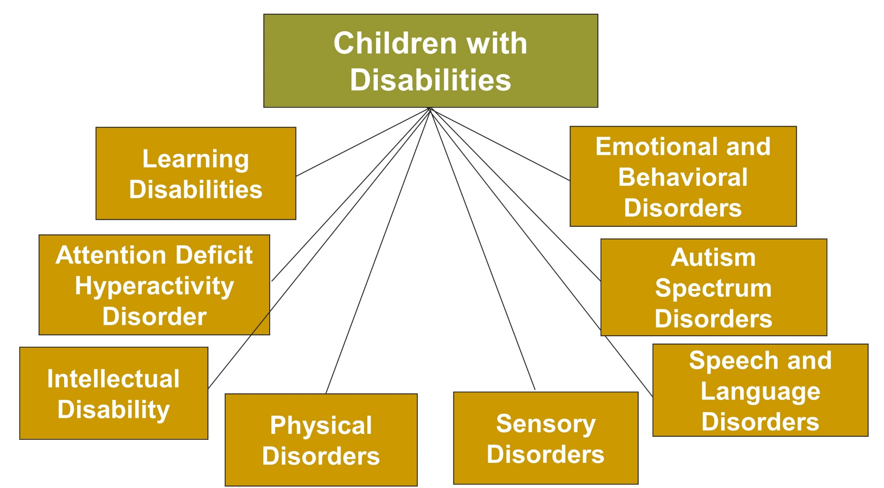
Learners Who Are Exceptional, 1
Jump to long description

Slide 4
Connecting with Teachers
Verna Rollins, a language arts teacher in Ypsilanti, Michigan, effectively deals with hard to teach or difficult students
She says her best strategy to use with these students is to find out what they need, decide how to provide it, provide it, and constantly evaluate whether it is working
Notes:
Children with disabilities must have a free, appropriate education; increasingly, they are educated in regular classrooms.

Slide 5
Learning Disability, 1
Difficulty in learning that involves understanding or using spoken or written language
  Difficulty can appear in listening, thinking, reading, writing, and spelling
Notes:
Handicapping condition - Used to describe the impediments to the learning and functioning of individuals with a disability

Slide 6

Learning Disabilities, 2
Children with learning disabilities
  Face difficulty in learning
  Have no other diagnosed problem/disorder
Outcomes
  Lifelong
  Poor academic records, high dropout rates, and poor employment and postsecondary education records
Notes:
From the mid-1970s to the early 1990s, there was a dramatic increase in the percentage of U.S. students receiving special education services.
About three times as many boys as girls are classified as having a learning disability (explanations include boys having greater biological vulnerability and referral bias).

Slide 7
Reading, Writing, and Math Difficulties
Dyslexia
  Difficulty with phonological skills and comprehension
  Severe impairment in the ability to read and spell
Dysgraphia
  Writing slowly and illegibly
  Numerous spelling errors
Dyscalculia
  Difficulty in math computation
  Cognitive and neuropsychological deficits
Notes:
A learning disability in reading affects 80% of children with learning disabilities.

Slide 8
Strategies for Working with Students with Learning Disabilities
Take the needs of the child with a learning disability into account during instruction
Provide accommodations for testing and assignments
Make modifications
Improve organizational and study skills
Work on reading and writing skills

Slide 9
Attention Deficit Hyperactivity Disorder
Characteristics of children with ADHD
  Inattention
  Hyperactivity
  Impulsivity
Onset - Early childhood
Characteristics must be debilitating for a child
Notes:
A national study found that 7% of U.S. children, 3–17 years of age, had ADHD (Bloom & Dey, 2006).
Disorder is 4 to 9 times more prevalent in boys than girls.

Slide 10
Strategies for Working with Students with ADHD, 1
Monitor the effectiveness of stimulant medication
Repeat and simplify instructions about in-class and homework assignments
Involve a special education teacher
State clear expectations and give the child immediate feedback

Slide 11
Strategies for Working with Students with ADHD, 2
Use proven, effective behaviour management strategies
Provide structure and teacher-direction
Provide opportunities for students to get up and move around
Break assignments into shorter segments

Slide 12
Intellectual Disability
Low intelligence - IQ score < 70
Difficulty in adapting to everyday life
Onset before age 18
CAUSES
Genetic factors | Down syndrome
Brain damage | Infections Environmental hazards Seizures
Notes:
Intellectual disability is classified as mild, moderate, severe, or profound. Approximately 89% of students with intellectual disability are in the mild category.

Slide 13
Classification of Mental Retardation
Intermittent
Limited
Extensive
Pervasive

Slide 14
Teaching Strategies for Students with Mental Retardation, 1
Help students make personal choices
Keep the child’s level of mental functioning in mind
Individualize instruction to meet the child's needs
Give concrete examples of concepts

Slide 15
Teaching Strategies for Students with Mental Retardation, 2
Give students opportunities to practice what they have learned
Have positive expectations for the child’s learning
Look for resource support
Use applied behavior analysis strategies

Slide 16
Physical Disorders
Orthopedic Impairments: Restrictions of movement because of muscle, joint, or bone problems
Seizure Disorders: Nervous disorders characterized by recurring sensorimotor attacks or movement convulsions

Slide 17
Sensory Disorders
VISUAL IMPAIRMENTS
Low Vision
Acuity between 20/70 and 20/200 with corrective lenses
HEARING IMPAIRMENTS
Oral Approaches
Lip reading and speech reading (reliance on visual cues)
Educationally Blind
Cannot use their vision in learning
Must use hearing and touch to learn
Manual Approaches
Sign language
Finger spelling

Slide 18
Strategies for Working with Students with a Hearing Impairment
Be patient
Speak normally (not too slowly or too quickly)
Don’t shout (speak distinctly)
Reduce distractions and background noises
Face the student; the student may need to read your lips and see your gestures
Check into obtaining recorded texts

Slide 19

Speech and Language Disorders
Speech Disorders
  Articulation
    Pronouncing words incorrectly
Language Disorders
  Difficulty in:
    Phrasing questions
    Following oral directions
    Following conversations
    Understanding and using words correctly in sentences
  Voice
    Producing speech that is hoarse, harsh, too loud, too high-pitched, or too low-pitched
  Fluency
    Prolongation
    Spasmodic hesitation
    Repetition
Notes:
Language disorders
Receptive language - Involves the reception and understanding of language
Expressive language - Involves using language for expressing one’s thoughts and communicating with others
Specific language impairment (SLI) or developmental language disorder - Involves language development problems with no other obvious physical, sensory, or emotional difficulties

Slide 20
Autism Spectrum Disorders
Autistic Disorder
Onset during the first three years of life
Deficiencies in social relationships
Communication abnormalities
Restricted, repetitive, and stereotyped behavior patterns
Asperger Syndrome
Child has relatively good verbal language skills and milder nonverbal language problems
Restricted range of
interests and relationships
Child engages in repetitive routines

Slide 21

Emotional and Behavioral Disorders
Serious, persistent problems that involve relationships, aggression, depression, and fears associated with school and personal matters

Slide 22
Aggressive, Out-of-Control Behavior
Children who have a serious emotional disturbance and engage in aggressive, defiant, and dangerous acts
Incidence is greater in boys than girls
Occurs more in students from low-income families

Slide 23
Depression
Symptoms
  Feelings of worthlessness
  Feelings of hopelessness
  Behaving lethargically for a prolonged period
  Having a poor appetite
  Not being able to sleep
Incidence
  More likely in adolescence than childhood
  Higher in girls

Slide 24
Anxiety & Fear
Anxiety involves a vague, highly unpleasant feeling of fear and apprehension
If intense and prolonged:
  It substantially impairs school performance
  Refer students to the school counselor

Slide 25
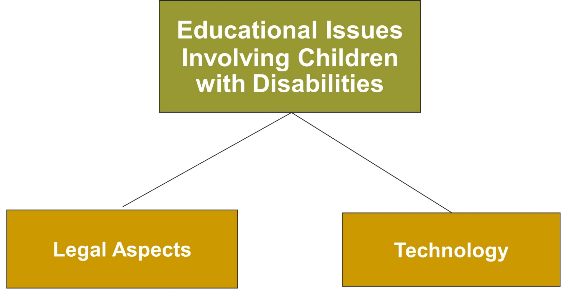
Learners Who Are Exceptional, 2
Jump to long description

Slide 26

Individuals with Disabilities Education Act (IDEA)
IDEA, 1990
Evaluation and eligibility determination
Appropriate education
Individualized education plan (IEP)
Education in the least restrictive environment (LRE)
Notes:
In 1975, Congress enacted Public Law 94-142, the Education for All Handicapped Children Act.
In 1990, Public Law 94-142 was recast as the Individuals with Disabilities Education Act (IDEA).
IDEA was amended in 1997 and reauthorized in 2004. It was renamed the Individuals with Disabilities Education Improvement Act.
Concerns for special education include: (1) service delivery (inclusion in the regular classroom with modifications versus special education outside the regular classroom) and (2) the disproportionate representation of students from minority backgrounds in special education classes.

Slide 27
Working with Children with Disabilities: Regular Classroom Teachers
Follow the student’s individualized education plan (IEP)
Encourage your school to provide increased support and training in how to teach children with disabilities
Become knowledgeable about the disabilities present in your classroom
Be cautious about labeling children with disabilities
Remember all children benefit from some of the same teaching strategies
Help children understand and accept children with a disability

Slide 28
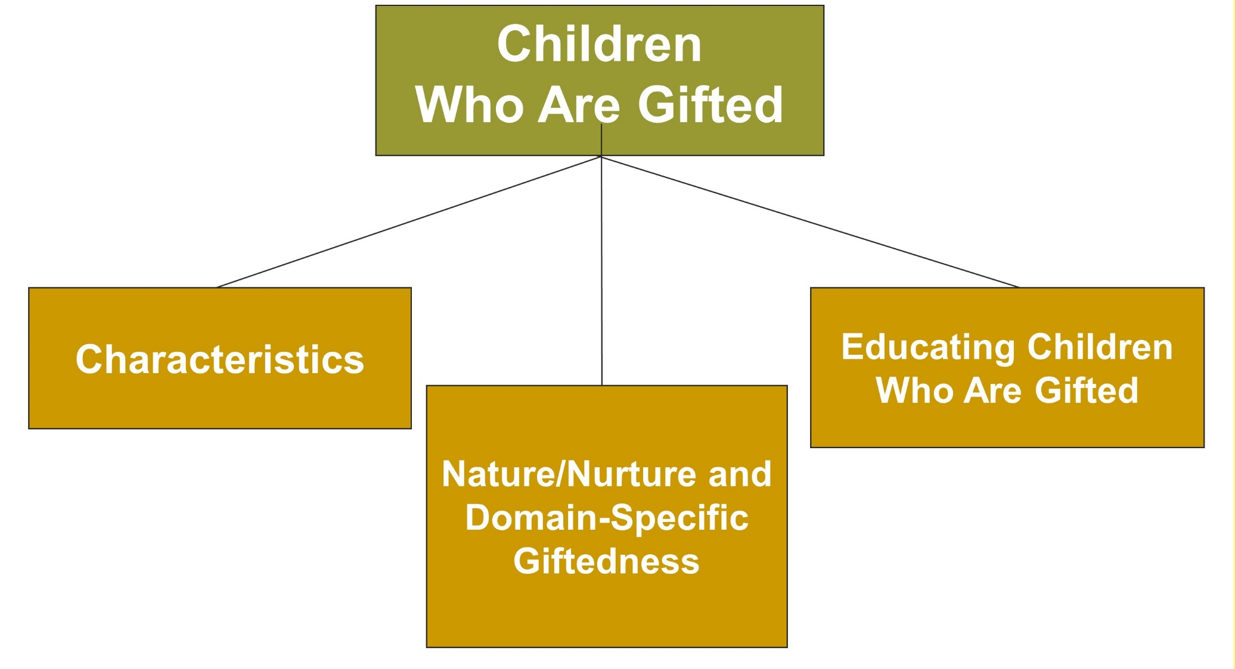
Learners Who Are Exceptional,
3
Jump to long description

Slide 29





Characteristics of Gifted Children
Children Who Are Gifted
  Are precocious
  March to their own drummer
  Have a passion for mastery
Notes:
Children who are gifted have above-average intelligence (usually defined as an IQ of 130 or higher) and/or superior talent in some domain such as art, music, or mathematics.
The U.S. government has described five areas of giftedness: intellectual, academic, creative, visual and performing arts, and leadership.

Slide 30
Nature/Nurture, Developmental Changes, and Domain-Specific Giftedness
Nature/nurture
  Gifted individuals have high ability in a particular area at a very early age, prior to or at the beginning of formal training
Developmental changes and domain-specific giftedness
  Many children typically become experts in some well-established domains

Slide 31
Educating Children Who Are Gifted
Special classes
Acceleration and enrichment in the regular classroom setting
Mentor and apprenticeship programs
Work/study and/or community-service programs

Slide 32
Strategies for Working with Students Who Are Gifted
Recognize that the student is academically advanced
Guide the student to new challenges and ensure that school is a positive experience
Remember that giftedness is usually domain-specific
Monitor the accurate evaluation of the child’s readiness for accelerated learning
Discuss with parents ways to appropriately challenge the child
Learn about and use resources for children who are gifted

Slide 33
Classroom Connections: Crack the Case—Now What?, 1
What are the issues in this case?
Why do you suppose Ms. Inez makes light of parents’ perceptions of their children’s strengths?
How should Ms. Inez approach the parents of the students she thinks might have ADHD?
Notes:
This case is on page 224 of the text.

Slide 34
Classroom Connections: Crack the Case—Now What?, 2
Is it appropriate for her to recommend testing of any of the children? Why or why not? Would it be appropriate for her to recommend a particular doctor for this testing? Why or why not?
If Alex can already read and subtract, are there other skills he has likely mastered? If so, what might they be? How might this impact his experiences in kindergarten?
How should Ms. Inez address this?
Notes:
This case is on page 224 of the text.

Slide 35
Appendix of Image for Long Descriptions

Slide 36
Learners Who Are Exceptional, 1 Long Description
The figure illustrates the topics under children with disabilities. There is a large rectangular box labeled children with disabilities. It is divided into eight small rectangular boxes. Starting from the left in an anticlockwise direction, the boxes are labeled learning disabilities, attention deficit hyperactivity disorder, mental retardation, physical disorders, sensory disorders, speech and language disorders, autism spectrum disorders, and emotional and behavior disorders.
Jump back to slide containing original image

Slide 37
Learners Who Are Exceptional, 2 Long Description
The figure illustrates the topics under educational issues involving children with disabilities. There is a large rectangular box labeled educational issues involving children with disabilities. There are two small rectangular boxes. The box on the left is labeled legal aspects. The box on the right is labeled technology.
Jump back to slide containing original image

Slide 38
Learners Who Are Exceptional,
3 Long Description
The figure illustrates the topics under children who are gifted. There is a large rectangular box labeled children who are gifted. It is divided into three small rectangular boxes. Starting from the left in an anticlockwise direction, the boxes are labeled characteristics, nature/nurture and domain-specific giftedness, and educating children who are gifted.
Jump back to slide containing original image

