Slide 1
CHAPTER 8
The Information-Processing Approach
© 2018 McGraw-Hill Higher Education. All rights reserved.

Slide 2
Learning Goals
Describe the information-processing approach.
Characterize attention and summarize how it changes during development.
Discuss memory in terms of encoding, storage, and retrieval.
Draw some lessons about learning from the way experts think.
Explain the concept of metacognition and identify some ways to improve children’s metacognition.

Slide 3
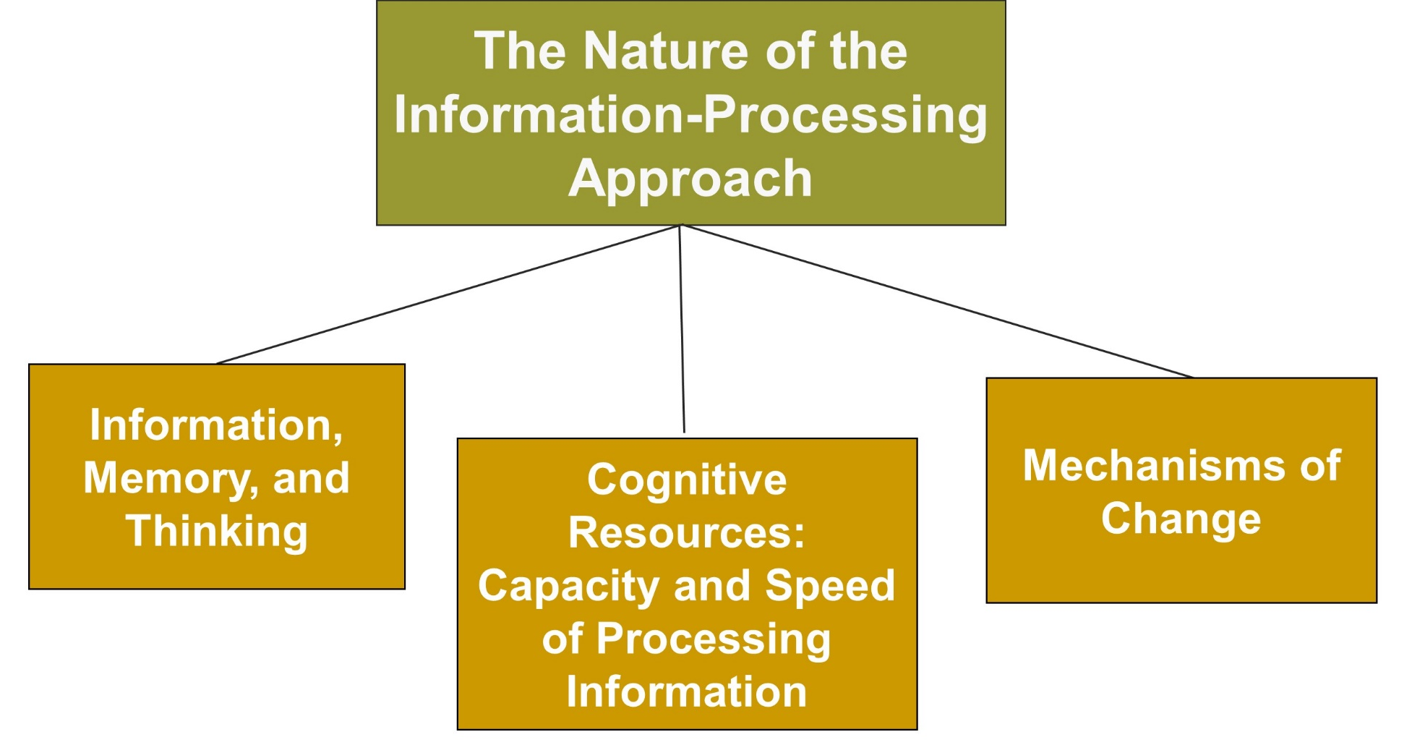
The Information-Processing Approach, 1
Jump to long description

Slide 4
Connecting with Teachers
Laura Bickford, who chairs the English Department at Nordoff High School in Ojai, California, believes a call to teach is a call to teach students how to think
  She encourages critical thinking and shows students how to ask their own questions
  She uses metacognitive strategies all the time
    Asks students to comment on their own learning and observe their own thinking

Slide 5
Information-Processing Approach
Emphasizes that children manipulate information, monitor it, and strategize about it
Is analogous to computers
Notes:
Cognitive psychology - Approaches that sought to explain behavior by examining mental processes

Slide 6
Cognitive Resources
Capacity and speed of information processing increase
Contributions of biology and experience as children grow and mature
  Biological developments occur in brain structures
    Blooming and pruning of connections between neurons that produces fewer but stronger connections
Notes:
As children age, grow and mature, and experience the world, their information-processing abilities increase.
How fast children can process information influences what they can do with that information.
Reaction-time task - Way of assessing processing speed

Slide 7
Change Mechanisms
Encoding: Getting information into memory
Automaticity: Processing information with little effort
Strategy construction: Discovering new processing procedures
Self-modification: Learning to use what they have learned in previous circumstances to adapt their responses to a new situation
Notes:
Three mechanisms work together to create changes in children’s cognitive skills: encoding, automaticity, and strategy construction (Siegler, 1998, 2016a, b).

Slide 8
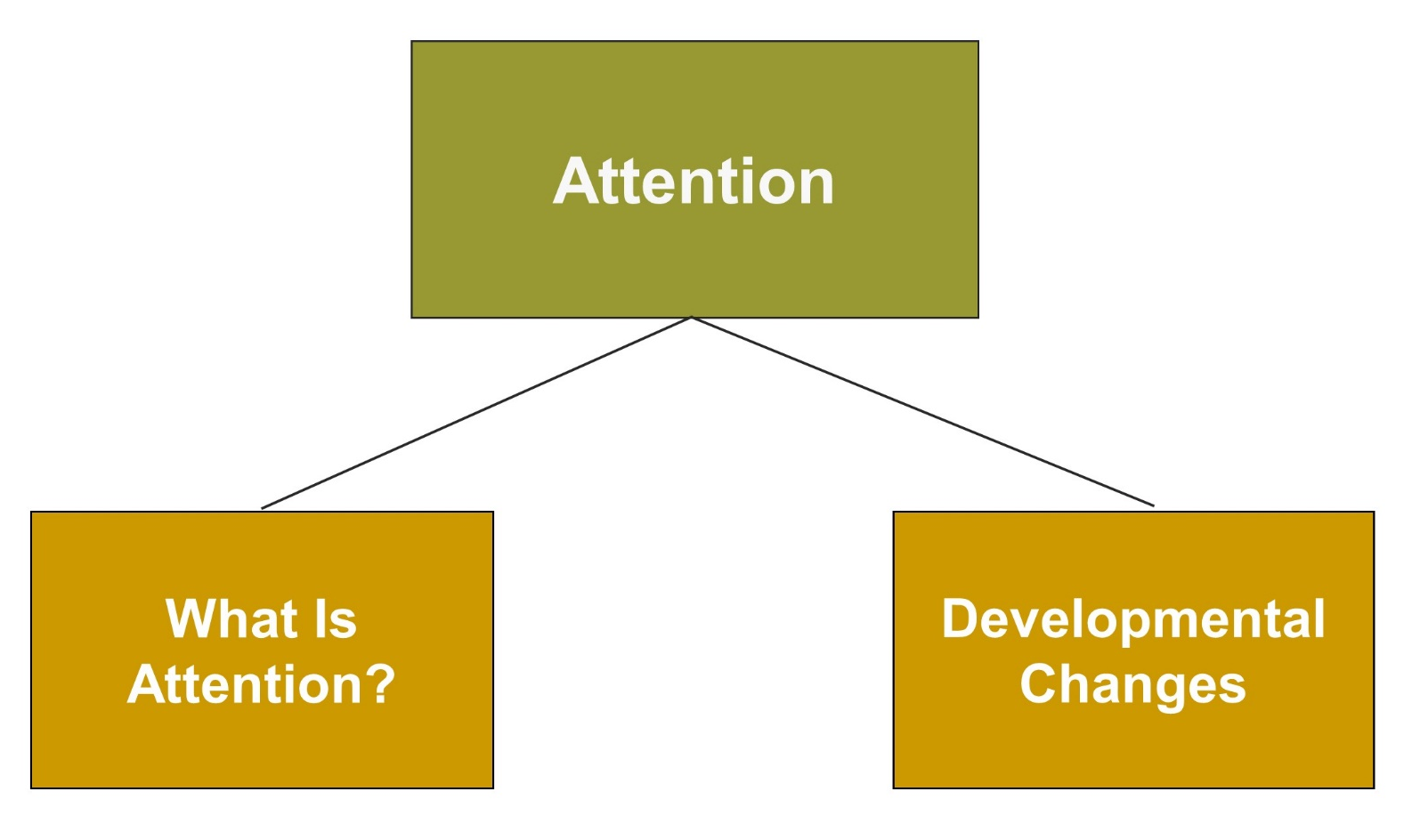
The Information-Processing Approach, 2
Jump to long description

Slide 9
What Is Attention?
Attention is the focusing of mental resources
Selective attention
Divided attention
Sustained attention
Executive attention
Notes:
Selective attention - Focusing on a specific aspect of experience that is relevant
Divided attention - Concentrating on more than one activity at the same time
Sustained attention - Ability to maintain attention over an extended period of time
Executive attention - Involves action planning, allocating attention to goals, error detection and compensation monitoring progress on tasks, and dealing with novel or difficult circumstances

Slide 10
Developmental Changes in Attention
Increase in selective attention
Increase in attention span
Increase in cognitive control of attention and less impulsivity
Increase in attention to relevant stimuli
Notes:
Control over attention improves during childhood.

Slide 11
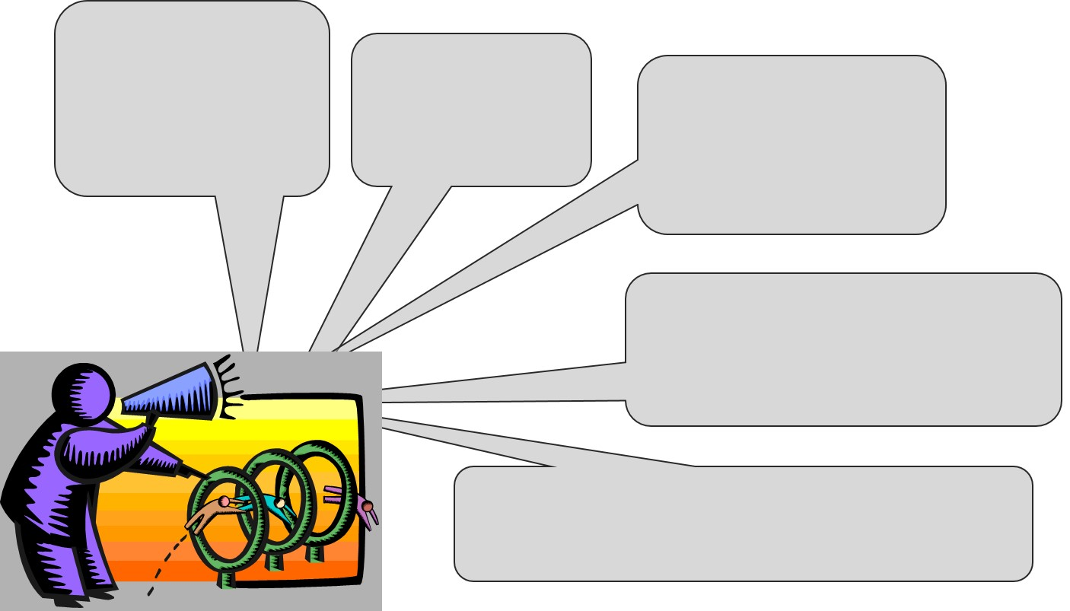
Getting Students to Pay Attention
Encourage attention and
minimize distraction
Make learning interesting
Use cues and gestures
for important material
Focus on active learning and be aware of individual differences
Use media and technology to make learning enjoyable
Notes:
Recently, computer exercises have been developed to improve children’s attention.

Slide 12
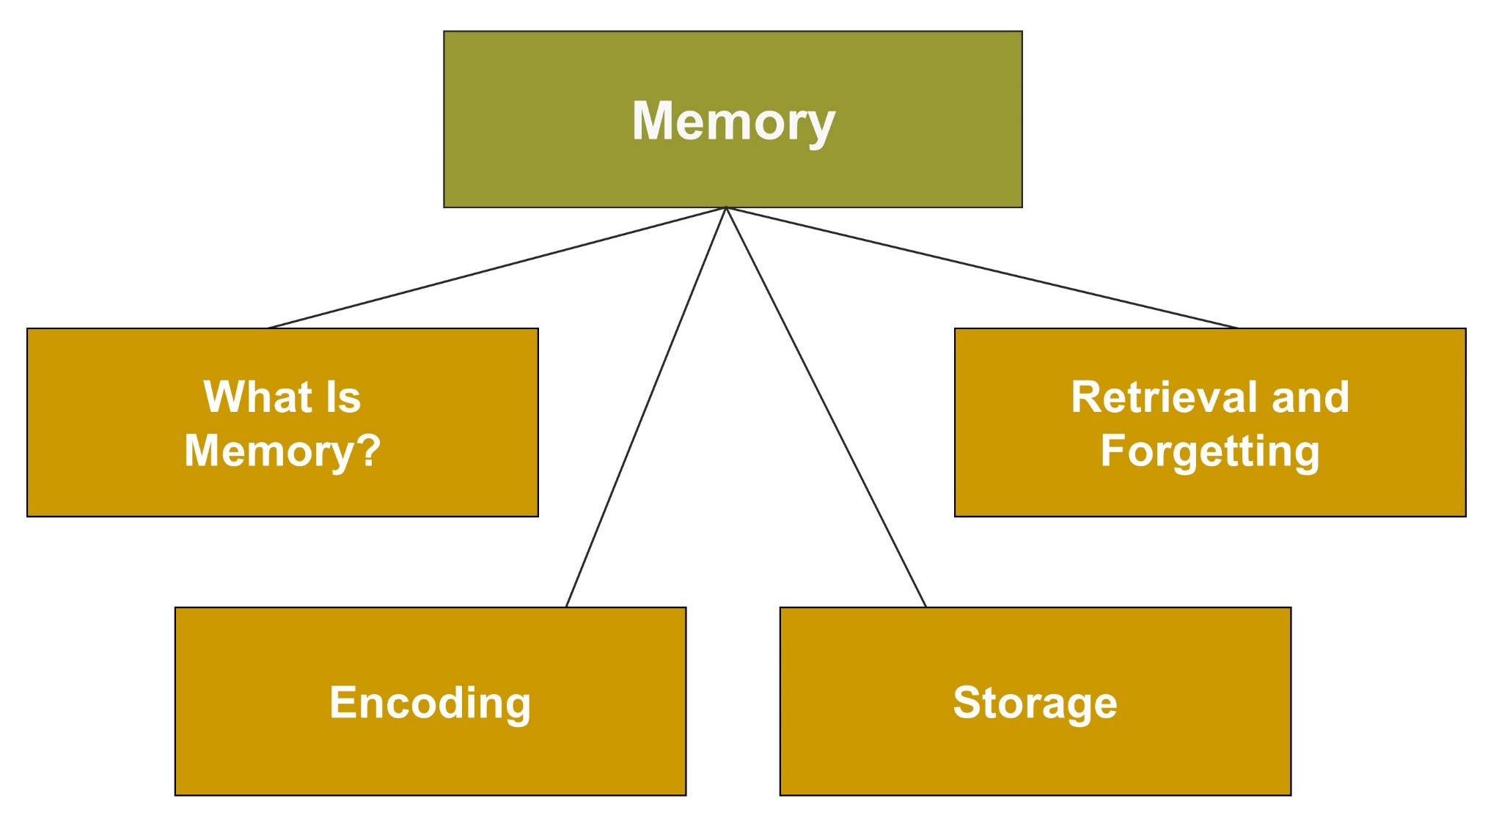
Memory, 1
Jump to long description

Slide 13
Enter the Debate
Should teachers require students to engage in rote memorization?
YES
NO
Notes:
During a slideshow, text may be written on the slides in the yes/no boxes, and then saved for later reference.

Slide 14
Memory, 2
…is the retention of information over time
ENCODING
STORAGE
RETRIEVAL
Taking
information
out of
storage
Getting
information
into memory
Retaining
information
over time
Notes:
Educational psychologists study how information is initially placed or encoded into memory, how it is retained or stored (after being encoded), and how it is later found or retrieved.

Slide 15
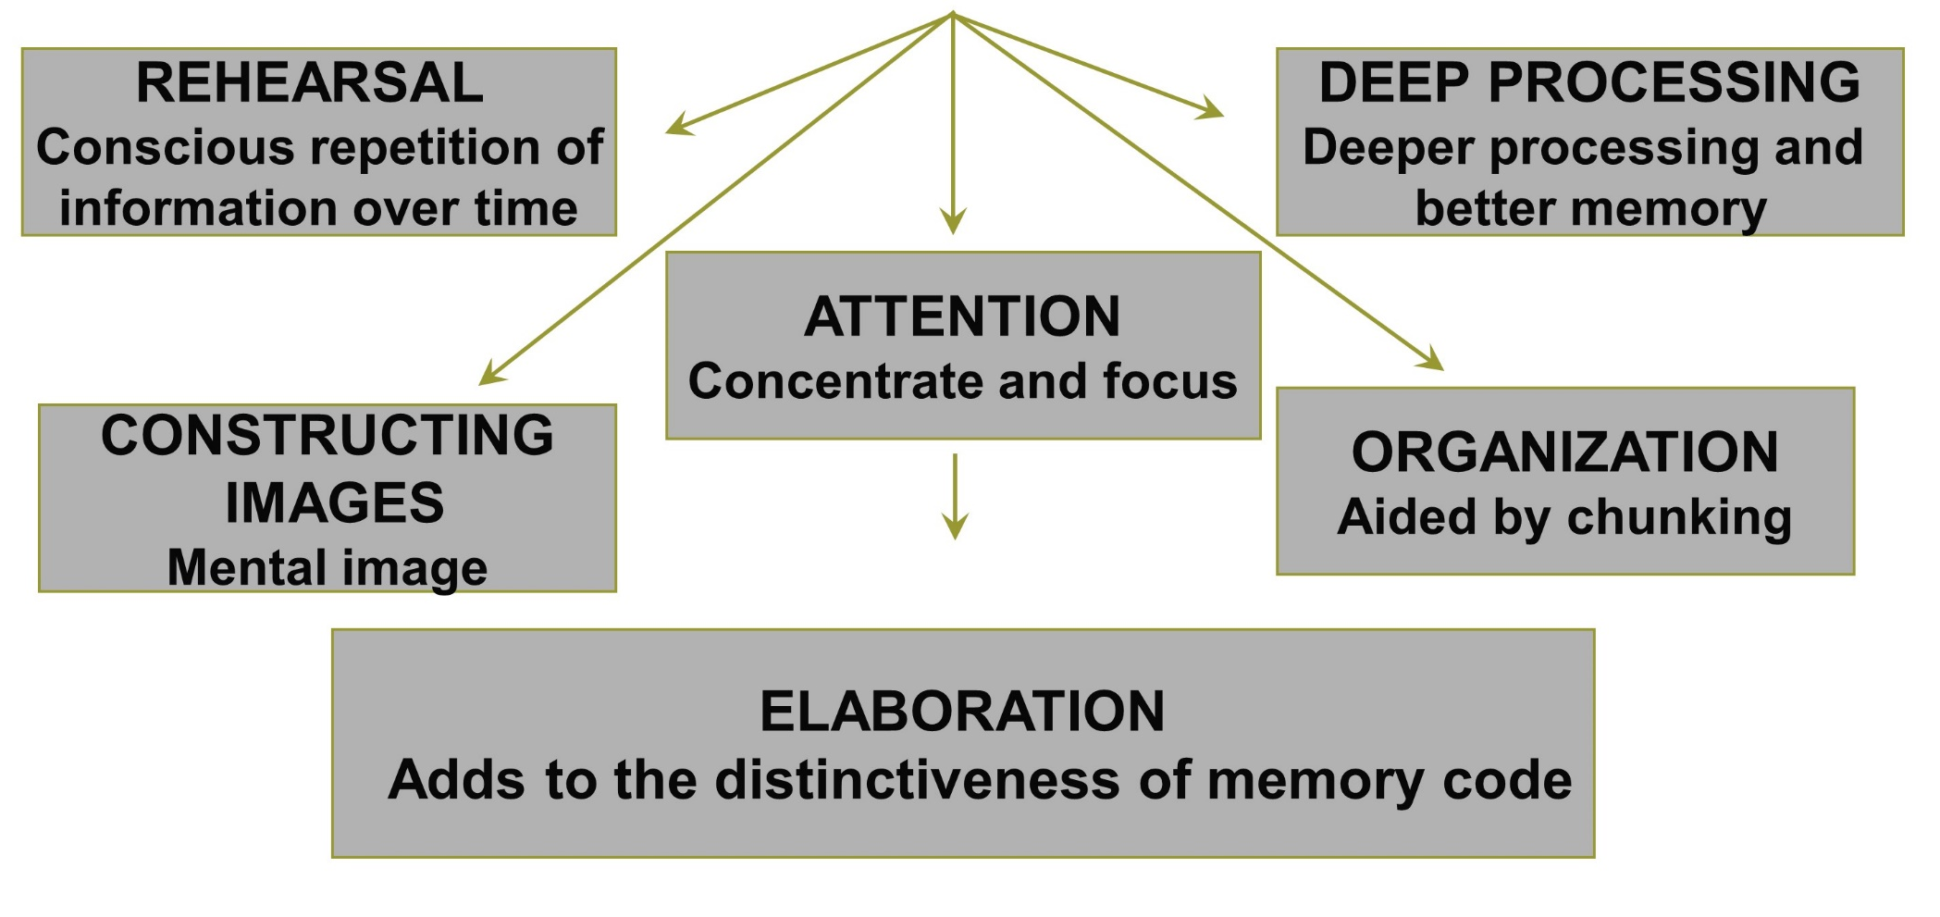
Encoding Strategies
Jump to long description
Notes:
Encoding consists of a number of processes: Rehearsal, deep processing, elaboration, constructing images, and organization.
Chunking - Organizational memory strategy that involves grouping, or “packing”, information into higher-order units than can be remembered as single units

Slide 16
Memory’s Time Frames
Sensory Memory - Retains information for an instant
Short-Term Memory - Limited capacity and retains for 30 seconds without rehearsal
Long-Term Memory - Unlimited capacity over a long period of time
Notes:
Memory is stored for different time frames. Sensory memory lasts a fraction of a second to several seconds, short-term memory lasts about 30 seconds, and long-term memory lasts up to a lifetime.

Slide 17
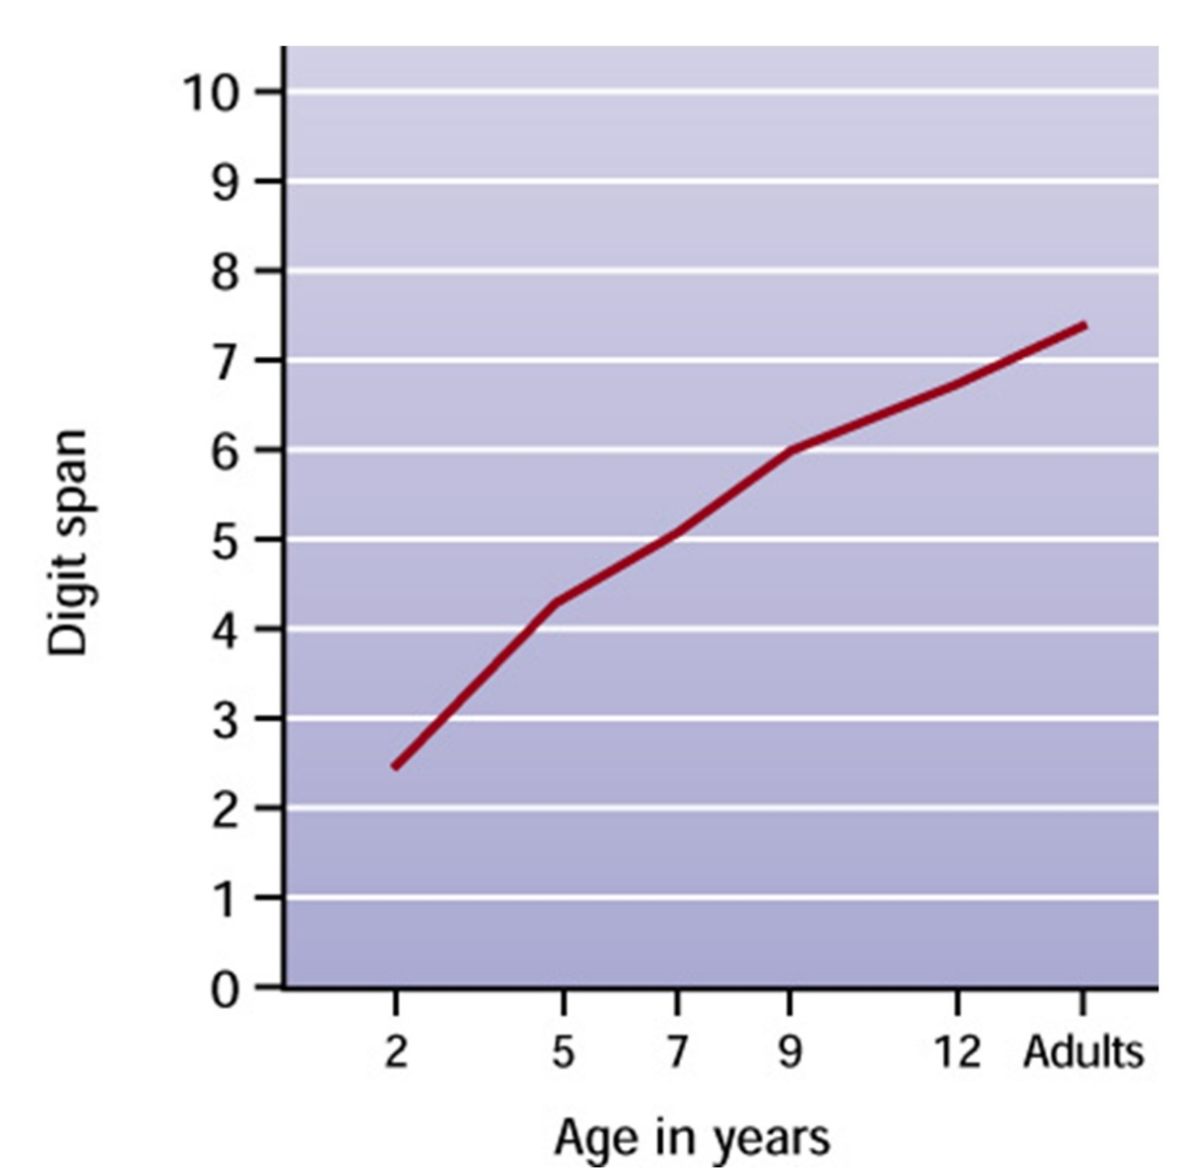
Figure 8.2 - Developmental Changes in Memory Span

Slide 18
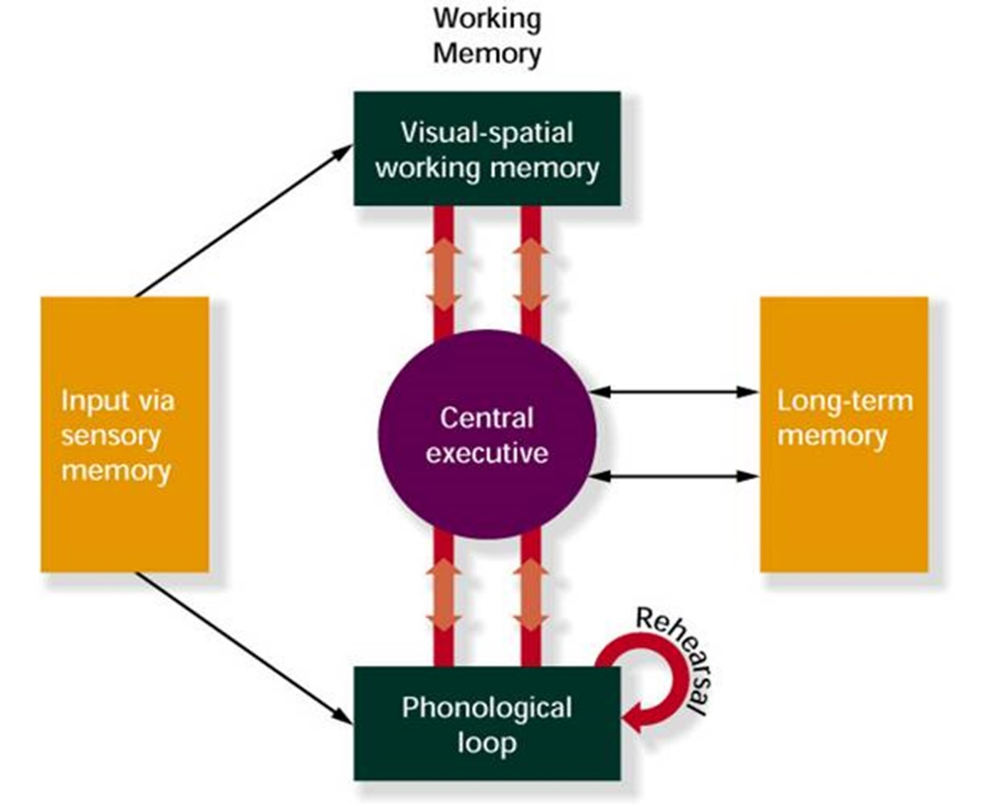
Figure 8.3 - Baddeley’s Model of Memory
Notes:
Working memory - Three-part system that temporarily holds information as people perform tasks
Mental “workbench” where information is manipulated and assembled to help us make decisions and solve problems
Phonological loop - Briefly stores speech-based information about the sounds of language
Has two separate components: acoustic code (decays in a few seconds) and rehearsal (allows individuals to repeat words)
Visuospatial working memory - Stores visual and spatial information (has limited capacity)
Central executive - Integrates information from the phonological loop and the visuospatial working memory and also integrates information from long-term memory

Slide 19
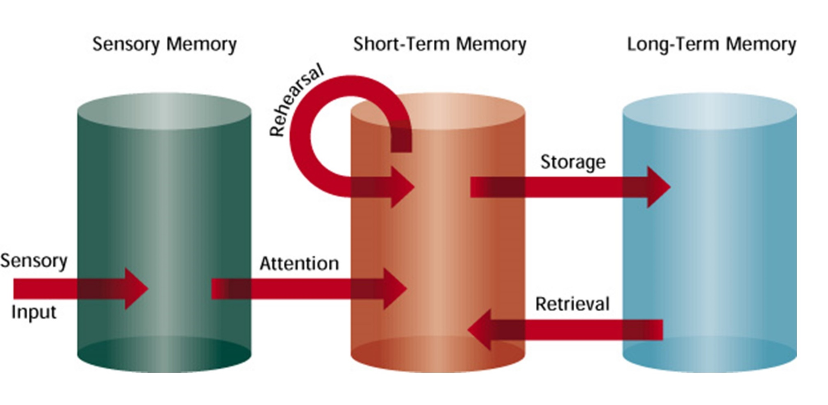
Figure 8.4 - Atkinson and Shiffrin’s Theory
Jump to long description

Slide 20
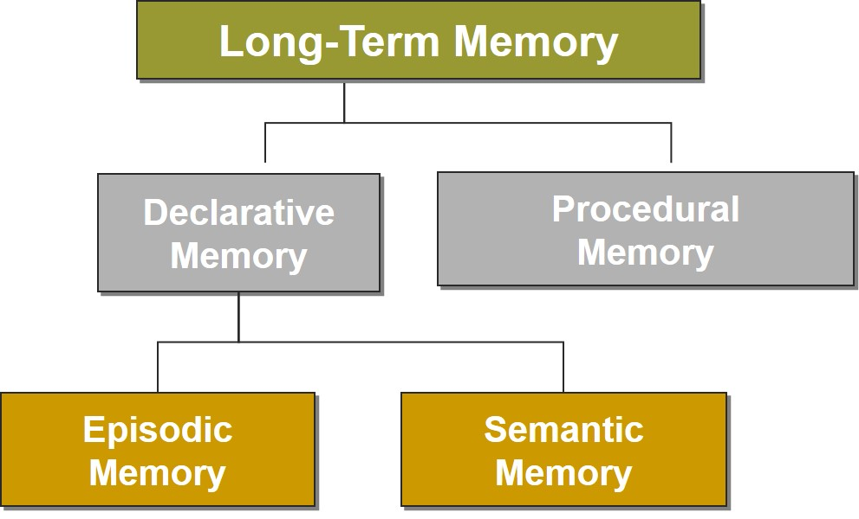
Memory, 3
Jump to long description
Notes:
Memory can be differentiated based on its contents.
Declarative memory - Conscious recollection of information (specific facts or events that can be verbally communicated)
Procedural memory - Nondeclarative knowledge, including skills and cognitive operations (“Knowing how” or implicit memory)
Two subtypes of declarative memory - Episodic memory and semantic memory
Episodic memory - Retention of information about the when and where of life’s happenings (memories of the first day of school)
Semantic memory - Student’s general knowledge about the world (information learned in school, knowledge of specific field on information)

Slide 21
Representing Information in Memory
Network Theories
Schema Theories
Nodes stand for labels and concepts
Network is viewed as irregular and distorted
Long-term searches are not exact
Retrieved information is fit into an existing formation (schema)
  Schemas: Concepts, knowledge, or information about events that already exist in the mind and influence the way we encode information
Notes:
Network theories - Describe how information in memory is organized and connected
Schema theory - Theory that when we construct information, we fit it into information that already exists in our mind
Scripts - A schema for an event, which is helpful when people need to figure out an activity or event
Fuzzy trace theory - When individuals encode information it creates two types of memory representations: (a) verbatim memory trace (precise details) and (b) fuzzy trace (gist of the central idea of the information).

Slide 22
Retrieval
Serial Position → | Recall is better for items at the beginning and end of list
Encoding Specificity → | Associations formed at the time of learning form effective cues
Recall → | Retrieving previously learned information
Recognition → | Identifying learned information, such as multiple-choice tests

Slide 23
Forgetting
Cue-Dependent Forgetting | Caused by a lack of effective retrieval cues
Interference Theory | Other information (new or old) gets in the way of what we are trying to remember
Decay Theory | Passage of time allows “memory trace” to disintegrate (transience)
Notes:
Memories decay at different speeds; “flashbulb” memories are vivid and last for long periods of time.

Slide 24
Improving Memory
Promote understanding of material
Vary instructional information and link early and often
Assist organization of knowledge
Teach mnemonics
  Method of loci
  Rhymes
  Acronyms
  Keyword
Embed memory retrieval language

Slide 25
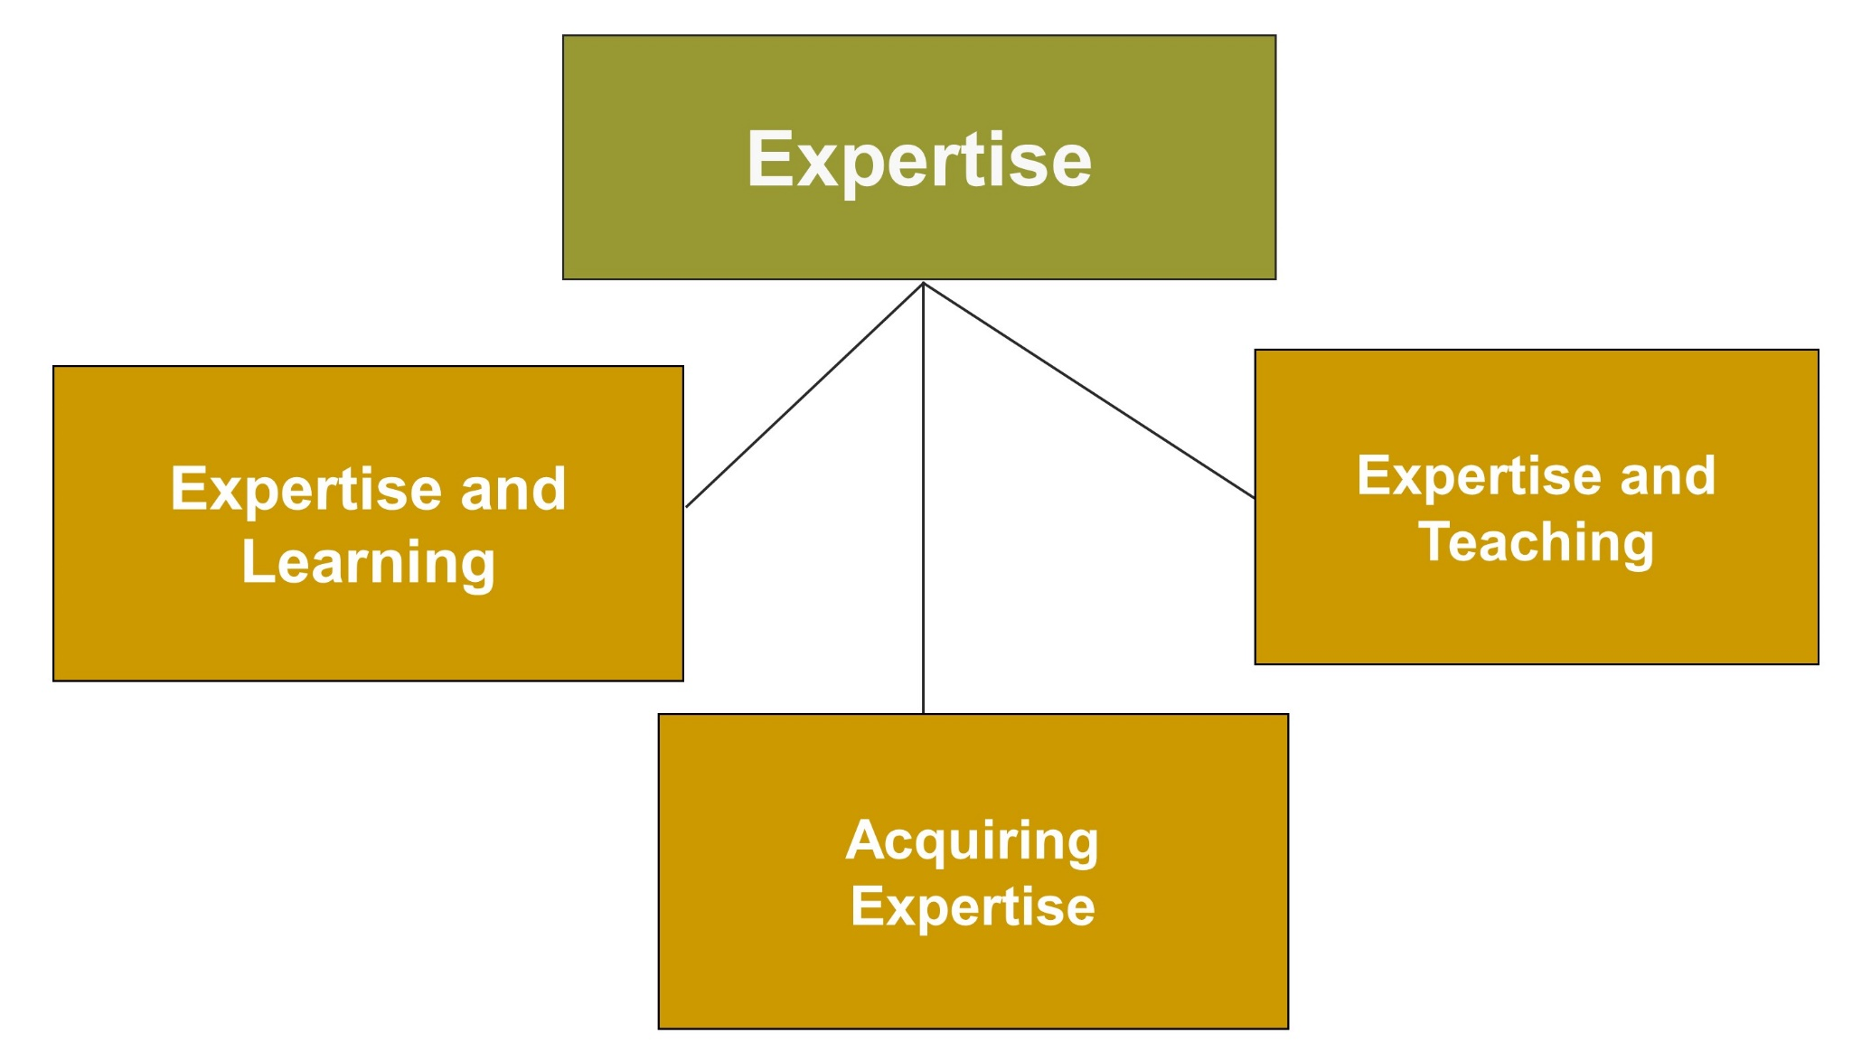
Expertise
Jump to long description

Slide 26
Experts
Detect features and meaningful patterns of information
Accumulate more content knowledge and organize it in a manner that shows an understanding of the topic
Retrieve important aspects of knowledge with little effort
Adapt an approach to new situations
Use effective learning strategies

Slide 27
Experts versus Novices, 1
Detecting features and meaningful patterns of organization
  Experts have attentional advantage; they are better at noticing important features of problems
  Superior recall is aided by the process of chunking
Organization and depth of knowledge
  Experts’ knowledge is organized around important ideas or concepts
  Experts establish more elaborate networks of information

Slide 28
Experts versus Novices, 2
Fluent retrieval
  They retrieve information in an effortless, automatic manner
    Effortless retrieval places fewer demands on conscious attention
Adaptive expertise
  Flexibility in approaching new situations
  Openness to rethinking important ideas and practices
Strategies
  Used by experts to understand information in their area of expertise

Slide 29
Acclimation
Acclimation: Initial stage of expertise
  Teachers must help students develop strategies to move beyond the acclimation stage and strategies include:
    Spreading out and consolidating learning
    Having students ask themselves questions
    Taking good notes (summarize, outline, use concept maps)
    Using a Study System

Slide 30
Acquiring Expertise
Practice and motivation
  Deliberate practice made at appropriate level of difficulty with corrective feedback
  Considerable motivation is required
Talent
  Needed for development of expertise in some areas

Slide 31
Expertise and Teaching
Difference between content knowledge and pedagogical content knowledge (teaching effectiveness)
Pedagogical content knowledge
  Expert teachers are aware of common difficulties students have as they try to learn a content area
  Expert teachers are good at monitoring students’ learning and assessing students’ progress

Slide 32
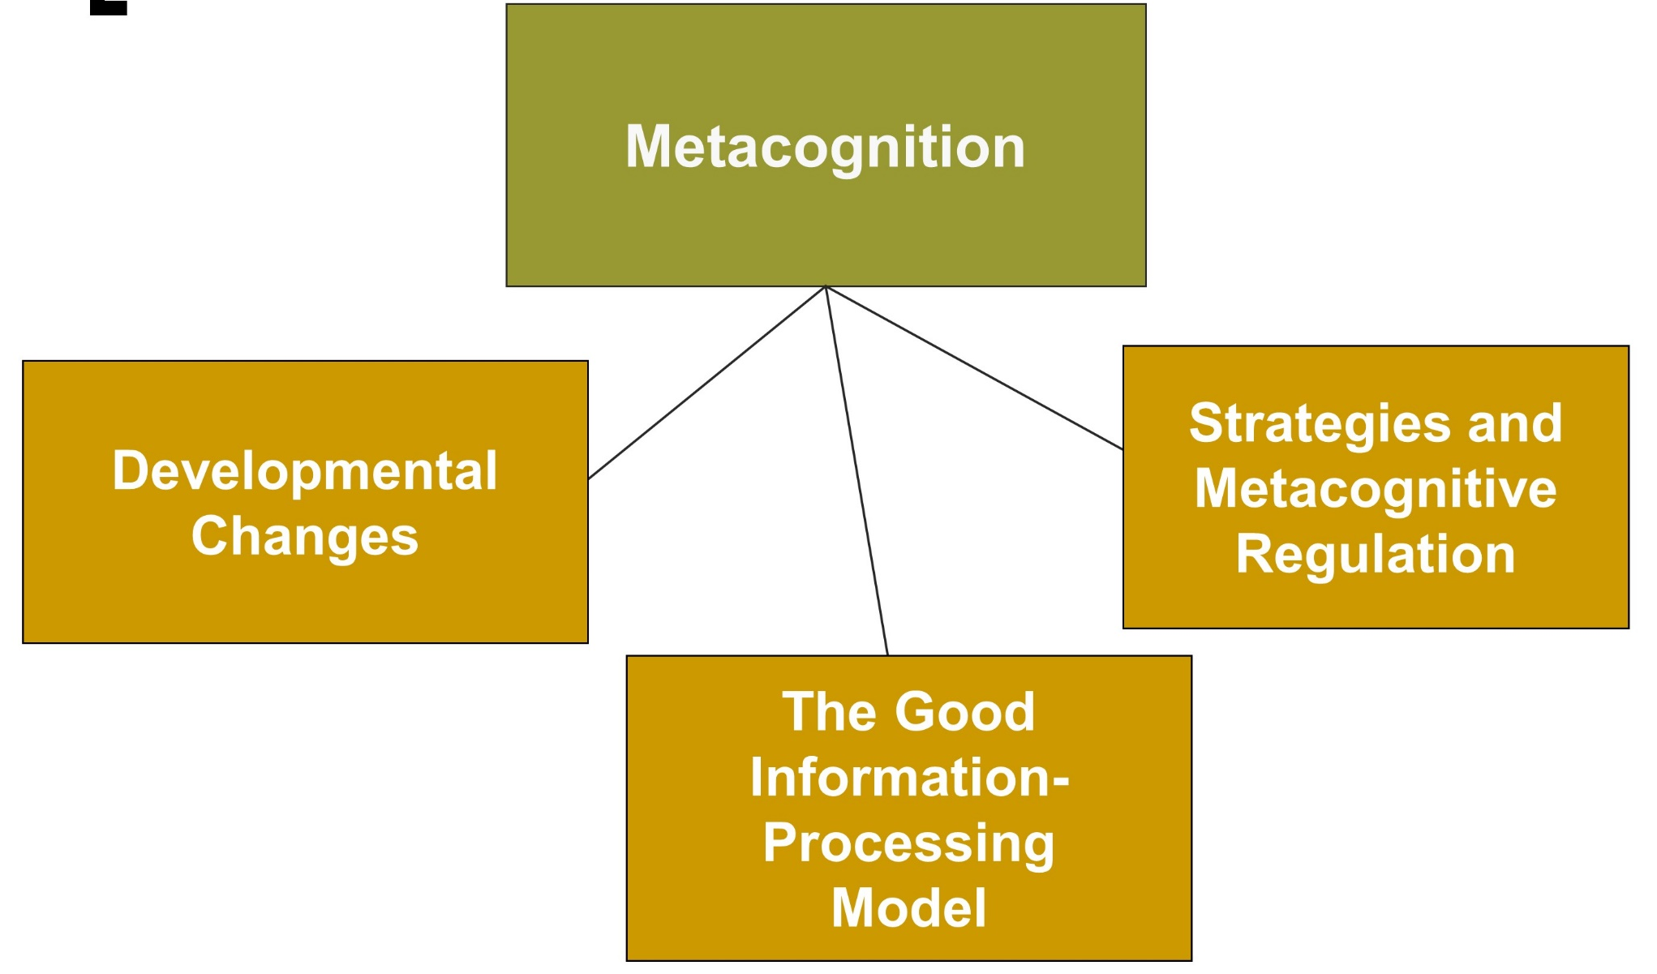
Metacognition, 1
Jump to long description

Slide 33
Metacognition, 2
“Knowing about knowing”
Metacognitive Knowledge
Monitoring and reflecting on one’s current or recent thoughts
Metacognitive Activity
Students consciously adapt and manage their thinking strategies during problem solving and purposeful thinking

Slide 34
Improving Metacognitive Skills
Improvement of metacognitive skills results from:
Developmental changes as student matures cognitively in metamemory and theory of mind
The Good Information-Processing model includes specific learning strategies, knowing the similarities and differences in multiple strategies, and the benefits of using them
Notes:
Theory of Mind - Awareness of one’s own mental processes and the mental processes of others
Children’s theory of mind changes as they develop through childhood. The main changes occur at: 2–3 years, 4–5 years, middle and late childhood, and adolescence.

Slide 35
Best Practices for Helping Students Use Strategies, 1
Model effective strategies for students
Give students opportunities to practice strategies
Encourage students to monitor the effectiveness of new strategies when compared with old strategies
Be patient and give students support for new strategy learning and use

Slide 36
Best Practices for Helping Students Use Strategies, 2
Encourage students to use multiple strategies
Read about strategy instruction
Question students to guide strategy thinking
Support low-achieving students and students with disabilities; they may need more time to become effective in independent strategy use

Slide 37
Classroom Connections: Crack the Case—The Test
What are the issues in this case?
With what type of learning is George having difficulty?
What type of learning is easier for George?
Design a study-skills program for George drawing on principles of the cognitive information-processing approach.
Notes:
This case is on page 305 of the text.

Slide 38

Reflection & Observation
Reflection:
What strategies have teachers used to help you understand difficult concepts?
Why were these strategies helpful?
Notes:
This slide accompanies the video segment, Information Processing in Fourth Grade Math, on the McGraw-Hill DVD Teaching Stories: A Video Collection for Educational Psychology.

Slide 39
Appendix of Image for Long Descriptions

Slide 40
The Information-Processing Approach, 1 Long Description
This figure consists of four rectangular boxes. There is a large rectangular box labeled the nature of the information-processing approach. It is divided into three small boxes. Starting from the left, the boxes are labeled information, memory, and thinking; cognitive resources: capacity and speed of processing information; and mechanisms of change.
Jump back to slide containing original image

Slide 41
The Information-Processing Approach, 2 Long Description
This figure consists of three rectangular boxes. There is a box on top that is labeled attention. This box is connected to the two boxes below it. The box on the left is labeled what is attention, and the box on the right is labeled developmental changes.
Jump back to slide containing original image

Slide 42
Memory, 1 Long Description
This figure consists of five rectangular boxes. There is a box on top that is labeled memory. This box is connected to the two boxes below it. Starting from the left, the boxes are labeled what is memory, encoding, storage, and retrieval and forgetting.
Jump back to slide containing original image

Slide 43
Encoding Strategies Long Description
The slide consists of a group of rectangular boxes connected by arrows. Five arrows point downward at five rectangular boxes. Starting from the left, the boxes are labeled REHEARSAL Conscious repetition of information over time, CONSTRUCTING IMAGES Mental image, ATTENTION Concentrate and focus, DEEP PROCESSING Deeper processing, better memory, and ORGANIZATION Aided by chunking. The box at the center has an arrow pointing downward at another rectangular box labeled ELABORATION Adds to the distinctiveness of memory code.
Jump back to slide containing original image

Slide 44
Figure 8.4 - Atkinson and Shiffrin’s Theory Long Description
The figure illustrates Atkinson and Shiffrin’s Model of Memory. In this model, sensory input goes into sensory memory. Through the process of attention, information moves into short-term memory, where it remains for 30 seconds or less, unless it is rehearsed. When the information goes into long-term memory storage, it can be retrieved over one's lifetime.
Jump back to slide containing original image

Slide 45
Memory, 3 Long Description
The figure shows a flowchart illustrating the types of long-term memory. A rectangular box is labeled long-term memory. It is divided into two boxes that are labeled declarative memory and procedural memory. The box labeled declarative memory is divided into two other boxes that are labeled episodic memory and semantic memory.
Jump back to slide containing original image

Slide 46
Expertise Long Description
This figure consists of four rectangular boxes. There is a box on top that is labeled expertise. This box is connected to the two boxes below it. Starting from the left, the boxes are labeled expertise and learning, acquiring expertise, and expertise and teaching.
Jump back to slide containing original image

Slide 47
Metacognition, 1 Long Description
This figure consists of four rectangular boxes. There is a box on top that is labeled metacognition. This box is connected to the two boxes below it. Starting from the left, the boxes are labeled developmental changes, The Good Information-Processing Model, and strategies and metacognitive regulation.
Jump back to slide containing original image

