Slide 1
CHAPTER 11
Learning and Cognition in the Content Areas
© 2018 McGraw-Hill Higher Education. All rights reserved.

Slide 2
Learning Goals, 1
Distinguish between expert knowledge
and pedagogical content knowledge.
Explain how reading develops and discuss some useful approaches to teaching reading.
Describe how writing develops and discuss some useful approaches to teaching writing.

Slide 3
Learning Goals, 2
Characterize how mathematical thinking develops and identify some issues related to teaching mathematics.
Identify some challenges and strategies related to teaching children how to think scientifically.
Summarize how learning in social studies is becoming more constructivist.

Slide 4
Connecting with Teachers
Wendy Nelson Kauffman, a 10th- and 12th- grade social studies teacher, helps students improve their thinking and writing skills.
  She believes students have to learn skills in writing, critical thinking, and class participation.
  She helps them do this by making learning fun and playing to their strengths.
    Her classroom activities include writing autobiographies, keeping journals, and participating in dramatic role-plays.

Slide 5

Expert and Pedagogical Content Knowledge
Expert knowledge means an excellent knowledge about the content of a particular discipline.
Pedagogical content knowledge is knowledge about how to effectively teach a particular discipline.
Notes:
Expert blind spots - The gap between what an expert knows and what students know
Too often experts (teachers) don’t communicate all the information and steps necessary for students (novices) to learn something.
Expert Teachers - Know the structure of their discipline
They are able to create cognitive road maps that guide the assignments they give students, assessments they use to evaluate students’ progress, and the types of questions and answers they generate in class.

Slide 6
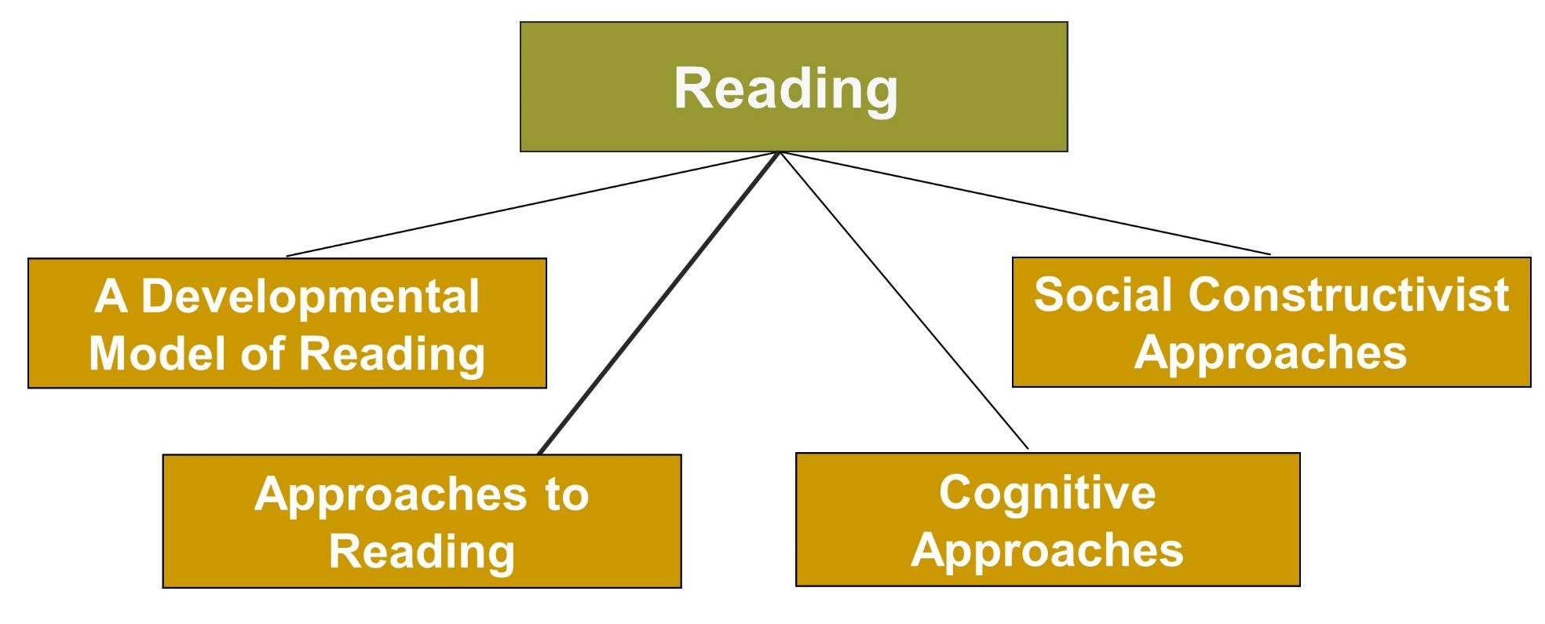
Learning and Cognition in the Content Areas, 1
Jump to long description

Slide 7
Goals of Reading Instruction
Three main goals of reading instruction (Stahl, 2002) to help children
  Automatically recognize words
  Comprehend text
  Become motivated to read and appreciate reading
All goals are interrelated.

Slide 8
Cognitive Processes in Reading
Cognitive processes needed by a child to read a printed word (Mayer, 2004, 2008)
  Being aware of sound units in words (recognizing phonemes)
  Decoding words (converting printed words into sounds)
  Accessing word meaning (finding a mental representation of a word’s meaning)

Slide 9


Developmental Model of Reading (Chall, 1979), 1
Stage 0 (birth to 1st grade) Learn left-to-right progression, identification of letters of the alphabet, and how to write their names
Stage 1 (grades 1 and 2) Learn to sound out words
Stage 2 (grades 2 and 3) Retrieve individual words and develop other reading skills
Notes:
Age boundaries are approximate and do not apply to every child.
Stages give a sense of the developmental changes involved in becoming a competent reader.

Slide 10

Developmental Model of Reading (Chall, 1979), 2
Stage 3 (grades 4 to 8) Read to learn, face difficulties in understanding various perspectives, and become increasingly able to obtain new information from print
Stage 4 (high school) Develop the ability to understand material written from different perspectives and discuss and become fully competent readers

Slide 11

Teaching Reading
Reading is the ability to understand written discourse.
Whole-Language
Approach
Phonics Approach
Notes:
Phonics approach - Reading instruction should focus on phonics and basic rules for translating written symbols into sounds.
Whole-language approach - Reading instruction should parallel children’s natural language learning. Reading materials should be whole and meaningful.
Children can benefit from both approaches, but instruction in phonics needs to be emphasized especially in kindergarten and the first grade.

Slide 12
Cognitive Approaches, 1
Decoding and Comprehending Words
Automaticity and Metacognitive Strategies:
Overview of text before reading
Seek and relate important ideas
Determine word meaning
Monitor comprehension
Understand relationships
Recognize the necessity to reread
Adjust pace based on difficulty of material
Notes:
Cognitive approaches to reading emphasize decoding and comprehending words, prior knowledge, and developing expert reading strategies.
Students’ fluency often improves when they (Mayer, 2008):
Hear others read a passage before and after they read it (assisted practice).
Spend considerable time at reading various passages.
Speak with appropriate expression and rhythm in oral reading.

Slide 13
Cognitive Approaches, 2
Prior Knowledge | A reader’s background knowledge is related to how he or she interprets and remembers reading material.
Develop Expert Strategies | The transactional strategy instruction approach allows students to learn strategies to monitor reading and to summarize information.
Notes:
In transactional strategy instruction approach, metacognitive strategies help control students’ abilities to remember what they read.

Slide 14
Social Constructivist Approaches, 1
Meaning is “socially negotiated” (involve reader’s contribution, social context, and purpose for reading)
Notes:
Social constructivist approaches emphasize the importance of giving students opportunities to engage in meaningful dialogue about their reading.

Slide 15
Social Constructivist Approaches, 2
Reciprocal teaching
  Generating questions about text
  Clarifying understanding of text
  Summarizing text
  Making predictions
School/family/community connections
Students from low-income families receive fewer language experiences.
Notes:
Reciprocal teaching can involve students taking turns leading small-group discussions or can involve a teacher and a student.
In reciprocal teaching, the teachers initially explain the strategies and model how to use them to make sense of the text. Then students demonstrate strategies with the teacher’s support.

Slide 16
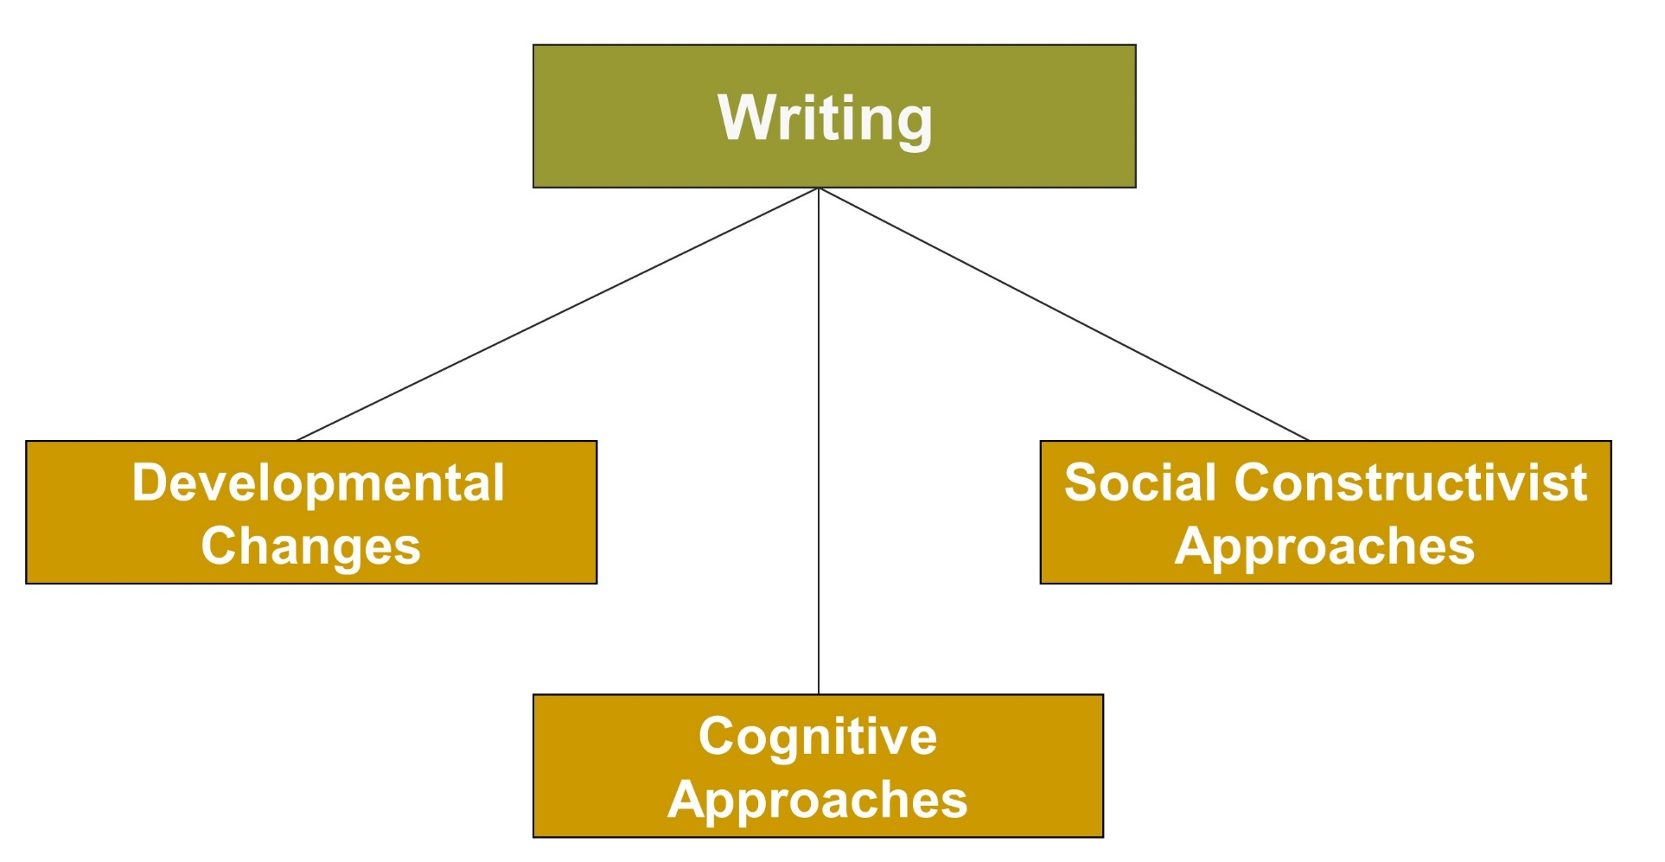
Learning and Cognition in the Content Areas, 2
Jump to long description

Slide 17

Developmental Changes in Writing, 1
Age 2 to 3 Writing emerges out of scribbles
Age 4 In the United States, children can usually reproduce their name
Age 5 Reproducing letters and copying short words
Notes:
There are increasing concerns about students’ current writing competence.
Seventy to seventy-five percent of U.S. students in grades 4–12 are low-achieving writers (Persky, Daane, & Jin, 2003).
College instructors report that 50% of high school graduates are not prepared for college-level writing (Achieve, Inc., 2005).

Slide 18

Developmental Changes in Writing, 2
Early Elementary School: Distinguish letter characteristics and continued reversal of letters (b-d;p-q); criticism of printing skills should be minimized and letter reversals are not a predictor of literacy problems
Middle and High School: Students develop sophisticated methods of organizing ideas

Slide 19
Cognitive Approaches to Teaching Writing, 1
Planning | Outlining and organizing content information
Problem Solving | Writers establish goals that include the purpose of the paper, the audience, and the role of the writer in the paper
Revising | Multiple drafts, getting feedback, and detecting and correcting errors

Slide 20
Cognitive Approaches to Teaching Writing, 2
Metacognition: Being receptive to feedback in order to become a good writer
Effective Writing Strategies:
  Prewriting
  Planning, revising, and editing
  Summarization
  Sentence combining

Slide 21
Social Constructivist Approaches to Teaching Writing
Creating a social context (writing community) that encourages writing
Meaningful writing and student-teacher writing conferences that promote writing about personal experieces
Shared rich peer collaboration and family/peer connections produce new insights.
Notes:
Social constructivist approaches emphasize that writing is best understood as being culturally embedded and socially constructed rather than being internally generated.

Slide 22
Best Practices for Incorporating Writing into the Curriculum
Nurture positive attitudes toward writing.
Foster student engagement through authentic writing tasks and contexts.
Provide a supportive context for writing.
Have students write to learn.
Use free-writing assignments.
Give students creative writing assignments.
Require formal writing assignments.
Invite writers to visit your classroom.

Slide 23
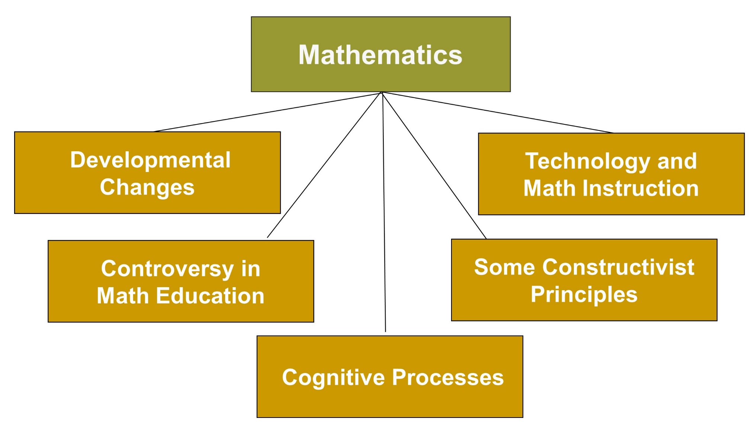
Learning and Cognition in the Content Areas, 3
Jump to long description

Slide 24

Developmental Changes in Mathematics, 1
Prekindergarten–Grade 2 Count past 20, many can count beyond 100, add/subtract single digits, and know the relative magnitudes of single-digit numbers (8 is greater than 6)
Grades 3 to 5 Multiplicative reasoning, equivalence, and computational fluency
Notes:
Experts recommend that young children learn two important aspects of math before entering school:
Basic aspects of numbers
Basic aspects of geometry
Early number competencies are linked to future math success.

Slide 25

Developmental Changes in Mathematics, 2
Grades 6 to 8 Balanced math program includes algebra and geometry, understanding how algebra and geometry are connected, and dealing with quantitative life solutions
Grades 9 to 12 Students should experience the interplay of algebra, geometry, statistics, probability, and discrete mathematics
Notes:
Currently, educators debate whether math should be taught using a cognitive, conceptual, and constructivist approach or a practice, computational approach.

Slide 26
Constructivist Principles for Teaching Mathematics
Make math realistic
and interesting
Consider the students’ prior knowledge
Make math curriculum
socially interactive
Notes:
The cognitive approach emphasizes constructivist mathematical problem solving.

Slide 27
Best Practices and Strategies for Teaching Mathematics
Teach students to become procedurally and conceptually competent in mathematics.
Help students develop good math problem-solving skills.
Encourage students to use metacognitive strategies.
Make math interesting for students.
Use technology effectively.
Connect with parents.
Join the NCTM and use its resources.

Slide 28
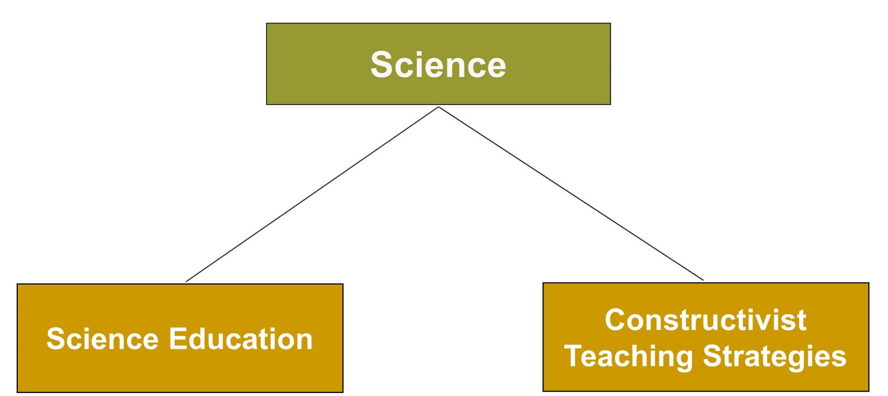
Learning and Cognition in the Content Areas, 4
Jump to long description

Slide 29
Best Practices and Strategies for Teaching Science
Promote scientific thinking
Address misconceptions about science
Develop inquiry skills
Allow exploration of everyday science problems
Notes:
There is a shortage of highly qualified middle and high school science teachers.
Critics of constructivist approaches argue that too much attention is given to inquiry skills and not enough is given to discipline-specific information.

Slide 30
Enter the Debate
Should teachers emphasize the scientific process or scientific facts in science instruction?
PROCESS
FACTS
Notes:
During a slideshow, text may be written on the slides in the yes/no boxes, and then saved for later reference.

Slide 31
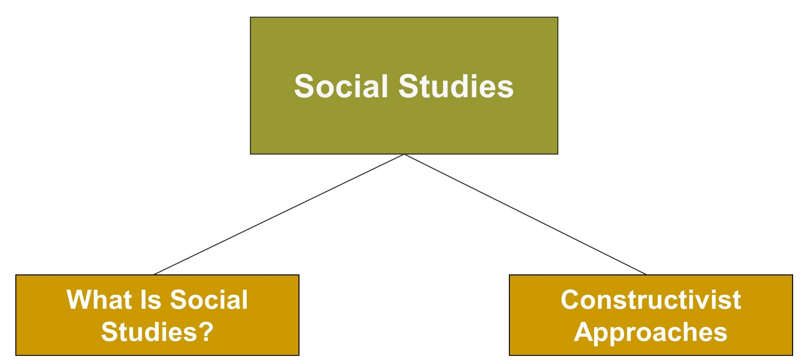
Learning and Cognition in the Content Areas, 5
Jump to long description

Slide 32
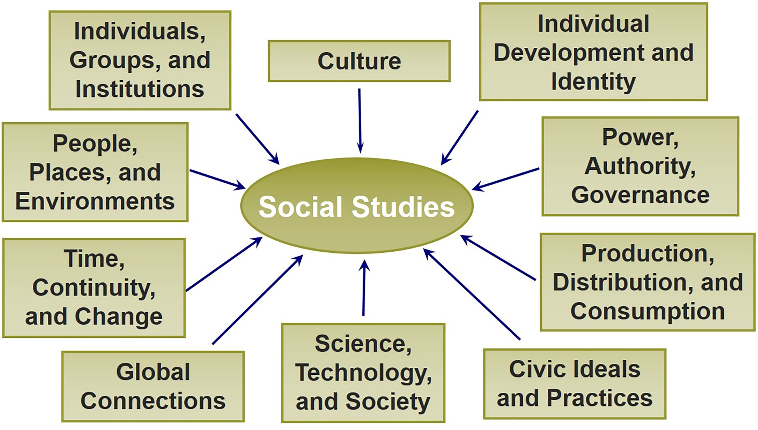
Social Studies Themes
(National Council for the Social Sciences, 2000)
Jump to long description

Slide 33

Reflection & Observation
Reflection:
How has working with others affected your learning experiences? Why?
Notes:
This slide accompanies the video segment, Social Constructivism in High School Math, on the McGraw-Hill DVD Teaching Stories: A Video Collection for Educational Psychology.

Slide 34
Classroom Connections: Crack the Case: The Constructivist Math Curriculum
What are the issues in this case?
The students in 1st and 2nd grades seem to be flourishing in this curriculum, whereas the older students are struggling. Why might this be? Tie your answer to a constructivist principle.
How should the teachers address parental concerns regarding the new curriculum?
How should they address the concerns of the algebra teacher?
What can the teachers do to help their students at this point?
Notes:
This case is on page 414 of the text.

Slide 35
Appendix of Image for Long Descriptions

Slide 36
Learning and Cognition in the Content Areas, 1 Long Description
This figure lists the topics discussed under reading. There are five rectangular boxes. The box at the top reads reading. There are four boxes below it. From the left in an anticlockwise direction, the boxes read a developmental model of reading, approaches to reading, cognitive approaches, and social constructivist approaches.
Jump back to slide containing original image

Slide 37
Learning and Cognition in the Content Areas, 2 Long Description
This figure lists the topics discussed under writing. There are four rectangular boxes. A box at the top reads writing. There are three boxes below it. From the left in an anticlockwise direction, the boxes read developmental changes, cognitive approaches, and social constructivist approaches.
Jump back to slide containing original image

Slide 38
Learning and Cognition in the Content Areas, 3 Long Description
This figure lists the topics discussed under mathematics. There are six rectangular boxes. The box at the top reads mathematics. There are five boxes below it. From the left in an anticlockwise direction, the boxes read developmental changes, controversy in math education, cognitive processes, some constructivist principles, and technology and math instruction.
Jump back to slide containing original image

Slide 39
Learning and Cognition in the Content Areas, 4 Long Description
This figure lists the topics discussed under science. There are three rectangular boxes. The box at the top reads science. There are two boxes below it. From the left in an anticlockwise direction, the boxes read science education and constructivist teaching strategies.
Jump back to slide containing original image

Slide 40
Learning and Cognition in the Content Areas, 5 Long Description
This figure lists the topics discussed under social studies. There are three rectangular boxes. The box at the top reads social studies. There are two boxes below it. From the left in an anticlockwise direction, the boxes read what is social studies? and constructivist approaches.
Jump back to slide containing original image

Slide 41
Social Studies Themes
(National Council for the Social Sciences, 2000) Long Description
This figure lists the ten themes of social studies. The themes are individuals, groups, and institutions; people, places, and environments; time, continuity, and change; global connections; science, technology, and society; civic ideals and practices; production, distribution, and consumption; power, authority, and governance; individual development and identity; and culture.
Jump back to slide containing original image

