Slide 1
CHAPTER 12
Planning, Instruction, and Technology
© 2018 McGraw-Hill Higher Education. All rights reserved.

Slide 2
Learning Goals
Explain what is involved in classroom planning.
Identify important forms of teacher-centered instruction.
Discuss important forms of learner-centered instruction.
Summarize how to effectively use technology to help children learn.

Slide 3
Connecting with Teachers
In Lois Guest’s fifth-grade classroom at Hesperian Elementary School in San Lorenzo, California, 30 students are working on their new laptop computers provided by the school district.
  Guest remembers when slide projectors were high tech.
  Now she is building a Web site for her class and learning how to use a digital camera and an optical scanner.
Groves took his fifth-grade class on a field trip to a botanical garden.
  He researches every link on his Web site to make sure that they are educational.

Slide 4
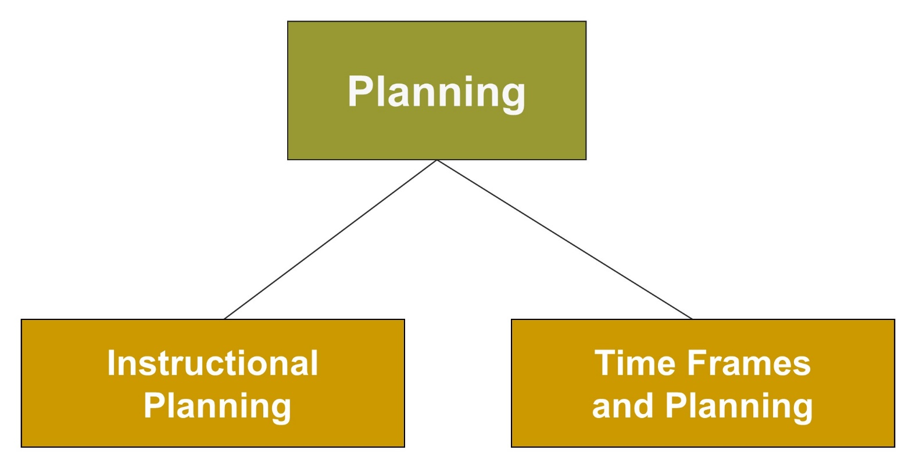
Planning, Instruction, and Technology, 1
Jump to long description

Slide 5
Planning
Instructional planning involves developing a systematic, organized strategy for lessons.
Notes:
Many planning strategies are organized around four elements—the nature of the subject matter, the learners, the context, and the teacher’s role.
Mapping backward - Going from goals to desired performances to activities and elements of scaffolding needed to support student progress
Teachers need to figure out which things students should do when, in what order, and how to implement the big picture of their curricular vision.

Slide 6
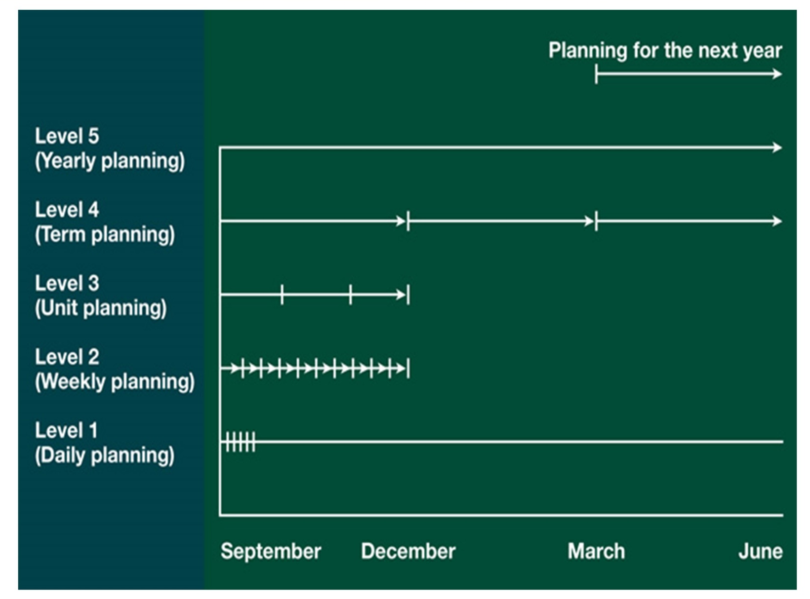
Figure 12.1 - Time Frames of
Teacher Planning
Jump to long description
Notes:
Teachers need to plan for different time spans, ranging from yearly to daily planning.
Robert Yinger identified five time spans of teacher planning: yearly planning, term planning, unit planning, weekly planning, and daily planning.
Teachers need to monitor and evaluate their curriculum planning in order to determine how well students progressed toward learning goals.

Slide 7
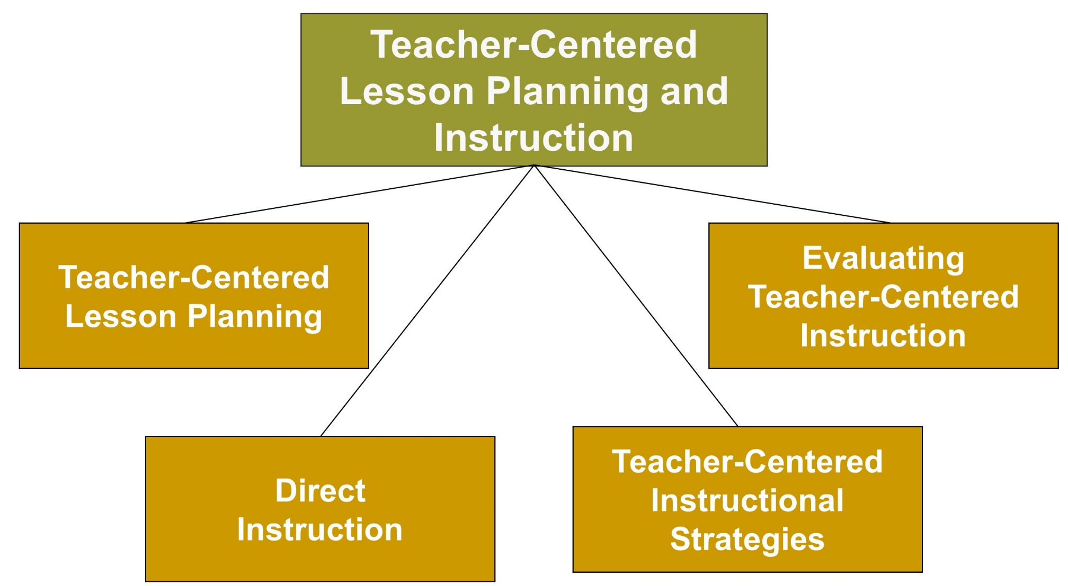
Planning, Instruction, and Technology, 2
Jump to long description

Slide 8
Teacher-Centered Lesson Planning, 1
Behavioral Objectives
What will the students do?
How will the behavior be assessed?
What level of performance will
be acceptable?

Slide 9
Task Analysis
Breaking down a complex task into its component parts
Three basic steps
  Determine what skills or concepts a student needs to have to learn the task.
  List any materials that will be needed.
  List all of the components of the task in the order in which they must be performed.

Slide 10
Teacher-Centered Lesson Planning, 2
Instructional Taxonomies
Cognitive Domain
Affective Domain
Psychomotor Domain
Notes:
Bloom’s Taxonomy—developed by Benjamin Blooms and his colleagues—classifies educational objectives into three domains: cognitive, affective, and psychomotor.

Slide 11
Affective Domain
Receiving
Responding
Valuing
Organizing
Value characterizing

Slide 12
Psychomotor Domain
Reflex movements
Basic fundamentals
Perceptual abilities
Physical abilities
Skilled movements
Nondiscussive behaviors

Slide 13
Teacher-Centered Instructional Strategies: Direct Instruction
Direct Instruction
Teacher direction and control
High teacher expectations
for students’ progress
Maximization of time on
academic tasks
(academic learning time)
Notes:
Cross-cultural research suggests that students in many Asian countries spend more time and effort in learning than do U.S. students.
Another emphasis in the direct-instruction approach is keeping negative affect to a minimum.

Slide 14
Teacher-Centered Instructional Strategies: Orienting/Lecturing, Explaining, and Demonstrating
In lectures, effective teachers:
Establish a framework and ORIENT students to new material using advance organizers
Take the time to EXPLAIN and DEMONSTRATE new material
Notes:
Advance organizers: Establishing a framework and orienting students to material before it is presented
Expository advance organizers : Provide students with new knowledge that will orient them to the upcoming lesson
Comparative advance organizer: Introduce new material by connecting it with what students already know

Slide 15
Best Practices and Strategies for Lecturing, 1
Be prepared; don’t “wing it”
Make the lecture interesting and exciting
  Intersperse the lecture with questions and activities
Follow a designated sequence and include certain key components
  Begin with advance organizers
  Verbally/visually highlight key concepts or new ideas

Slide 16
Best Practices and Strategies for Lecturing, 2
  Present new information in relation to what students already know
  Check for understanding and encourage active listening
  Summarize main ideas at the end of the lecture
  Make connections to future lectures

Slide 17
Teacher-Centered Instructional Strategies: Questions and Discussion, 1
Respond to each student’s learning needs while maintaining the group’s interest
Allow students to contribute while
maintaining focus on the lesson
Encourage overall classroom participation while retaining class enthusiasm

Slide 18
Teacher-Centered Instructional Strategies:
Questions and Discussion, 2
Use fact-based questions before thinking-based questions
Avoid yes/no and leading questions
Give students time to think about the answers
Ask clear, purposeful, brief, and sequenced questions
Monitor your response to students’ answers
Pose questions to the whole class or individual students cautiously
Encourage students to ask questions

Slide 19
Teacher-Centered Instructional Strategies:
Mastery Learning
Specify the learning task
Design learning units based on instructional objectives
Plan instruction procedures to include corrective feedback
Evaluate mastery level at the end of the unit/course

Slide 20
Enter the Debate
Should teachers assign homework to elementary students?
YES
NO
Notes:
During a slideshow, text may be written on the slides in the yes/no boxes, and then saved for later reference.

Slide 21
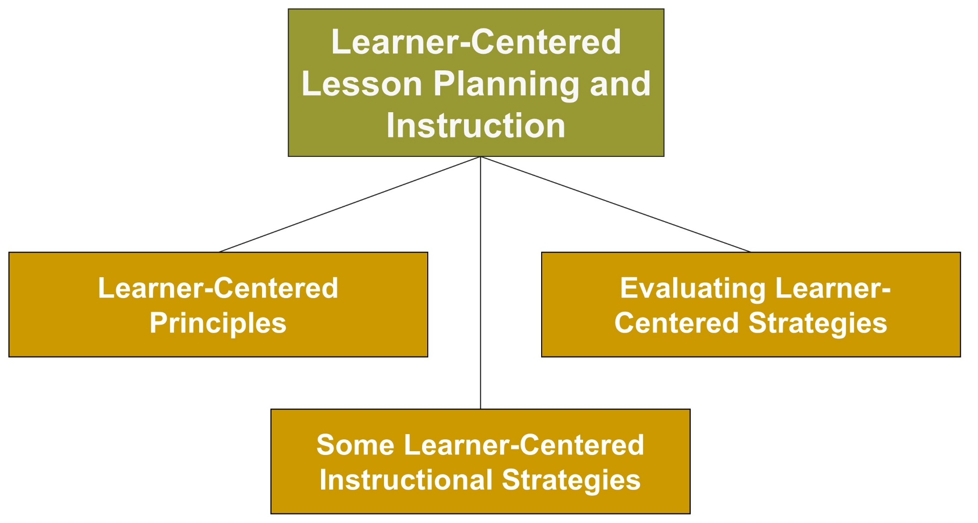
Planning, Instruction, and Technology, 3
Jump to long description

Slide 22
Learner-Centered Psychological Principles
Cognitive and Metacognitive Factors
Nature of the learning process
Goals of the learning process
Construction of knowledge
Strategic thinking
Thinking about thinking
Context of learning
Notes:
Learner-Centered Psychological Principles: A Framework for School Reform and Redesign (Presidential Task Force on Psychology and Education, 1992; Work Group of the American Psychological Association Board of Educational Affairs, 1995, 1997).
The 14 learner-centered principles can be classified in four main sets of factors: cognitive and metacognitive, motivational and emotional, developmental and social, and individual differences.

Slide 23
Learner-Centered Psychological Principles
Motivational and Affective Factors
Motivational and emotional influences on learning
Intrinsic motivation to learn
Effects of motivation on effort

Slide 24
Learner-Centered Psychological Principles
Developmental and Social Factors
Developmental influences on learning
Social influences on learning

Slide 25
Learner-Centered Psychological Principles
Individual Differences Factors
Individual differences in learning
Learning and diversity
Standards and assessments

Slide 26
Learner-Centered Instructional Strategies
Problem-Based
Learning
Essential
Questions
Discovery
Learning
Students identify
real-life problems,
locate materials,
and address the issues, and teachers guide problem-solving efforts.
Questions that reflect the most important things that students should learn
Students construct an understanding of their own.
Notes:
Guided discovery learning - Students are encouraged to construct their understanding with the assistance of teacher-guided questions and directions.

Slide 27
Best Practices and Strategies for Using Learner-Centered Instruction
Become familiar with learner-centered psychological principles
  Incorporate them into lesson planning and teaching
Focus on the whole child
  Pay attention to motivational, affective, developmental, social, and cognitive factors
Use problem-based learning, essential questions, and guided discovery learning
Don’t exclusively use direct instruction or learner-centered instruction

Slide 28
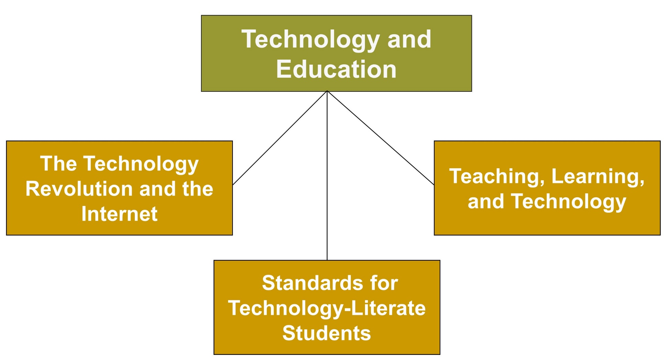
Planning, Instruction, and Technology, 4
Jump to long description

Slide 29
The Internet
System of computer networks that operates worldwide providing an incredible array of information for students to access
Web: System for browsing Internet sites that refers to the World Wide Web

Slide 30
Standards for Technology-Literate Students
Creativity and innovation
Communication and collaboration
Research and information fluency
Critical thinking, problem solving, and decision making
Digital citizenship
Technology operations and concepts

Slide 31
Using Technology to Improve Students’ Understanding
Evaluate which topics are worth understanding
Think about what students should understand about a topic
Pay attention to how students develop and demonstrate understanding
Consider how students and teachers assess learning
Reflect on how students and teachers can learn together

Slide 32
Classroom Connections: Crack the Case—The Big Debate
What are the issues in this case?
Where should Mrs. Rumer go from here?
How can she take a curriculum that has been taught in a teacher-centered manner and convert it to a learner-centered curriculum?
  Should she? Why or why not?
How can she incorporate technology into the curriculum so that the computers don’t become mere electronic flash cards?
Notes:
This case is on page 453 of the text.

Slide 33

Reflection and Observation
Reflection
In your educational experiences, how have teachers used technology?
How has it affected your learning? Explain.
Notes:
This slide accompanies the video segment, Technology in the Classroom, on the McGraw-Hill DVD Teaching Stories: A Video Collection for Educational Psychology.

Slide 34
Appendix of Image for Long Descriptions

Slide 35
Planning, Instruction, and Technology, 1 Long Description
This figure shows the two topics under planning. It consists of three rectangular boxes. The large box positioned at the center of the illustration is labeled planning. Two lines arise from the bottom of this box and lead to the other boxes. The box on the left is labeled instructional planning, and the box on the right is labeled time frames and planning.
Jump back to slide containing original image

Slide 36
Figure 12.1 - Time Frames of
Teacher Planning Long Description
This graph depicts the time frames of teacher planning. The x-axis contains four markings. From the left to the right, these markings read September, December, March, and June. The y-axis contains five markings. From the bottom to the top, these read level 1 daily planning, level 2 weekly planning, level 3 unit planning, level 4 term planning, and level 5 yearly planning.
A line arises from each marking on the y-axis and runs parallel to the x-axis.
The line that runs from level 1 on the y-axis contains five markings because planning needs to be done on a daily basis. These markings are contained within the month of September.
The line that runs from level 2 on the y-axis contains ten markings. These markings are rightward arrows with a bar on them. These markings run from September to December.
The line that runs from level 3 on the y-axis contains three markings. These markings represent units for which planning is done. These markings run from September to December.
The line that runs from level 4 on the y-axis contains three markings. These markings are rightward arrows with a bar on them. They run from September to December.
The line that runs from level 5 on the y-axis contains one long rightward arrow that runs from September to June.
Jump back to slide containing original image

Slide 37
Planning, Instruction, and Technology, 2 Long Description
This figure depicts the four topics under teacher-centered lesson planning and instruction. It contains five boxes, one of which is positioned at the center and contains text that reads teacher-centered lesson planning and instruction. Four lines arise from the bottom of this box and lead to the other boxes. From the left to the right, the content in the other four boxes reads teacher-centered lesson planning, direct instruction, teacher-centered instructional strategies, and evaluating teacher-centered instruction.
Jump back to slide containing original image

Slide 38
Planning, Instruction, and Technology, 3 Long Description
This figure shows the three topics under learner-centered lesson planning and instruction. It contains four rectangular boxes, one of which is positioned at the center and contains text that reads learner-centered lesson planning and instruction. Three lines arise from the bottom of this box and lead to the other boxes. In an anticlockwise direction, the boxes are labeled learner-centered principles, some learner-centered instructional strategies, and evaluating learner-centered strategies.
Jump back to slide containing original image

Slide 39
Planning, Instruction, and Technology, 4 Long Description
This figure shows the three topics under technology and education. It contains four rectangular boxes, one of which is positioned at the center of the illustration and contains text that reads technology and education. Three lines arise from the bottom of this box and lead to the other boxes. In an anticlockwise direction, the boxes are labeled the technology revolution and the Internet, standards for technology-literate students, and teaching, learning, and technology.
Jump back to slide containing original image

