Slide 1
CHAPTER 14
Managing the Classroom
© 2018 McGraw-Hill Higher Education. All rights reserved.

Slide 2
Learning Goals
Explain why classroom management is both challenging and necessary.
Describe the positive design of the classroom’s physical environment.
Discuss how to create a positive classroom environment.
Identify some good approaches to communication for both students and teachers.
Formulate some effective approaches that teachers can use to deal with problem behaviors.

Slide 3
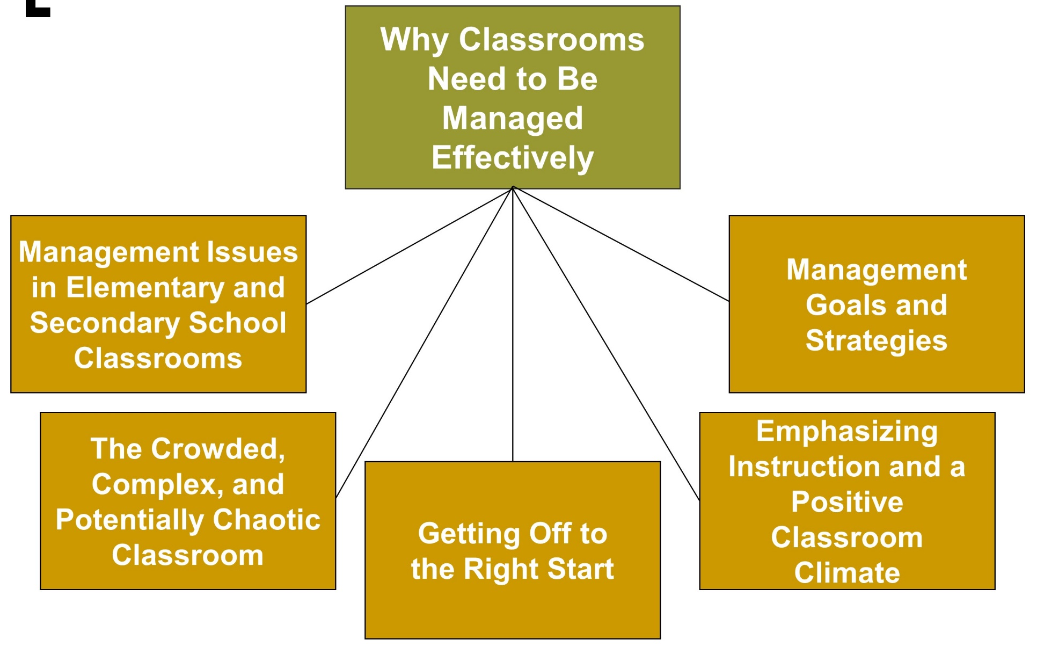
Managing the Classroom, 1
Jump to long description

Slide 4
Connecting with Teachers
Adriane Lonzarich, owner of a small preschool in San Mateo, California, talks about her classroom management ideas.
When she has a classroom problem, she asks herself three questions (in this order):
  Is it the environment?
  Is it the teacher?
  Is it the child?
The approach is empowering.
  It is easier to change the environment or oneself than to change someone else’s behavior

Slide 5
Classrooms Can Be Crowded, Complex, and Potentially Chaotic
There is little privacy.
Activities occur simultaneously.
Classrooms are multidimensional.
Things happen quickly.
Events are often unpredictable.
Classrooms have histories.
Notes:
There’s been a change in thinking about the best way to manage classrooms.
The older view of classroom management emphasized creating and applying rules to control students’ behavior
The newer view of classroom management focuses more on students’ needs for nurturing relationships and opportunities for self-regulation.
Good managers design classrooms for optimal learning, create positive environments for learning, establish and maintain rules, get students to cooperate, effectively deal with problems, and use good communication skills.

Slide 6
Getting Off to the Right Start
Communicate your rules and procedures.
  Elicit student cooperation in following them.
Engage students in all learning activities.
Notes:
Make careful use of the first few days and weeks of school. Engage in advanced planning before the school year begins.

Slide 7
Best Practices for a Good Beginning of the School Year
Establish expectations for behavior.
Resolve student uncertainties.
Make sure students experience success.
Be available and visible.
Be in charge.

Slide 8
Emphasizing Instruction and a Positive Classroom Climate
Use preventive, proactive strategies rather than becoming immersed in reactive disciplinary tactics.
Teachers should competently guide and structure classroom activities.
  This is more effective than teachers who emphasize their disciplinary role.

Slide 9
Best Practices for Increasing Academic Learning Time
Maintain activity flow.
  Don’t engage in “flip-flopping.”
Minimize transition time.
  Prepare students for upcoming transitions.
  Establish transition routines.
Hold students accountable.
  Clearly communicate assignments and requirements.
  Help students monitor their progress.

Slide 10
Management Goals and Strategies
Help students spend more time on learning and less time on non-goal-directed activity.
Prevent students from developing problems.

Slide 11
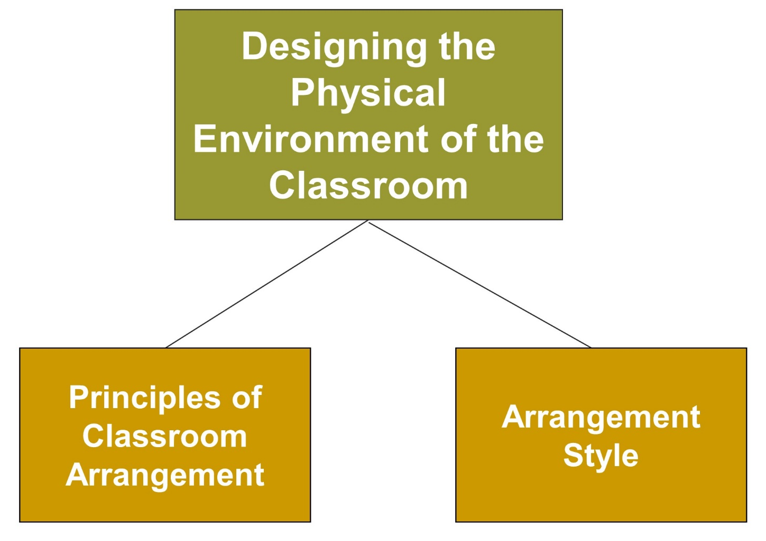
Managing the Classroom, 2
Jump to long description

Slide 12
Basic Principles of Classroom Arrangement
Reduce congestion in high-traffic areas.
Make sure that you can easily see all students.
Make often-used teaching materials and student supplies easily accessible.
Make sure that students can easily observe whole-class presentations.

Slide 13
Classroom Arrangement Styles
Auditorium style - All students face the teacher.
Face-to-face style - Students face each other.
Offset style - Small number (3 or 4) sit at tables but do not sit directly across from one another.
Seminar style - Larger number of students (10 or more) sit in circular, square, or U-shaped arrangements.
Cluster style - Small number of students (4 to 8) work in small, closely bunched groups.

Slide 14
The Action Zone
“Action Zone” Students in these seats are more likely to interact with the teacher, ask questions, and initiate discussion.

Slide 15
Best Practices for Designing a Classroom Arrangement
Consider what activities the students will be engaging in.
Draw up a floor plan.
Involve students in designing the classroom layout.
Try out the arrangement.
  Be flexible redesigning it.

Slide 16
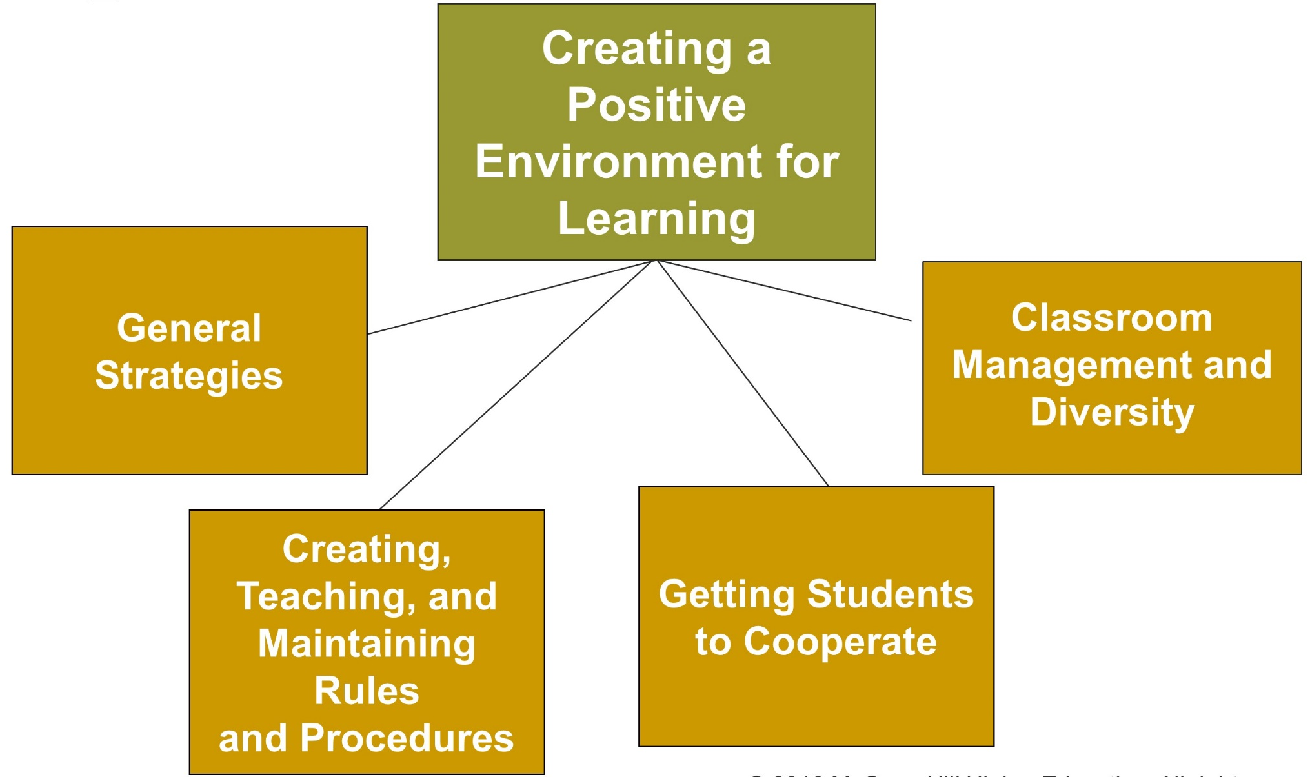
Managing the Classroom, 3
Jump to long description

Slide 17
Teacher Management Styles
Authoritative: Encourages students to be independent thinkers but provides monitoring and verbal give-and-take
Authoritarian: Restrictive and punitive, with the focus mainly on keeping order rather than learning
Permissive: Students have autonomy but little support for developing learning skills or managing behavior.

Slide 18
Effective Classroom Managers…
Show how they are “with it”
Cope effectively with overlapping situations
Maintain smoothness and continuity in lessons
Encourage students in a variety of challenging activities

Slide 19
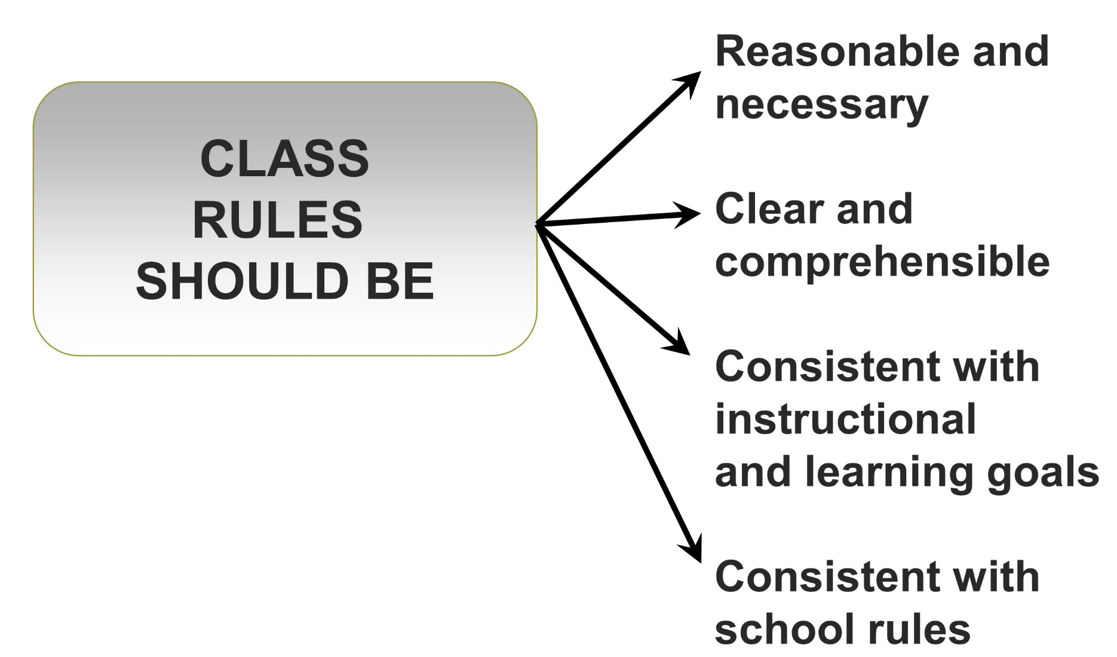
Creating, Teaching, and Maintaining Rules and Procedures
Jump to long description

Slide 20
Getting Students to Cooperate
Develop
positive student/teacher relationships
COOPERATION
Share classroom responsibilities
Reward appropriate behavior

Slide 21
Best Practices for Guiding Students to Share and Assume Responsibility
Involve students in planning school and classroom initiatives.
Encourage student to self-evaluate behavior.
Don’t accept excuses.
Have students participate in decision making.
Reward appropriate behavior.
Choose effective reinforcers.
Use prompts and shaping effectively.
Use rewards to communicate mastery.

Slide 22
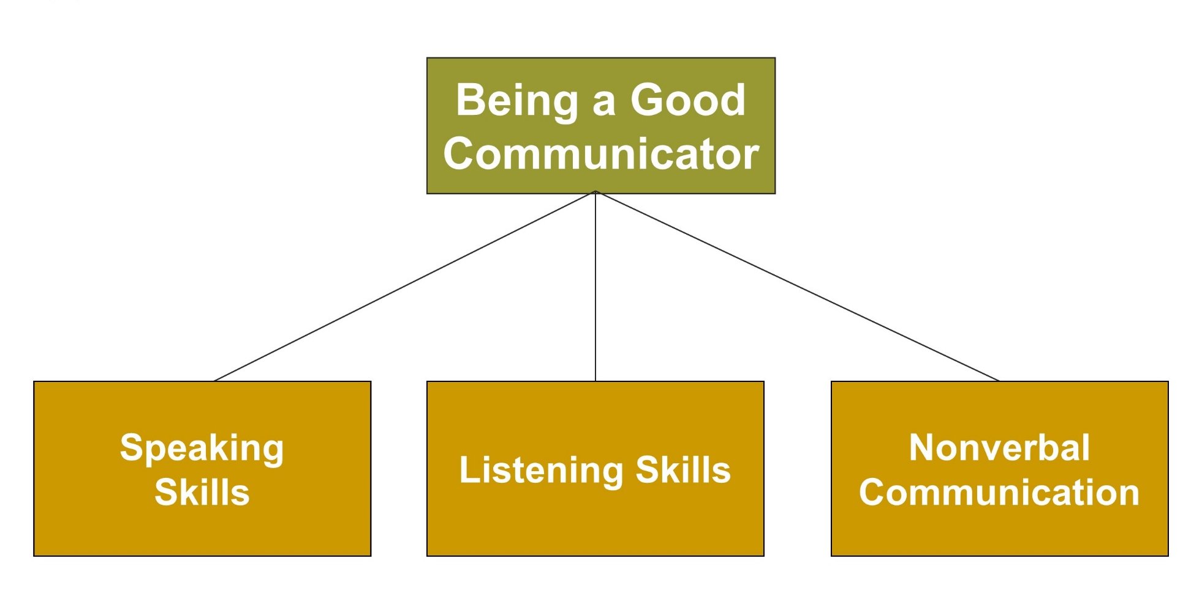
Managing the Classroom, 4
Jump to long description

Slide 23
Being a Good Communicator, 1
SPEAKING SKILLS
Select developmentally appropriate vocabulary.
Speak at an appropriate pace.
Communicate precisely.
Use good planning and logical thinking skills.
Notes:
Barriers to effective verbal communication include:
Criticizing
Name-calling and labeling
Advising
Ordering
Threatening
Moralizing

Slide 24
Being a Good Listener
Active Listening
Pay careful attention to the person who is talking.
Paraphrase.
Synthesize themes and patterns.
Give feedback in a competent manner.

Slide 25
Being a Good Communicator, 2
NONVERBAL
COMMUNICATION
PERSONAL
SPACE
FACIAL
EXPRESSIONS
SILENCE

Slide 26
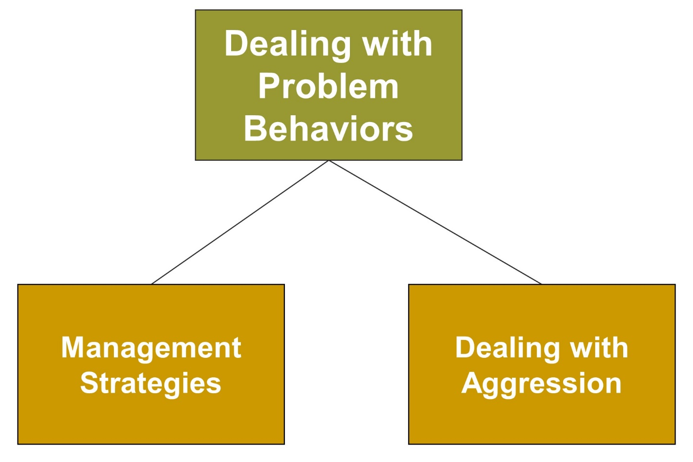
Managing the Classroom, 5
Jump to long description

Slide 27
Enter the Debate
Should teachers withhold recess as a punishment for children who misbehave and/or don’t finish their work?
YES
NO
Notes:
During a slideshow, text may be written on the slides in the yes/no boxes, and then saved for later reference.

Slide 28
Management Strategies
Minor
Interventions
Use nonverbal cues.
Keep the activity moving.
Move closer to students.
Redirect the behavior.
Provide needed instruction.
Be direct and assertive.
Give the student a choice.
Moderate
Interventions
Withhold privileges or desired activities.
Isolate or remove
students.
Impose a penalty.

Slide 29
Using Others as Resources
Peer mediation - Can get students to behave more appropriately
Parent-teacher conference - Meetings with parents can get students to improve behavior
Get help from the principal or counselor - Schools have prescribed consequences for certain behaviors, which can save the teacher’s time
Find a mentor - Can provide students with guidance to reduce problem behaviors

Slide 30
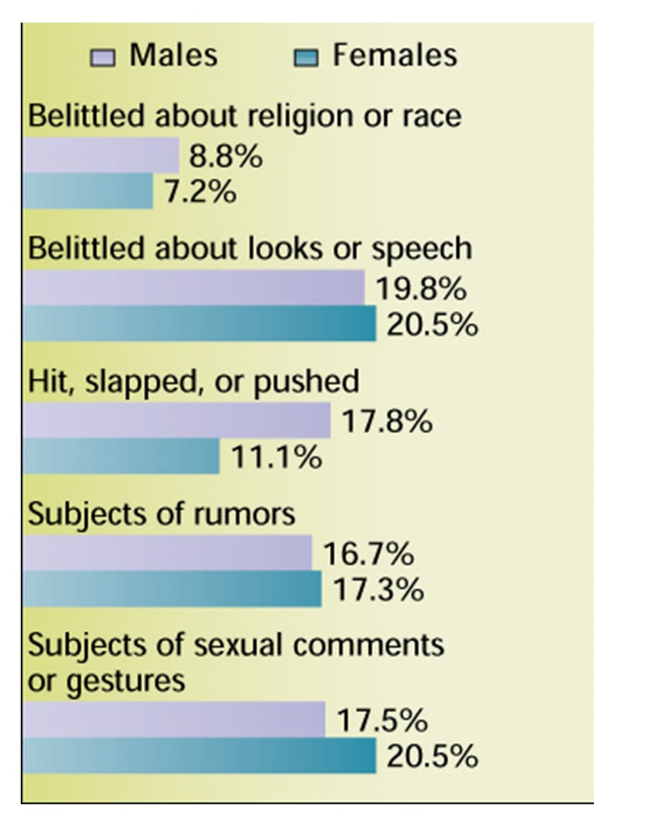
Dealing with Aggression
Fighting: Emphasize inappropriateness and the importance of perspective-taking and cooperation.
Bullying: Develop a school climate characterized by high standards, parent involvement, and effective discipline.
Defiance: Defuse privately and avoid power struggles.
Jump to long description

Slide 31
Best Practices or Strategies for Reducing Bullying
Confront the bully in a firm manner.
Get older peers to serve as monitors for bullying.
  Have older peers intervene when they see bullying.
Be aware that bullying often occurs outside the classroom.
Determine if observed bullying incident should be reported to school authorities or parents.
Develop school-wide rules and sanctions against bullying.

Slide 32
Classroom Connections: Crack the Case—The Chatty Student, 1
What are the issues in this case?
Is removal from the algebra class an appropriate consequence for Darius? Why or why not?
Do you think removal from algebra class would have a positive effect on Darius’s behavior? Why or why not?
What impact do you think this would have on his motivation in school?
Notes:
This case is on page 534 of the text.

Slide 33
Classroom Connections: Crack the Case—The Chatty Student, 2
How do you think this situation will impact the relationship between Mrs. Welch and Darius?
What do you think Darius’s mother will do now?
How do you think Mrs. Zaccinelli will react when she hears about the situation?
How do you think the principal will react?
What should Mrs. Welch do?
Notes:
This case is on page 534 of the text.

Slide 34

Reflection and Observation
Reflection
What strategies have teachers used to manage your classrooms?
How have these strategies affected the learning environment?
Notes:
This slide accompanies the video segment, Classroom Management, on the McGraw-Hill DVD Teaching Stories: A Video Collection for Educational Psychology.

Slide 35
Appendix of Image for Long Descriptions

Slide 36
Managing the Classroom, 1 Long Description
The slide contains six rectangular boxes, one of which is positioned at the center and contains text that reads why classrooms need to be managed effectively. Five lines arise from the bottom of the box at the center and lead to the other five boxes. In an anticlockwise direction, these boxes are labeled management issues in elementary and secondary school classrooms, the crowded, complex, and potentially chaotic classroom, getting off to the right start, emphasizing instruction and a positive classroom climate, and management goals and strategies
Jump back to slide containing original image

Slide 37
Managing the Classroom, 2 Long Description
The slide contains three rectangular boxes, one of which is positioned at the center of the illustration and contains text that reads designing the physical environment of the classroom. Two lines arise from the bottom of this box and lead to the other boxes. The box on the left is labeled principles of classroom arrangement, and the box on the right is labeled arrangement style.
Jump back to slide containing original image

Slide 38
Managing the Classroom, 3 Long Description
The slide contains five rectangular boxes, one of which is positioned at the center and contains text that reads creating a positive environment for learning. Four lines arise from the bottom of the box at the center and lead to the other four boxes. In an anticlockwise manner of appearance, the boxes are labeled general strategies; creating, teaching, and maintaining rules and procedures; getting students to cooperate; and classroom management and diversity.
Jump back to slide containing original image

Slide 39
Creating, Teaching, and Maintaining Rules and Procedures Long Description
There are four arrows originating from the rectangular box labeled class rules should be. Starting from the top, the first arrow points at the content reasonable and necessary, the second arrow points at the content clear and comprehensible, the third arrow points at the content consistent with instructional and learning goals, and the fourth arrow points at the content consistent with school rules.
Jump back to slide containing original image

Slide 40
Managing the Classroom, 4 Long Description
The slide contains four rectangular boxes, one of which is placed at the center of the illustration and contains text that reads being a good communicator. Three lines arise from the bottom of the box at the center and lead to the other boxes. Starting from the left, the boxes are labeled speaking skills, listening skills, and nonverbal communication.
Jump back to slide containing original image

Slide 41
Managing the Classroom, 5 Long Description
The slide contains three rectangular boxes, one of which is positioned at the center and contains text that reads dealing with problem behaviors. Two lines arise from the bottom of this box and lead to the other boxes. The box on the left is labeled management strategies, and the box on the right is labeled dealing with aggression.
Jump back to slide containing original image

Slide 42
Dealing with Aggression Long Description
This graph shows the types of bullying most often experienced by the American youth. The percentages reflect the extent to which bullied students said that they had experienced a particular type of bullying. There are five types of belittling or bullying. The first is belittling about religion or race, the second is belittling about looks or speech, the third is being hit, slapped, or pushed, the fourth is being the subject of rumors, and the fifth is being the subject of sexual comments or gestures. The graph shows that the percentage of males being subject to bullying is slightly higher when compared to the percentage of females.
8.8 percent of the male population in America are belittled about religion or race. 7.2 percent of the female population in America are belittled about religion or race.
19.8 percent of the male population in America are belittled about looks or speech. 20.5 percent of the female population in America are belittled about looks or speech.
17.8 percent of the male population in America are hit, slapped, or pushed. 11.1 percent of the female population in America are hit, slapped, or pushed.
16.7 percent of the male population in America are subjects of rumors. 17.3 percent of the female population in America are subjects of rumors.
17.5 percent of the male population in America are subjects of sexual comments or gestures. 20.5 percent of the female population in America are subjects of sexual comments or gestures.
Jump back to slide containing original image

