Slide 1
CHAPTER 15
Standardized Tests and Testing
© 2018 McGraw-Hill Higher Education. All rights reserved.

Slide 2
Learning Goals
Discuss the nature and purpose of standardized tests as well as the criteria for evaluating them
Compare aptitude and achievement tests and describe different types of achievement tests as well as some issues involved in these tests
Identify the teacher’s roles in standardized testing
Evaluate some key issues in standardized testing

Slide 3
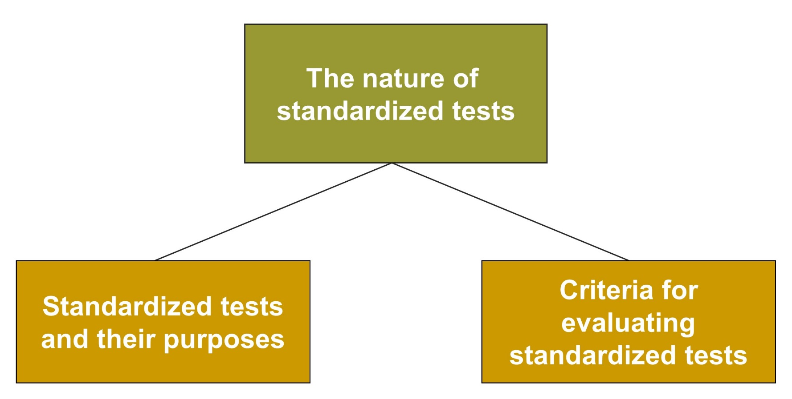
Standardized Tests and Teaching, 1
Jump to long description

Slide 4
Connecting with Teachers
Barbara Berry, a French and humanities teacher at Ypsilanti High School in Ypsilanti, Michigan, tutored a 4th-year French student in mathematics
  The student, a minority, did well on the verbal part of the SAT but did not do well enough on the math section to get a “full-ride” scholarship at a major university
  Berry did two things: (1) Communicated enthusiasm for math and (2) Focused the student’s efforts on the material the test assessed
  The student did well and got the scholarship

Slide 5
The Nature of Standardized Tests, 1
Standardized Tests
Have uniform procedures for
administration and scoring
Allow comparison of student
performances at the age or grade level on a national basis

Slide 6
Enter the Debate
Should students have to pass a test to earn a high school diploma?
YES
NO
Notes:
During a slideshow, text may be written on the slides in the yes/no boxes, and then saved for later reference.

Slide 7

Purposes of Standardized Tests
Diagnose students’
strengths and
weaknesses
Provide information for planning and improving instruction
Provide information about students’ progress
Contribute to
accountability
Provide evidence for placement of students in specific programs

Slide 8
The Nature of Standardized Tests, 2
Standards-based tests assess skills that students are expected to have mastered before they can be permitted to move to the next grade or be permitted to graduate
High-stakes testing is using tests in a way that will have important consequences for the student, affecting major educational decisions

Slide 9
Evaluating Standardized Tests
Norms - Does the normative group represent all students who may take the test?
Validity - Does the test measure what it is purported to measure?
Reliability - Are test scores stable, dependable, and relatively free from errors?
Notes:
Norm-referenced tests - A student’s score is interpreted by comparing it with how well other (the norm group) performed.
Criterion-referenced tests - Standardized tests in which the student’s performance is compared with established criteria or standards

Slide 10
Types of Validity
Content: | Test’s ability to sample the content that is being measured
Criterion: | Test’s ability to predict a student’s performance as measured by other assessments or criteria
Concurrent: | The relation between a test’s score and other available criteria
Predictive: | The relation between a test’s score and future performance
Construct: | The extent to which there is evidence that a test measures a particular construct
Notes:
Validity - Extent to which a test measures what it is intended to measure and whether inferences about test scores are accurate and appropriate

Slide 11
Reliability
Test-retest: The extent to which a test yields the same performance when given to a student on two different occasions
Alternate-form: Two different forms of the same test given on two different occasions to determine the consistency of the scores
Split-half: Dividing the test items into two halves and comparing the scores to determine test score consistency
Notes:
Reliability - Extent to which a test produces a consistent, reproducible score

Slide 12
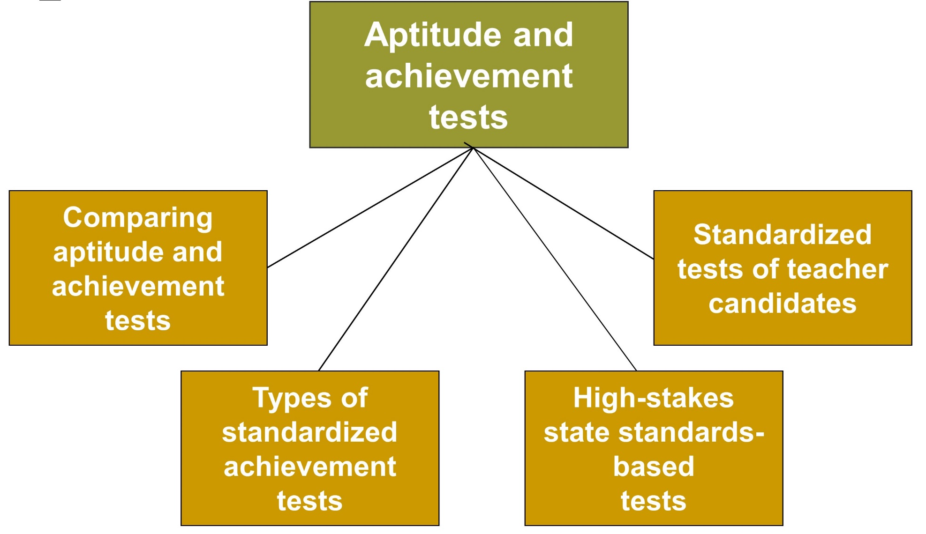
Standardized Tests and Teaching, 2
Jump to long description

Slide 13
Aptitude versus Achievement Tests
Aptitude Tests
Predict a student’s ability to learn a skill
or accomplish a task with further education or training
Achievement Tests
Measure what the
student has learned
or mastered

Slide 14
Types of Standardized Achievement Tests
Survey batteries
  Group of individual subject-matter tests
  Designed for a particular level of students
Tests for specific subjects
  Assess skills in a particular area
  (Example - Math)
Diagnostic tests
  In-depth evaluation of a specific
  area of learning

Slide 15
High-Stakes State Standards-Based Tests
Improved student performance
More teaching time
Higher student expectations
Identification of poor-performing schools/teachers
Improved confidence in schools
Possible
Advantages
“Dumbing down” and more emphasis on rote memorization
Less time for problem-solving and critical thinking skills
Teachers “teaching to the test”
Discrimination against low-socioeconomic-status and ethnic minority children
Criticisms
Notes:
The public and the government have demanded increased accountability of how effectively schools are educating our nation’s children.

Slide 16
No Child Left Behind
By 2014, every U.S. student will test to proficiency in core math and literacy skills
Adequate Yearly Progress (AYP) for entire school and sub-groups
Notes:
All teachers now are required to be “highly qualified” (licensed and having an academic major in the field in which they teach).
Criticisms of NCLB:
Using a single test score as the sole indicator of students’ and teachers’ progress and competence focuses on a very narrow aspect of students’ and teachers’ skills.
Assessments for NCLB do not measure important areas such as creativity, motivation, persistence, flexible thinking, and social skills.
Increased cost of carrying out standardized testing on a statewide basis.
High-stakes testing encourages test-score inflation.
NCLB fails to close the ethnic achievement gap.
NCLB neglects needs of students who are gifted.

Slide 17
Assessment of Teachers
Praxis and State Tests
Basic skills
Subject-matter knowledge
Pedagogical knowledge
National Tests
National Academy of Education
National Board for Professional Teaching Standards

Slide 18
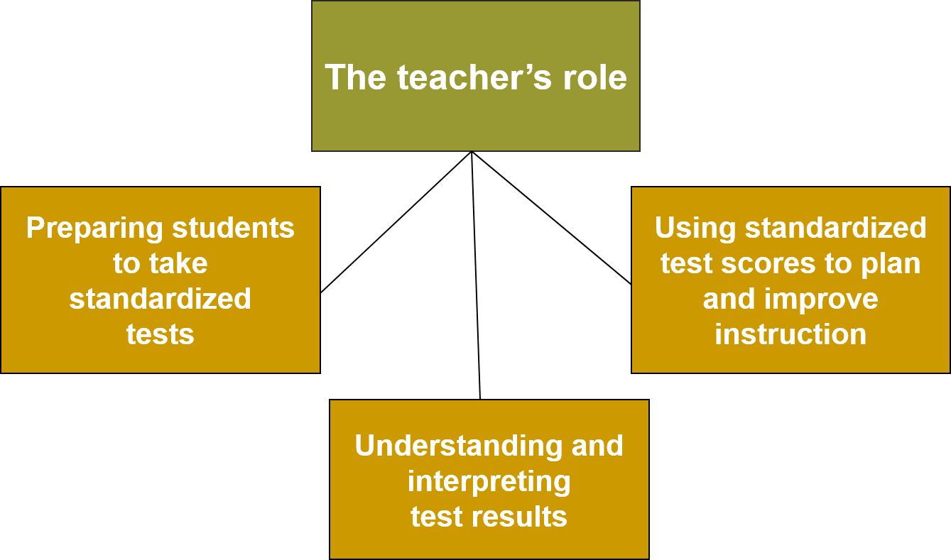
Standardized Tests and Teaching, 3
Jump to long description

Slide 19
Don’ts of Standardized Testing
Do not:
  Teach to the test
  Use the standardized test format for classroom tests
  Describe tests as a burden
  Tell students that important decisions will be made solely on the results of a single test
  Use previous forms of the test to prepare students
  Convey a negative attitude about the test
Notes:
Prepare students to take the test.
Convey a positive attitude about the test to students.
Explain the test’s nature and purpose.
Describe the test as an opportunity and challenge rather than an ordeal.

Slide 20
Best Practices for Improving Students’ Test-Taking Skills
Read instructions and individual items carefully
Keep track of time; work quickly enough to finish the test
Skip difficult items; return to them later
Make informed guesses instead of omitting items
On multiple-choice tests, eliminate as many items as possible
Follow directions carefully when marking responses
Check answer sheets; make sure the appropriate response is marked
Double-check if time permits

Slide 21
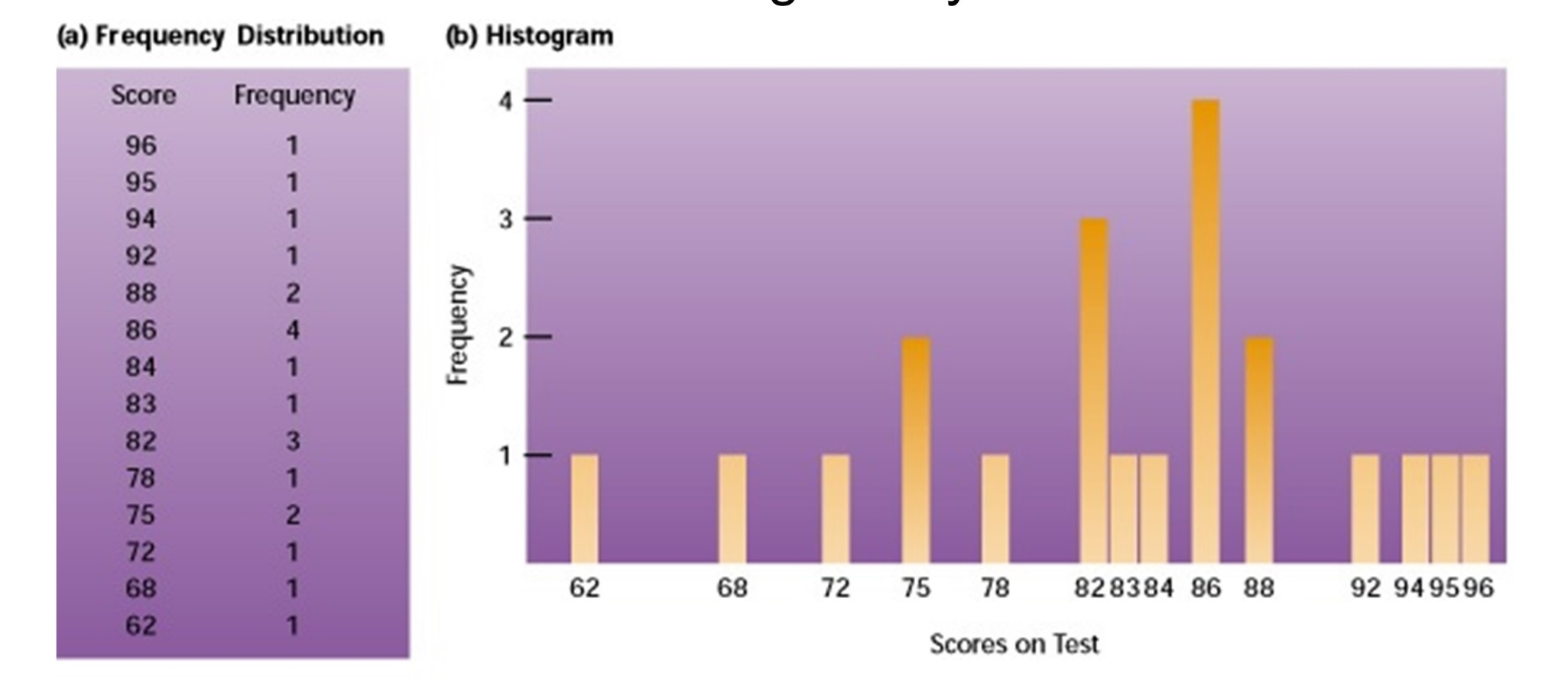
Descriptive Statistics
Descriptive statistics are the mathematical procedures that are used to describe and summarize data in a meaningful way
Jump to long description

Slide 22
Measures of Central Tendency
  Mean: The numerical average of a group of scores
  Median: The score that falls exactly in the middle of a data set
  Mode: The score that occurs most often
Notes:
Central tendency - Number that provides information about the average, or typical, score in a set of data

Slide 23
Measures of Variability
Range: The distance between the lowest and the highest scores
Standard deviation: A measure of how much a score varies on the average around the mean of the scores
Notes:
Measures of variability tell how much scores vary from one another.

Slide 24
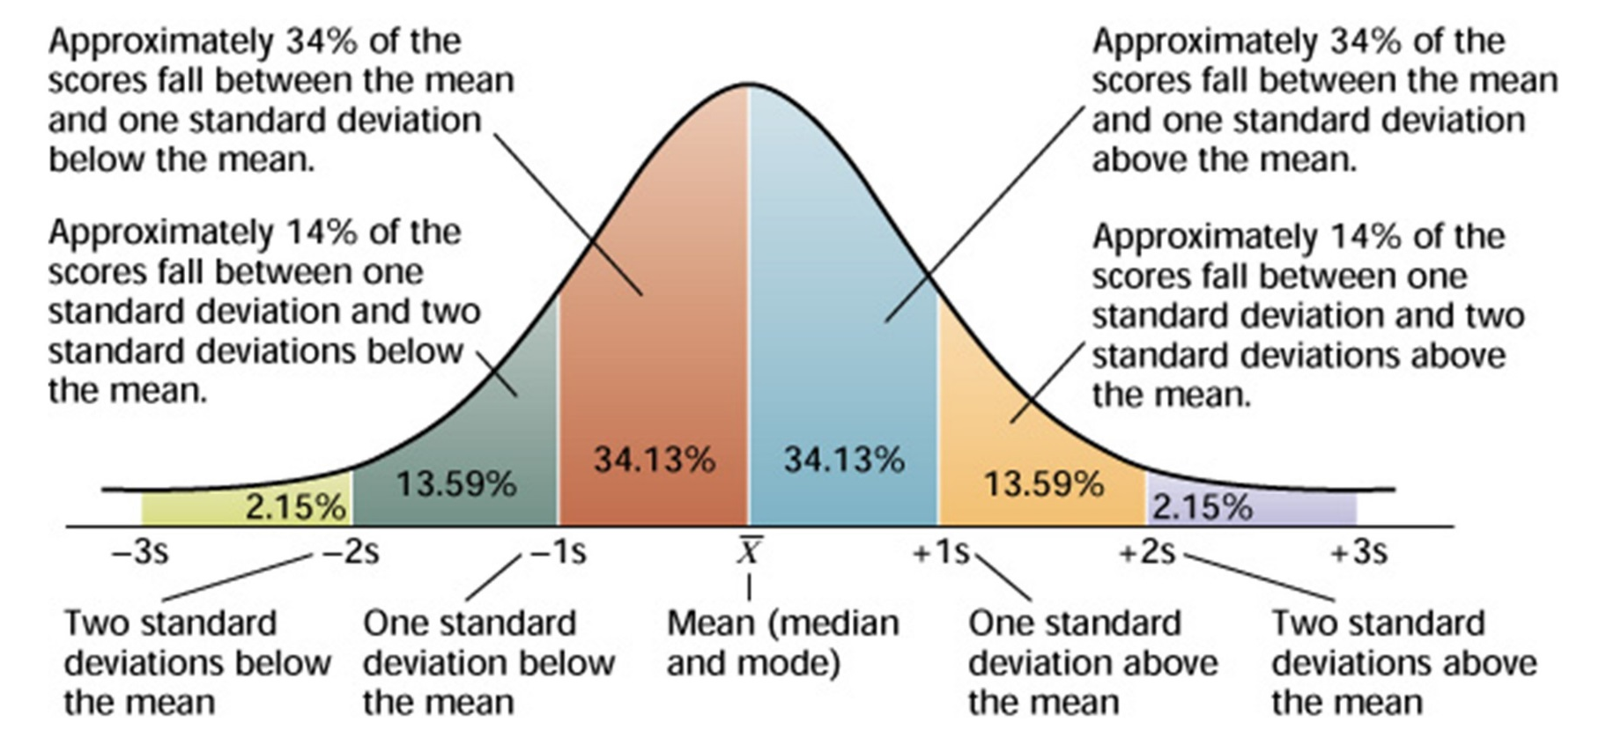
Understanding Descriptive Statistics
The Normal Distribution: A “bell-shaped” curve in which most of the score s are clustered around the mean; the farther from the mean, the less frequently the score occurs.
Jump to long description

Slide 25
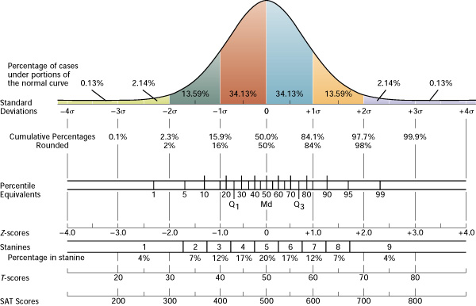
Commonly Reported Test Scores Based on the Normal Curve
Jump to long description
Notes:
Raw score - Number of items the student answered correctly on the test
Percentile-rank score - Percentage of the distribution that lies at or below the score
Stanine score - Describes student’s test performance on a 9-point scale (ranges from 1 to 9)
Grade-equivalent score - Indicates student’s performance in relation to grade level and months of the school year, assuming a 10-month school year
Standard score - Expressed as a deviation from the mean, which involves the concept of standard deviation
Z-score - Provides information about how many standard deviations a raw score is above or below the mean

Slide 26
Best Practices for Communicating Test Results to Parents
Don’t report test results in isolation
Use easy-to-understand language when describing students’ test results
Tell parents that scores are approximate rather than absolute
Remember that percentile scores are the easiest for parents to understand
Familiarize yourself with student’s test report.
Be ready to answer parents’ questions about student’s scores and progress
Talk “with” not “to” parents in a discussion format

Slide 27
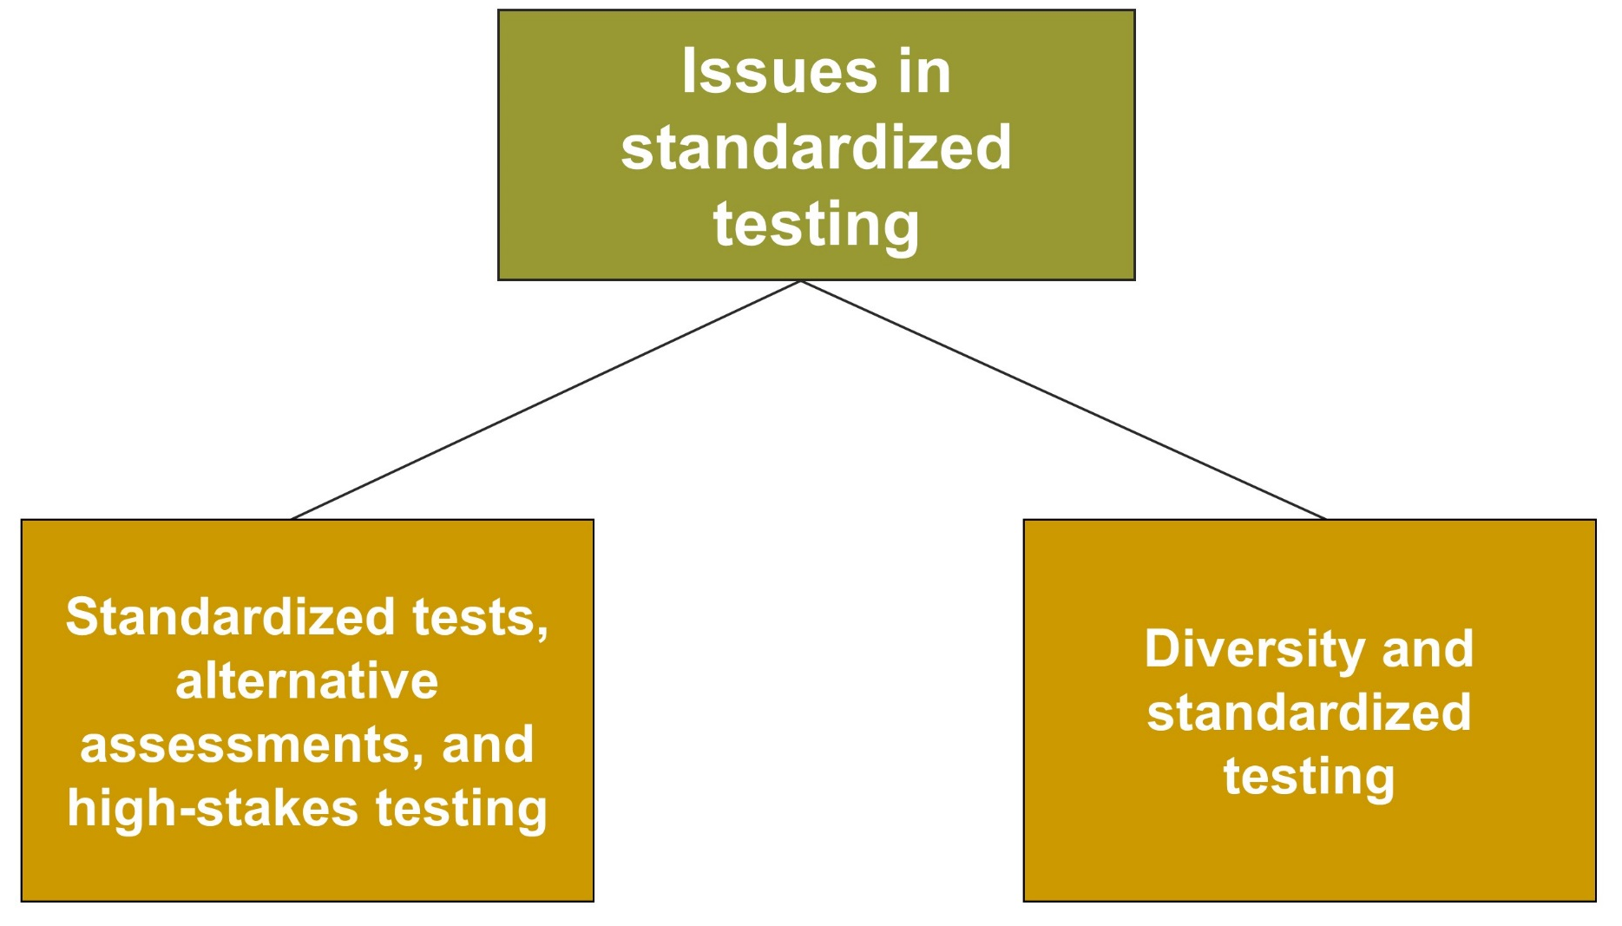
Standardized Tests and Teaching, 4
Jump to long description

Slide 28
Issues in Standardized Assessment
Standardized Tests, Alternative Assessments, and High-Stakes Testing
Avoid misuse of tests
Understand test’s capabilities
Include a variety of assessments
Diversity and Standardized Tests
Special concern in creating culturally unbiased tests
Performance and portfolio assessments may reduce performance inequity for some students

Slide 29
Classroom Connections: Crack the Case—Standardized Test Pressure
What testing issues are evident in this case?
What does Ms. Pryor do correctly in terms of preparing her students to take standardized tests?
What does Ms. Pryor do incorrectly in terms of preparing her students to take standardized tests?

Slide 30

Reflection & Observation
Reflection:
What standardized tests have you taken?
How have these tests affected your perceptions of competence?
Notes:
This slide accompanies the video segment, Explaining Standardized Tests, on the McGraw-Hill DVD Teaching Stories: A Video Collection for Educational Psychology.

Slide 31
Appendix of Image for Long Descriptions

Slide 32
Standardized Tests and Teaching, 1 Long Description
This slide illustrates standardized tests and teaching using a flowchart. There is a box on top that is labeled the nature of standardized tests. This box is connected to the two boxes below it. The first box is labeled standardized tests and their purposes. The second box is labeled criteria for evaluating standardized tests.
Jump back to slide containing original image

Slide 33
Standardized Tests and Teaching, 2 Long Description
This slide illustrates standardized tests and teaching using a flowchart. There is a box on top that is labeled aptitude and achievement tests. This box is connected to the four boxes below it. The first box reads comparing aptitude and achievement tests. The second box reads types of standardized achievement tests. The third box reads high-stakes state standards-based tests. The fourth box reads standardized tests of teacher candidates.
Jump back to slide containing original image

Slide 34
Standardized Tests and Teaching, 3 Long Description
This slide illustrates standardized tests and teaching using a flowchart. There is a box on top that is labeled the teacher’s role. This box is connected to the three boxes below it. The first box reads preparing students to take standardized tests. The second box reads understanding and interpreting test results. The third box reads using standardized test scores to plan and improve instruction.
Jump back to slide containing original image

Slide 35
Descriptive Statistics Long Description
This figure illustrates an example of the two ways of collecting descriptive statistics. The first is an example of a frequency distribution table. It contains two columns. The first column lists scores on a test, and the second column lists frequency. The second way of collecting descriptive statistics is through a histogram. It is in the form of a bar graph in which the X axis measures scores on a test and the Y axis measures their frequency.
There is a box that reads descriptive statistics are the mathematical procedures that are used to describe and summarize data in a meaningful way.
Jump back to slide containing original image

Slide 36
Understanding Descriptive Statistics Long Description
This figure illustrates an example of normal distribution. It is in the form of a curved line that has been divided into six parts based on the measurements of negative three s, negative two s, negative one s, X, positive one s, positive two s, and positive three s. The negative numbers represent the number of standard deviations below the mean. X represents the mean, median, and mode. The positive numbers represent the number of standard deviations above the mean. The first part is 2.15 percent.
The second part is 13.59 percent. There is an explanation that reads approximately 14 percent of the scores fall between one standard deviation and two standard deviations below the mean. The third part is 34.13 percent. There is an explanation that reads approximately 34 percent of the scores fall between the mean and one standard deviation below the mean. The fourth part is 34.13 percent. There is an explanation that reads approximately 34 percent of the scores fall between the mean and one standard deviation above the mean.
The fifth part is 13.59 percent. There is an explanation that reads approximately 14 percent of the scores fall between one standard deviation and two standard deviations above the mean.
The sixth part is 2.15 percent.
Based on the values of these parts, the curve slopes upward until it reaches the mean and then slopes back downward.
Jump back to slide containing original image

Slide 37
Commonly Reported Test Scores Based on the Normal Curve Long Description
This figure illustrates commonly reported test scores based on the normal curve. The figure uses the example of the normal curve from the previous slide along with the standard deviation values as a scale to compare it with the values of cumulative percentages rounded, percentile equivalents, z-scores, stanines percentages, T-scores, and SAT scores.
Jump back to slide containing original image

Slide 38
Standardized Tests and Teaching, 4 Long Description
This slide illustrates standardized tests and teaching using a flowchart. There is a box on top, which is connected to two boxes below. The box on top reads issues in standardized testing. The first of the two other boxes reads standardized tests, alternative assessments, high-stakes testing. The second box reads diversity and standardized testing.
Jump back to slide containing original image

