Slide 1
CHAPTER 16
Classroom Assessment and Grading
© 2018 McGraw-Hill Higher Education. All rights reserved.

Slide 2
Learning Goals
Discuss the classroom as an assessment context
Provide some guidelines for constructing traditional tests
Describe some types of alternative assessments
Construct a sound approach to grading

Slide 3
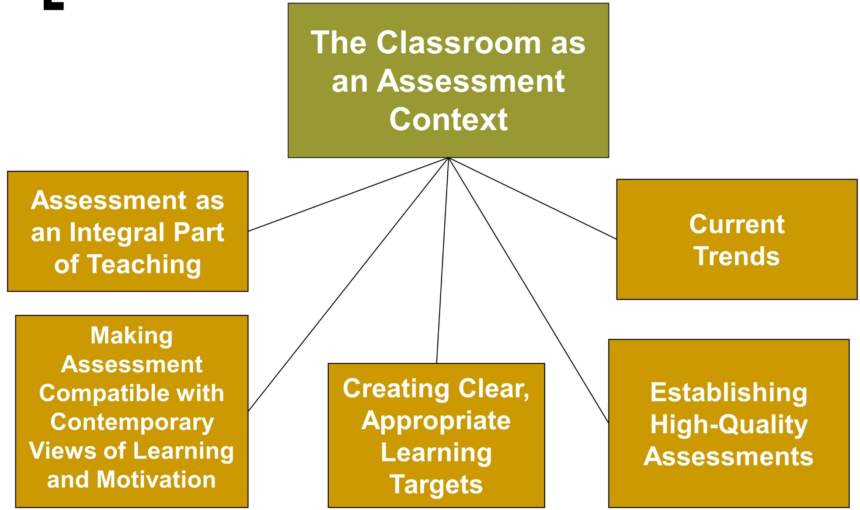
Classroom Assessment, 1
Jump to long description

Slide 4
Connecting with Teachers
Vicky Farrow, a former high school teacher who currently teaches educational psychology, believes that classroom assessment is an ongoing process
  It is more than giving tests or assigning grades
  It is everything a teacher does to determine if his or her students are learning
  Without ongoing assessment, a teacher can never knows if instruction is effective or needs modification
  Assessment provides teachers with valuable information
    Helps them provide optimal learning for all students

Slide 5
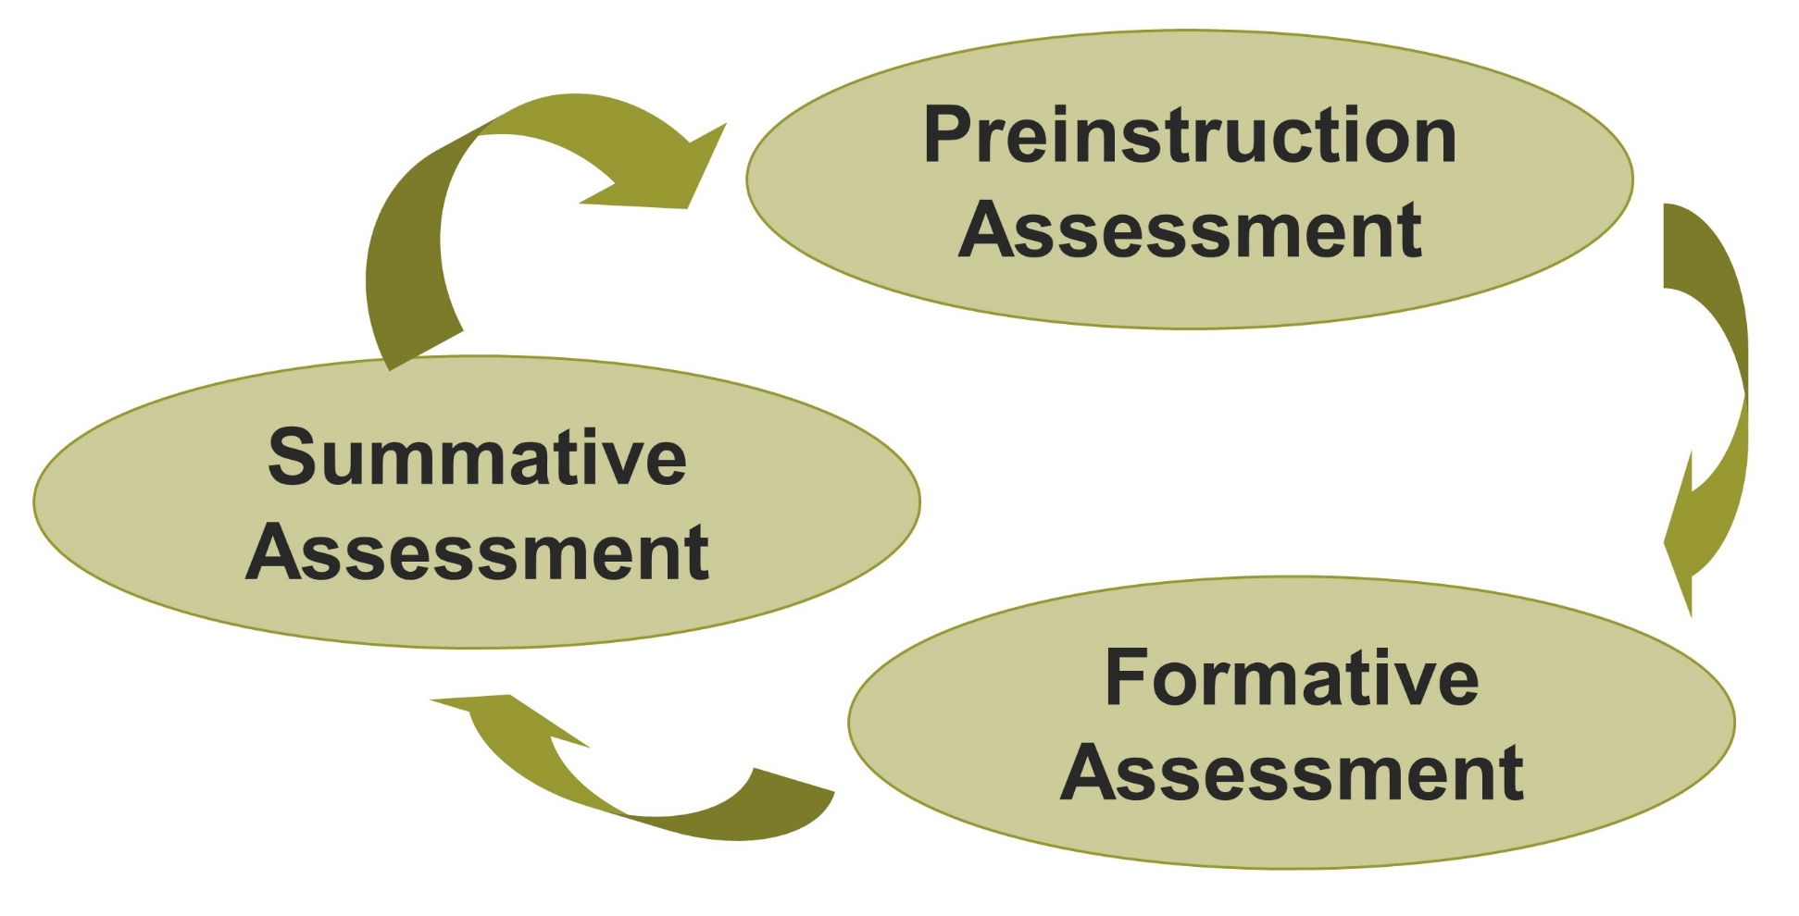
Assessment as an Integral Part of Teaching
Jump to long description
Notes:
Preinstruction Assessment - Teacher determines students’ current level of skill before formal instruction (informal observation, prior grades and scores on standardized test, or diagnostic pretest in subject area).
Formative Assessment - Occurs during the course of instruction rather than after it is completed and emphasizes assessment for learning rather than assessment of learning
Summative Assessment - Postinstruction assessment or formal instruction that involves assessment after instruction is finished with the purpose of documenting student performance

Slide 6
Learning Targets
Define what students should know and be able to do
Provide criteria for judging whether students have attained the stated learning target

Slide 7
Establishing High-Quality Assessments
Validity | Does the assessment measure what it is intended to measure?
Reliability | Does the assessment yield stable and dependable scores that are relatively free of measurement errors?
Fairness | Do all students have equal opportunity to learn and demonstrate their knowledge and skill?
Notes:
Inferences - Conclusions the teacher draws from the assessment information

Slide 8
Current Trends in Classroom Assessment
Include some performance-based methods of assessment
Examine higher-level cognitive skills
Use multiple assessment methods
Use more multiple-choice items to prepare students for taking high-stakes state standards-based tests
Have high-performance standards
Use computers as part of assessment
Notes:
Historically, classrooms have used objective tests (multiple-choice) that have clear, unambiguous scoring criteria.
Performance-based assessments require students to create answers or products that demonstrate their knowledge or skill (portfolios).

Slide 9
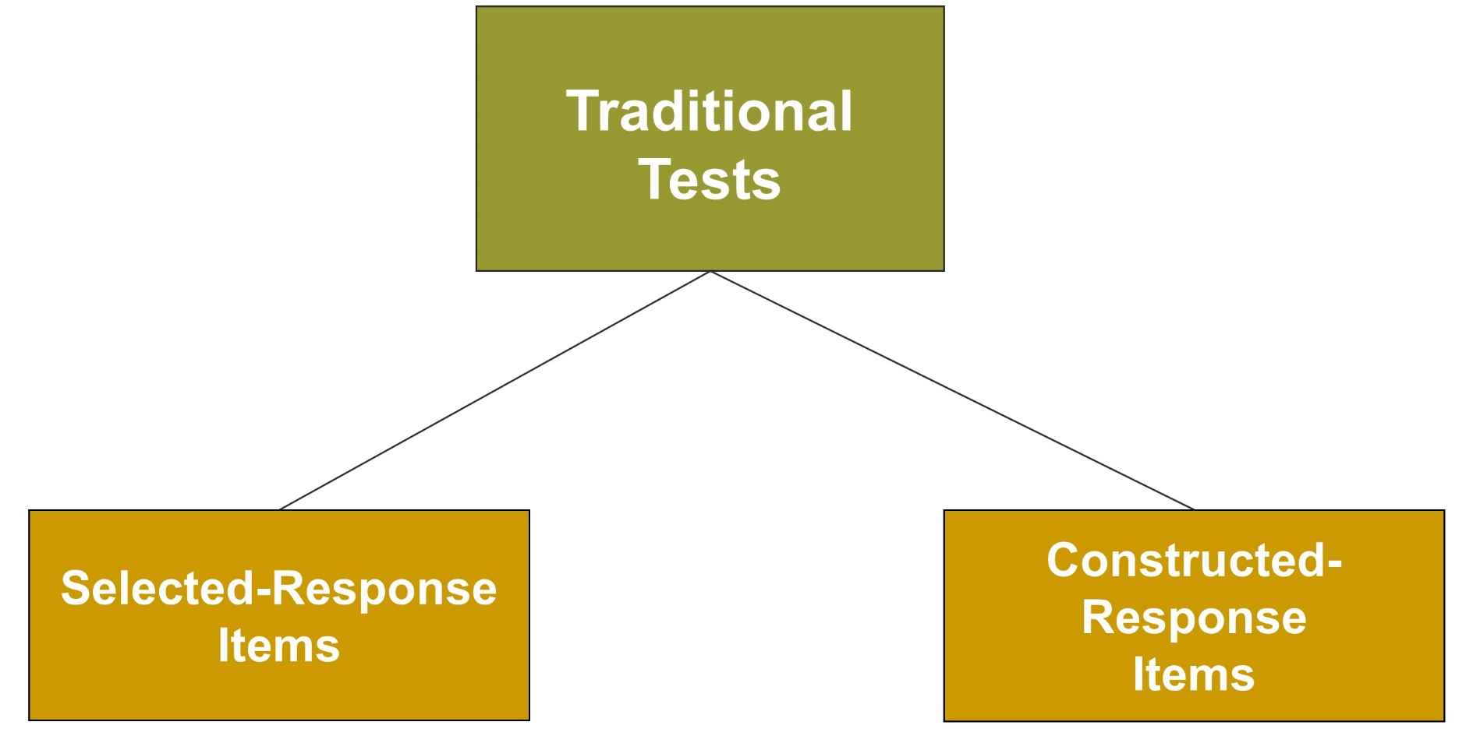
Classroom Assessment, 2
Jump to long description

Slide 10
Traditional Tests
Traditional tests are typically paper-and-pencil tests in which students select from choices, calculate numbers, construct short responses, and write essays
Two main types:
Selected-response items
Constructed-response items

Slide 11
Selected-Response Items: Multiple-Choice Items
Strengths
Both simple and complex learning outcomes can be measured.
The task is highly structured and clear.
A broad sample of achievement can be measured.
Incorrect alternatives provide diagnostic information.
Scores are less influenced by guessing than true/false items.
Scoring is easy, objective, and reliable.
Limitations
Constructing good items is time consuming.
It is frequently difficult to find plausible distractors.
The multiple-choice format is ineffective for measuring some types of problem solving and the ability to organize and express ideas.
Score can be influenced by reading ability.

Slide 12
Best Practices for Writing Multiple-Choice Items, 1
Write the stem as a question
Give 3 or 4 possible alternatives for the correct answer
State items and options positively if possible
Make the stem long and the alternatives short
Ensure that the alternatives grammatically match the stem
Write items that have a clearly defensible correct or best answer

Slide 13
Best Practices for Writing Multiple-Choice Item, 2
Vary the placement of the correct option
Beware of cues in option length
Don’t expect students to make narrow distinctions among answer choices
Don’t overuse “None of the above” and “All of the above”
When writing questions, don’t use the exact wording in the textbook
Write some items that encourage students to use higher-level thinking

Slide 14
Selected-Response Items: True-False Items
Strengths
The item is useful for outcomes where there are only two possible alternatives (e.g., fact or opinion, valid or invalid).
Less demand is placed on reading ability than in multiple-choice items.
A relatively large number of items can be answered in a typical testing period.
Scoring is easy, objective, and reliable.
Limitations
It is difficult to write items at a high level of knowledge and thinking that are free from ambiguity.
When a statement indicates correctly that a statement is false, that response provides no evidence that the student knows what is correct.
No diagnostic information is provided by the incorrect answers.
Scores are more influenced by guessing than with any other item type.

Slide 15
Constructed-Response Items:
Short-Answer Items and Essay Items
Strengths
The highest level of learning outcomes (analysis, synthesis, evaluation) can be measured.
The integration and application of ideas can be emphasized.
Preparation time is usually less than for selection-type formats.
Limitations
Achievement may not be adequately sampled due to the time needed to answer each question.
It can be difficult to relate essay responses to intended learning outcomes because of freedom to select, organize, and express ideas.
Scores are raised by writing skill and bluffing, and lowered by poor handwriting, misspelling, and grammatical errors.
Scoring is time-consuming, subjective, and possibly unreliable.

Slide 16
Best Practices for Scoring Essay Questions
Determine what constitutes a good or acceptable answer prior to administering and scoring student responses
Devise a method to score essays without knowing which students wrote them
Evaluate all answers to the same questions together
Devise a policy for handling irrelevant or incorrect responses
Reread papers before handing them back
Write comments on the paper

Slide 17
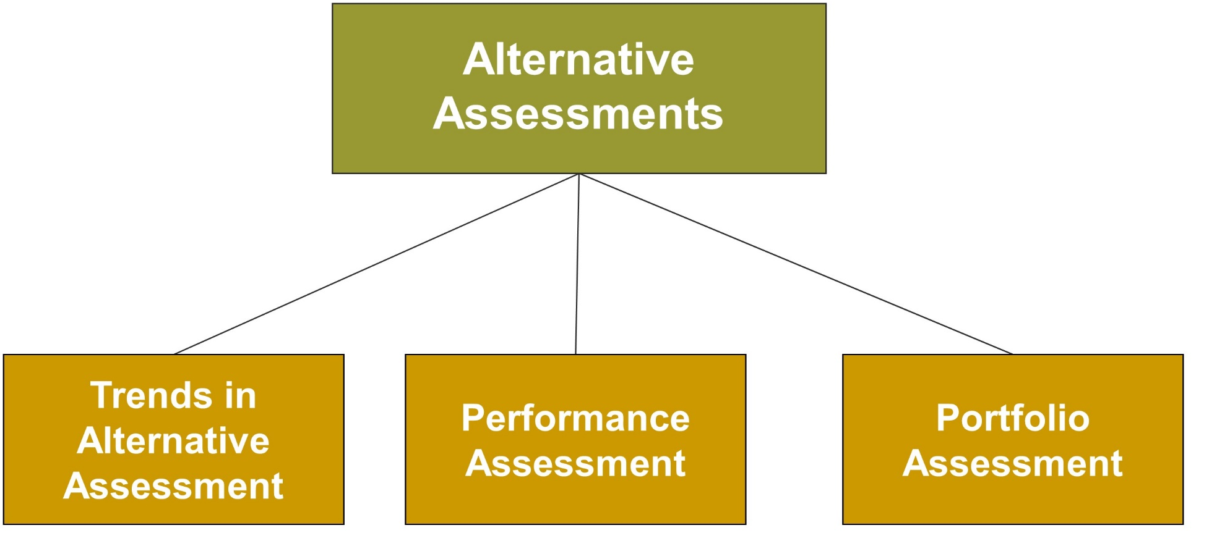
Classroom Assessment, 3
Jump to long description

Slide 18
Alternative Assessments
Authentic assessment means evaluating a student’s knowledge or skill in a context that approximates the real world or real life as closely as possible

Slide 19
Performance Assessments
Performance assessments
are evaluated when
specific criteria (behaviors)
are performed
by the student
Performance assessment includes dance, music, art, and physical education as well as papers, projects, experiments, and portfolios
Notes:
Performance assessments - Commonly thought of as students’ actual performances (dance, music, art, and physical education) as well as papers, projects, oral presentations, experiments, and portfolios

Slide 20
Guidelines for
Performance Assessments
Establishing a clear purpose
Identifying observable criteria
Providing an appropriate setting
Judging or scoring the performance
Notes:
Scoring rubrics involve:
(1) the criteria that are used to judge performance
(2) what the range in the quality of the performance should look like
(3) what score should be given and what that score means
(4) how the different levels of quality should be described and differentiated from one another

Slide 21
Best Practices for Developing Scoring Rubrics
Match the rating type to the purpose of the assessment
Share the criteria with students prior to instruction
Build your rubric from the top, starting from a description of an exemplary performance
Carefully construct the rubric language
Make rubrics more authentic
Show students models
Minimize scoring error

Slide 22

Portfolio Assessments
Artifacts: Students’ papers and homework
Reproductions: Documentation of a student’s work outside
the classroom
Attestations: Teachers’
or other persons’ documentation of a student’s progress
Productions: Documents prepared especially for the portfolio
Portfolio assessment is a systematic and organized collection of a student’s work that demonstrates the student’s skills and accomplishments

Slide 23
Using Portfolios Effectively
Establishing purpose
  Growth portfolio
  Best-work portfolio
Involving students in selecting portfolio materials
Reviewing with students
Setting criteria for evaluation
Scoring and judging
Student self-reflection
Notes:
Growth portfolio - Student’s work over an extended time period (throughout a school year) that reveals the student’s progress in meeting learning targets
Best-work (showcase) portfolio - Showcases the student’s most outstanding work

Slide 24
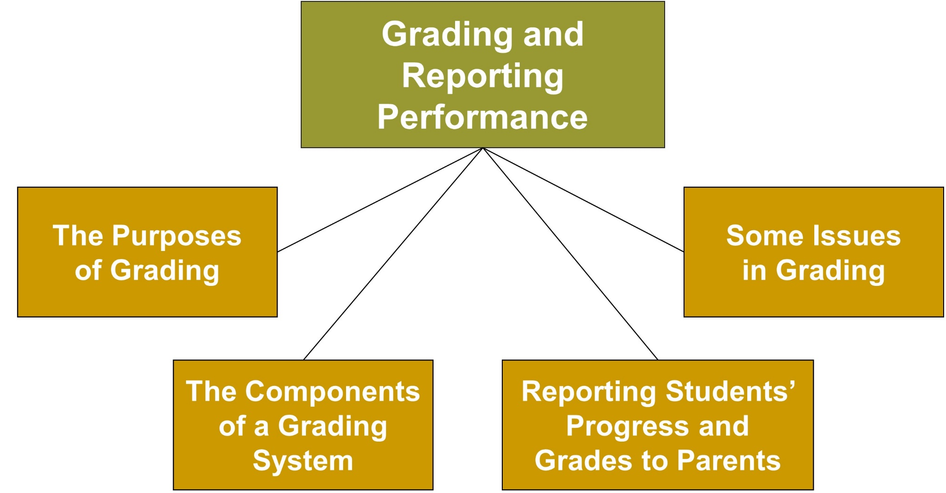
Classroom Assessment, 4
Jump to long description
Notes:
Grading - Translating descriptive assessment information into letters, numbers, or other marks that indicate the quality of a student’s learning or performance

Slide 25

Purposes of Grading
Motivational: Students
are motivated to achieve high grades and to fear low grades
Administrative: Grades help determine students’ class rank, credits for graduation, and promotion to the next grade
Informational: Grade
represents the teacher’s
summary judgment of student performance
Guidance: Helps in appropriate course selection and identifying students with special needs

Slide 26
Standards of Comparison
Norm-Referenced Grading
Criterion-Referenced Grading
Based on comparison of a student’s performance with other students
Referred to as “grading on the curve”
Grading scale determines what percentages of students get particular grades
Based on comparisons with predetermined standards or criteria
Referred to as “absolute grading”
Grading is based on level of mastery reached in a performance skill
Notes:
Norm-referenced grading - Comparing performance across students
Criterion-referenced grading - Comparing performance with a predetermined standard

Slide 27
Grading and Reporting Performance
The Report Card | Standard method of reporting student progress Typically uses letter grades, numerical scores, and checklists Some report affective characteristics. Some provide the teacher’s summative comments
Written Progress Report | Can include student’s performance on tests, projects, and reports Can include comments on student motivation, cooperation, and behavior Can also include suggestions for parents
Parent-Teacher Conference | Provides an opportunity to give parents useful information Provides an avenue to develop parent-teacher partnerships on the student’s behalf

Slide 28
Best Practices for Parent-Teacher Conferences: Grades and Assessment
Be prepared
  Review student’s progress prior to the meeting
Be positive
  Discuss areas in which the student shows good performance
Be objective and honest about improvements needed
Practice good communication skills
Don’t discuss other students

Slide 29
Enter the Debate
Should grades be abolished?
YES
NO
Notes:
During a slideshow, text may be written on the slides in the yes/no boxes, and then saved for later reference.

Slide 30
Classroom Connections: Crack the Case—The Case of the Project
What are the issues involved in this situation?
What did Mr. Andrews do wrong?
How should he have gone about developing his alternative assessments?
How should he have developed his grading guide?
What do you think of the practice of including an effort grade on students’ projects? Why?
Notes:
This case is on page 609 of the text.

Slide 31

Reflection and Observation
Reflection
How have teachers assessed your learning?
How did different types of feedback affect your self-perceptions and motivation to learn?
Notes:
This slide accompanies the video segment, Portfolio Assessment, on the McGraw-Hill DVD Teaching Stories: A Video Collection for Educational Psychology.

Slide 32
Appendix of Image for Long Descriptions

Slide 33
Classroom Assessment, 1 Long Description
This slide illustrates a flowchart on classroom assessment. It contains six boxes, one of which is positioned at the center. The other boxes are connected to the box at the center via lines. The box at the center reads the classroom as an assessment context.
In an anticlockwise manner of appearance, the content in the other five boxes reads assessment as an integral part of teaching, making assessment compatible with contemporary views of learning and motivation, creating clear, appropriate learning targets, establishing high-quality assessments, and current trends.
Jump back to slide containing original image

Slide 34
Assessment as an Integral Part of Teaching Long Description
This figure illustrates the concept of assessment as an integral part of teaching. The figure is in the form of a cyclic flowchart with three components. In a clockwise manner of appearance, these three components read preinstruction assessment, formative assessment, and summative assessment.
Jump back to slide containing original image

Slide 35
Classroom Assessment, 2 Long Description
This slide illustrates a flowchart on classroom assessment. It contains three boxes, one of which is positioned at the center of the illustration. The other boxes are connected to the box at the center via lines. The box is labeled traditional tests.
Of the other two boxes, the box on the left is labeled selected-response items. The box on the right is labeled constructed-response items.
Jump back to slide containing original image

Slide 36
Classroom Assessment, 3 Long Description
This slide illustrates a flowchart on classroom assessment. It contains four boxes, one of which is positioned at the center. The other boxes are connected to the box at the center via lines. The content in the box positioned at the center reads alternative assessments.
From the left to the right, the content in the other three boxes reads trends in alternative assessment, performance assessment, and portfolio assessment.
Jump back to slide containing original image

Slide 37
Classroom Assessment, 4 Long Description
This slide illustrates a flowchart on classroom assessment. It contains five boxes, one of which is positioned at the center. The other four boxes are connected to the box at the center via lines. The content in the box positioned at the center reads grading and reporting performance.
In an anticlockwise manner of appearance, the content in the other boxes reads the purposes of grading, the components of a grading system, reporting students’ progress and grades to parents, and some issues in grading.
Jump back to slide containing original image

