Slide 1
Social and Emotional Development
Chapter 10 Pt 1
p. 321-337

Slide 2
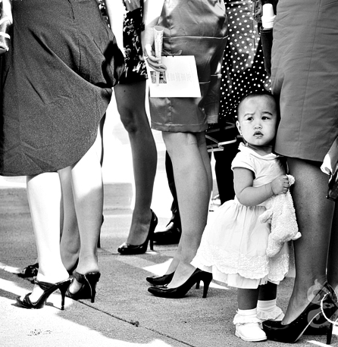
Why study social and emotional development?
Important in child’s overall development
Positive development in this area linked to positive outcomes in adolescence and adulthood
Experiences in preschool years influential in academic and social behavior
Self-regulation, restraint, prosocial development
Notes:
Researchers’ findings suggest that a child’s social and emotional behaviors and his/her interactions with the social environment are critical in the child’s development.
In other words, children who got a more positive experience during the preschool years were found to be more academically and socially correct, and to have less behavior problems.

Slide 3
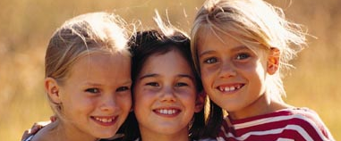
Processes in Social Behavior
Notes:
Q. WHAT IS SOCIAL BEHAVIOR?

Slide 4
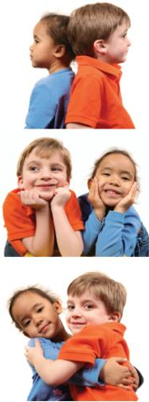
Social Behavior as Operant Interactions
Social transactions are reciprocal
Behavior is controlled by social stimuli and at the same time serves as a social stimuli. This is the essence of social interaction!
EXAMPLE: Bert and Ernie meet
Bert's Contingency:
Sees Ernie → "Hi Ernie" → E smiles
S^{d} → R → S^{r+}
( Setting Event = Walking along)
Ernie's Contingency:
"Hi Ernie“ → E smiles→ Bert Smiles
S^{d} → R → S^{r+}
(Setting Event = In a good mood)
Notes:
Social transactions are unique because one person’s behavior works as a discriminative or reinforcing (or both) stimuli for another. Thus, social transactions are reciprocal and these influence the development of the behavior of individuals.
Behavior is both an event controlled by social stimuli and at the same time serves as a social stimuli for the behavior of others; this is the essence of social transaction.
Notice that “hi ernie” that functions as a response for Bert functions as a Sd for Ernie

Slide 5
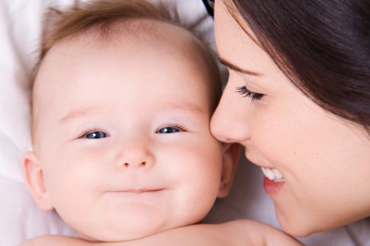
The Function of Social Behavior
Prosocial Behaviors: sympathetic, cooperative, empathetic, helpful, comforting, and generous manner
All of the good social behaviors we want to see from our children
Universal behaviors at birth (reflexes, temperament, crying) immediately begin interacting with environment.
ALWAYS IN THE INTERACTION: First look at phylogenetic contributions….
Notes:
Ethologists suggest that the universal behaviors that infants possess (crying, smiling) coupled with certain characteristics (cuteness) evolved because of natural selection. Individuals who elicited caregiving from their parents were more likely to survive the vulnerable period of infancy to grow to maturity and have offspring of their own who possessed these characteristics as well

Slide 6
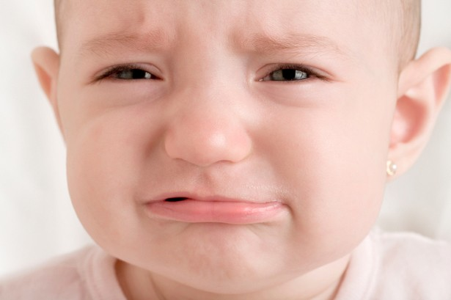
Phylogenic Contributions to Social Development
Physical Characteristics: Babies are “cute”
Big heads, big eyes, small chin
These also seen in other animals
These “cute” characteristics evoke nurturing behaviors from caregivers. Adaptive! This creates the earliest social environment
Social Reflexes
Smiling, grimacing, crying
Universal
Very quickly come under the control of consequences and are no longer reflexive
Notes:
Physical Characteristics
Disproportionately large heads, large foreheads, prominent eyes, flattened nose, and small chin.
A universal “cute,” even for some nonhuman babies, that evolved through natural selection to elicit positive emotions in the adult members of the species in order to promote caregiving.
2. Social Reflexes
The have the function of evoking parental caregiving (smiling, grimacing, and crying).
a) Facial Expressions
Both the expressions of interest and disgust are present at birth
Human face=interest reflex; painful stimuli=disgust.
According to research, children before the age of 1 can learn to avoid negative stimuli and seek out pleasant stimuli.
b) Reflexive Crying
Infants can have an influence on parental care even if the parent is at a distance.
Infants show a preference for the familiar.
3) Neonatal Imitation
The only behavior for which there is strong evidence for imitation is tongue protrusion.
Some researchers say it isn’t true imitation, rather a S→ R.

Slide 7
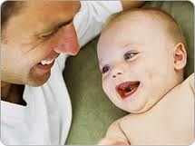
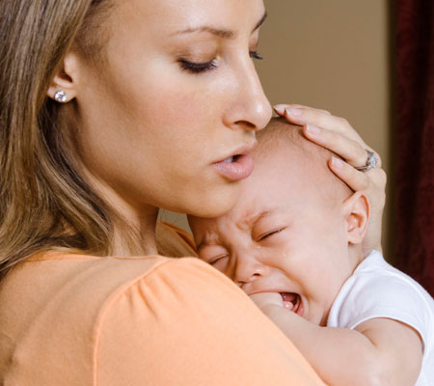
Phylogenic Contributions to Social Development
Facial Expression
Most facial expressions are universal
“Interest” and “disgust” present at
birth, smile appears 3-4 wks.
9-mo-olds able to recognize “joy” and “fear” on parent’s faces as predictive of positive/negative consequence (toy v. loud noise) (Gerwitz & Pelaz, 1992)
7-mo-olds showed preference for happy faces v. sad faces (Soken & Pick, 1999)
In natural environment, happy faces predict good things
Notes:
Physical Characteristics
Disproportionately large heads, large foreheads, prominent eyes, flattened nose, and small chin.
A universal “cute,” even for some nonhuman babies, that evolved through natural selection to elicit positive emotions in the adult members of the species in order to promote caregiving.
2. Social Reflexes
The have the function of evoking parental caregiving (smiling, grimacing, and crying).
a) Facial Expressions
Both the expressions of interest and disgust are present at birth
Human face=interest reflex; painful stimuli=disgust.
According to research, children before the age of 1 can learn to avoid negative stimuli and seek out pleasant stimuli.
b) Reflexive Crying
Infants can have an influence on parental care even if the parent is at a distance.
Infants show a preference for the familiar.
3) Neonatal Imitation
The only behavior for which there is strong evidence for imitation is tongue protrusion.
Some researchers say it isn’t true imitation, rather a S→ R.

Slide 8
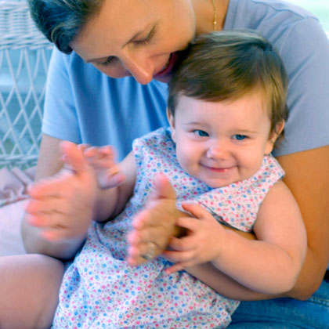
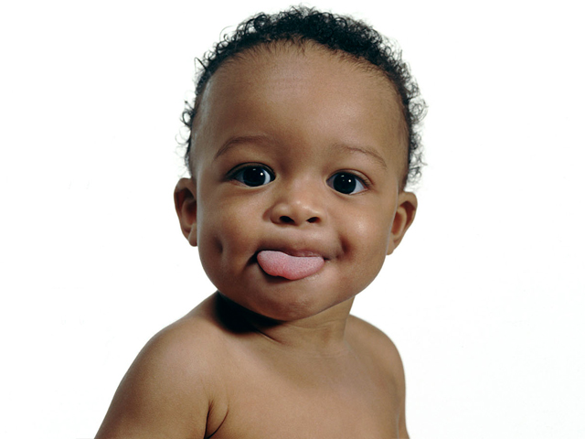
Phylogenic Contributions to Social Development
Neonatal Imitation
Jury is out – some say facial expression, but only evidence for tongue protrusion
Robust imitation appears to occur at about 9-months-old
Little evidence that phylogenic factors lead to generalized imitation
Most social behavior occurs after infancy and is due to….
Notes:
Physical Characteristics
Disproportionately large heads, large foreheads, prominent eyes, flattened nose, and small chin.
A universal “cute,” even for some nonhuman babies, that evolved through natural selection to elicit positive emotions in the adult members of the species in order to promote caregiving.
2. Social Reflexes
The have the function of evoking parental caregiving (smiling, grimacing, and crying).
a) Facial Expressions
Both the expressions of interest and disgust are present at birth
Human face=interest reflex; painful stimuli=disgust.
According to research, children before the age of 1 can learn to avoid negative stimuli and seek out pleasant stimuli.
b) Reflexive Crying
Infants can have an influence on parental care even if the parent is at a distance.
Infants show a preference for the familiar.
3) Neonatal Imitation
The only behavior for which there is strong evidence for imitation is tongue protrusion.
Some researchers say it isn’t true imitation, rather a S→ R.

Slide 9
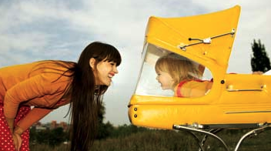
Ontogenic Contributions
Social Behaviors
Reinforcement
Proximity
Attention
Affection
Observational Learning

Slide 10
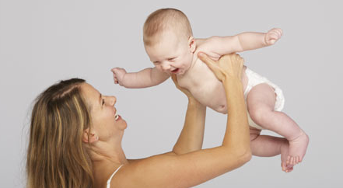
Social Reinforcement
Social behaviors are strengthened by the actions of others and can act as social reinforcers.
Think of a long social interaction – one’s behavior is another’s consequence
Social reinforcers are conditioned reinforcers
From the beginning, people are associated with:
Food, water, warmth, touch, and the removal of sharp objects, harsh light, gas in the stomach, pain on the gums
Parents become VERY powerful reinforcers
Proximity- reinforcer is the nearness of you
Children will behave in a variety of ways to access caregivers
Imprinting chicks
Notes:
Social behaviors are strengthened by the actions of others and can act as social reinforcers.
Social reinforcers are considered secondary reinforcers (paired with primary and other secondary reinforcers).
Caregivers become acquired positive reinforcers because they provide positive reinforcers and remove aversive ones.

Slide 11
Proximity
Proximity is a reinforcer, but also signals reinforcers in the form of attention
“What’s wrong?” “Don’t fuss sweetheart.”
Mands everywhere!
Crying, whining, eye contact, reaching, “Mommy!”, hitting a sibling
“attention-seeking behavior”
Functional approach to behavior
If it gets attention, it will continue to occur (yelling, scolding, eye contact proven reinforcers)
No matter if it’s appropriate of inappropriate; no matter how the consequence looks to caregiver
Notes:
Bijou and Baer (1965) – the child engages in behaviors that bring the mother near. These behaviors might start out as reflexes (smiling & crying), but soon acquire a new function.

Slide 12
Reducing Mands for Attention
Extinction
Ignore behaviors – will work, but extinction burst will be difficult to endure
May shape even more troublesome behavior
Differential Reinforcement
Combination of extinction and reinforcement for behaviors different from problematic behavior
Differential Reinforcement of Other Behaviors (DRO)
Ignoring crying and reinforcing calm
Ignoring perseverative mands and reinforcing independent play
ALWAYS strengthen a alternative behavior in tandem with an extinction procedure!!

Slide 13
Reducing Mands for Attention
Positive punishment
Spanking, a threat when child inappropriately mands for attention (parent on phone, talking to an adult)
Often this actually strengthens behavior and isn’t punishment at all
Scolding, threatening, reasoning still attention. What’s the reinforcer? Attention!
Often makes children “fearful” of parent and limits positive interactions

Slide 14
Reducing Mands for Attention
Negative punishment
Time-out, taking away a toy
Too often consequence is delayed and not effective (“No TV tonight”)
Almost never used appropriately.
Should be a brief loss of attention, not isolation
Many repetitions better than long durations

Slide 15
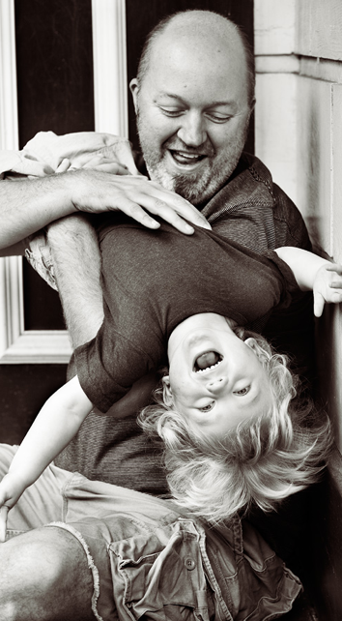
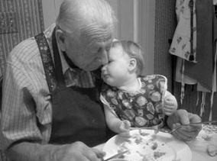
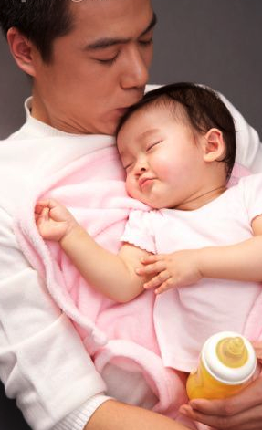
Affection
Usually reinforces desirable behavior
Hugs, kisses, smiles, pats, nuzzles hair ruffling
Functions as reinforcer, but different from attention
Notes:
Those who do provide affection often find that because it follows desirable behavior, it strengthens them. Contingent use of affection is an effective way to shape desired behaviors.
Q. TYPES OF AFFECTION? (HUGS, KISSES, SMILES, PATS, NUZZLING, TICKLING, HAIR RUFFLING, CROONING TONE OF VOICE, WORDS..)
Q. WHEN MIGHT AFFECTION NOT REINFORCE DESIRABLE BEHAVIOR?

Slide 16
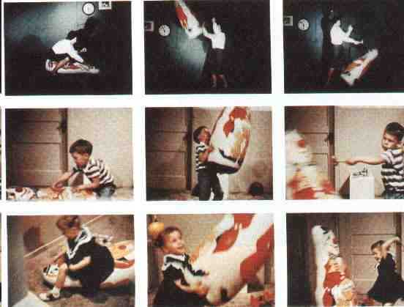
Observational Learning
Notes:
WHAT IS IT?
Q. EXAMPLES?

Slide 17
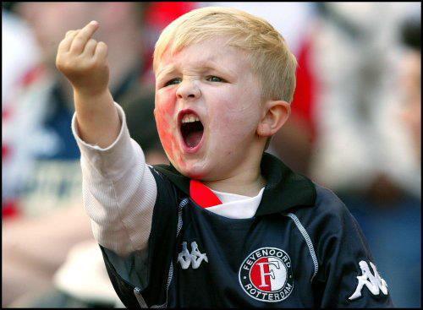
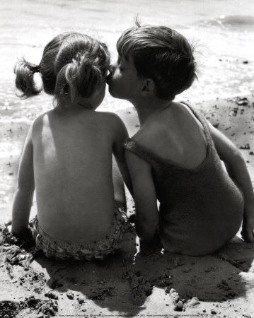
Observational Learning
Changes in behavior brought about by watching the behavior of others
Imitation
12 second: Child imitates smoking
https://www.youtube.com/watch?v=tD4GecoVhN4
28 seconds: Child imating talking on phone
https://www.youtube.com/watch?v=B37yJxFkQ8o
Bandura’s Bobo doll studies
5:03 Bobo Doll experiment
http://www.youtube.com/watch?v=eqNaLerMNOE
Direct reinforcement affects performance, but distinction between
Learning
Performance
Vicarious consequences affect learning
Vicarious reinforcement
Vicarious punishment
Notes:
Imitation is the basis for observational learning (changes in behavior brought about by watching the behavior of others).
Albert Bandura → Bobo doll studies
He believed reinforcement of behavior was important, but he felt that reinforcement affected the performance of the behavior and not the learning of it.
He also concluded that reinforcement and punishment need not be direct, but could also be experienced by watching others (vicarious consequences).

Slide 18
Observational Learning: An Operant Approach
Vicarious reinforcement may not be necessary
Instead, the behavior of the model is a discriminative stimulus
Behavior that matches this will be reinforced
Generalized imitation
Behaviors that match a model are frequently reinforced, and, because of the history of reinforcement, generalization occurs
Doing a puzzle – imitates – Rf in outcome
Stack blocks – imitates – Rf in tall tower
Counter imitation
Imitation usually encounters punishers
Do the opposite of your naughty sibling
Notes:
Although Bandura felt that new principles, such as vicarious consequence, were needed to explain observational learning, others felt that existing principles of operant learning were sufficient.
Generalized imitation: the behaviors that match a model’s behaviors are frequently reinforced by the consequences they produce (e.g., child sees another complete a puzzle; when child imitates the puzzle-solving behavior, he/she is reinforced by the solution to the puzzle)
Counter imitation: child observes another child do something that is reinforced; but the observer does the opposite of the model. Child sees another child steal and get away with it, but the observing child does not do what the model does

Slide 19
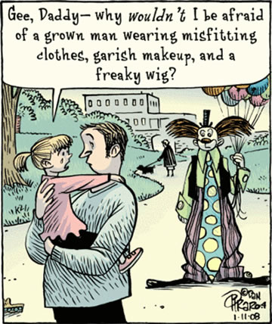
Observational Learning of Respondents: Emotional Behavior
Other’s emotional response serves as UCS for emotional response (UCR)
Berger (1962): P. watched arm jerking
Either race or shock
Then measured reflexive physiological reactions
Shock= more GSR
Notes:
A neutral stimulus becomes a conditioned stimulus because of its pairing with an unconditional stimulus for the emotional response. Thus, we learn emotional responses by observing them in others and then matching the behavior and experiencing the consequences ourselves.
The study of college students by Berger (1962)→ vicarious respondent conditioning.
Both groups witnessed a model seated at a table, as the light dimmed, a buzzer sounded and the model rapidly jerked his arm off the table.
The control group was told that this reaction was a reaction time study and the model was trying to lift his arm off the table as soon as the buzzer sounded. (NO PAIN)
The experimental group was told that that the model was receiving an electric shock when the buzzer sounded and that the jerking response was a response to pain. (PAIN)
Each subject was seated in the room, and a machine similar to a polygraph measured their sweating associated with emotional arousal
WHAT DO YOU THINK THEY FOUND WHEN THEY PLACED THE CONTROL GROUP PARTICIPANTS IN THE ROOM? ( no arousal; buzzer as neutral stimulus); EXPERIMENTAL GROUP? (high arousal; buzzer as conditioned stimulus)
This suggests that we may come to fear (or like) things by merely watching others become conditioned to them, not just by experiencing the conditioning directly ourselves (EXAMPLES?)

Slide 20
Consider this:
Given what we know about observational learning and imitation, how do you feel about violent media and video games? Do you think early exposure to these models impacts development?

Slide 21
Social and Emotional Development
Chapter 10 Pt 2
p.337 - 370

Slide 22
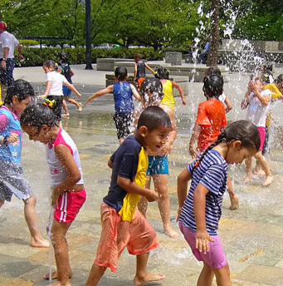
The origins of social phenomena
Attachment
Depression
Touch
Fears
Social Referencing
Jealousy
Notes:
In this section we examine the origins and learning of diverse social learning phenomena; which include attachment, depression and touch, fear of the dark and fear of strangers, social referencing and jealousy

Slide 23
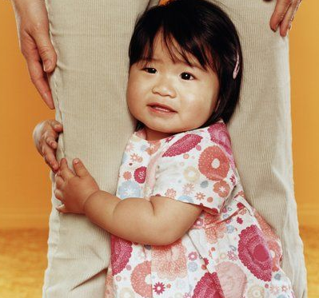
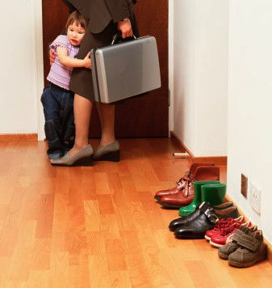
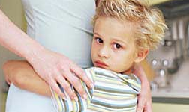
Attachment
Organized pattern of proximity-regulating behavior directed toward one or more individuals.
Result of phyologenic & ontogenic factors
Evolutionary significance, also cond. reinforcer
Ontogenic – reinforcement of proximity, imitation, and identification behaviors
Notes:
Organized = more than just individual behaviors occur
Bowlby suggests that attachment evolved because of phylogenic contingencies in which behaviors that protected the child from predators were naturally selected/
Petrovich and Gewirtz argued that it was both ontogenic and phylogenic contingences contribute to attachment when caregivers reinforce proximity, imitation, and identification.
When we the infant’s proximity and security-regulating behaviors become organized around one or more particular caregiver we say the child is developing an attachment

Slide 24
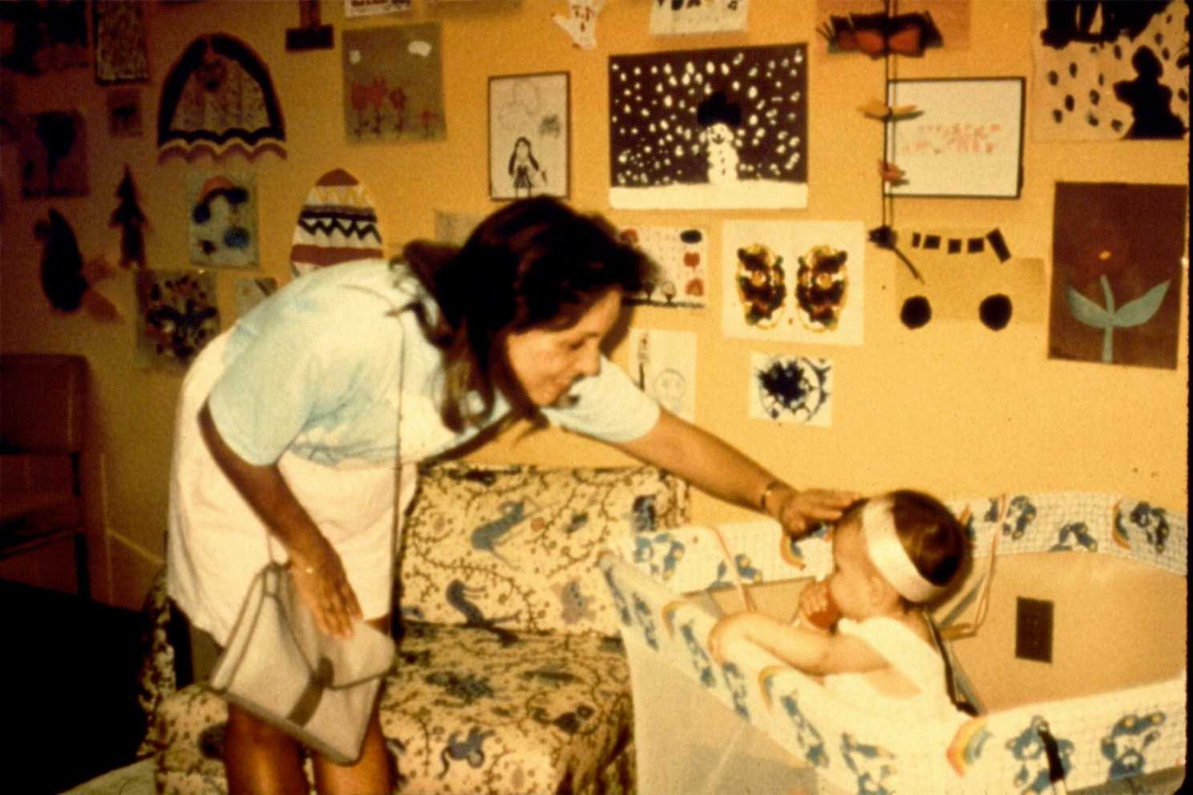
Reinforcement of Separation Protests
Loss of primary caregiver results in loss of reinforcers– extinction burst
“seperation anxiety 54 s”
https://www.youtube.com/watch?v=Y6QtuU1L_A8
Separation protests dramatically decrease with DRO (Gerwitz & Peleaz, 1991)
CRF = protests
DRO = toy play, etc.
Inappropriate attachment can be shaped. Easy to see how:
Mother receives S^{r-}
Child stops crying
Child reciveves S^{r+}
Mom comes/gives attention
Notes:
Separation protests: child behavior (e.g., crying, whining, throwing tantrums) used as an index of child-caretaker attachment
Loss of parent=loss of reinforcer, which is aversive to the child. The loss elicits some emotional responses as well as evokes behavior that may function to get the mother back (extinction bursts).
Gewirtz & Pelaez-Nogueras study:
Mothers inadvertently reinforce protestations because in doing so, the mother is likely to reduce, at least temporarily, the crying.

Slide 25
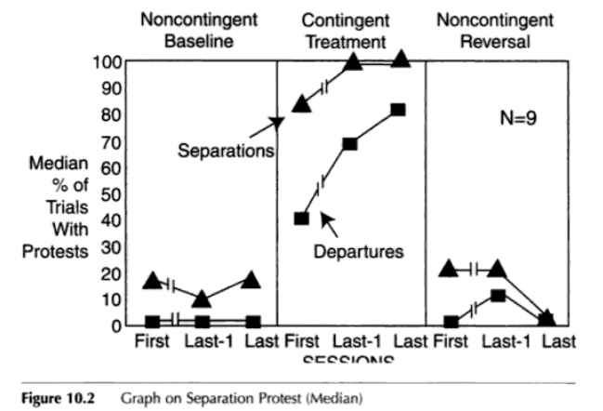
Another One: Gewirtz & Pelaez-Nogureras (1996)
Notes:
N=23 (aged 6 – 11 months old) and mothers
Mothers were given cues by a private earphone to signal to the child that she was leaving by standing up, kissing the child, waving, and saying “bye bye, I’ll be right back”; mother left room for up to 3 minutes, then returned. After a brief reunion, another separation trial was conducted.
Departures = protests immediately
Separations = protests delayed (after a minute, possibly)
Baseline- noncontingent reinforcement—protests were low
Contingent reinforcement by mothers of protests – (continuous reinforcement) protests increase
Noncontingent (reversal) – Protest decrease
Q. WHAT DOES THIS SHOW? (this is trained/shaped up inadvertently by “loving”mothering interactions; mothers “inadvertently” reinforce protestation because in doing so, the mother is likely to reduce (at least temporarily) the whining and crying) - - mother’s behavior shaped by negative reinforcement, while simultaneously the child’s protests are shaped by the mother through positive reinforcement

Slide 26
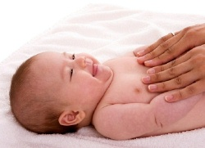
Touch
Powerful reinforcer
Powerful therapy
Experiments demonstrate:
A powerful social reinforcer
Some research says most powerful
Synchronous reinforcement procedure: the onset of the infant response corresponds to the onset of the consequent stimuli
(Pelaz-Nogueras, Gerwitz, et. Al. (1996)
Eye contact + social and touch
Eye contact + social
Notes:
Early on, researchers used touch with smiles and vocalizations for reinforcement; but without appropriate controls, touch elicits behavior
So how can we determine that touch is reinforcing?
Human touch can a very powerful reinforcer
Research has shown that infants show a preference towards touch among all social reinforcers.
Touch has also been found to be a powerful therapy for depressed mothers and their infants
Synchronous reinforcement procedure: the onset of the infant response corresponds to the onset of the consequent stimuli.

Slide 27
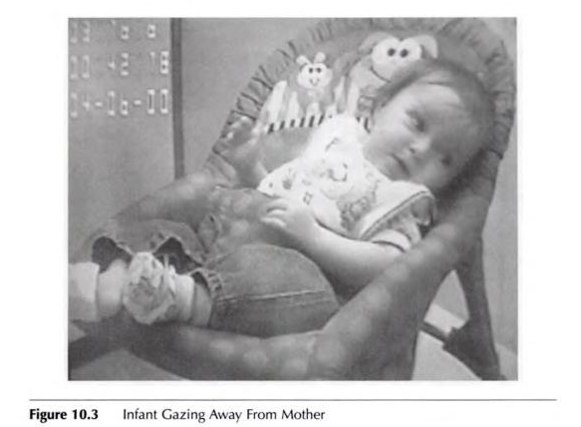
Notes:
When infant gazed away reinforcement ceased

Slide 28
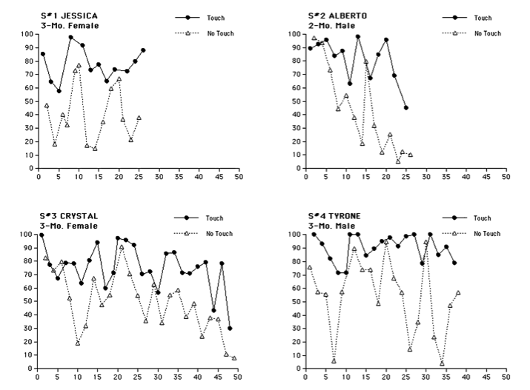
Notes:
The Touch Condition:
A female adult smiling, cooing, and rubbing the child’s legs and feet was provided contingent upon the infant making eye contact. The tactile stimulation continued for as long as the child made eye contact in what is called a synchronous reinforcement procedure.
The No-Touch Condition:
The rubbing was omitted.
All infants showed more social behavior when their eye contact produced touch.
WHAT WAS FOUND: infants showed more social behavior (vocalizations and smiles) when their eye contact produced the additional reinforcer that included touch stimulation, compared with the condition in which touch was not provided (only smiles and vocal sounds were made contingent on infant eye contact)
When touch was not included in the reinforcement treatment, infants also spent more time crying, gazing away and protesting!
Further, Pelaez-Nogueras (1997) conducted a study comparing massage-like touch (deep but gentle circular rubs starting at the infant’s legs and moving up to the abdomen and forearm) with poking/tickling touch (pattern of deep but short nudges along the same path on the child’s body); found poking/tickling to be a negative reinforcer; massage-type touching was not only a positive reinforcer, but also evoked and maintained a positive effect (smiling and vocalizations, decreased crying)

Slide 29
Does the Type of Touch Matter?
Yes! (Peleaz-Nogueras, 1997)
Tickling, poking touch a negative reinforcer
Aversive stimulation
Circular, massage-like touch a positive reinforcer
Data for Infants, however.

Slide 30
Depressed Mothers and Infants
Depressed mothers more likely to have nonfacilitative environments
Fussy, lower activity levels, fewer smiles/eye contact
Correlated with behavior problems, criminal bx, etc.
Mother’s flat expression brought these problematic behavioral characteristics out in children
Paired with massage-like touch
Immediate increase in prosocial behaviors
Touch may help buffer the effects of a depressed parent
Results replicated MANY times

Slide 31
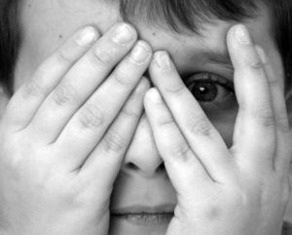
What is Fear?
Emerges between 6 and 7 months
Peak at 8 and 10 months
Notes:
Said to emerge between 6 and 7 months of age and peak at 8 to 10 months
Found that infants picked up a stranger in the mother’s presence cry more than if the mother is not there Q. WHAT WILL HAPPEN? WHAT”S GOING ON?

Slide 32
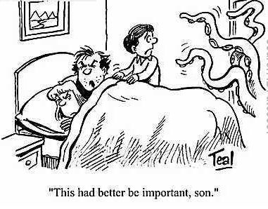
Fear
Fear of the Dark
Fear of Strangers
Stranger anxiety
As always, environment contributes
Fears can be (and usually are) learned
Initial reflex, shaped by parental attention
Shaping protests
Notes:
The Conditioning of Fear of the Dark & Fear of Strangers
Contribution of environmental factors and learning processes to these behavior problems.
“Shaping protest”: Emergence of fear from caregiver’s behavior contingent on the infant initiations to protest in particular contexts
The protests and approach-and-avoidance responses towards strangers may result from operant conditioning
Fearful response to darkness can be conditioned by contingent maternal attention.
The Conditioning of Fear of the Dark & Fear of Strangers
“Shaping Protests”
Operant Conditioning
Contingent Maternal Attention

Slide 33
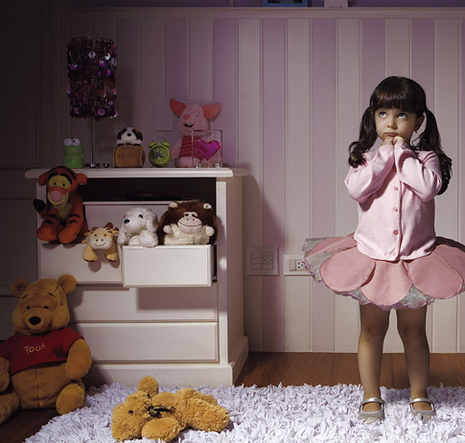
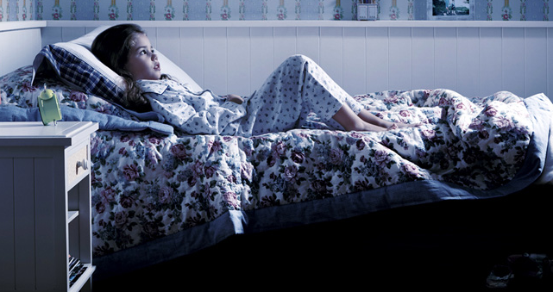
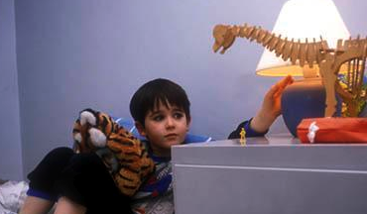
Fear of the Dark
Notes:
WHY ARE SOME CHILDREN AFRAID OF THE DARK? WHY WOULD BABIES BE AFRAID OF THE DARK?
Fear of the Dark
Fear of the Dark can be conditioned.
As research shows that fear-denoting protests are as readily conditioned in light as in darkness by contingent maternal attention.

Slide 34
Fear of Dark (GEWIRTZ & PELAEZ-NOGUERAS, 2000)
Fear of the dark can be conditioned
Used CRF and DRO to shape the frequency of protests in both light and dark conditions
CRF: continuously reinforced protests
DRO: reinforced other appropriate behaviors
CRF produced high rates of protesting; DRO produced low rates of protesting
Regardless of the presence of light or dark
Much less reflexive grimacing or “fear” responses in DRO

Slide 35
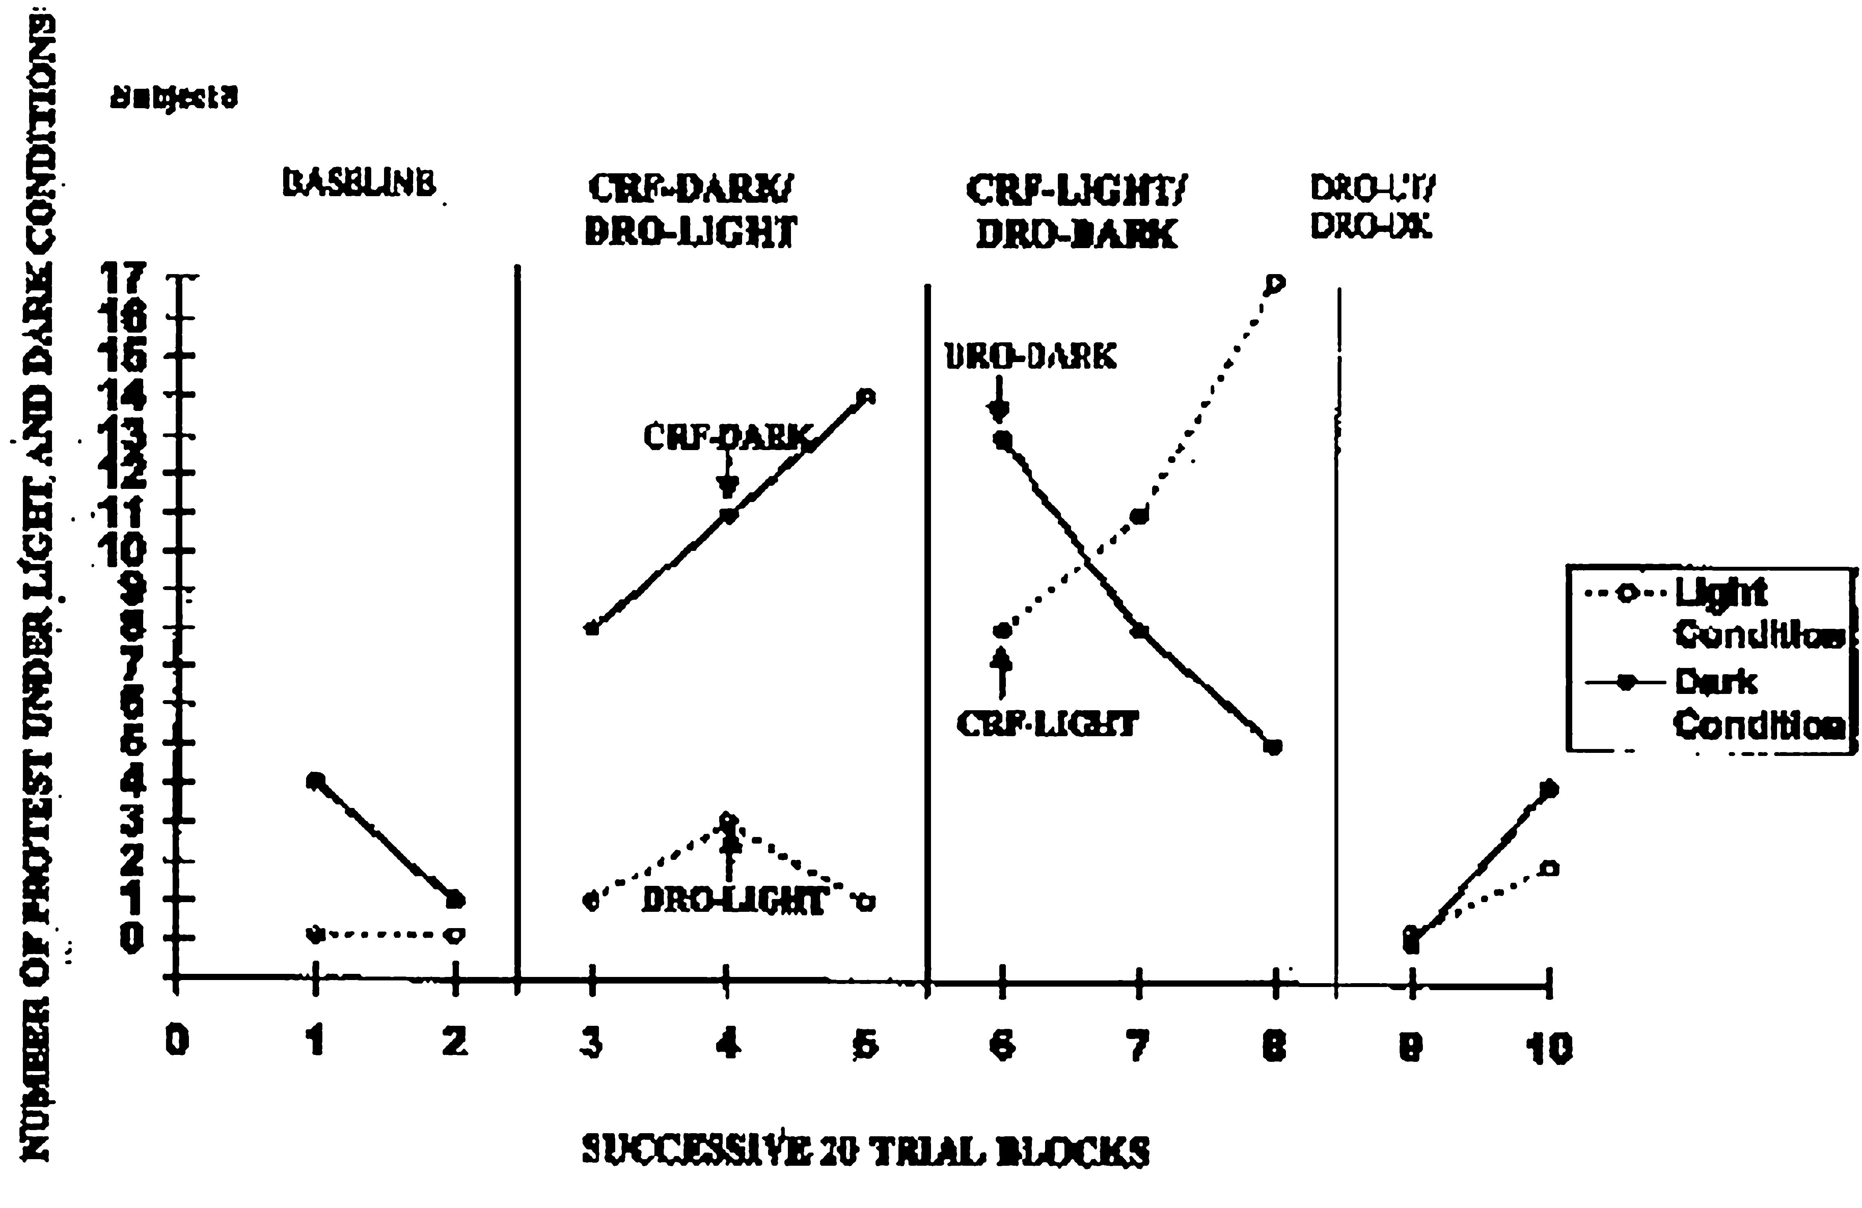
Fear of Dark (GEWIRTZ & PELAEZ-NOGUERAS, 2000)
Notes:
One of the most important factors contributing to the emergence of fears is the caregiver’s behavior contingent on the infant initiations to protests in particular contexts.
Experiment by Aida Sanchez:
Ten 6- to 8-month old infants; they sat in a high chair for 25 minutes a day for 10 to 20 weekdays.
Used a single subject, alternating treatments reversal design with 4 experimental phases.
Baseline (neither class of behaviors targeted).
CRF for protests in light and DRO for non-protests in dark.
CRF for protests in dark and DRO for non-protests in light.
(reversal) elimination of protest both in darkness and light with DRO.
Every one of the 10 infants showed increasing and dramatically greater protest frequencies in the CRF than in the DRO treatment, separately in the light and in the dark conditions. It was demonstrated that fear-denoting protests are as readily conditioned in light as in darkness by contingent maternal attention.
Found no difference in facial expressions for any one of the 10 infants between the light and dark condition

Slide 36
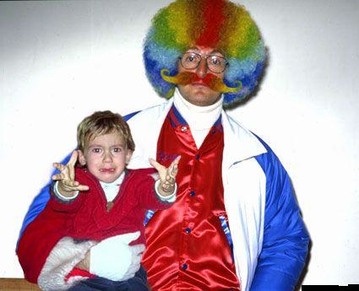
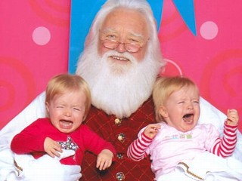
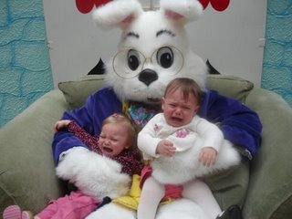
Fear of Strangers
Notes:
WHY ARE SOME CHILDREN AFRAID OF STRANGERS AND OTHERS ARE NOT? WHY WOULD BABIES BE AFRAID OF NEW PEOPLE?
Fear of Strangers
Not all children show fear-of-strangers response, nor do all researchers conceive that fear is related to age or developmental level.
Behaviors denoting the fear of strangers in life setting may be strongly influenced by operant learning process unwittingly provided by maternal behavior.
Stranger anxiety
Development of attachment and cognitive representation of the mother

Slide 37
Fear of Strangers (GEWIRTZ & PELAEZ-NOGUERAS, 2000)
Fear of strangers can also be conditioned
Stranger = S^{d} for interrupted interaction
Many large-scale studies suggest that not all children develop a fear of strangers and that it is not related to age
Looked at the effects of maternal attention contingent upon either approach to a stranger or avoidance of them.
Toddler showed interest in stranger → parent attention
Toddler avoided stranger → parent attention
Infant learned to approach or avoid strangers depending on what what reinforced

Slide 38
Fear of Strangers
Notes:
Six, 8-10month old infants participated in a four-phase, single subject design
Baseline: infant’s initial approach rate to the female stranger in the absence of maternal-provided cues or contingencies
CRF: parent attention contingent on infant approaches to female strangers
DRI: parent attention contingent on the infant avoidance or/withdrawal from the strangers
CRF: parent attention contingent on infant approaches to strangers
Each trial began with the infant on the right side of a playpen, beyond a red line that divided the playpen in two. Mother sat to the side (2-feet away). Stranger approached the infant on repeated trials, on each occasion initiating contact by smiling and talking, when the infant moved in the stranger’s direction across the red dividing line, and approach was scored; when the infant moved away from the stranger, across the red dividing line, or remained beyond the red line; an avoidance response was scored.
SHOWED: each infant learned to approach or avoid the stranger depending on the discriminative and reinforcing stimuli provided by the mother.; fears may be strongly influenced by operant learning processes unwittingly provided by maternal behavior.

Slide 39
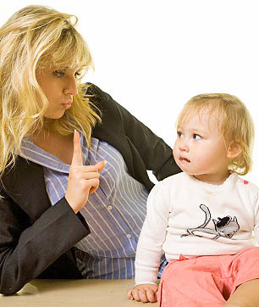
Social Referencing
Social Referencing:
looking at another’s facial, vocal, or bodily expression as a discriminative stimulus for one’s own behavior
In ambiguous or uncertain contexts, maternal expressive facial cues come reliably to predict positive or aversive consequences for the infant’s responses.
1:08 example of social referencing-visual cliff
https://www.youtube.com/watch?v=Y6QtuU1L_A8
EX: stranger approaches, child views face of caretaker, behaves with respect to her facial features
Frowns, baby withdraws; smiles, baby approaches
Smile = S^{r}
Frown = S^{p}
Notes:
Social Referencing
Social Referencing – the looking at another’s facial, vocal, or bodily expression as a discriminative stimulus for one’s own behavior.
Behaviorally, we view social referencing as an example of social knowledge.
Example: if the mother is smiling, the stranger may evoke attention from the child; if the mother is showing concern the stranger may evoke crying from the child.
Social referencing (whether instrumental or affective) can result from the infant’s contingency-based learning.
In ambiguous or uncertain contexts, maternal expressive facial cues come reliably to predict positive or aversive consequences for the infant’s instrumental (reaching) responses.
WHAT MIGHT THIS LOOK LIKE?
WHEN MIGHT WE ENGAGE IN THIS?

Slide 40
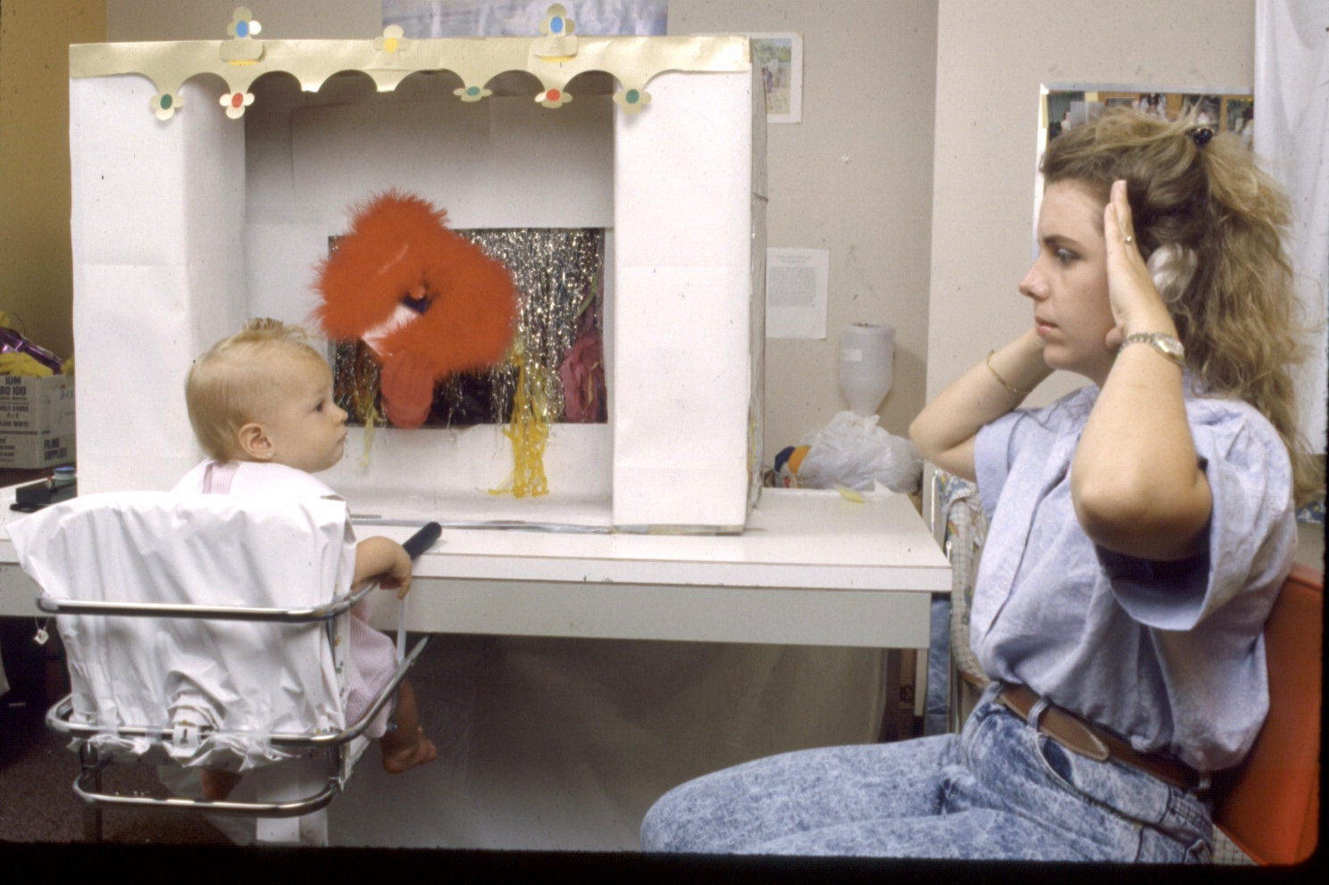
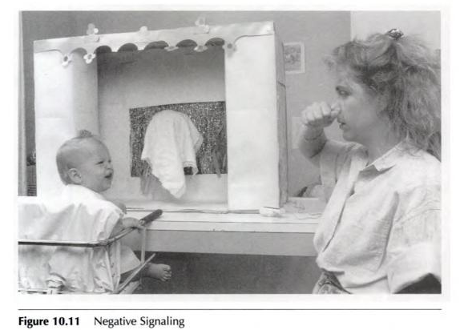
Social Referencing
Conditioning of Meaningless Arbitrary Cues
Gerwirtz & Pelaez-Nogueras (1992c)
Covered object
Positive signal = nice toy
Negative signal = aversive (noise, smell)
After conditioning, babies only reached after referencing the positive signal
Positive Signal
Negative Signal
Notes:
Conditioning of Meaningless Arbitrary Cues
Young children learn to use mother’s cues as a discriminative stimulus for reaching, depending on the consequences that accompanied the given cue.
Top image: Positive signaling
Bottom image: Negative signaling
20 infants from 9 to 12 months
On each trial, a covered, ambiguous object was placed before the child
The mother gave one of two initially neutral cures when the child turned and looked at her
When the child turned back, the object had been uncovered and moved within reach of the child
If the child reached for the object, one of two consequences was delivered, based on the cue
For half the children, the mother’s palms-to-both-cheeks was predictive of a pleasant consequence
- - reaching was followed by a brief musical baby melody and slow movements of the object
For the other half, the fist-to-nose was predictive of an unpleasant consequence, a harsh door buzzer, concrete drill, or food blender sounds accompanied by rapid movements of the object
Found that children use the mother’s cue as a SD for reaching, depending on the consequences that accompanied that cue
Q. WHY WOULD THEY USE “MEANINGLESS ARBITRARY CUES”?

Slide 41
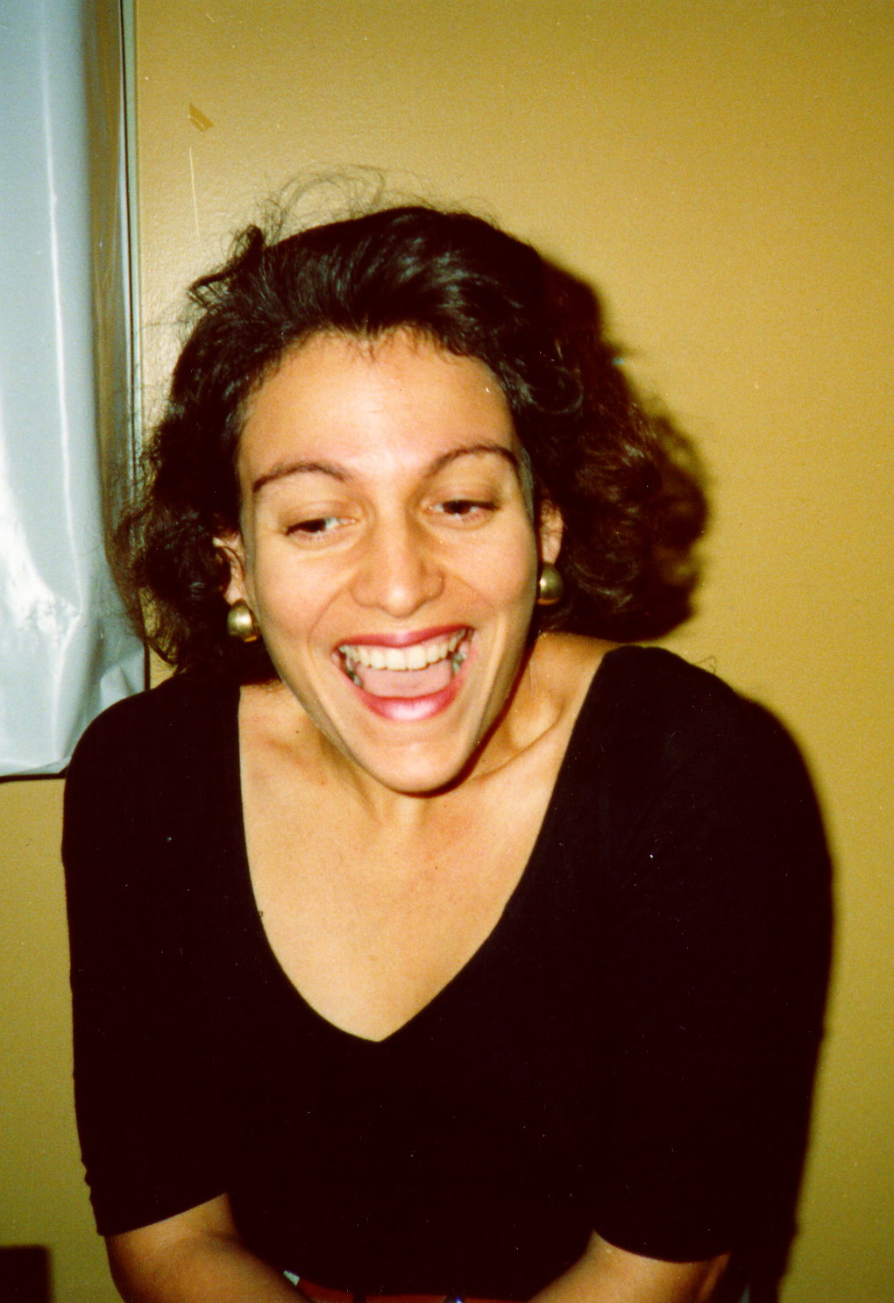
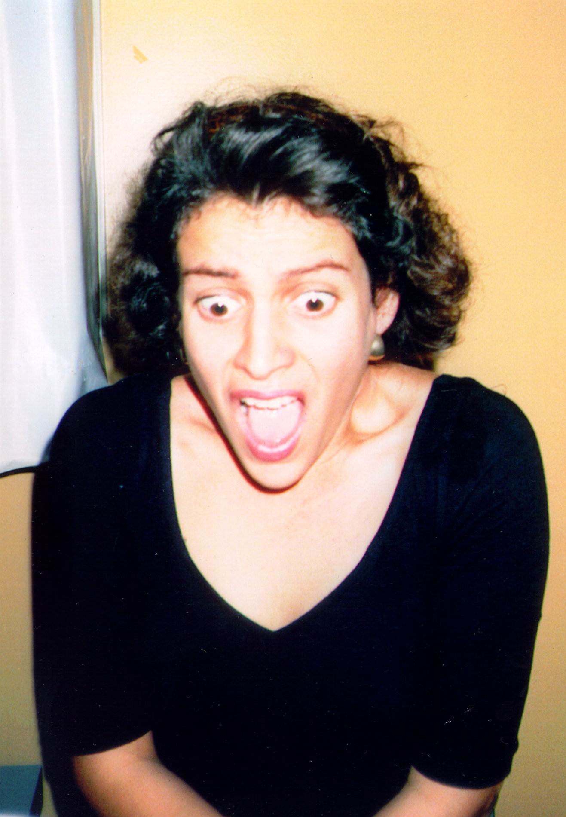
Social Referencing
Facial expressions are the most important cues in natural settings
The child learns that the caregiver’s facial expression of joy or fear becomes reliably associated with specific consequences
Notes:
Conditioning of Joyful and Fearful Originally Meaningful Maternal Cues
Facial expressions are the most important cues in natural settings.
The child learns through operant conditioning that the caregiver’s facial expression of joy or fear becomes reliably associated with specific consequences.

Slide 42
Conditioning of Joyful & Fearful Originally Meaningful Maternal Cues PELAEZ-NOGUERAS (1992a)
Very similar to previous study, but with younger infants (4-5 mo) who did not engage in social referencing
Reinforcing consequence paired with joyful expression
Aversive consequence paired with fearful expression

Slide 43
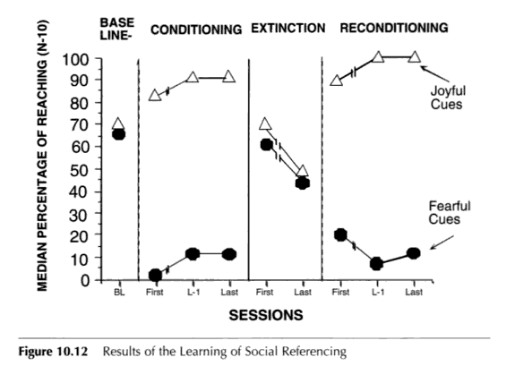
Conditioning of Joyful & Fearful Originally Meaningful Maternal Cues PELAEZ-NOGUERAS (1992a)
Notes:
Wanted to see if maternal joyful and fearful expressions could also function as conditioned cues for infant referencing
18, 4 to 5 month old infants
Pretreatment assessment: found difference in the incidence of infant reaching for ambiguous objects following either maternal joyful or fearful expressions
Conditioning treatment: infants learned to reach for ambiguous objects when reaching was cued by a joyful maternal expression and followed by positive consequences
Learned to avoid ambiguous objects when reaching was cued by fearful maternal expression and followed by extrinsic aversive consequence contingent on their reaching
Extinction
Reconditioning phase: cues recovered their predictive power
ANY ARBITRARY STIMULUS COULD COME TO FUNCTION AS A DISCRIMINATIVE STIMULUS WHOSE FUNCTION IS MUCH LIKE THAT OF THE MOTHER’S FACIAL EXPRESSION IN SOCIAL REFERENCING
CHILD LEARNS THROUGH OPERANT CONDITIONING THAT THE CAREGIVER’S FACIAL EXPRESSION OF JOY OR FEAR BECOMES RELIABLY ASSOICATED WITH SPECIFIC CONSEQUENCES

Slide 44
Social Referencing
One of the first complex social behaviors!
Facial features of others important

Slide 45
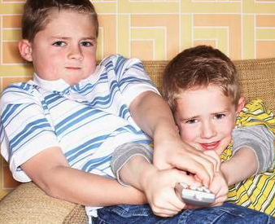
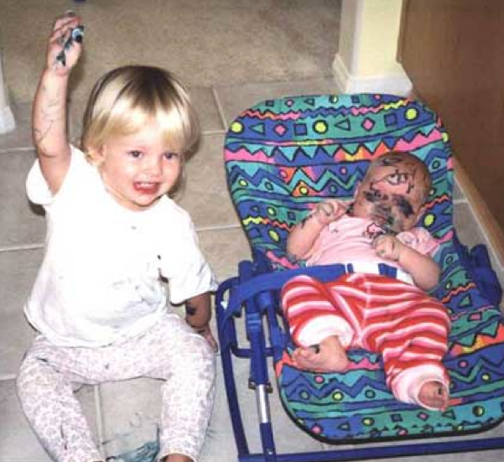
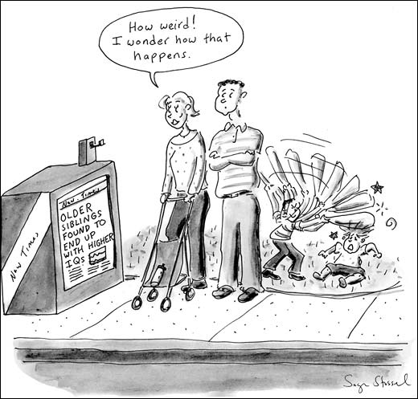
Sibling Rivalry & Jealousy
Cause of sibling rivalry?
Notes:
WHAT IS IT? WHY WOULD VERY YOUNG CHILDREN DISPLAY THIS BEHAVIOR?
Is this an explanation of behavior? (NO! They are descriptive terms!)
e.g., parent on phone and children start fighting

Slide 46
Sibling Rivalry & Jealousy
Usually occurs in triads (two children and father)
Setting event: telephone rings, neighbor at door
No attention for children
“Jealousy” not an explanation, it’s a description
Under what conditions does it occur?
Caregiver attention elsewhere is an S^{d} for “jealous” behavior
Crying, whining, fussing, hitting, proximity seeking, frowning, pouting, blocking sibling = functional class of “jealous” behaviors
Caregiver falls victim to contingencies of negative reinforcement
Make it stop!
Jealous behavior more likely
Notes:
Sibling Rivalry & Jealousy
A further problem with the jealous behavior is that the rival observes the reinforcing consequences received by the other child, which makes the second child more likely to imitate jealous behavior as well. THIS OCCURS IN TRIADS (two children and a parent - - usually)
Jealousy, as a social behavior, as a class of operants reinforced by dynamical interactions in the family system rather than as individual traits.
Regardless of topography, the functional class of jealous responses is aversive to the mother, she is negatively reinforced for attending to them because when she does, the aversive jealous behavior stops. At the same time, mother’s attention positively reinforces that child’s jealous behaviors
The rival can engage in observational learning (HOW?) - - observes the reinforcing consequences received by the other child, which makes the second child more likely to imitate jealous behavior as well
HOW CAN SIBLING RIVALRY BE STOPPED? (DRO, ….)

Slide 47
Sibling Rivalry & Jealousy
Roth & Gerwitz (1995)
Three sets of twins and their mothers (triad)
CRF for jealous behavior
DRO for non-jealous behavior
Then switched kids
MUCH more jealous behavior for twin that was reinforced for it, relatively none for other twin
Shaped up longer and longer periods of non-jealous behavior throughout the study
Observational learning important here too. One sibling views the jealous behavior of a sibling be reinforced, they imitate the action too
Notes:
Sibling Rivalry & Jealousy
A further problem with the jealous behavior is that the rival observes the reinforcing consequences received by the other child, which makes the second child more likely to imitate jealous behavior as well. THIS OCCURS IN TRIADS (two children and a parent - - usually)
Jealousy, as a social behavior, as a class of operants reinforced by dynamical interactions in the family system rather than as individual traits.
Regardless of topography, the functional class of jealous responses is aversive to the mother, she is negatively reinforced for attending to them because when she does, the aversive jealous behavior stops. At the same time, mother’s attention positively reinforces that child’s jealous behaviors
The rival can engage in observational learning (HOW?) - - observes the reinforcing consequences received by the other child, which makes the second child more likely to imitate jealous behavior as well
HOW CAN SIBLING RIVALRY BE STOPPED? (DRO, ….)

Slide 48
Social Cognition & Environment
Social Cognition – development of social knowledge and reasoning (thinking and behaving) (Shantz, 1983)
Social Knowledge - knowing about things in social situations.
Know about Halloween and wear a costume, know about baseball and bring a bat
Social Abilities – knowing how do do things of a social nature
Initiate conversations, pretend play
Social Problem Solving – manipulations of public and private behavior to produce solutions to social problems
Turn taking, sharing, backing down, bullying
Notes:
Social Cognition – development of social knowledge and reasoning (Shantz, 1983)
It focuses on “understanding the relationship between social behavior and cognitive development, between thinking and behaving, between social and nonsocial knowing”
Three aspects of social cognition:
Social Knowledge – knowing about things in social situations.
Social Abilities – knowing how to do things of a social nature.
Social Problem Solving – manipulations of public and private events (i.e. thoughts) to produce solutions to social problems.
Social cognition is treated in the same way as other cognitive behavior.

Slide 49
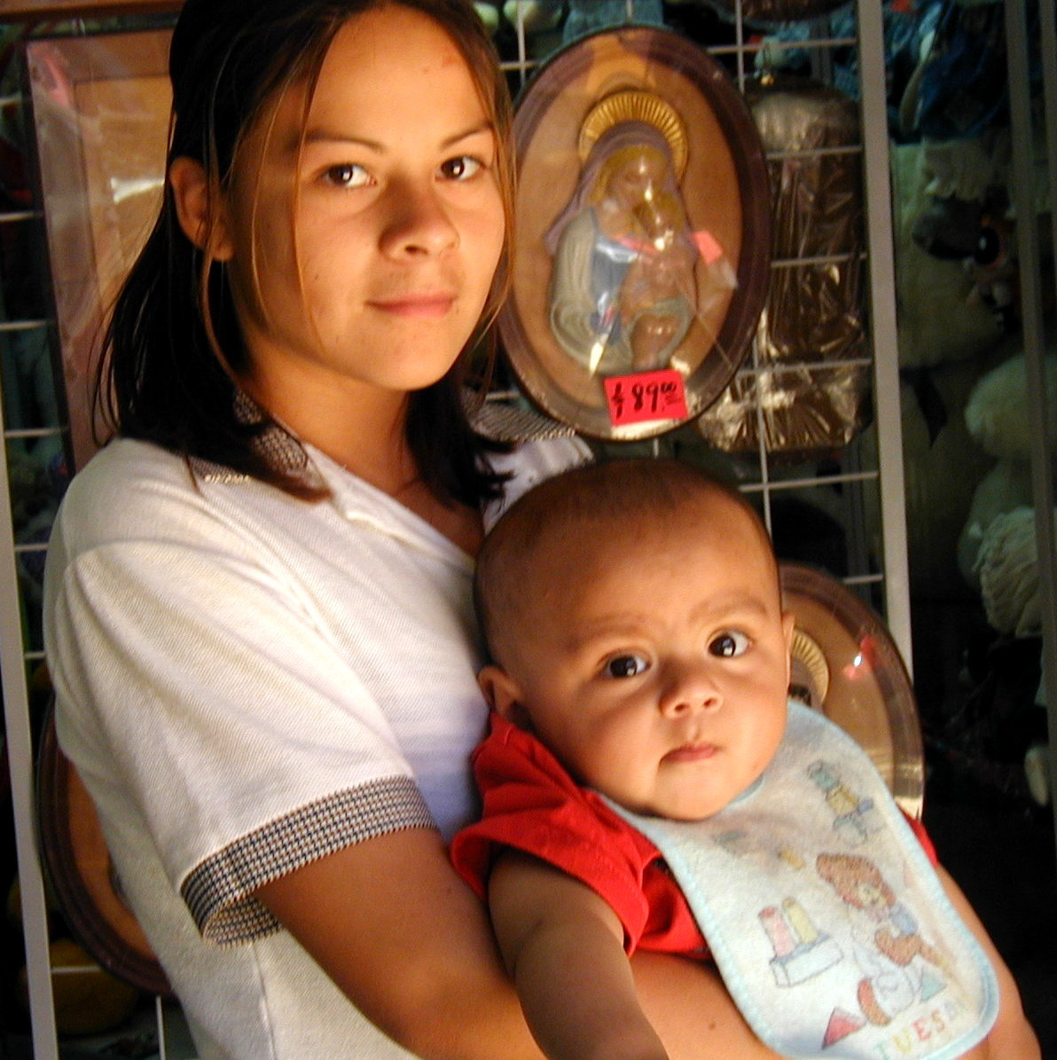
Carrying Positions Affect Infant Social Behavior
Child: Facing Inward
More sleeping time
Rarely awake
Child: Facing Outward
More active (arm/leg movements
Attend to more env. stimuli
Notes:
What else affects social behavior?
Carrying Position Affects Infant Behavior
Q. WHICH ONE’s BEST? ADVANTAGES TO EACH?
Infants carried inward→ more time sleeping and were rarely actively awake.
Infants carried outward→ more active, moved their arms and legs more, turned their heads to look at the environment.
Fathers typically hold their infants outward.

Slide 50
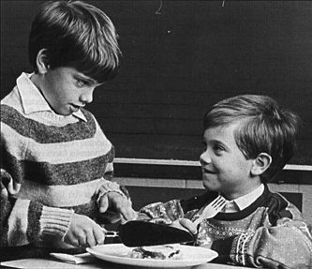
Prosocial Behaviors in Early Childhood (that lead to prosocial behavior in adolescence):
Prosocial behaviors:
cooperation
emphatic responses
sharing
honesty
justice
loyalty
conscience
Altruism
How Achieved?
Modeling/imitation
Reinforcement
Notes:
How do prosocial behaviors develop?
Prosocial behaviors: cooperation, emphatic responses , sharing, honesty, justice, loyalty, conscience and altruism are fostered very early in development.
Behaviors can be fostered through modeling; All imitative behaviors then would become part of the individual’s repertoire of moral and immoral behaviors.
Empathy establishes after social referencing has been acquired. The development of empathy is seen as multifaceted and relates to referencing and interpreting the emotional signals of others.

Slide 51
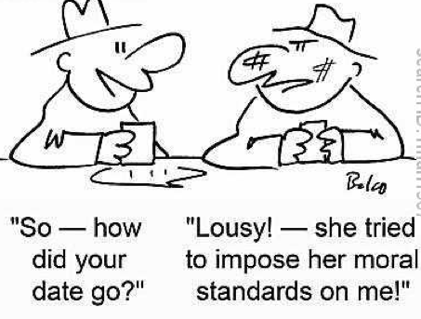
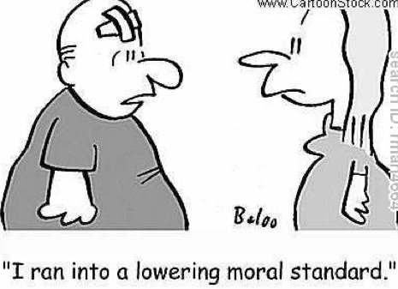
Moral Development

Slide 52
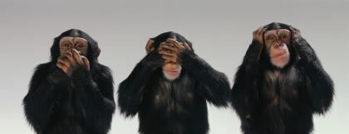
Moral Development
Two main approaches to moral development :
The behavior-analytic approach
Interaction
Kohlberg’s cognitive-developmental approach
Stages
Notes:
Kohlbreg proposed that the child’s rule-governed behavior, and the complexity of his/her moral repertoire depends on the child’s being at a certain stage of moral development. Level of moral reasoning was determined based on the level of moral reasoning children (or adults) displayed while responding to hypothetical dilemmas.

Slide 53
Morality: Behavior-Analytic Approach
An increasingly sophisticated repertoire of behaviors to further one’s long-term interests based on predicted outcomes.
Perspective taking!
An organized system of rule governed behavior that controls behavior patterns that society considers “moral”.
Sometimes goes against the best interest of the person. Rules are so important to moral bx.
Develops from the interaction of the child and environment in active interaction.
Context crucial (think different culture’s morality!)
Notes:
The history of interactions is crucial in analyzing moral development. The unique history of contingencies for each person results in individual differences in moral behavior patterns and in the development of the rules governing moral behavior. - - RULE GOVERNED BEHAVIOR; these rules come to acquire discriminative control over the individuals’ moral behavior
Does not view the child as a passive organism who does not contribute to his or her own development; the external forces applied to the child are seen as the only causes for behavior.
WHY WOULD CONTEXT BE CRUCIAL? (E.G., SETTING EVENT)
cooperation
emphatic responses
sharing
honesty
justice
loyalty
conscience
altruism

Slide 54
A Cognitive View of Morality: Kohlberg’s Theory
Moral Reasoning – maturity and stages
Based on hypothetic dilemmas (only males)
Level I – Preconventional Morality
Stage 1) Tangible consequences
Stage 2) Hedonistic get rewards/avoid punishment
Level II - Conventional Morality
Stage 3) Follows rules to get social approval
Stage 4) Follow conventional rules to support social order
Level III – Postconventional Morality
Stage 5) Have a social contract to do what is right
Stage 6) Universal principles of justice, democracy, etc.
Notes:
Kohlberg proposed that the child’s rule-governed behavior, and the pattern, quality, and extensiveness of his or her moral repertoire, depends on the child’s being “mature” or being at a higher or lower stage of moral development.
The levels of moral reasoning have to do with an experiment in which children and adults were interviewed using hypothetical moral dilemmas in which there was no clear right or wrong answer. Answers were scored according to level of complexity of moral reasoning they displayed.
Preconventional Morality – judgments are based on punitive and pleasurable consequences.
Conventional Morality – based on the child’s desire to gain approval (good boy/girl) or follow laws and social rules that maintain the social order.
Postconventional Morality – based on social contracts and the idea of democracy; universal principles of ethics such as justice and fairness.

Slide 55
Kohlberg’s Theory
2:59 Interactive Video Example of Kohlberg's Morality Theory
https://www.youtube.com/watch?v=YxJ07klMhr0

Slide 56
Kohlberg & Behavioral Systems
Differences:
Absolutistic v. relativistic
Universal v. contextual
Schemes (in → out) v. person-environment interaction
Can you think of any ways that morality changes based on culture?
Circumstance?
SO CLOSE to moral breakdown!
Notes:
Donner party
Hunger in WW2
Riots after sports events
Riots in other countries

Slide 57
Why Important?
Immoral or illegal behaviors harm society
Moral and ethical behaviors are crucial to cultural survival
Vested interest to teach people to anticipate the effects of their behavior and provide rules about consequences
Legal system designed for this purpose
History of moral behavior begins in childhood
Perspective taking
Theory of mind
Rule following
Behavioral history
Notes:
Direct contingency-shaped behavior is shaped directly by its consequences
Rule-governed behavior is responding to discriminative stimuli (like verbal stimuli) that is shaped by rule-following reinforcement, and can be modified by altering its antecedents, its consequences, or both
Rules specify the contingencies of reinforcement and punishment.
Rule-governed behavior is reinforced (at least intermittently) through reinforcement or punishment.
Since direct contingency-shaped behavior can be a slow and costly way to learn the contingencies of reinforcement, rule-governed behavior is an alternative that can insulate the child from the adverse consequences that the former can produce.
Through rule-governed behavior, the child learns to respond differentially to proximal or immediate consequences as opposed to remote, indirect, or delayed consequences for following or not following rules.
Q. WHO MAKES RULES? (PARENTS, SCHOOL, GOVERNMENT, RELIGIOUS INSTITUTIONS, PEERS, NATURE - - PHYSICS)

Slide 58
Contingency-Shaped vs. Rule-governed behavior
Direct contingency-shaped behavior
Shaped by consequences
Rule-governed behavior
Learn to follow simple rules in childhood (reinforcement and punishment available for following/not following rules) and then you get generalization of rule following behavior
Rules specify contingencies
Rules offer an alternative to direct contingency shaped behavior
Proximal or immediate consequences as opposed to remote, indirect, or delayed consequences
Notes:
Direct contingency-shaped behavior is shaped directly by its consequences
Rule-governed behavior is responding to discriminative stimuli (like verbal stimuli) that is shaped by rule-following reinforcement, and can be modified by altering its antecedents, its consequences, or both
Rules specify the contingencies of reinforcement and punishment.
Rule-governed behavior is reinforced (at least intermittently) through reinforcement or punishment.
Since direct contingency-shaped behavior can be a slow and costly way to learn the contingencies of reinforcement, rule-governed behavior is an alternative that can insulate the child from the adverse consequences that the former can produce.
Through rule-governed behavior, the child learns to respond differentially to proximal or immediate consequences as opposed to remote, indirect, or delayed consequences for following or not following rules.
Q. WHO MAKES RULES? (PARENTS, SCHOOL, GOVERNMENT, RELIGIOUS INSTITUTIONS, PEERS, NATURE - - PHYSICS)

Slide 59
Contingency-Shaped vs. Rule-governed behavior
Rule-Governed | Contingency-Governed
Studying grammar to speak a second language | Learning to speak a second language by just doing it
Learning to use your iPad by reading the instructions | Learning to use your iPad by playing around with it
Learning to drive a stick shift by following Dad’s instructions | Learning to drive a stick shift by just doing it
Learning not to touch a hot stove because your mother told you not to | Learning not to touch a stove because you’ve been burned
Notes:
Direct contingency-shaped behavior is shaped directly by its consequences
Rule-governed behavior is responding to discriminative stimuli (like verbal stimuli) that is shaped by rule-following reinforcement, and can be modified by altering its antecedents, its consequences, or both
Rules specify the contingencies of reinforcement and punishment.
Rule-governed behavior is reinforced (at least intermittently) through reinforcement or punishment.
Since direct contingency-shaped behavior can be a slow and costly way to learn the contingencies of reinforcement, rule-governed behavior is an alternative that can insulate the child from the adverse consequences that the former can produce.
Through rule-governed behavior, the child learns to respond differentially to proximal or immediate consequences as opposed to remote, indirect, or delayed consequences for following or not following rules.
Q. WHO MAKES RULES? (PARENTS, SCHOOL, GOVERNMENT, RELIGIOUS INSTITUTIONS, PEERS, NATURE - - PHYSICS)

Slide 60
Why is this important to social/moral behavior?
Can you imagine if all behavior was contingency-shaped?
Animals
Lifetime not long enough to learn social behavior
Rule governance is the vehicle of cultural norms, values, etc.
Delayed consequences
Justice system, smoking, drinking, unsafe sex
Makes impossible or very delayed consequences real for us
Religion
Terrorism

Slide 61
How are the rules acquired/followed?
Two styles of rule following:
Tracking
People that track, are sensitive to the environmental contingencies that are in place. Rule following puts them on the right track, then they modify based on the actual contingencies in effect.
Pliance
People that respond based on compliance learn to comply with the behavior specified by the rules, even if the rules do not accurately specify the contingencies in effect
Kohlberg?
Notes:
Rules are acquired through basic imitation first, and then through generalized imitation of role models.
Rule generalization is a process of transference of rules across settings, individuals, and circumstances.
Zettle and Hayes identified two styles of responding based on the relationship between rules and contingencies.
Track: People that track, are sensitive to the environmental contingencies that are in place. Rule following puts them on the right track, then they track the actual contingencies in effect.
Compliance: People that respond based on compliance learn to comply with the behavior specified by the rules, even if the rules do not accurately specify the contingencies in effect.

Slide 62
Pelaez and Moreno’s Taxonomy of rules
How likely to follow?
Based on four dimensions
Explicitness
Riddle v. “Your shoes under couch”
Accuracy
“Don’t study get A” v. “Study get A”
Complexity
One or multi-step
The source of the rule
Other people v. generated by own experiences
Children need explicit, accurate, and simple rules that are followed consistently with specified consequences → generalized rule following → adults that follow implicit, complex, and self-generated rules
Notes:
This taxonomy takes into account dimensions of the entire contingency arrangement
Explicitness:
Explicit rules verbally describe the entire three-term contingency arrangement.
Implicit rules only imply the components of the three-term contingency.
Accuracy:
Accurate rules describe contingencies that when followed, match certain event-consequence relationships in the environment.
Inaccurate rules describe contingencies that don not correspond ti those encountered in the environment.
Complexity:
High complexity rules specify a complex relational network that specifies more than one contingency.
Low complexity rules describe no contingency, no conditions under which there are exceptions.
The source of the rule:
Rules provide by others are rules that the speaker (not the listener) specifies the criterion for the listener’s behavior.
Self-provided rules mean that the speaker and the listener is the same person. The probability that the child will behave according to a rule would depend on these dimensions, and on the context in which the rule is provided, the child’s developmental level, and the child’s learning history with that or other similar rules.

Slide 63
Development of rule-governed behavior
Riegler and Baer’s analysis consists of five steps:
Compliance
Do as I say
Generalized compliance
Follow nearly all instructions
Discrimination
Understand which rules to follow
Self Instruction
Self-generated rules in same situations
Generalized self instruction
Rules used in new settings; “No, I really shouldn’t”
Moral behavior best once generalized self-instruction occurs
Notes:
Early on, parents provide stimuli for compliance, the child follows these requests (or rules), and the parent is likely to reinforce compliance of the requests,
The rules function as instructions, they become discriminative stimuli because they specify what responses will produce reinforcing, and the result is that the child will engage in generalized compliance. He/she will follow nearly all instructions because of his/her history of reinforcement with responding to other members of the same instructional stimulus class, and it will be maintained as long as there is a correspondence between the rules, behavior and consequences,
Compliance generalizes to other aspects of the child’s environment, like following the rules of others other than the parents in the same manner, and he/she learns to discriminate those whose rules lead to reinforcement and those whose rules do not,
The child generates his/her own rules from imitating the rule-giving behavior of adults, and develops self-instruction
The use of self-instructions generalizes so that the instructions can be used in novel situations.

