Slide 1
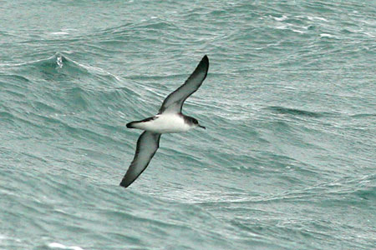
Animal Navigation

Slide 2
?
?
?
?
Point toward your home

Slide 3
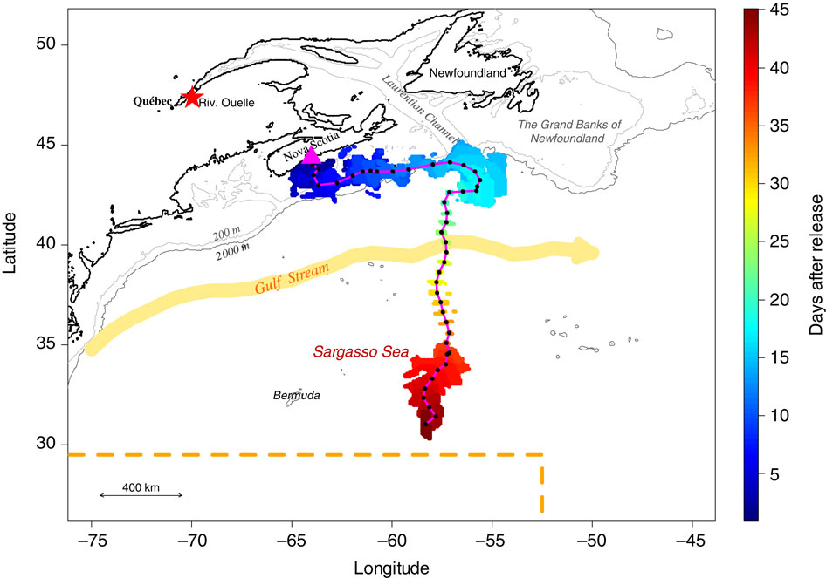
Béguer-Pon M. et al. (2015) Direct observations of American eels migrating across the continental shelf to the Sargasso Sea.
Nature Communications 6, 8705
The red star represents the capture location of this eel in the SLE while it was performing its downstream migration. The magenta triangle represents the release location after tagging. The black dots are the mean reconstructed daily locations and the magenta line is the corresponding mean trajectory. A colour gradient is used to show the temporal dimension of the reconstructed trajectory (each day is represented by a colour). The range of potential daily locations is lowest for days 19–33.

Slide 4
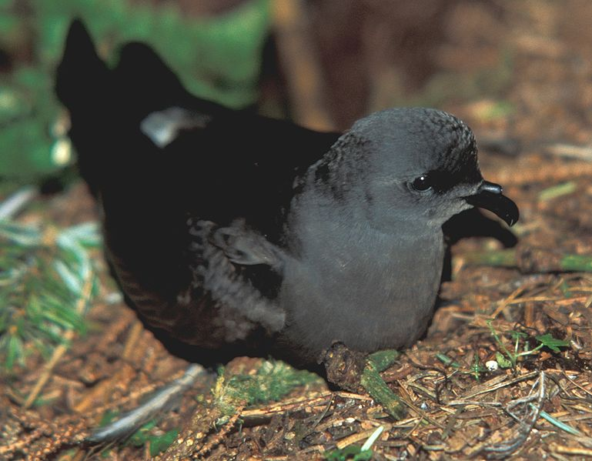
Leach’s Storm Petrel
Early displacement experiments

Slide 5
?
?
?
?

Slide 9
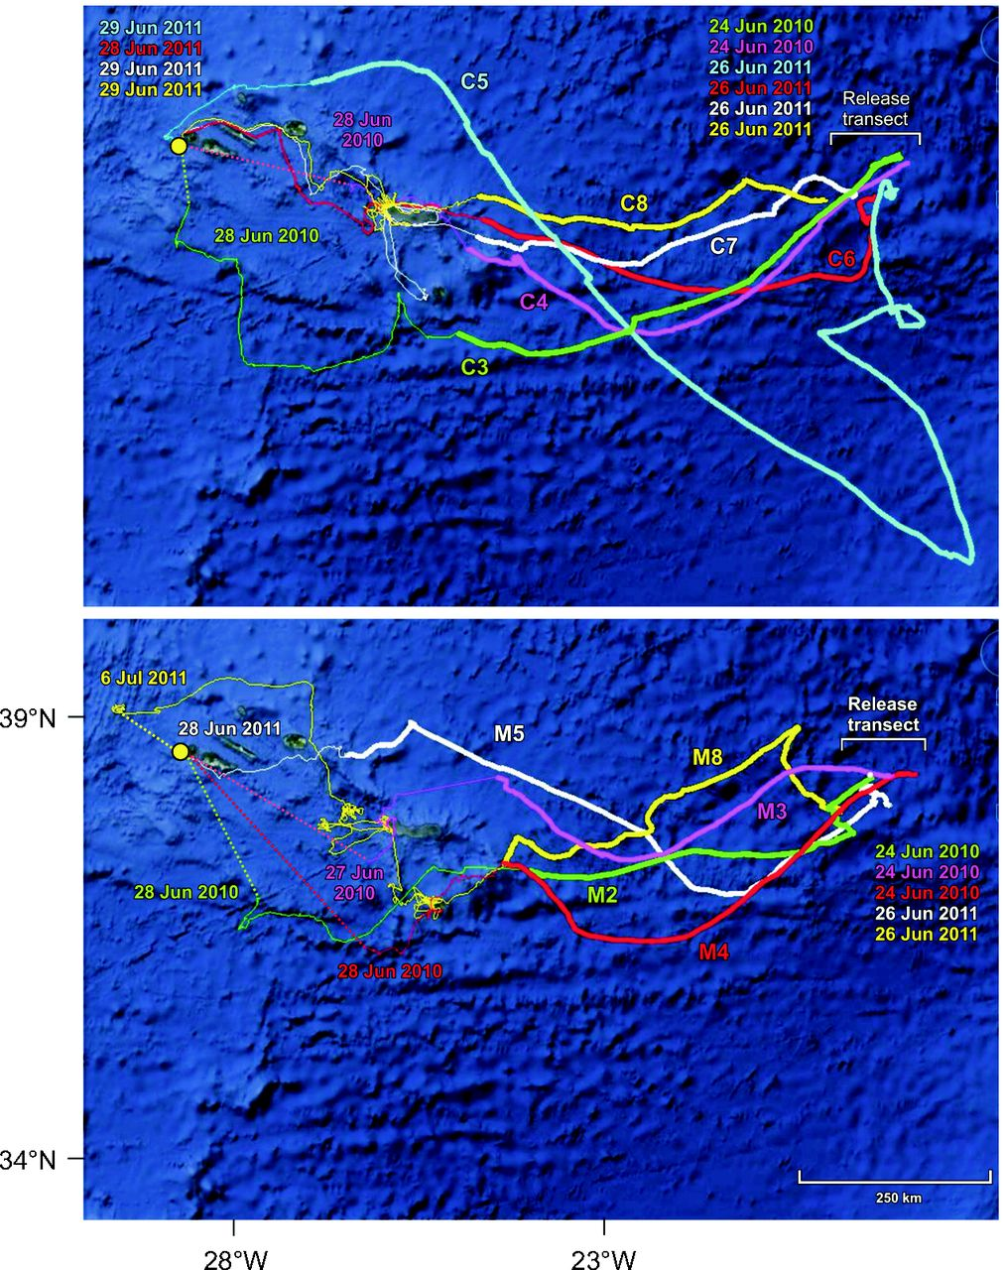
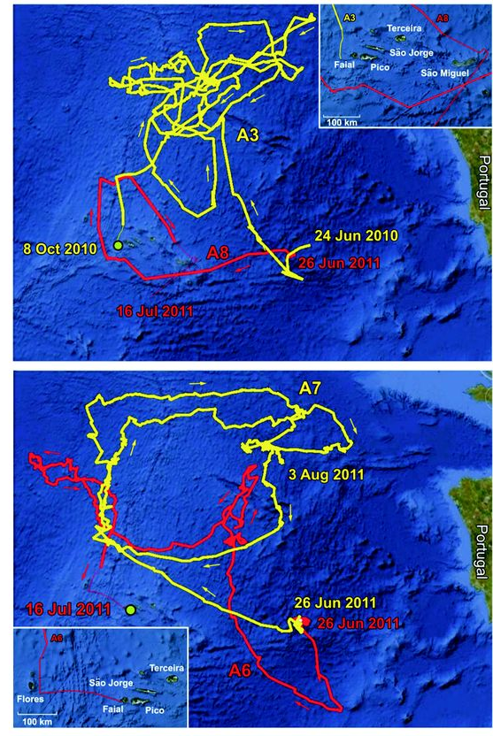
Homing paths of Cory’s Shearwaters
unmanipulated control birds
anosmic birds
birds with magnets
anosmic birds
Gagliardo A et al. J Exp Biol 2013; 216:2798-2805
Notes:
The yellow circle indicates the home colony. For birds that homed but were not tracked as far as the home island, broken lines link the last location obtained and the colony. Thick lines represent the oceanic journey; thin lines represent the track recorded after the bird got closer than 50 km to any one of the islands of the Azores Archipelago. For each bird, colour-coded dates of release and of the last fix recorded are reported.

Slide 10
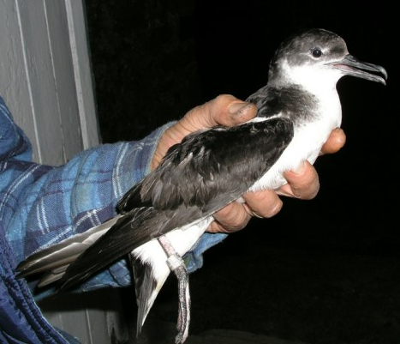
Manx Shearwater

Slide 11
3200 miles
in 12 days
(250 mi/day)
Manx Shearwater

Slide 12
Small birds
feed by day and migrate at night

Slide 13
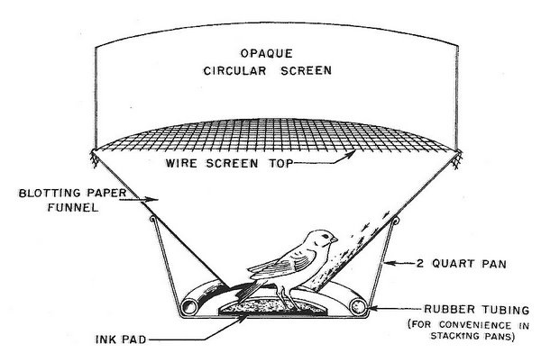
Small birds
feed by day and migrate at night

Slide 14
Small birds
feed by day and migrate at night

Slide 15
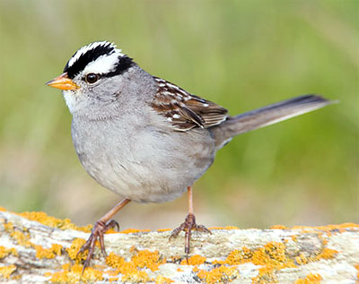
White-crowned Sparrow
Notes:
(B) White-crowned sparrows displaced from Seattle, WA, USA, to Princeton, NJ, USA. The map to the left shows the displacement and breeding area (green), wintering area (cyan) and normal migration route (blue) as well as possible migration routes [red arrows: (1) normal migration direction, (2) toward normal winter grounds and (3) toward capture site] after release at New Jersey. The circle to the right shows the directions with the mean and confidence interval indicated in which adults (blue) and juveniles (red) flew after being released in New Jersey. Adults flew in the direction toward their normal wintering grounds whereas juveniles continued in their normal migration direction. After Thorup et al. (Thorup et al., 2007). (C) Reed warblers displaced from Rybachi to Zvenigorod, Russia. The map to the left shows the displacement and possible orientation responses after displacement [dotted arrows: (1) normal migration direction, (2) toward normal breeding grounds and (3) toward capture site]. The circles to the right show the observed orientation with mean and confidence interval indicated before (upper) and after (lower) displacement. The birds clearly correct for the eastward displacement and turn their orientation to the west. Reprinted from Chernetsov et al. (Chernetsov et al., 2008) with permission from Elsevier.

Slide 16
White-crowned Sparrow
ADULTS
JUVENILES
Notes:
(B) White-crowned sparrows displaced from Seattle, WA, USA, to Princeton, NJ, USA. The map to the left shows the displacement and breeding area (green), wintering area (cyan) and normal migration route (blue) as well as possible migration routes [red arrows: (1) normal migration direction, (2) toward normal winter grounds and (3) toward capture site] after release at New Jersey. The circle to the right shows the directions with the mean and confidence interval indicated in which adults (blue) and juveniles (red) flew after being released in New Jersey. Adults flew in the direction toward their normal wintering grounds whereas juveniles continued in their normal migration direction. After Thorup et al. (Thorup et al., 2007). (C) Reed warblers displaced from Rybachi to Zvenigorod, Russia. The map to the left shows the displacement and possible orientation responses after displacement [dotted arrows: (1) normal migration direction, (2) toward normal breeding grounds and (3) toward capture site]. The circles to the right show the observed orientation with mean and confidence interval indicated before (upper) and after (lower) displacement. The birds clearly correct for the eastward displacement and turn their orientation to the west. Reprinted from Chernetsov et al. (Chernetsov et al., 2008) with permission from Elsevier.

Slide 17
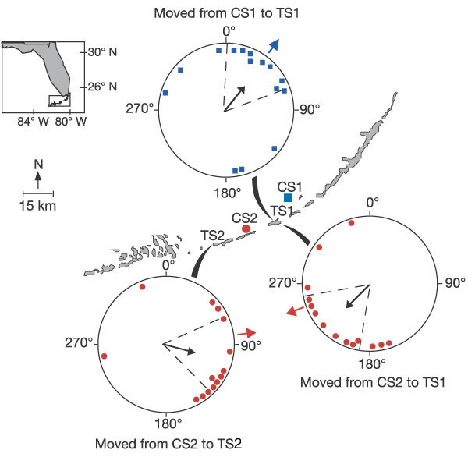
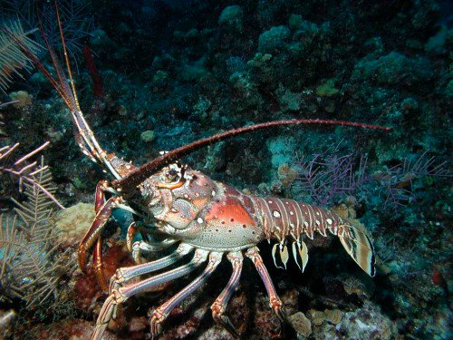

Slide 18
spiny lobsters walk home

Slide 19
spiny lobsters walk home

Slide 20
spiny lobsters walk home

Slide 21
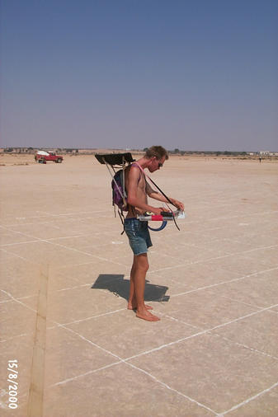
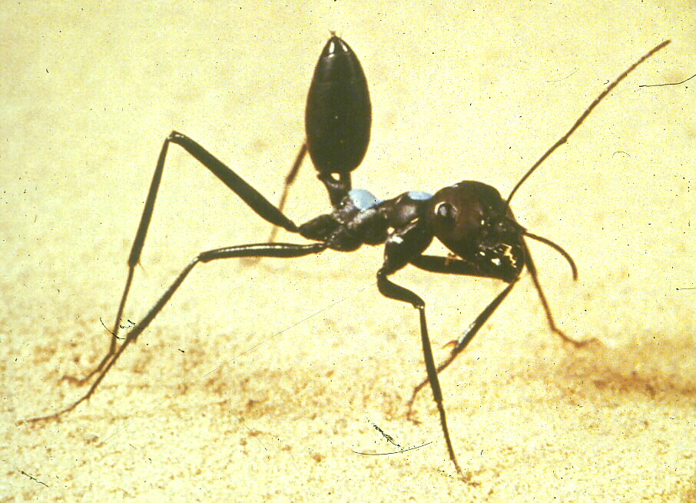
How about
Cataglyphys
desert ants ?

Slide 22
∂

Slide 23
∂

Slide 24
Dancing with the stars
Are we better than ants?
Notes:
Orientation after displacement
Try with Vannak or Gray

Slide 25
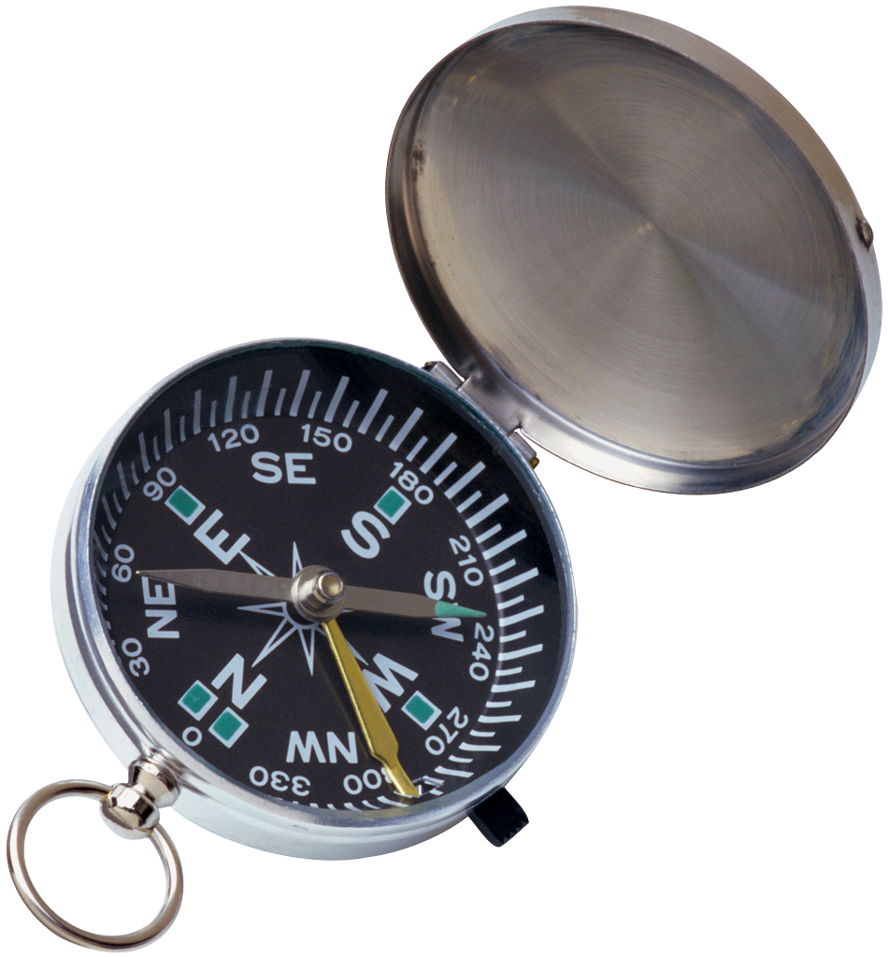
Animals have compasses

Slide 26
Outdoors

Slide 27
No stars

Slide 28
Planetarium

Slide 29
Planetarium
(no motion)

Slide 30
Planetarium
Planetarium
Reversed
Planetarium
Planetarium
Reversed

Slide 31
Planetarium
star donut

Slide 32
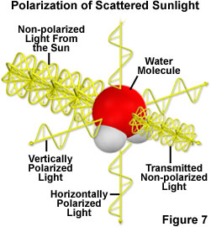
Notes:
Light striking atoms and molecules in the atmosphere is unpolarized if it keeps traveling in the same direction and is polarized if it scatters in a perpendicular direction (either vertically or horizontally) (From: http://www.microscopyu.com/articles/polarized/polarizedlightintro.html
Seems everyone sees polarized light except us: insects, fish, birds…

Slide 33
sun’s location
behind clouds
Polarized light at sunset
on a cloudy day

Slide 34
sun’s location
behind clouds
Polarized light at sunset
on a cloudy day
Notes:
Umbrella demo

Slide 35
(yes – with “sky stones”)

Slide 36
Homing pigeons can find home
without seeing the sun
HOME
LOFT
Vanishing bearings
on an overcast day

Slide 37
Magnetic Coil
HOME
LOFT
HOME
LOFT
Sunny day
Overcast day
on an overcast day,
MAGNETISM matters!

Slide 38
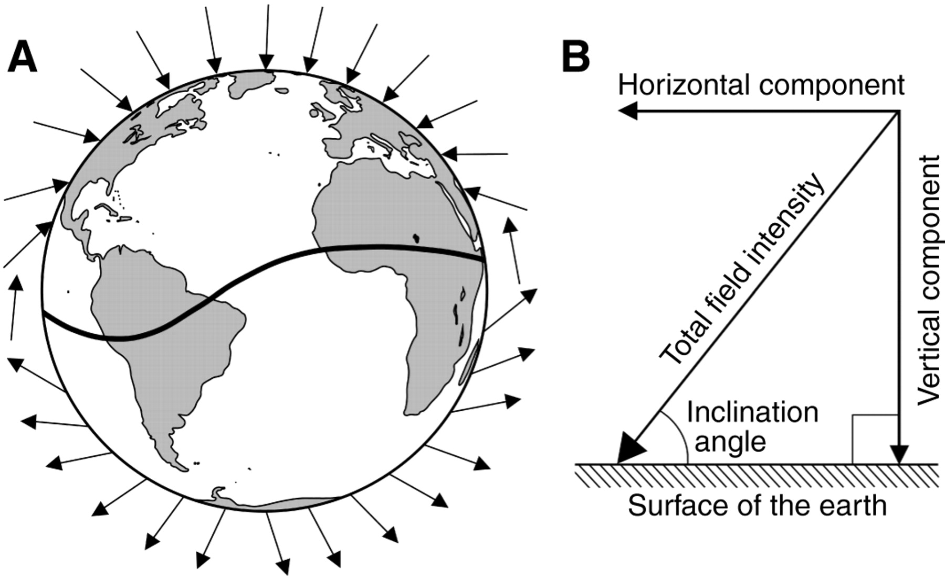
Understanding the Earth’s magnetic field
(azimuth compass)
Notes:
(A) Diagrammatic representation of the Earth's magnetic field illustrating how field lines (represented by arrows) intersect the Earth's surface, and how inclination angle (the angle formed between the field lines and the Earth) varies with latitude. At the magnetic equator (the curving line across the Earth), field lines are parallel to the Earth's surface. The field lines become progressively steeper as one travels north toward the magnetic pole, where the field lines are directed straight down into the Earth and the inclination angle is 90°. (B) Diagram illustrating four elements of geomagnetic field vectors that might, in principle, provide animals with positional information. The field present at each location on Earth can be described in terms of a total field intensity and an inclination angle. The total intensity of the field can be resolved into two vector components: the horizontal field intensity and the vertical field intensity. (Whether animals are able to resolve the total field into vector components, however, is not known.)‏

Slide 39
Animals sense the “dip” angle…
maximum dip = North
(azimuth compass)
Notes:
(A) Diagrammatic representation of the Earth's magnetic field illustrating how field lines (represented by arrows) intersect the Earth's surface, and how inclination angle (the angle formed between the field lines and the Earth) varies with latitude. At the magnetic equator (the curving line across the Earth), field lines are parallel to the Earth's surface. The field lines become progressively steeper as one travels north toward the magnetic pole, where the field lines are directed straight down into the Earth and the inclination angle is 90°. (B) Diagram illustrating four elements of geomagnetic field vectors that might, in principle, provide animals with positional information. The field present at each location on Earth can be described in terms of a total field intensity and an inclination angle. The total intensity of the field can be resolved into two vector components: the horizontal field intensity and the vertical field intensity. (Whether animals are able to resolve the total field into vector components, however, is not known.)‏

Slide 40
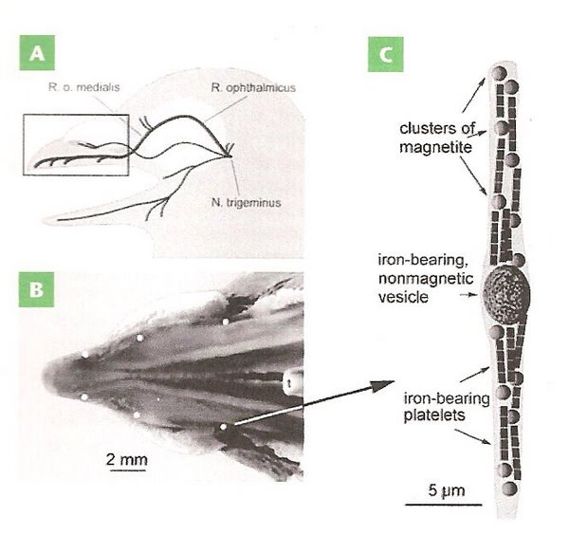
Magnetite-coupled nerves in beaks of pigeons
Notes:
Figure 17. Magnetoreceptors in the bill of a homing pigeon. (A) Pigeon head showing location of nerves in the upper beak thought to play a role in magnetoreception. (B) The upper beaked viewed from below showing the location (the six white spots) of iron oxide particles. (C) Diagram of the end of a neuron (dendrite) containing a non-magnetic vesicle, several clusters of magnetite crystals, and chains of iron-bearing platelets (From: Pósafi and Dunin-Borkowski 2009)

Slide 41
1) Knock out the
magneto-receptive
neurons

Slide 42
1) Knock out the
magneto-receptive
neurons
2) See how they orient

Slide 43
1) Knock out the
magneto-receptive
neurons
2) See how they orient

Slide 44
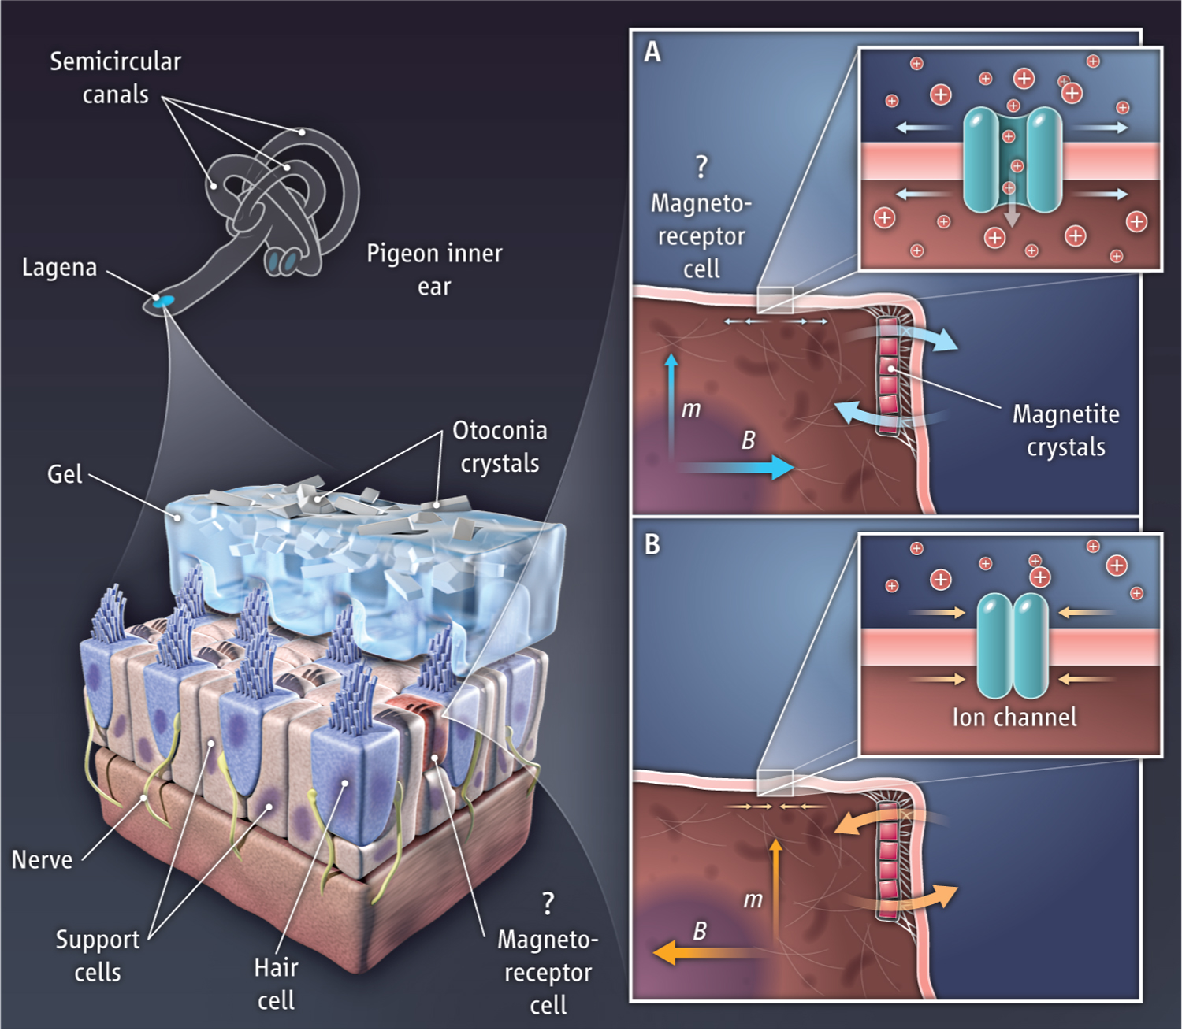
Magnetoreception.The lagena in the inner ear is a candidate site of the magnetic sensory organ in the pigeon.
M Winklhofer Science 2012;336:991-992
Published by AAAS
Notes:
Magnetoreception.The lagena in the inner ear is a candidate site of the magnetic sensory organ in the pigeon. (Left) Schematic view of the lagena otolith composed of a gelatinous membrane loaded with otoconia crystals; vestibular hair cells, with attached nerve fibers; supporting cells; and a hypothetical magnetoreceptor cell. (Right) A chain of magnetite crystals acting as a permanent magnet (with dipole moment m indicated by arrow) is the key component in a transduction model in which ion channels gate the inflow of extracellular ions in response to the local membrane tension and thereby modulate the electric potential across the membrane. (A) External magnetic field B parallel to the direction of maximum stimulation produces a clockwise force couple (pair of arrows) that twists the top of the magnet in one direction, thereby stretching the membrane to open ion channels, which enhances the firing rate. (B) Field of opposite polarity produces counterclockwise force couple, which closes the channels and reduces the firing rate.

Slide 45
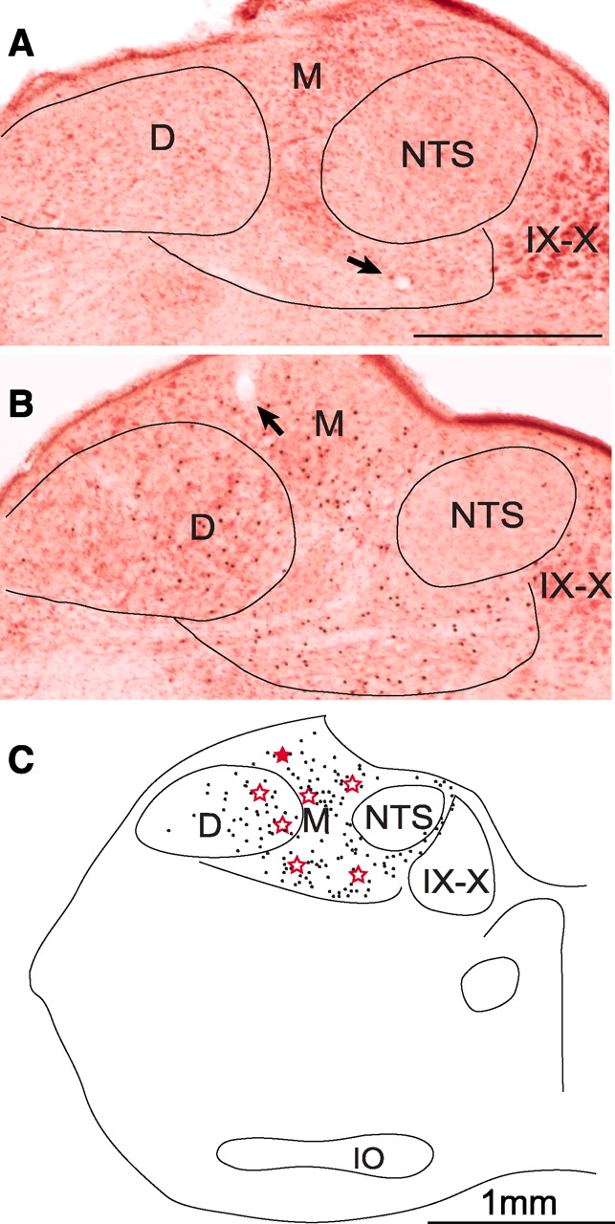
Fig. 2 Recording site verification and c-Fos expression in response to magnetic field stimulation.
L Wu, and J D Dickman Science 2012;336:1054-1057
Published by AAAS
Notes:
Recording site verification and c-Fos expression in response to magnetic field stimulation. (A and B) Vestibular brainstem sections from two pigeons, each with an electrolytic lesion (arrows) made from a recording electrode on the last experimental day. In (B), the brain was processed to show c-Fos transcription factor (black dots), a marker for neural activation, after 72 min of magnetic field stimulation (18). (C) Anatomical reconstruction of section B, with c-Fos–positive cell locations (black dots) and recording site lesion locations (red stars) for all seven birds (collapsed onto one representative section). D, descending vestibular nucleus; IO, inferior olivary nucleus; M, medial vestibular nucleus; NTS, nucleus of the solitary tract; IX-X, glossopharyngeal-vagal nuclei. Scale bar = 1 mm.

Slide 46
Seeing magnetism with CRYPTOCHROMES

Slide 47
Seeing magnetism with CRYPTOCHROMES
Red –
Green +

Slide 48
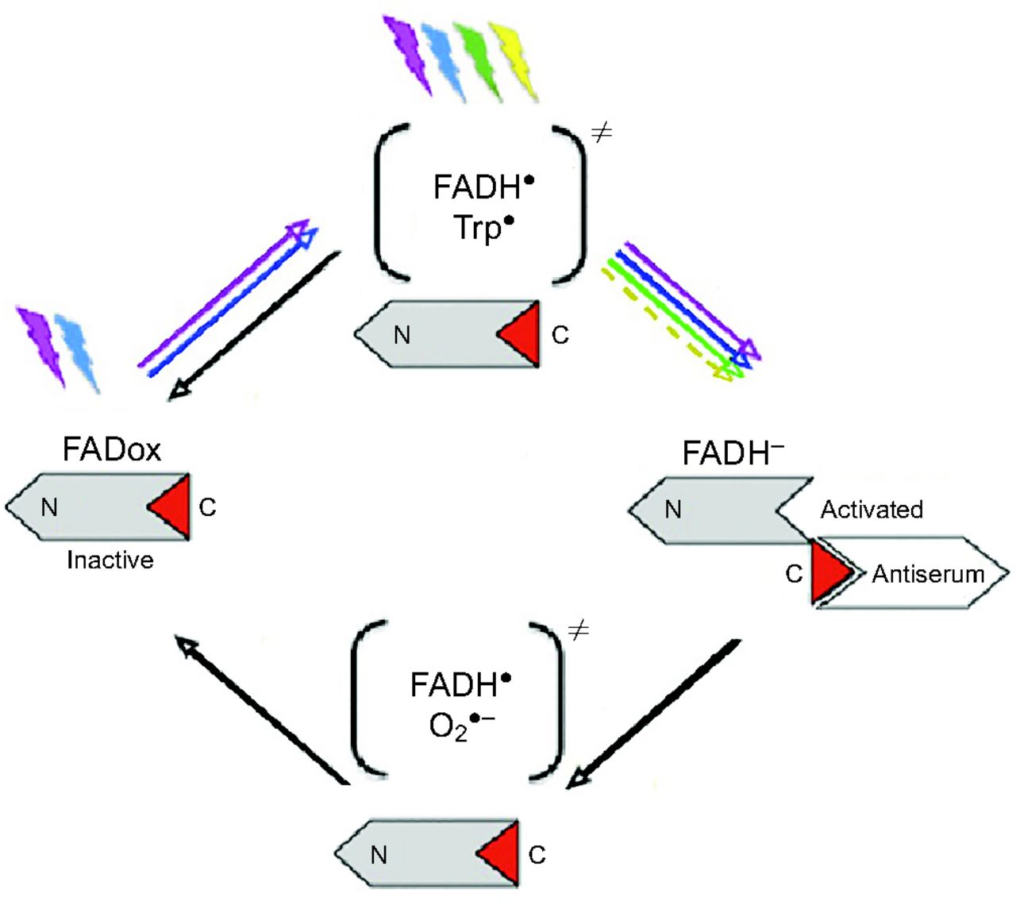
Flavin cycle of cryptochrome.
Nießner C et al. J Exp Biol 2014;217:4221-4224
©2014 by The Company of Biologists Ltd
Notes:
Flavin cycle of cryptochrome. N, N-terminus of the protein; C, C-terminus of the protein; the antiserum-binding epitope is in red, indicating that the antiserum probably binds the fully reduced FADH⁻. Radical pairs are shown in parentheses; coloured arrows indicate light-driven reactions, black arrows indicate light-independent reactions (from Nießner et al., 2013).

Slide 49
Orientation behaviour of European robins in light of different wavelengths after being kept in total darkness for 1 h.
Wiltschko R et al. J Exp Biol 2014;217:4225-4228
©2014 by The Company of Biologists Ltd
Notes:
Orientation behaviour of European robins in light of different wavelengths after being kept in total darkness for 1 h. C, control under green light, after being in the ‘white’ light of the bird room. D, darkness followed by exposure to the respective light: B, 424 nm blue; T, 502 nm turquoise; G, 565 nm green light. The triangles at the periphery of the circles mark the mean headings of the individual birds tested three times in the respective condition: solid symbols, unimodal mean headings; open symbols, preferred end of an axis. The arrow represents the mean vector or the mean axis, and the two inner circles indicate the 5% (dotted) and the 1% significance border of the Rayleigh test.

Slide 50
Birds cross-calibrate their multiple
compass systems at sunset
Sunset direction (polarized sky)
Magnetic inclination compass
magnetite or
cryptochrome
Star + clock compass

Slide 51
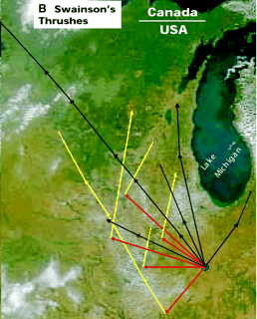
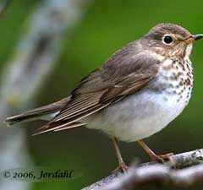
Multi-compass
cross-calibration
sunset x stars
Normal
Didn’t see sunset
Night 2

Slide 52
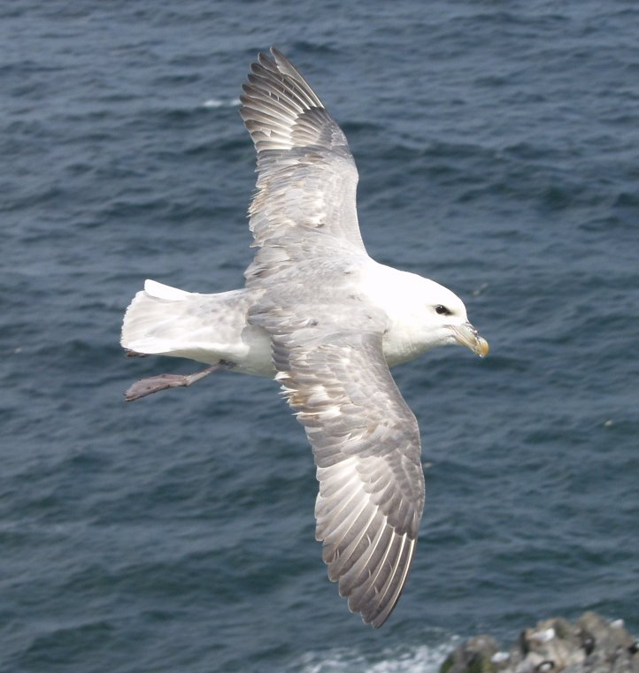
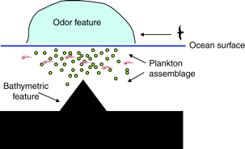
Birds smell

Slide 53
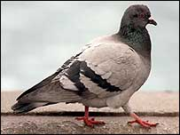
Notes:
Pigeons with frosted goggles

Slide 54
Orientation requires more
than a simple compass –
You have to know where you are
relative to where you want to be
Notes:
Pigeons with frosted goggles

Slide 55
Dodging the Virtual Mediterranean
Natural Magnetic
Field of Germany
Pied Flycatcher
Notes:
Orientation of young pied flycatchers held in captivity during the time of their first migration. Results are shown from birds maintained in the magnetic field of Frankfurt, Germany (left), and birds subjected to a sequence of magnetic fields approximately matching those that they encounter along the migratory pathway (right). During the time corresponding to the first leg of the migration (Leg 1), both groups of birds were significantly oriented toward the south-southwest, corresponding with the direction that they initially travel. Only the birds exposed to the magnetically simulated migration, however, adopted appropriate southeasterly orientation during the time corresponding to the second leg of the migration (Leg 2). The arrow in the center of each circle represents the mean angle of the group. Arrows that extend across the first inner circle (dotted line) denote distributions that are significantly oriented at P<0.05, whereas those that extend across the second inner circle (solid line) denote P<0.01. (Modified from Beck and Wiltschko, 1988; Wiltschko and Wiltschko, 2005.)‏

Slide 56
Dodging the Virtual Mediterranean
Natural Magnetic
Field of Germany
Simulated Magnetic Fields
Simulated Magnetic
Field of Germany
Notes:
Orientation of young pied flycatchers held in captivity during the time of their first migration. Results are shown from birds maintained in the magnetic field of Frankfurt, Germany (left), and birds subjected to a sequence of magnetic fields approximately matching those that they encounter along the migratory pathway (right). During the time corresponding to the first leg of the migration (Leg 1), both groups of birds were significantly oriented toward the south-southwest, corresponding with the direction that they initially travel. Only the birds exposed to the magnetically simulated migration, however, adopted appropriate southeasterly orientation during the time corresponding to the second leg of the migration (Leg 2). The arrow in the center of each circle represents the mean angle of the group. Arrows that extend across the first inner circle (dotted line) denote distributions that are significantly oriented at P<0.05, whereas those that extend across the second inner circle (solid line) denote P<0.01. (Modified from Beck and Wiltschko, 1988; Wiltschko and Wiltschko, 2005.)‏

Slide 57
Dodging the Virtual Mediterranean
Natural Magnetic
Field of Germany
Simulated Magnetic Fields
Simulated Magnetic
Field of Germany
these birds
are clueless
Notes:
Orientation of young pied flycatchers held in captivity during the time of their first migration. Results are shown from birds maintained in the magnetic field of Frankfurt, Germany (left), and birds subjected to a sequence of magnetic fields approximately matching those that they encounter along the migratory pathway (right). During the time corresponding to the first leg of the migration (Leg 1), both groups of birds were significantly oriented toward the south-southwest, corresponding with the direction that they initially travel. Only the birds exposed to the magnetically simulated migration, however, adopted appropriate southeasterly orientation during the time corresponding to the second leg of the migration (Leg 2). The arrow in the center of each circle represents the mean angle of the group. Arrows that extend across the first inner circle (dotted line) denote distributions that are significantly oriented at P<0.05, whereas those that extend across the second inner circle (solid line) denote P<0.01. (Modified from Beck and Wiltschko, 1988; Wiltschko and Wiltschko, 2005.)‏

Slide 58
Dodging the Virtual Mediterranean
Natural Magnetic
Field of Germany
Simulated Magnetic Fields
Simulated Magnetic
Field of Germany
Simulated Magnetic
Field of Spain
Notes:
Orientation of young pied flycatchers held in captivity during the time of their first migration. Results are shown from birds maintained in the magnetic field of Frankfurt, Germany (left), and birds subjected to a sequence of magnetic fields approximately matching those that they encounter along the migratory pathway (right). During the time corresponding to the first leg of the migration (Leg 1), both groups of birds were significantly oriented toward the south-southwest, corresponding with the direction that they initially travel. Only the birds exposed to the magnetically simulated migration, however, adopted appropriate southeasterly orientation during the time corresponding to the second leg of the migration (Leg 2). The arrow in the center of each circle represents the mean angle of the group. Arrows that extend across the first inner circle (dotted line) denote distributions that are significantly oriented at P<0.05, whereas those that extend across the second inner circle (solid line) denote P<0.01. (Modified from Beck and Wiltschko, 1988; Wiltschko and Wiltschko, 2005.)‏

Slide 59
requires both
a magnetometer
and a calendar !
Dodging the Virtual Mediterranean
Natural Magnetic
Field of Germany
Simulated Magnetic Fields
Simulated Magnetic
Field of Germany
Simulated Magnetic
Field of Spain
Notes:
Orientation of young pied flycatchers held in captivity during the time of their first migration. Results are shown from birds maintained in the magnetic field of Frankfurt, Germany (left), and birds subjected to a sequence of magnetic fields approximately matching those that they encounter along the migratory pathway (right). During the time corresponding to the first leg of the migration (Leg 1), both groups of birds were significantly oriented toward the south-southwest, corresponding with the direction that they initially travel. Only the birds exposed to the magnetically simulated migration, however, adopted appropriate southeasterly orientation during the time corresponding to the second leg of the migration (Leg 2). The arrow in the center of each circle represents the mean angle of the group. Arrows that extend across the first inner circle (dotted line) denote distributions that are significantly oriented at P<0.05, whereas those that extend across the second inner circle (solid line) denote P<0.01. (Modified from Beck and Wiltschko, 1988; Wiltschko and Wiltschko, 2005.)‏

Slide 60
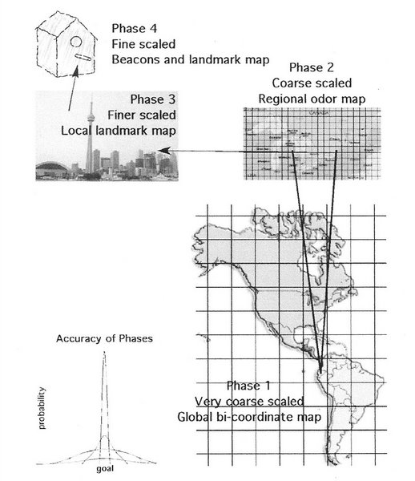

Slide 61
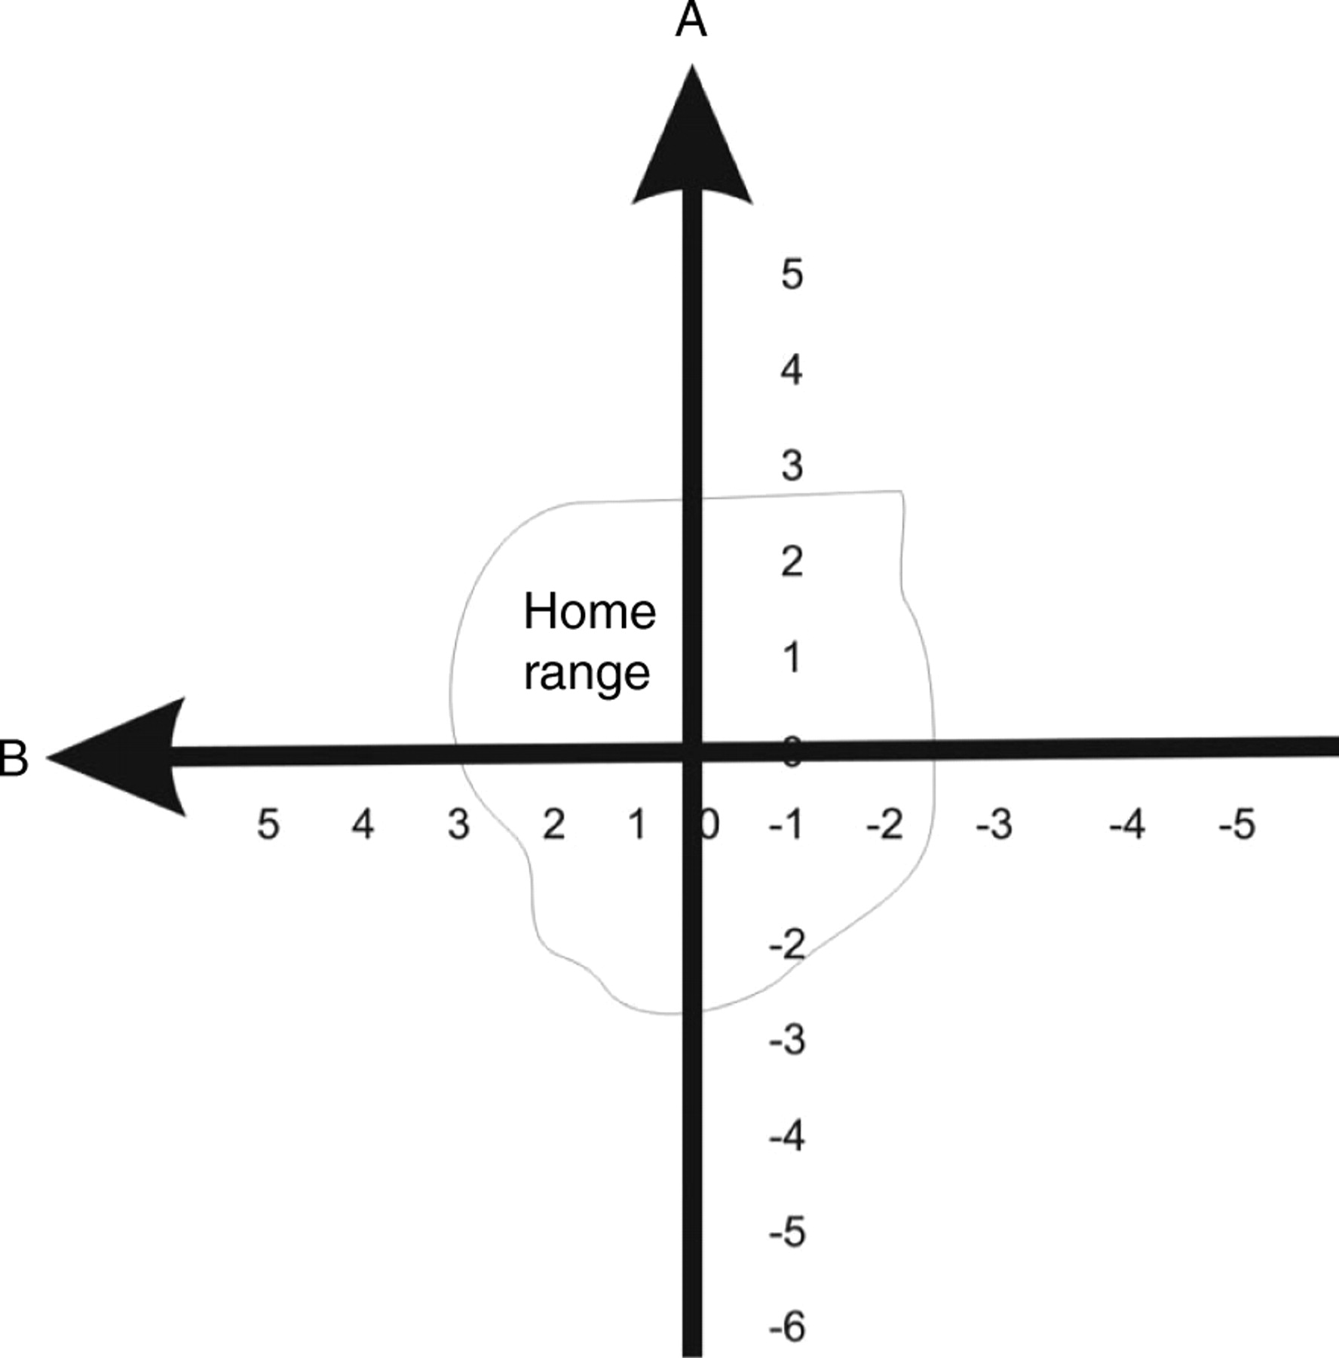
Bicoordinate sensory gradients – “Map Sense”
Magnetic cues:
1. inclination
2. intensity
3. declination
Notes:
In a bi-coordinate gradient map animals learn that at least two cues, ideally intersecting at 90 deg., vary in strength within the home range, and the animal assumes by extrapolation that they continue to vary in this way outside the home range. In the case of many long distance migrants, these cues would need to vary consistently on a global scale, but at the very least on the basis of current evidence, on a continental scale. In the schematic shown, if the animal finds itself at A5, B5, then even though it has never encountered these values in its home range, they are both increasing values. As gradient A increases northward and gradient B increases westward within the home range, this means that it is north and west of its home range and must fly south east to return.

Slide 62
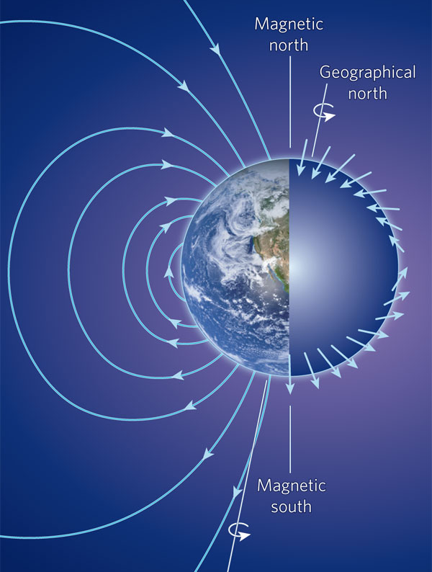
Magnetic & axial poles
are slightly different
(local angle = declination)

Slide 63
Magnetic inclination
angle varies with latitude

Slide 64
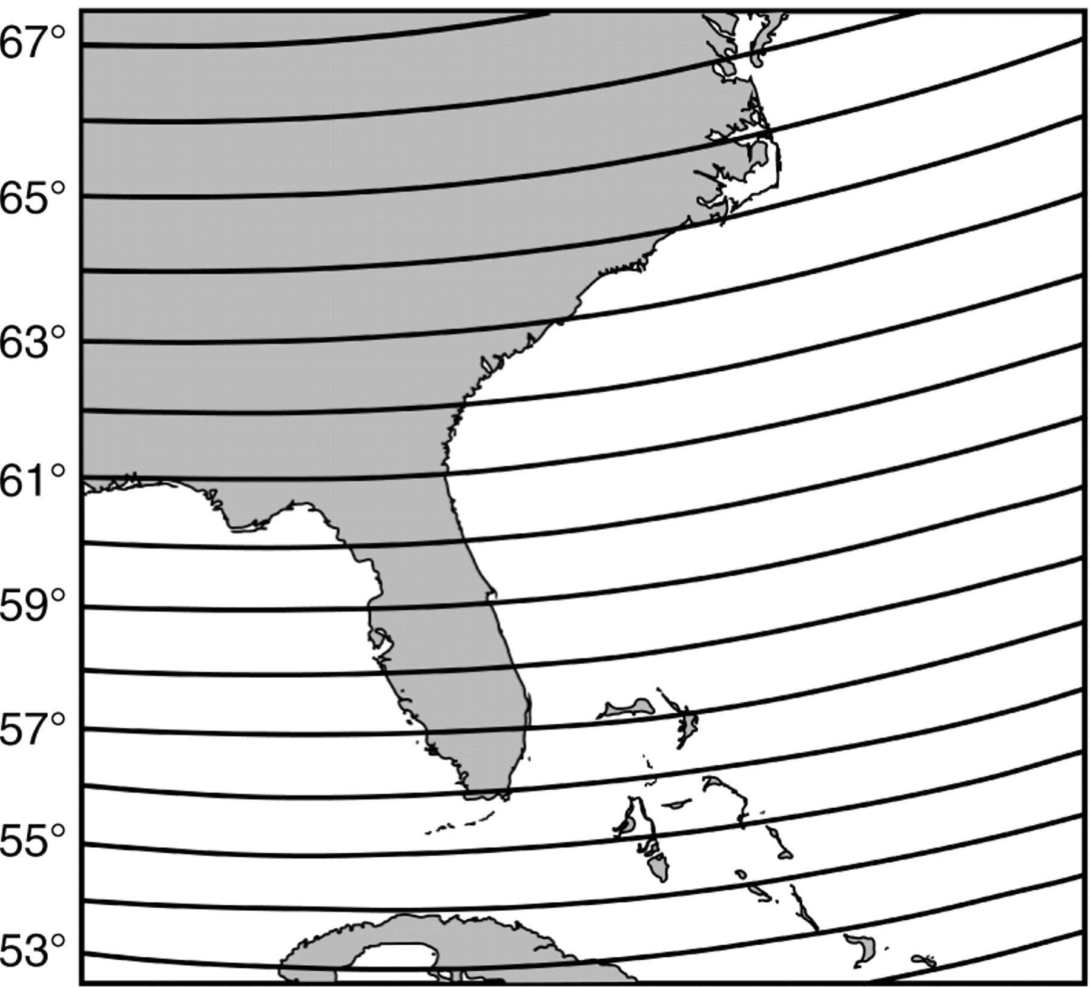
magnetic dip angle
Notes:
Map of magnetic field inclination along the southeastern coast of the United States. The isolines represent isoclinics (lines of equal magnetic field inclination). In this part of the world the isoclinics trend east–west, while the coastline is aligned approximately north–south. As a result, each area of coastline along the eastern seaboard is marked by a unique inclination angle. A similar pattern exists for the isolines of total intensity. A sea turtle navigating along the east coast to a particular coastal feeding or nesting area might thus hypothetically do so by detecting a single magnetic element such as inclination or intensity (see text for details).

Slide 65
Understanding the Earth’s magnetic field
(azimuth compass)
Notes:
(A) Diagrammatic representation of the Earth's magnetic field illustrating how field lines (represented by arrows) intersect the Earth's surface, and how inclination angle (the angle formed between the field lines and the Earth) varies with latitude. At the magnetic equator (the curving line across the Earth), field lines are parallel to the Earth's surface. The field lines become progressively steeper as one travels north toward the magnetic pole, where the field lines are directed straight down into the Earth and the inclination angle is 90°. (B) Diagram illustrating four elements of geomagnetic field vectors that might, in principle, provide animals with positional information. The field present at each location on Earth can be described in terms of a total field intensity and an inclination angle. The total intensity of the field can be resolved into two vector components: the horizontal field intensity and the vertical field intensity. (Whether animals are able to resolve the total field into vector components, however, is not known.)‏

Slide 66
Bivariate Grid
Magnetic inclination
(2° dip)
Magnetic Intensity
(1 μT)
Notes:
Figure 20. Isolines of magnetic field elements in North America. ( A) Isoclinics (isolines of magnetic field inclination). Adjacent isoclinics represent differences in inclination of 2°. ( B) Isodynamics (isolines of total field intensity). Adjacent isolines represent differences in intensity of 1,000 nT (From: Lohmann et al. 2008).

Slide 67
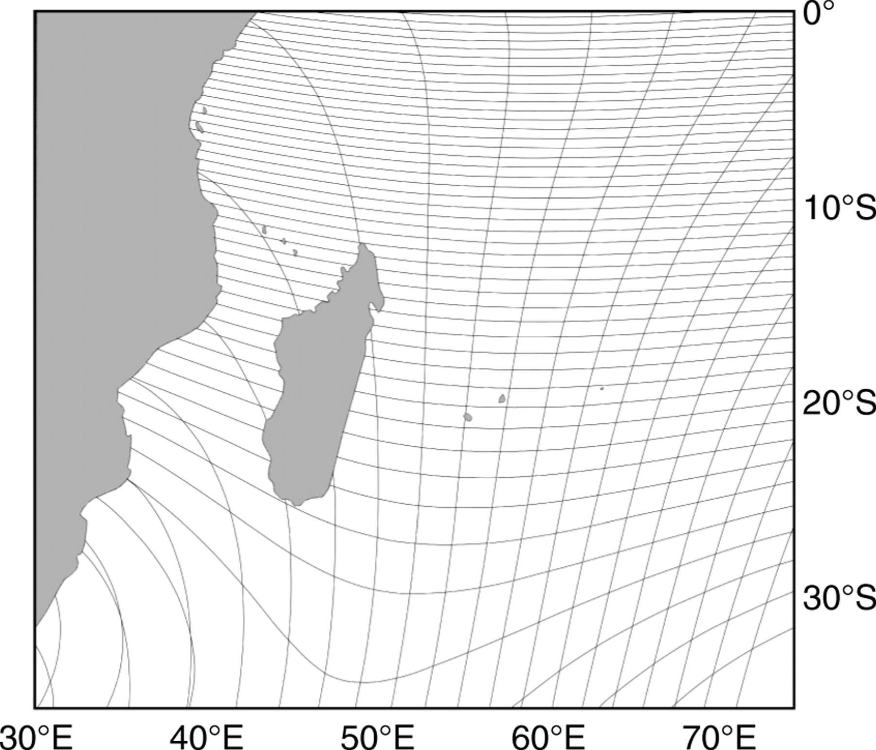
Even better grid in the Indian Ocean,
along the east coast of Africa.
Magnetic Intensity (1000 nT)
Magnetic dip angle (1° inclination)
Notes:
Isoclinics (lines of equal magnetic inclination) and isodynamics (lines of equal magnetic field intensity) in the Indian Ocean, along the east coast of Africa. Isoclinics run approximately east–west in this region and are shown in 1° contours. Isodynamics run approximately north–south and are represented in 1000 nT increments. Thus, in this geographic area, the two sets of isolines form a nonorthogonal grid that birds, sea turtles, fish or other animals might, in principle, exploit as a kind of bicoordinate magnetic map. Whether any animal does this is not known. (Modified from Lohmann et al., 1999.) Isolines were derived for the year 1995 from the International Geomagnetic Reference Field (IGRF) 1995 model.

Slide 68
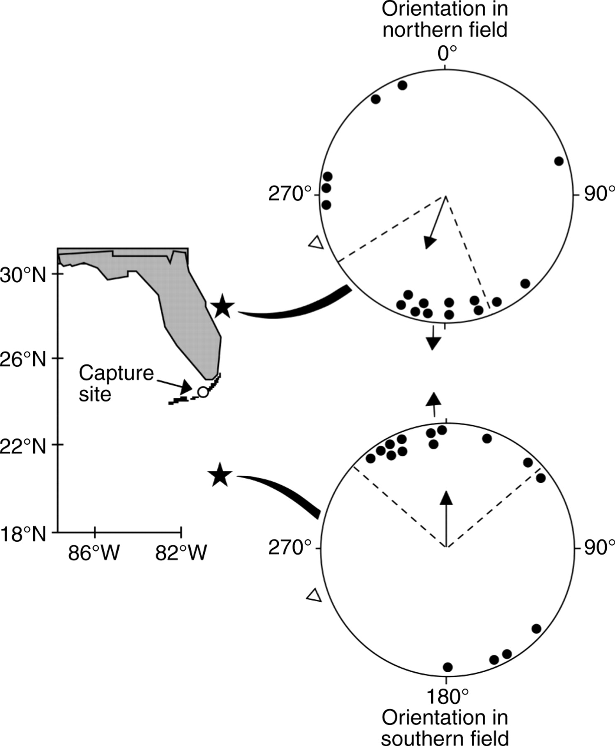
simulated
Daytona
Magnetic map sense
in spiny lobsters
simulated
Jamaica
Notes:
A magnetic map in spiny lobsters. Lobsters from the middle Florida Keys were subjected to magnetic fields that exist in locations north or south of the location where they were captured. As with juvenile green turtles, lobsters subjected to the field from the northern site oriented approximately southward, whereas those exposed to the field from the southern site crawled approximately north. The open triangle outside each orientation diagram indicates the actual direction to the capture site from the test site. In each case, lobsters responded as if they had been displaced to the locations marked by the stars rather than orienting in the direction that was actually toward the capture site. Conventions are as in Fig. 2. (Modified from Boles and Lohmann, 2003.)‏

Slide 69
Magnetic map sense
in green sea turtles
simulated
Savannah
simulated
Key Largo
Notes:
(A) A juvenile green turtle swimming in a magnetic navigation experiment. Turtles were placed into soft cloth harnesses and tethered to an electronic tracking device that monitored their orientation as they swam in a water-filled arena surrounded by a magnetic coil system (Lohmann et al., 2004). (B) Evidence for a magnetic map in green turtles. Juvenile turtles were captured in feeding grounds near the test site in Melbourne Beach, Florida, USA. Each turtle was exposed to a magnetic field that exists at one of two distant locations along the coastline (represented by stars). Turtles exposed to the field from the northern site swam approximately southward, whereas those exposed to the field from the southern site swam approximately north. Conventions are as in Fig. 2. (Modified from Lohmann et al., 2004.) See text for details.

Slide 70
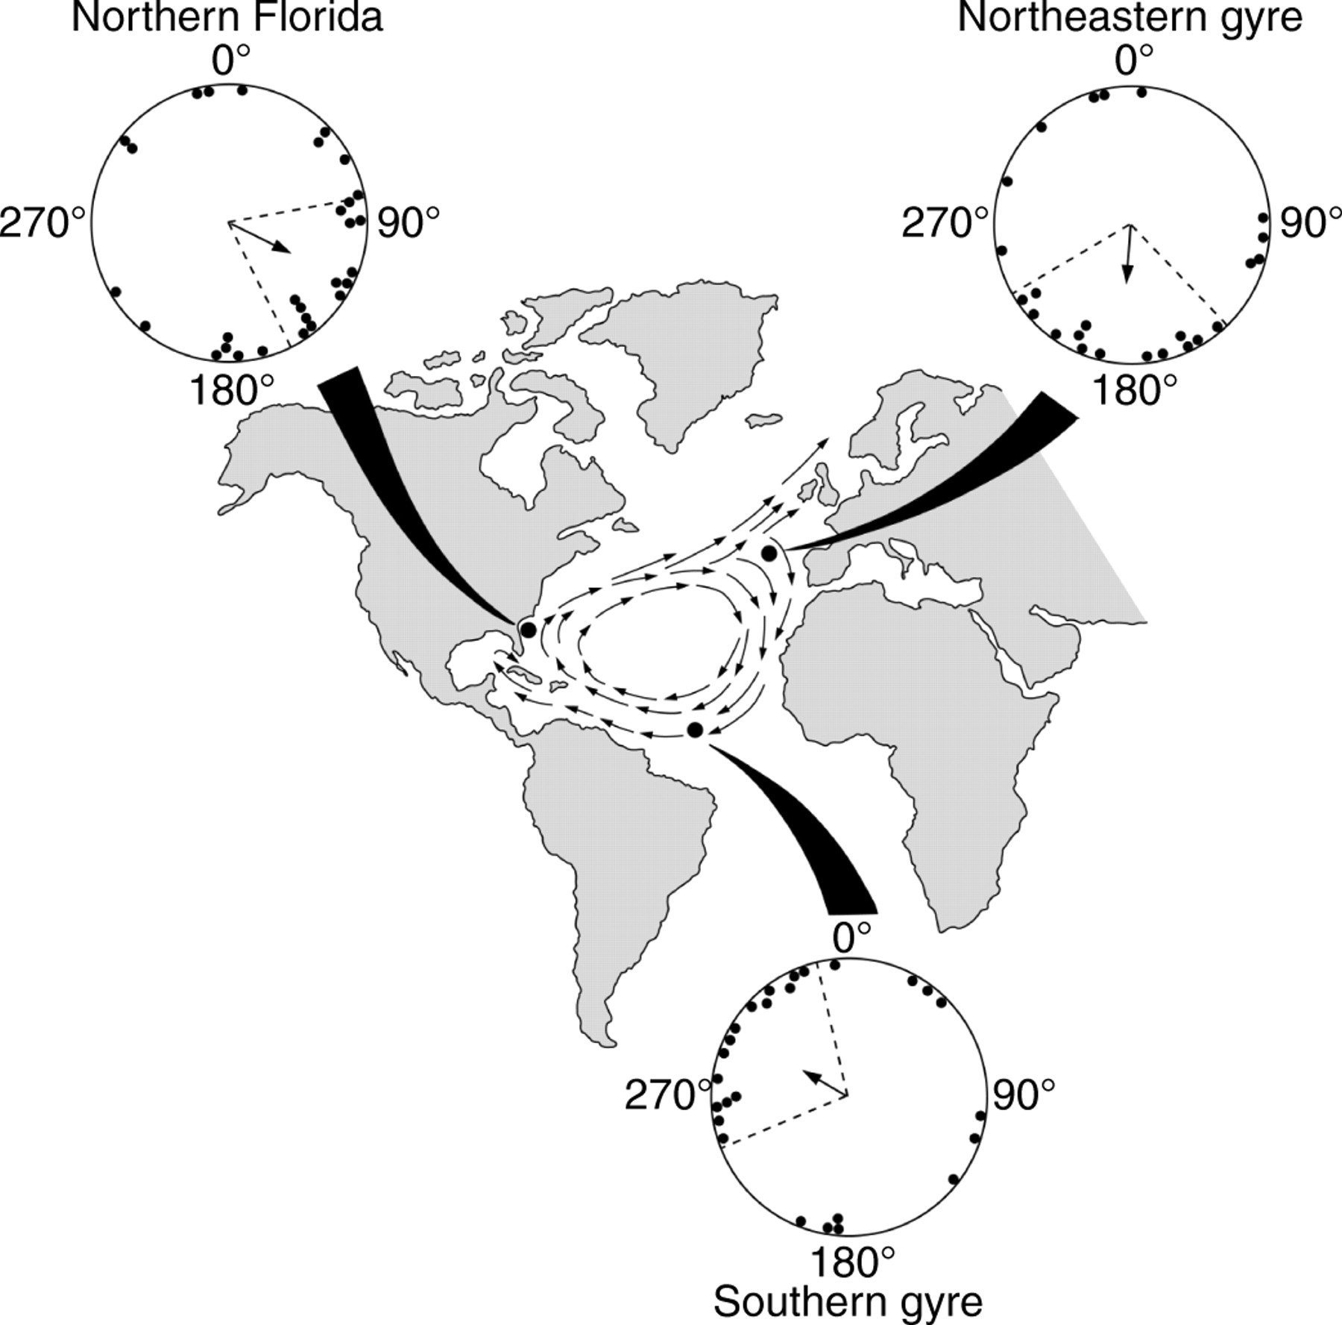
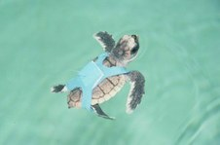
Young green sea turtles
know the magnetic grid
of the North Atlantic gyre
Lohmann K J et al. J Exp Biol 2007;210:3697-3705
Notes:
Orientation of hatchling loggerhead turtles in magnetic fields characteristic of three widely separated locations (marked by black dots on the map) along the migratory route. Generalized main currents of the North Atlantic gyre are represented on the map by arrows. In the orientation diagrams, each dot represents the mean angle of a single hatchling. The arrow in the center of each circle represents the mean angle of the group. Broken lines represent the 95% confidence interval for the mean angle. See text for details. (Modified from Lohmann et al., 2001.)‏

Slide 71
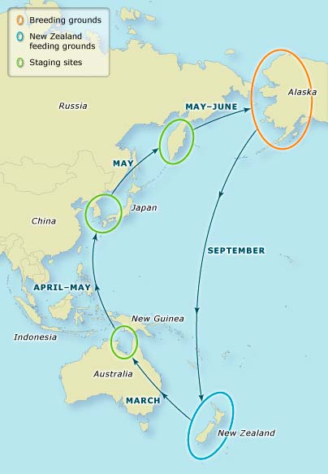
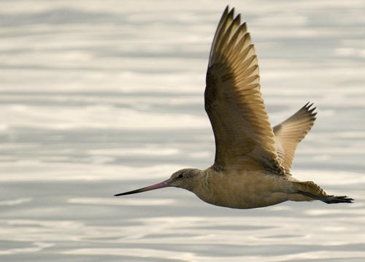
How do over-sea
migrants cope
with wind drift?

Slide 72
flight
angle
Wind
The problem of drift

Slide 73
flight
angle
actual
track
Wind
The problem of drift

Slide 74
flight
angle
actual
track
Wind
Drift compensation

Slide 75
flight
angle
actual
track
Drift recovery

Slide 76
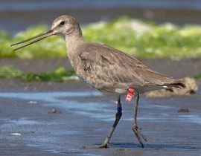
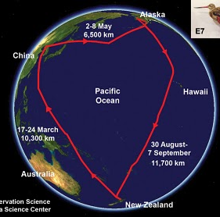
Actual
satellite
track

Slide 77
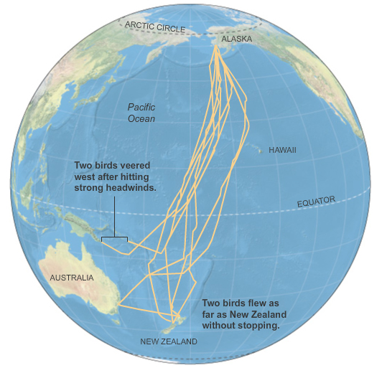
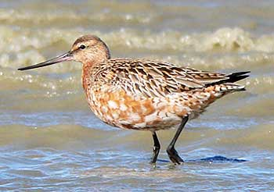

Slide 78
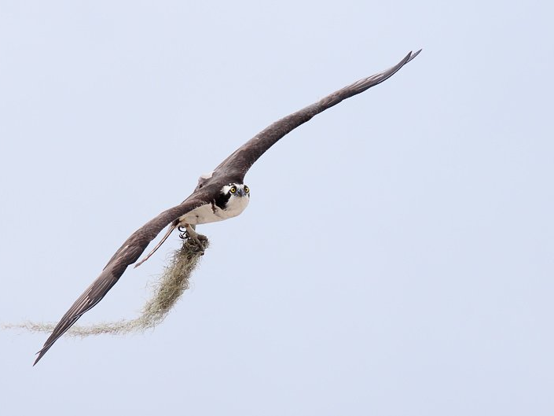
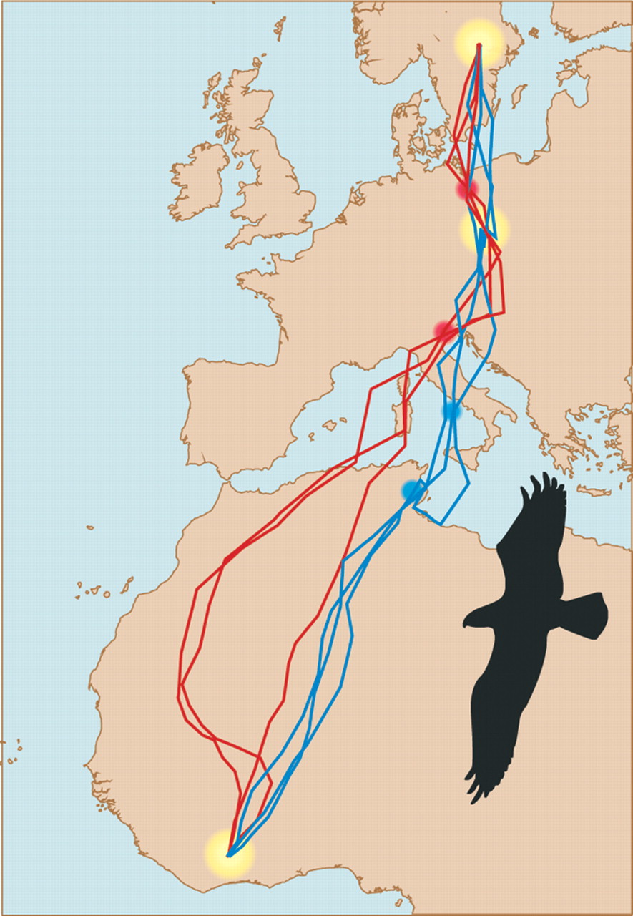
our Loch Moss Nester always finds its nest
Notes:
Routes followed by the same individual osprey (Pandion haliaetus) during three successive autumn (blue) and spring (red) migration journeys, as recorded by satellite tracking. The bird showed fidelity not only to its breeding and wintering site but also to an intermediary stopover site in Europe that was visited on all journeys (yellow). Additional possible goal areas, where the routes converge either on autumn or spring migration, are indicated in blue (potential autumn goal area) or red (spring goal area). The map is a Mercator projection. [Image based on (27)]

Slide 81
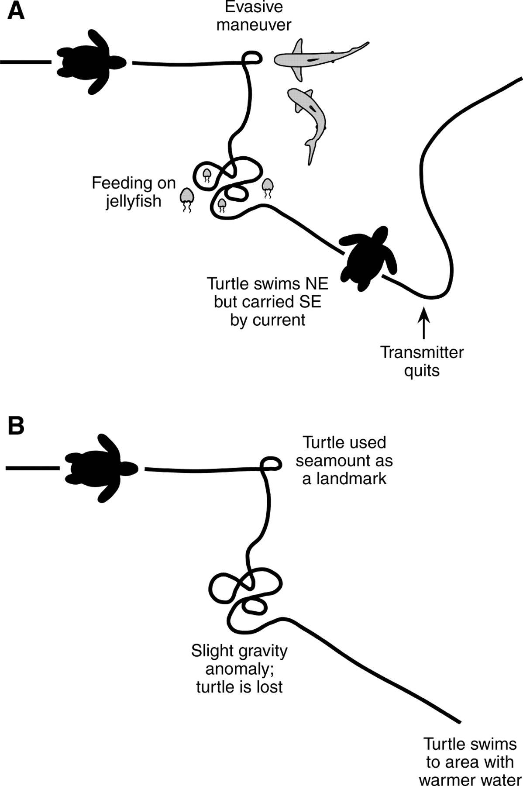
Diagram illustrating potential problems in attempting to infer
mechanisms of navigation from the tracks of animals.
Lohmann K J et al. J Exp Biol 2008;211:1719-1728
Notes:
Diagram illustrating potential problems in attempting to infer mechanisms of navigation from the tracks of animals. (A) Overhead view of the track of a hypothetical sea turtle moving hundreds of kilometers through the ocean and monitored with satellite telemetry; events that occurred along the way are indicated. (B) A plausible but erroneous interpretation of the turtle's path. In this hypothetical example, researchers unaware of what happened in the ocean superimposed the track on several topographical and geophysical maps until correlations were found between changes in the turtle's behavior and specific features of the environment. These environmental cues were then assumed to have elicited the behavioral changes, leading to incorrect inferences about navigational mechanisms.

