Slide 1
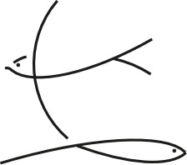
LOVE, EMPATHY, AGGRESSION, & DRUGS neurochemistry of behavior
Philip Stoddard
Department of Biological Sciences
Florida International University

Slide 2
Point 1. Questions reflect interests
Evolutionary Biology –
interest in patterns in nature
Psychology –
interest in people (and most people are animals)
Biomedicine –
animal model to address human diseases

Slide 3
Point 2. Strategies vs. Tactics

Slide 4
Point 2. Strategies vs. Tactics
STRATEGIES
Mating System
monogamy
polygyny
polyandry
polygynandry
Parental Care
none
maternal
paternal
bi-parental
Space Use
territorial
non-exclusive home range
nomadic
TACTICS
inbreeding avoidance
pair bonding
parent-offspring bonding
no pair bonding
mate-recognition
parent-offspring recognition
male-male aggression
avoidance
subordinance
cooperation
reliable signaling
exaggeration
deception

Slide 5
Point 3. Cherchez la femme

Slide 6
Point 4. organization & activation
Organization –
action at key points in development that result in permanent changes in behavior.
Activation –
action at any stage that temporarily switches behavior on/off or up/down.

Slide 7
Love
as distinct from sex

Slide 8
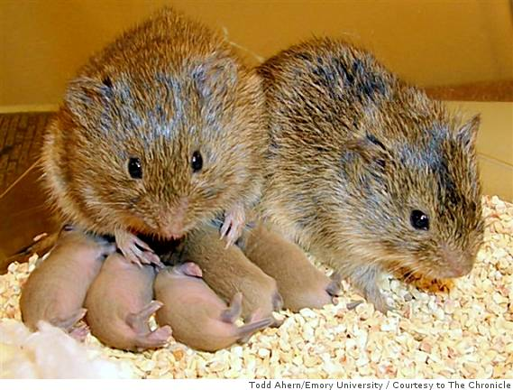
socially monogamous prairie voles (Microtus pennsylvanicus)

Slide 9
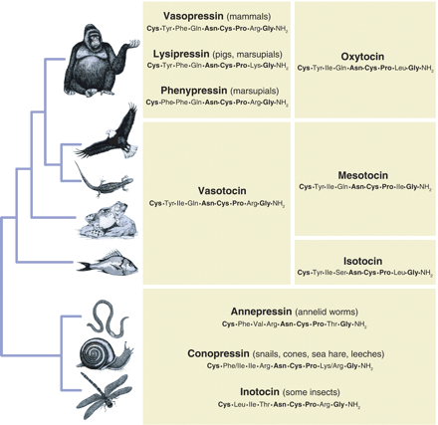
Nonapeptide hormones actions on behavior fits life history, not phylogeny
Donaldson & Young 2008

Slide 10
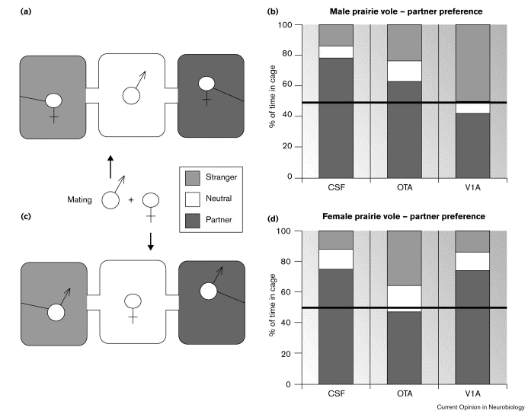
Partner preference in prairie voles is mediated by
Vasopressin (AVT) in males
Oxytocin (OT) in females
OTA = oxytocin receptor antagonist
V1A = vasopressin 1A receptor antagonist
CSF = saline control
Insel & Young 2000

Slide 11
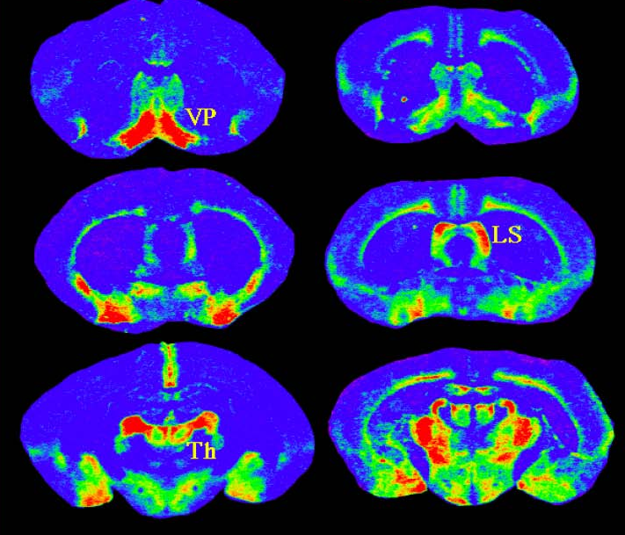
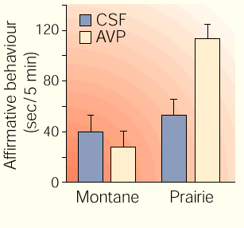
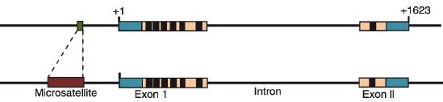
Prairie Vole
socially
monogamous
Montane Vole
polygamous
vasotocin effects
in males
vasotocin
AVP1AR
receptor
binding
microsatellite difference
in promoter region AVP1AR gene
Prairie Vole
Montane Vole

Slide 12
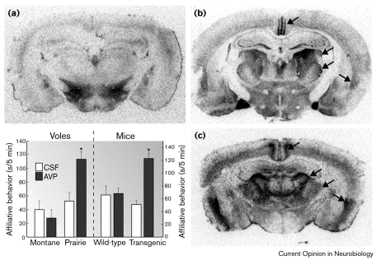
AVP1AR transgene changes social behavior by changing expression location
Montane Vole
Highly polygynous
Prairie Vole
Socially monogamous
Vassopressin receptors
(AVP1AR)
Transgenic house mouse
(formerly polygynous)
expressing prairie vole
AVP1AR
Insel & Young 2000

Slide 13
adenoviral gene transfer changes behavior
AVP1AR spatial
distribution
prairie vole
socially monogamous
prairie vole
meadow vole
polygamous
meadow vole
meadow vole adenoviral
overexpression of
prairie vole AVP1AR
partner
preference
Young & Wang 2004

Slide 14
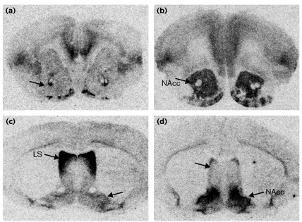
Oxytocin receptors little sex difference, big species difference
Montane Vole
Highly polygynous
Prairie Vole
Socially monogamous
Oxytocin receptors
Vasopressin receptors
(AVP1AR)
Insel & Young 2000

Slide 15
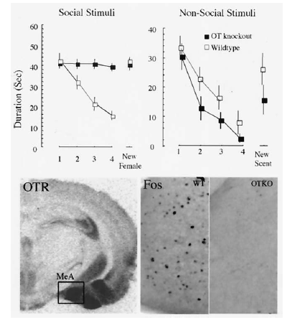
Male oxytocin receptor knockout mice have no social memory for females
new female
lemon or almond scent
Fos expression in
medial amygdala
1 hour after
90 sec social exposure
wildtype
oxytocin
receptors
Young 2002 from
Ferguson et al. 2001
Notes:
Figure 1. Social recognition in the oxytocin knockout mouse.
Upper left: The graph illustrates the duration of olfactory
investigation of a stimulus female mouse by a wildtype (open
box) or oxytocin knockout mouse (filled box) after 4 repeated
1-min exposures each separated by a 10-min interval. After the
fourth trial, a novel female mouse was used as the stimulus
animal. Note decline in investigation time in the wildtype but not
the mutant mice. Upper right: The graph illustrates that both
wildtype and OT knockout mice habituate to nonsocial olfactory
stimuli, such as cotton balls scented with lemon or almond scent.
Lower left: Receptor autoradiography illustrating the distribution
of OT receptors in mouse brain. Note the high density of
receptors in the medial nucleus of the amygdala (MeA). The box
indicates the region shown in the following photomicrographs.
Lower right: Fos immunoreactivity in the medial amygdala of
wildtype (WT, left panel) and OT knockout (OTKO, right panel)
mice after a 90-sec social exposure. Wildtype mice show a
significant induction of Fos positive cells in the region compared
with unexposed animals, whereas OT knockout mice fail to show
a Fos induction after a social exposure. Adapted from Ferguson
et al, 2000 and Ferguson et al, 2001.

Slide 16
adenoviral overexpression of oxytocin receptors in female voles
 | Prairie Vole socially monogamous | Meadow Vole polygynous
OTR in female n. accumbens | speeds mating & bonding with male | no change
Ross et al. 2009

Slide 17


Slide 18
even in prairie voles love ≠ sex
“She mated with him, and then she attacked him, ran him off and went back to her established partner.”
Sue Carter
Nature, 7 Feb 2008

Slide 19
and love ≠ sex ≠ parenting
Adenoviral knockdown
Juvenile male prairie voles were injected with viral vectors expressing shRNA sequences targeting Avpr1a mRNA into the ventral pallidum. Down-regulation of pallidal V1aR density resulted in a significant impairment in the preference for a mated female partner and a reduction in anxiety-like behavior in adulthood.
No effect on alloparenting was detected.
Barretta CE, Keebaugha AC, Aherna TH, Bassd CE, Terwilligerd EF, Young LJ (2013) Variation in vasopressin receptor (Avpr1a) expression creates diversity in behaviors related to monogamy in prairie voles. Hormones and Behavior 63, 518–526

Slide 20
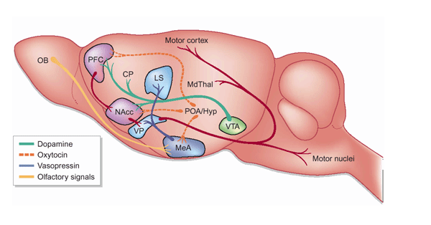
Larry Young’s curious observation:
social bonding activates the same circuitry and neurochemistry as addictive behavior.
Did the selective benefits of social bonding provide a substrate for drug addictions?

Slide 21
2 kinds of empathy
Cognitive empathy (CE) –
recognizing what someone else feels
Emotional empathy (EE) –
feeling what someone else feels

Slide 22
Empathy correlates
Women higher than men in both CE & EE.
CE & EE are correlated.
People high in one are often high in the other.

Slide 23
Neurogenetics of empathy
AVPR1a-327 repeat polymorphism
low CE scores (no effect on EE)
higher amygdala activation
lower partner bonding in men
lower altruistic giving
higher autism frequency

Slide 24
Neurogenetics of empathy
AVPR1a-327 repeat polymorphism
OXTR rs53576 SNP (G or A allele)
GG have higher social cognition including empathy.
AA & GA have low EE scores (no effect on CE)
this SNP lowers potency of oxytocin in eliciting emotional empathy

Slide 25
Lessons from AVT/OT
1. Evolution acts on receptors to change behavior.
2. Circuits tend to be conserved across taxa, whereas receptor locations vary evolutionarily.
3. Neuromodulators only determine valence of behavior within a species or sex.
4. Receptor distributions determine valence of behavior across species & sex.
5. Single nucleotide polymorphisms (SNPs) in nonapeptide receptors can affect behavior in fundamental and profound ways.

Slide 26
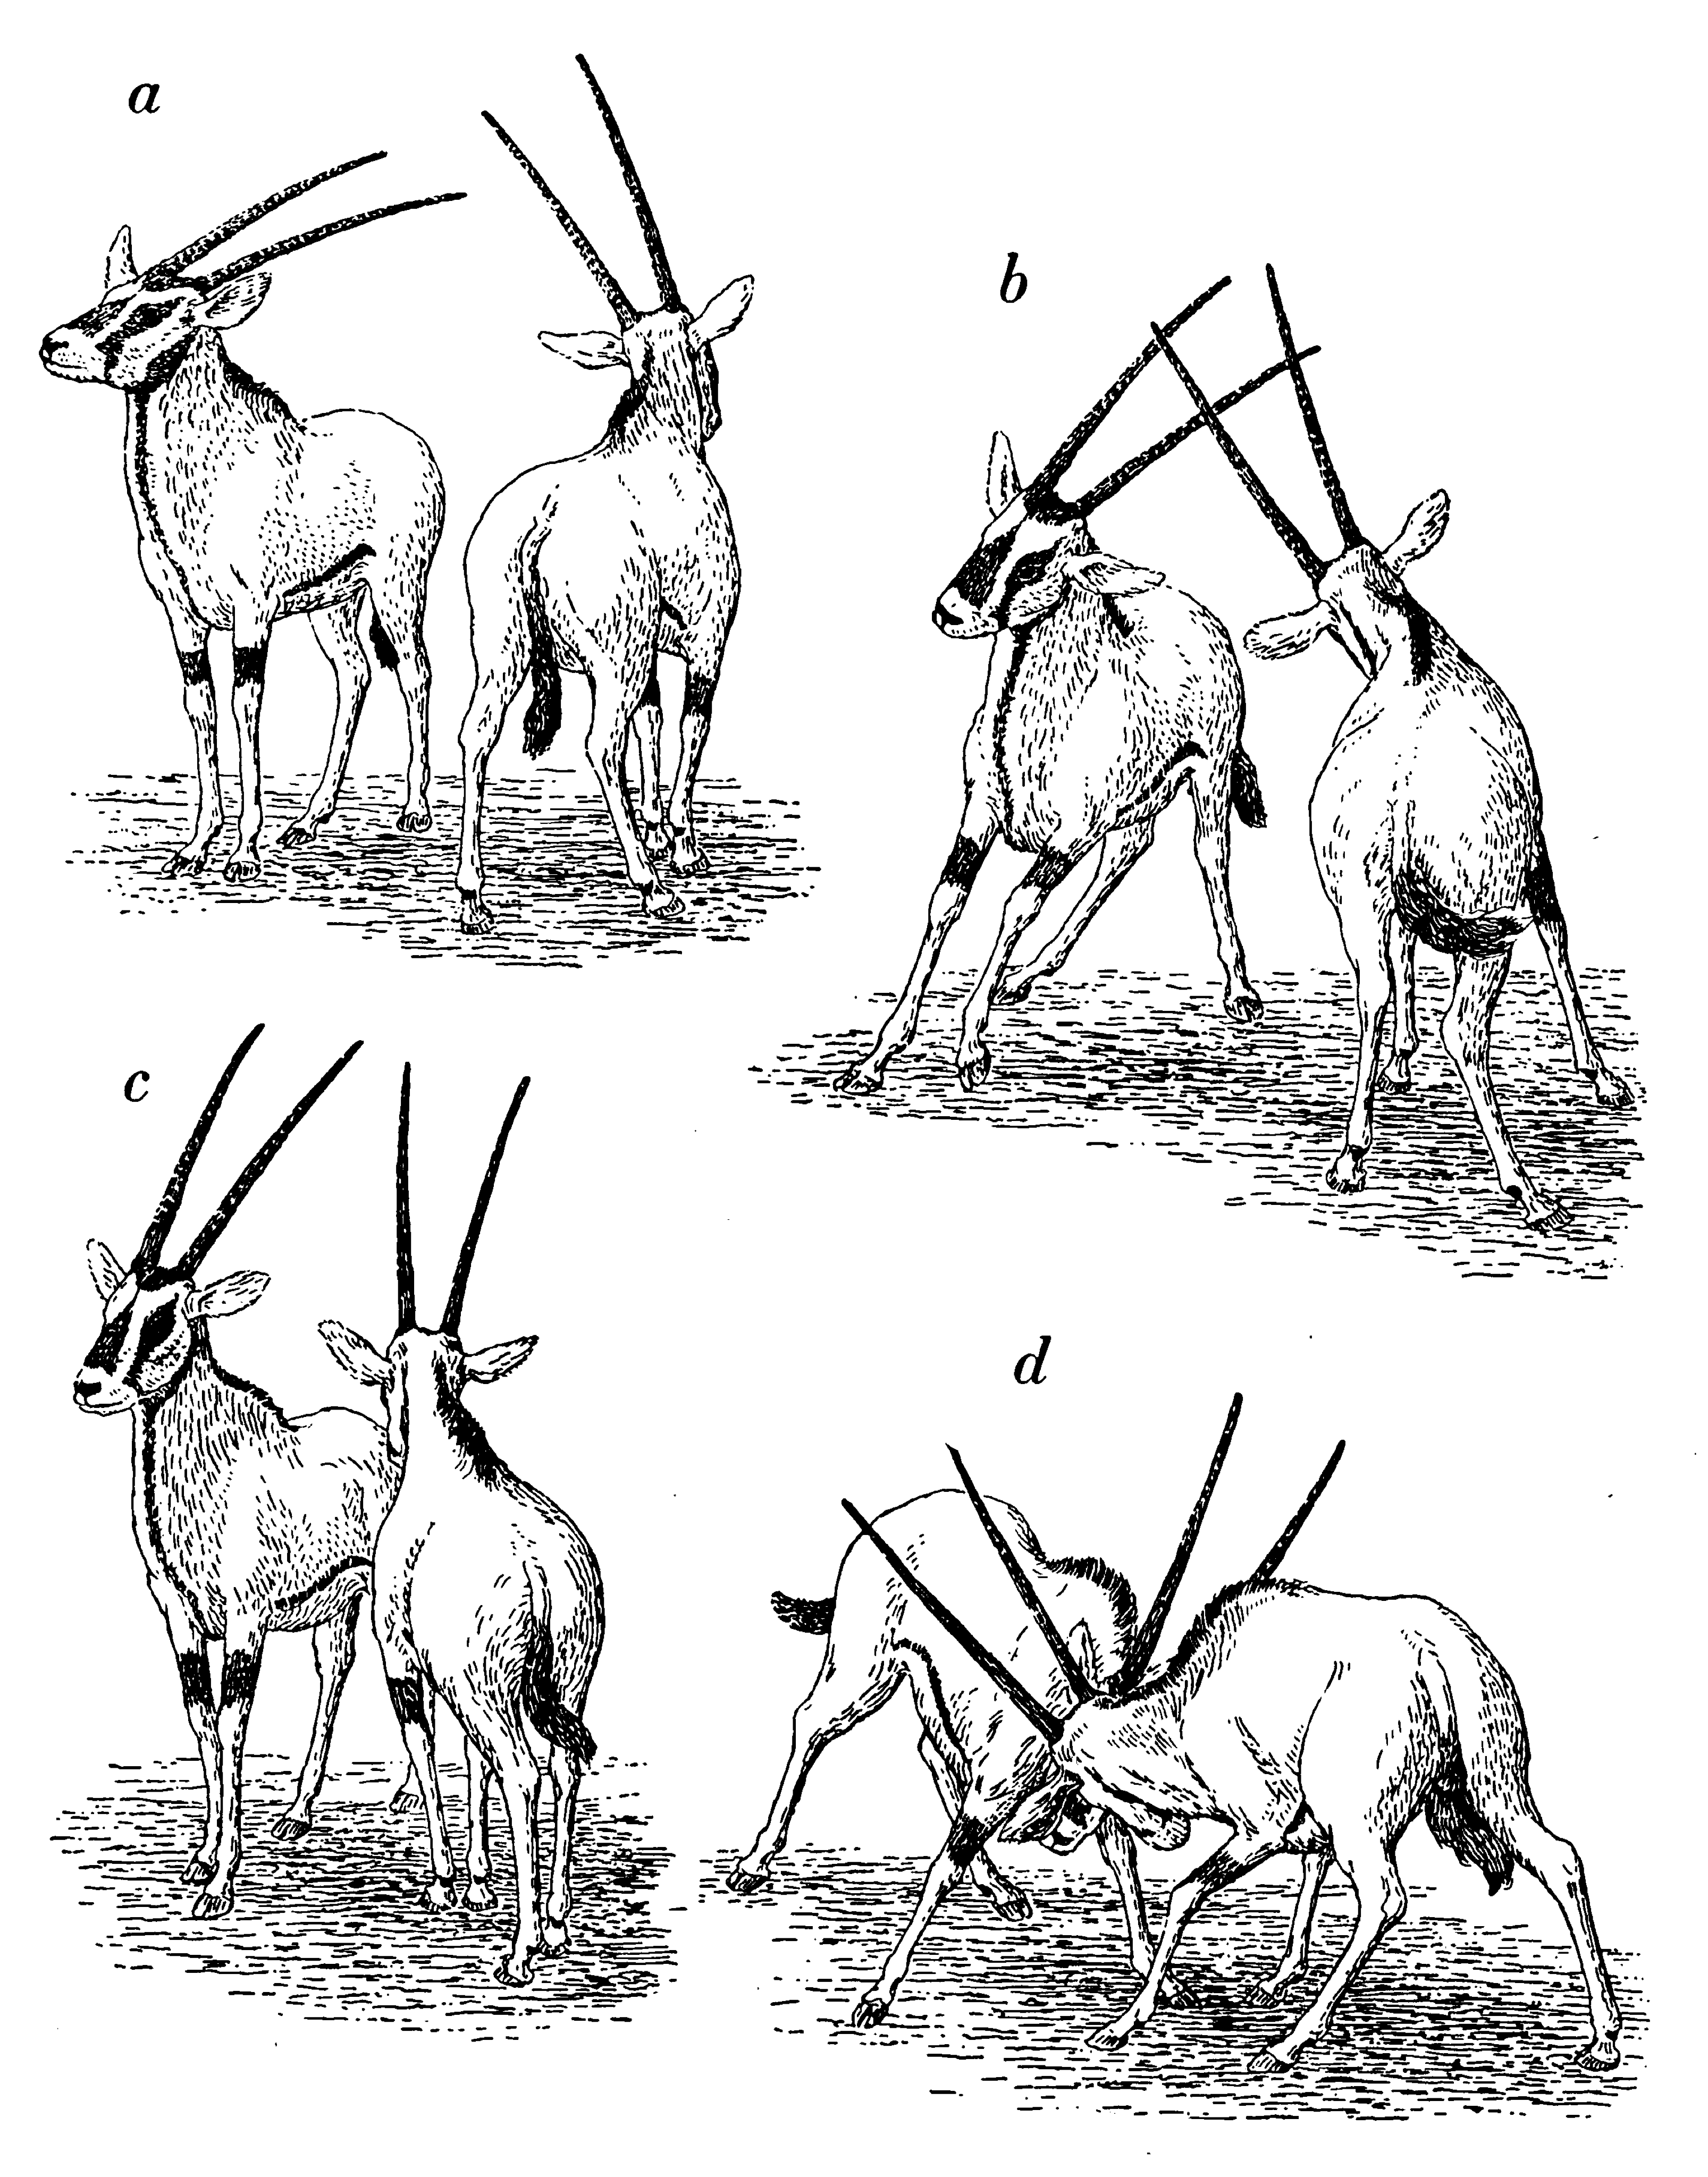
aggression
Fritz Walther, in Eibl-Eibsfeldt 1961

Slide 27
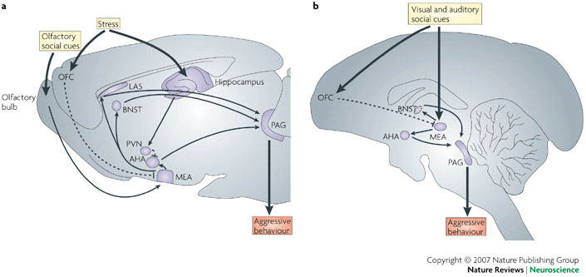
aggression circuitry
brown rat
marmoset

Slide 28
Electrical brain stimulation studies
Different aggression types have different neural substrates
Collared lizards:
same sites evoke
offensive & defensive behavior.
(Sugerman & Demski 1978)
House cats:
different sites evoke
defensive biting & predation biting.
(Siegel, Roeling, Gregg, Kruk, 1999)

Slide 29
Animal aggression
Human aggression
Ecological categories
Food resources
Territory
Social dominance
Mate acquisition
Infanticide
Protect offspring
Anti-predator
Defensive
Irritable
Operational categories
Instrumental vs.
Reactive
Direct (harming indiv) vs.
Indirect (harming relationship)

Slide 30
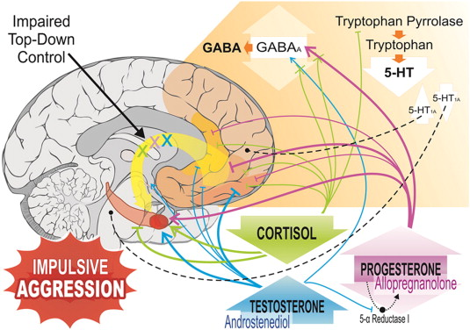
Fig. 1. Steroid hormones and the neurobiology of human aggression. Aggressive behaviour is determined by a cascade of physiological changes, which includes GABAergic and serotonergic systems, as well as sexual neurosteroids, resulting in amygdala hyperactivation and hypofunction of prefrontal cortex structures (i.e., ventromedial prefrontal cortex, orbitofrontal cortex and anterior cingulated cortex) responsible for impulse control. Hormones play a key role in human aggression. Intermediate levels of progesterone, high levels of testosterone and low levels of cortisol are key factors for aggression. The effect of the positive allosteric modulators of GABAA receptors is associated with aggressive behaviours. Intermediate levels of allopregnanolone and high levels of androstenediol, both endogenous positive modulators of GABAA receptors, can increase aggressiveness. Furthermore, GC can reduce the manifestation of aggressive behaviour caused by the positive modulators of the GABAA receptor. Decreased serotonergic activity can lead to aggressive behaviour in humans. The density of 5-HT1A receptors is associated with aggression, mainly with a decrease of its density in the prefrontal cortex and an increase in the raphe nuclei.
Martins de Almeida RM, Centurion Cabral JC, Narvaes R (2015) Behavioural, hormonal and neurobiological mechanisms of aggressive behaviour in human and nonhuman primates. Physiology & Behavior, 143, 2015, 121–135

Slide 31
Pathological aggression
“Pathologically aggressive individuals do not fight furiously in a situation when anyone would fight; they fight in situations in which virtually nobody else would fight.”
Nelson & Trainor (2007)

Slide 32
Pathological aggression
“Pathologically aggressive individuals do not fight furiously in a situation when anyone would fight; they fight in situations in which virtually nobody else would fight.”
Nelson & Trainor (2007)
“I hate it when people attack me
and then try to talk to me.”

Slide 33
Alternate forms of pathological aggression
Reactive aggression
high autonomic arousal (forebrain / preorbital cortex)
Instrumental aggression
autonomic suppression
suppression of empathy (n. accumbens)

Slide 34
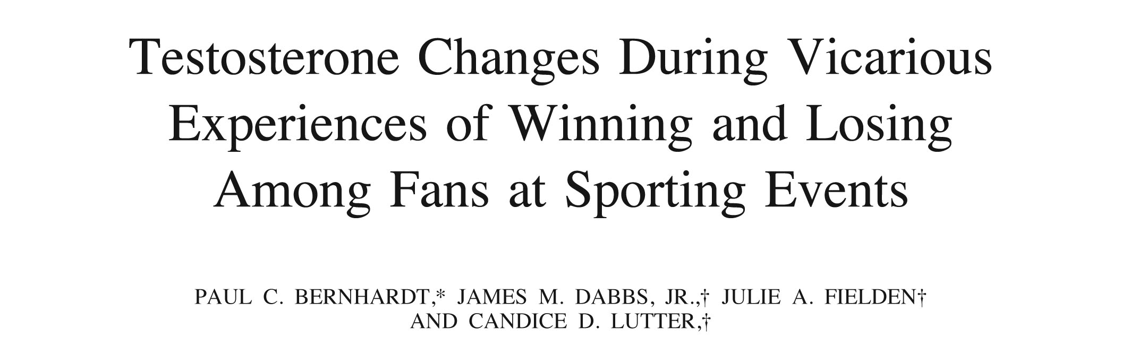
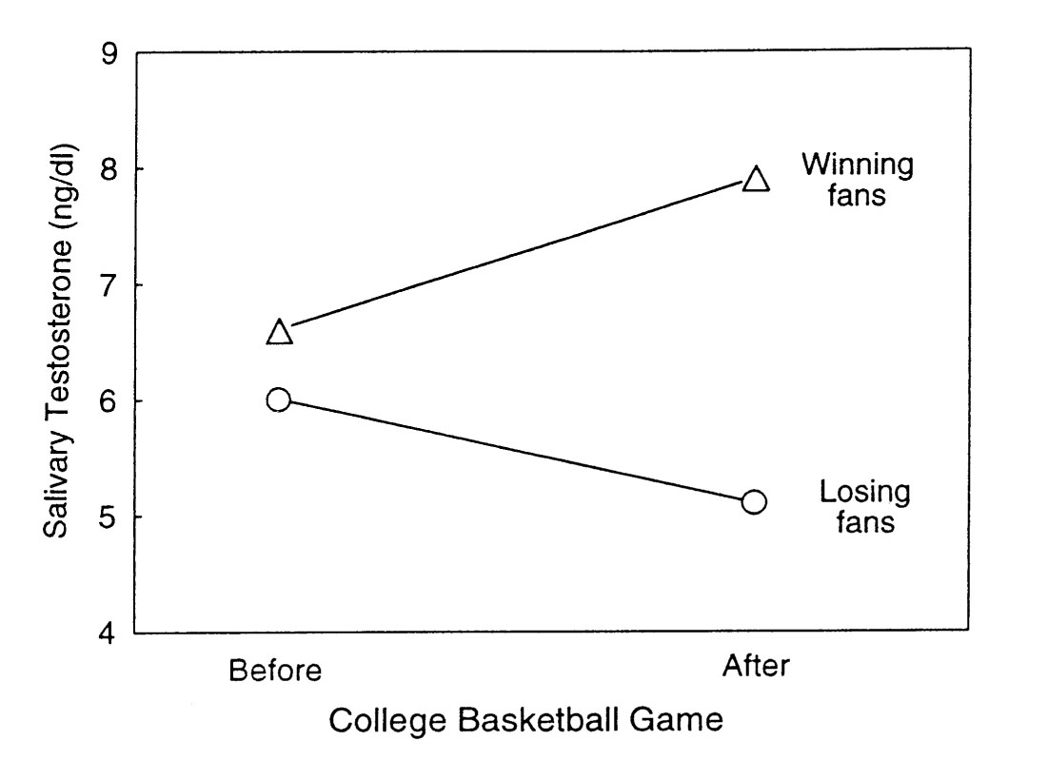
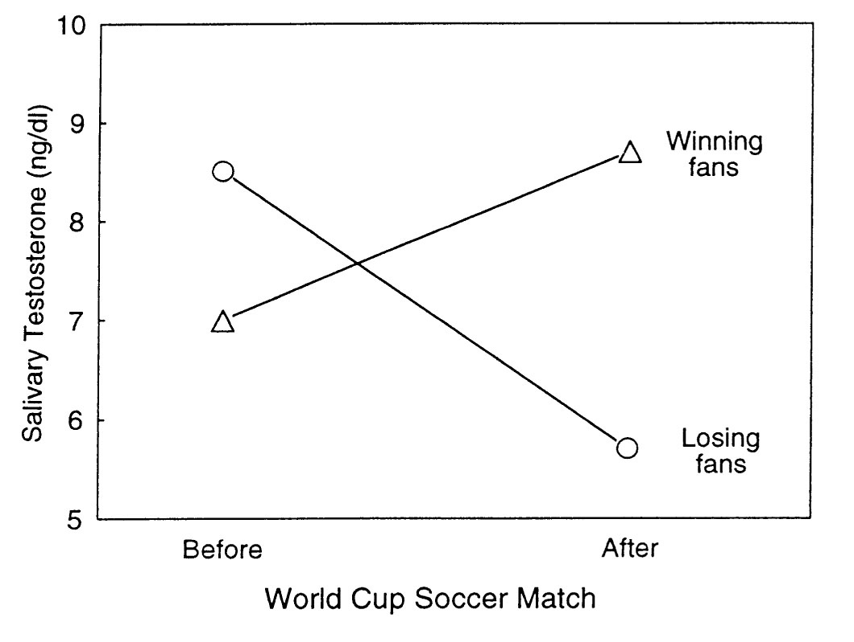
function of testosterone in human aggression is somewhat mysterious
Brazil
winning
fans
Italy
losing
fans
Do you know what year?

Slide 35
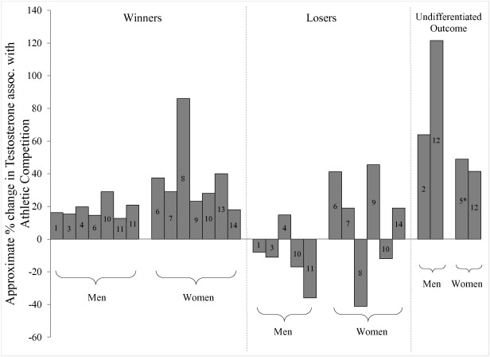
Fig. 1. 1 = Booth et al., 1989; 2 = Guezennec et al., 1995; 3 = González-Bono et al., 1999; 4 = Suay et al., 1999; 5 = Bateup et al., 2002; 6 = Edwards et al., 2006; 7 = Hamilton et al., 2009; 8 = Oliveira et al., 2009; 9 = Edwards and Kurlander, 2010; 10 = Ji...
Kathleen V. Casto, David A. Edwards (2016) Testosterone, cortisol, and human competition. Hormones and Behavior, 82, 21–37

Slide 36
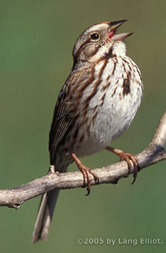
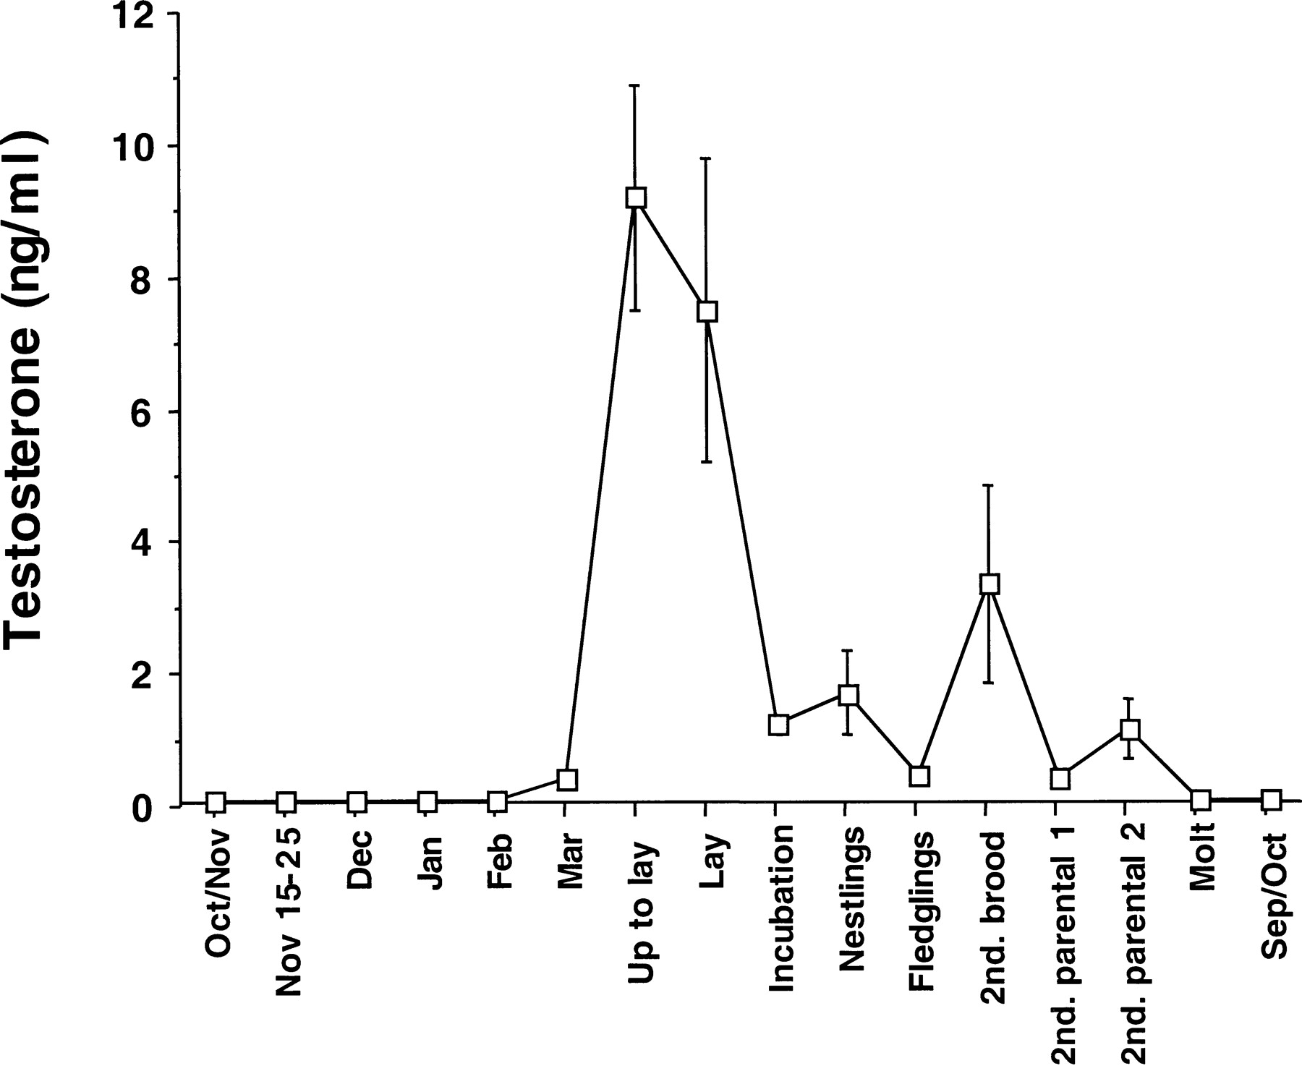
Androgens facilitate male-male aggression in songbirds.
Behavior mediated release varies with life history.
Song sparrow
(Melospiza melodia)
Wingfield & Soma 2002

Slide 37
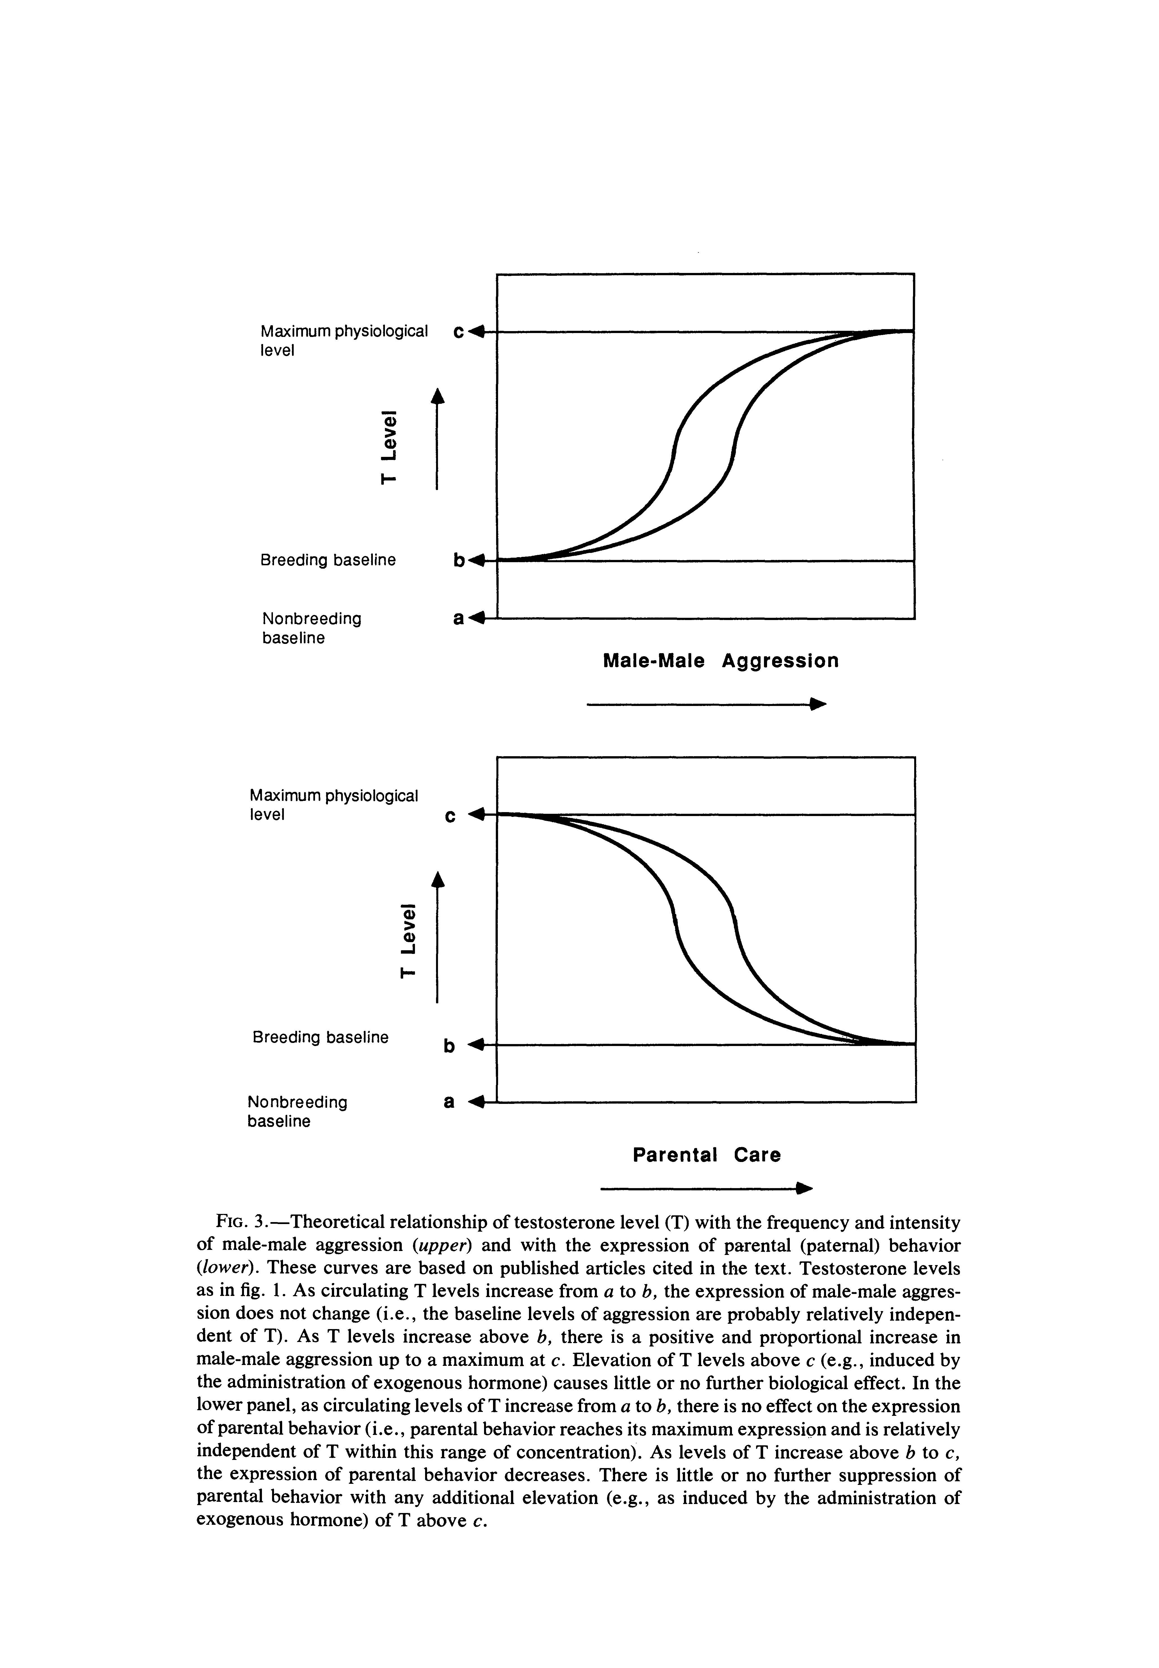
Androgens facilitate male-male aggression
Aggression takes time away from parental care
T = Testosterone
Wingfield et al. 1990

Slide 38
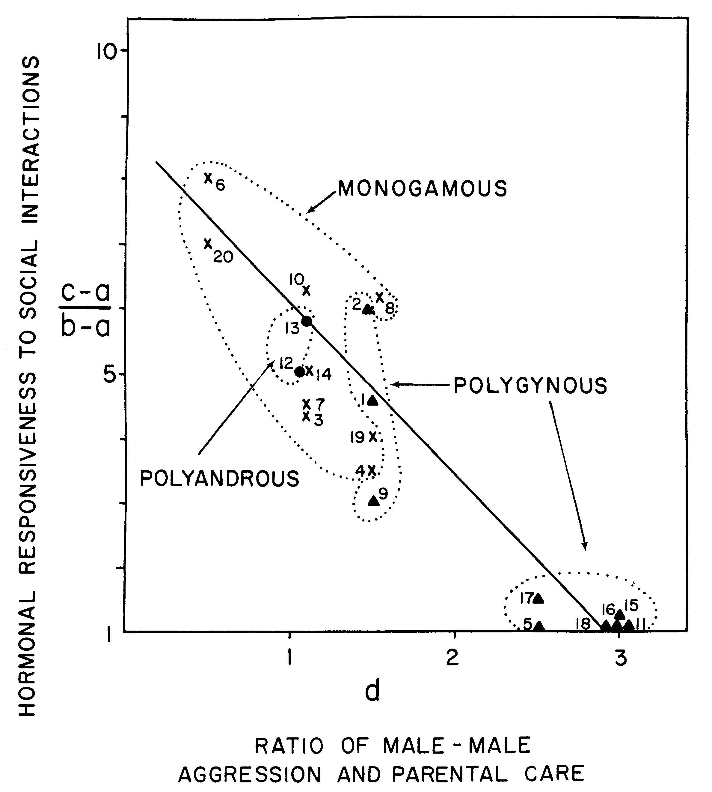
Social regulation of testosterone tracks the breeding systems of birds
High male parental care
Low male aggression
Low male parental care
High male aggression
Wingfield et al. 1990

Slide 39
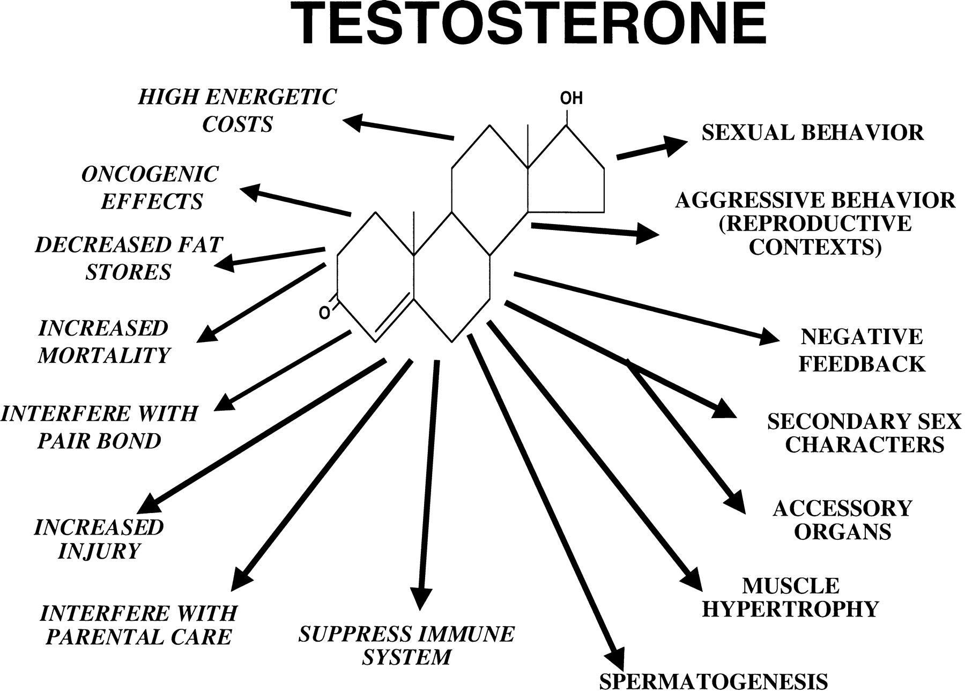
Physiological effects of testosterone good reasons for keeping T low except when breeding
Wingfield & Soma 2002

Slide 40
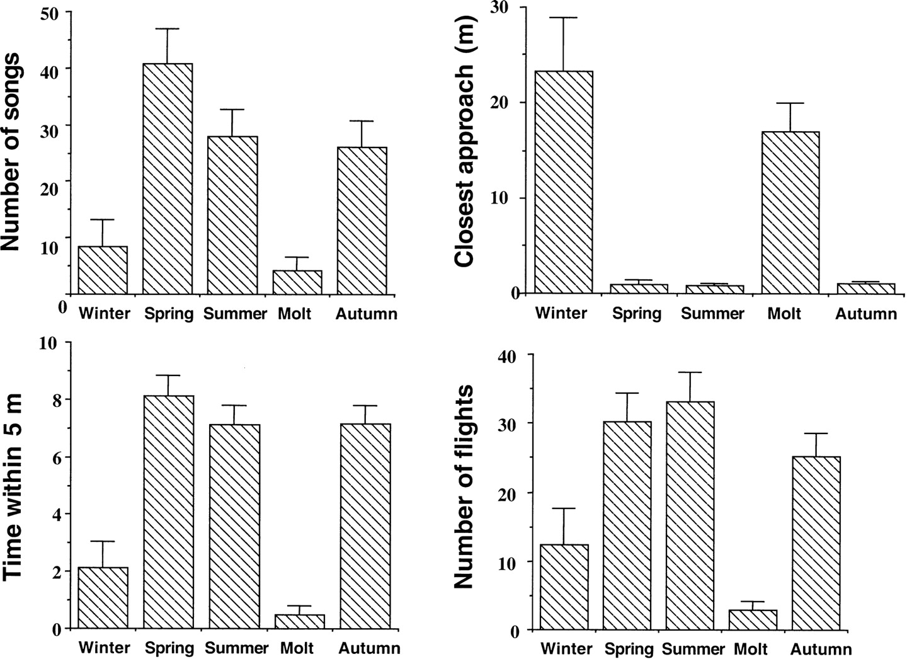
Male-male aggression returns in autumn when T levels are low – But how?
Wingfield & Soma 2002

Slide 41
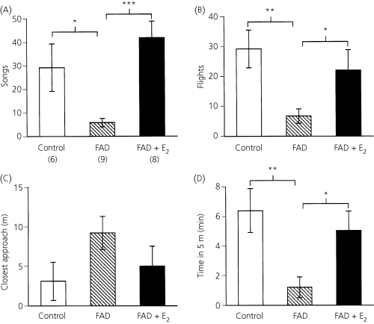
watch the receptors: androgens mediate aggression through estrogen receptors
Fadrizole inhibits aromatase E₂ = estradiol
Soma 2006

Slide 42
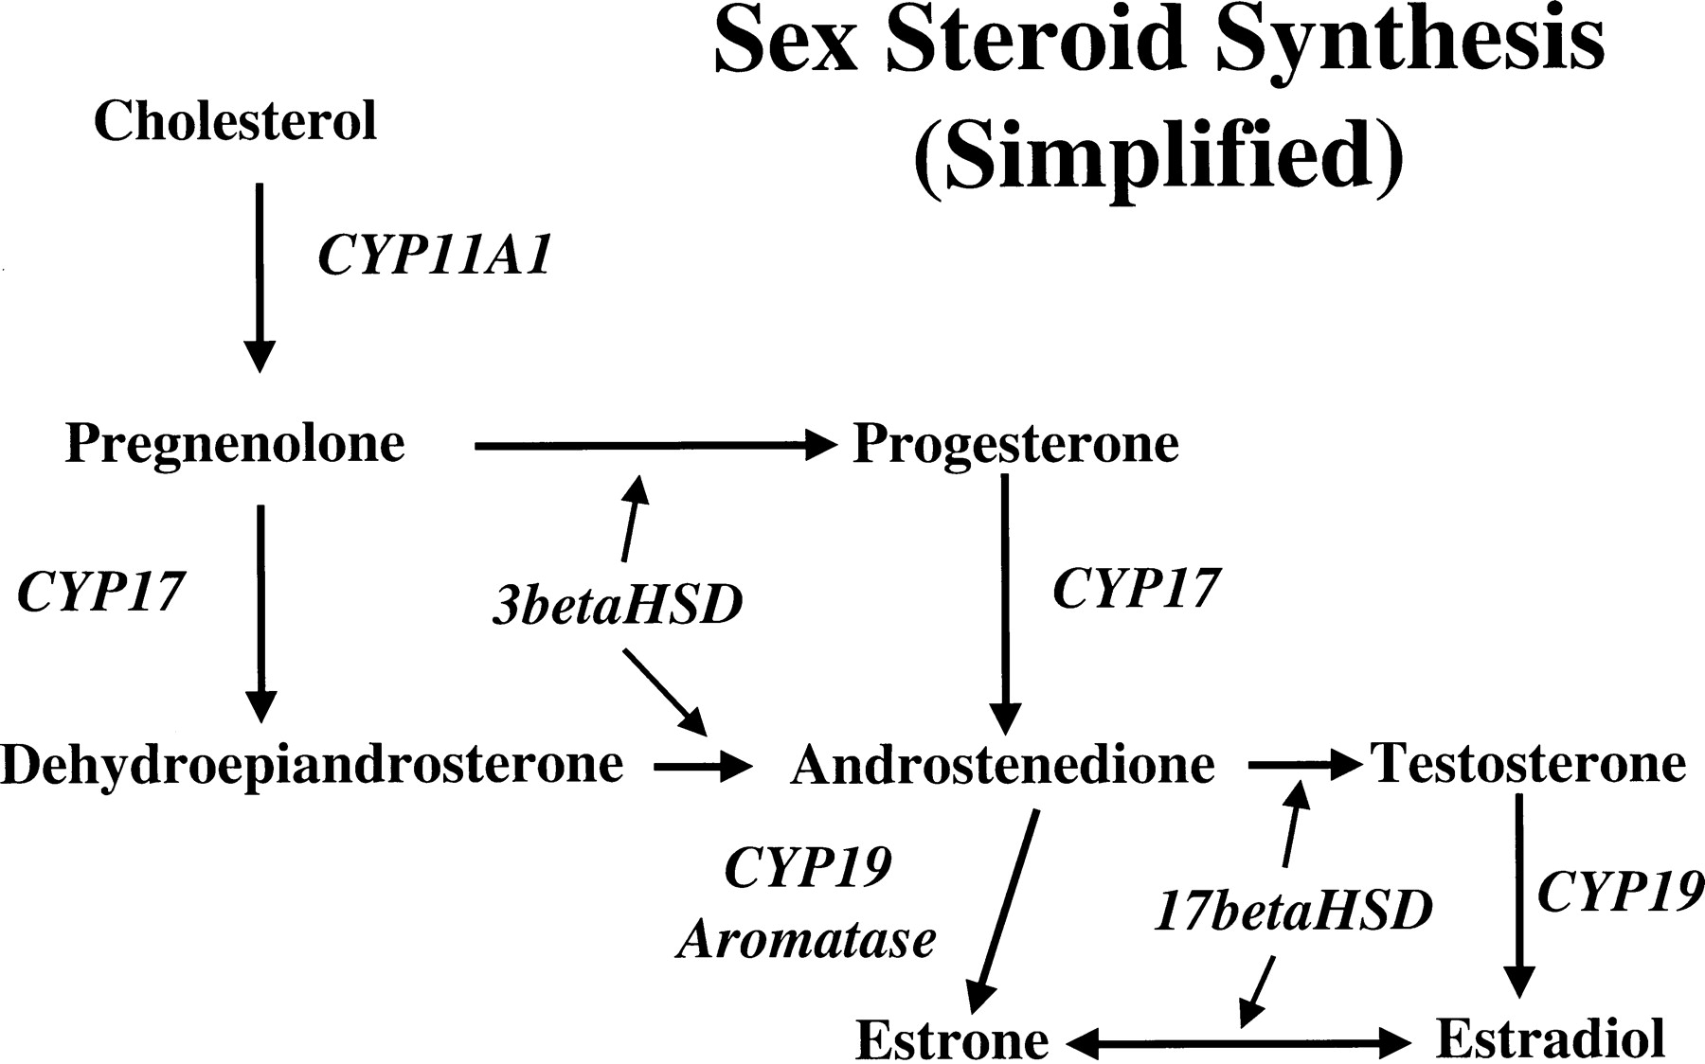
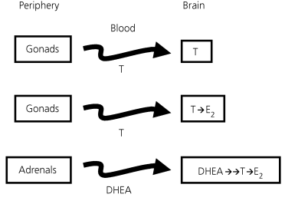
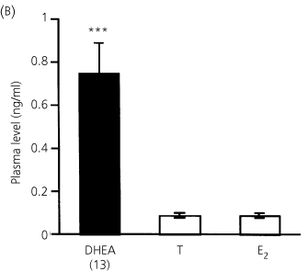
Aggression in the autumn season sustained by conversion of adrenal DHEA
Soma 2006

Slide 43
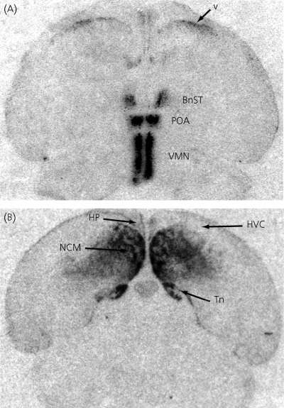
brains regulate aggression by making their own steroids
aromatase in the brain
of a male song sparrow
Soma 2006

Slide 44
Lessons from testosterone
1. Life history drives evolution of steroid release timing and locus.
2. Steroid actions on behavior are better conserved across taxa than peptide actions.
3. Brains make their own neurosteroids,
so watch the receptors.

Slide 45
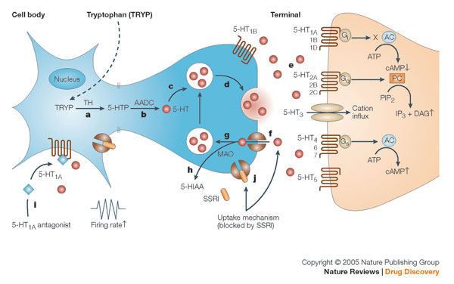
Serotonin synapse targets for evolution, experiment, & treatment

Slide 46
Serotonin & aggression dogma & paradox
Dogma: Chronic inhibition of aggression
5-HT release in pre-orbital cortex limits impulsive behavior, including aggression.
Low 5-HT activity facilitates aggressive behavior.
Paradox: Acute promotion of aggression
Inhibitory 5HT_{1A}R autoreceptors reduce 5-HT activity and inhibit aggressive reactions.
Sudden 5-HT rise in forebrain precedes aggression.

Slide 47
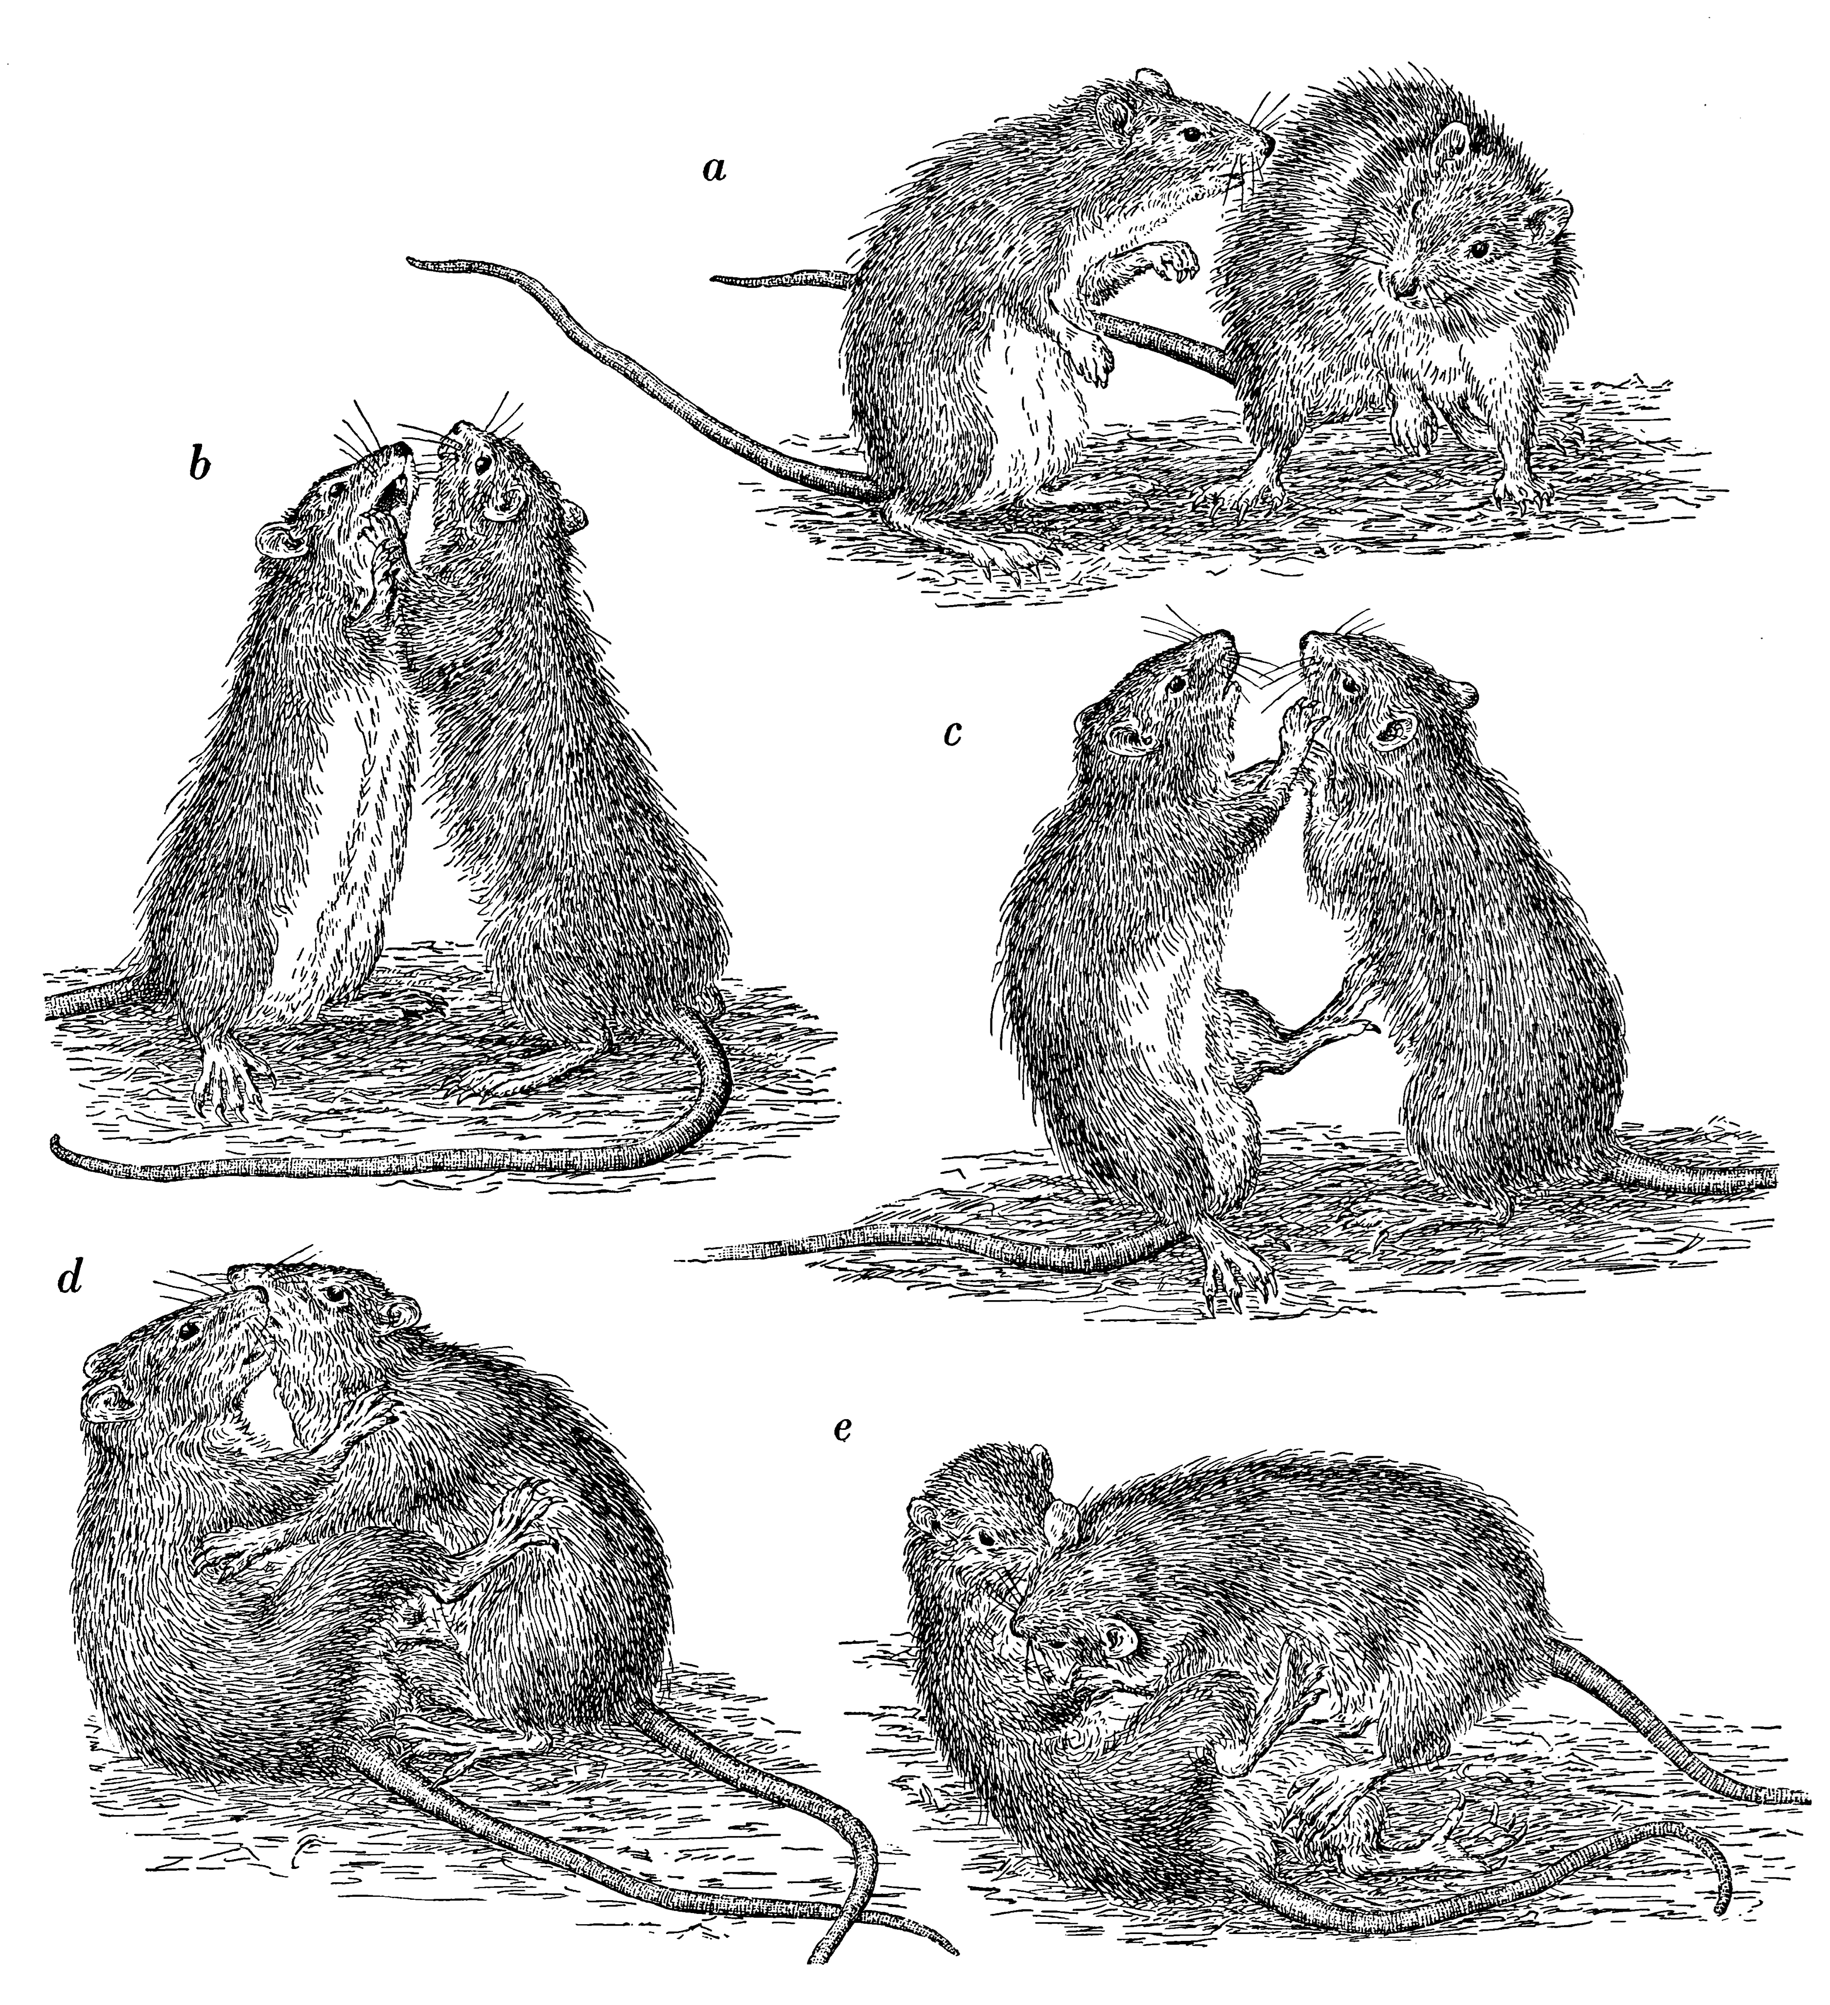
different forms of natural aggression have different neurochemistry
Wild-type brown rats
5-HT autoreceptors suppress
territorial aggression but not defensive aggression.
Autoreceptors are inhibitory,
so inhibition of 5-HT neurons decreases aggression.
Eibl-Eibsfeldt 1961
de Boer, Lesourd, Mocaer, Koolhaas, 2000

Slide 48
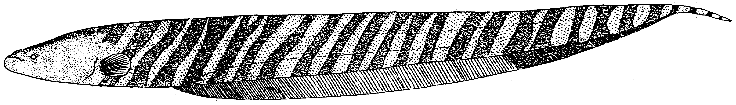
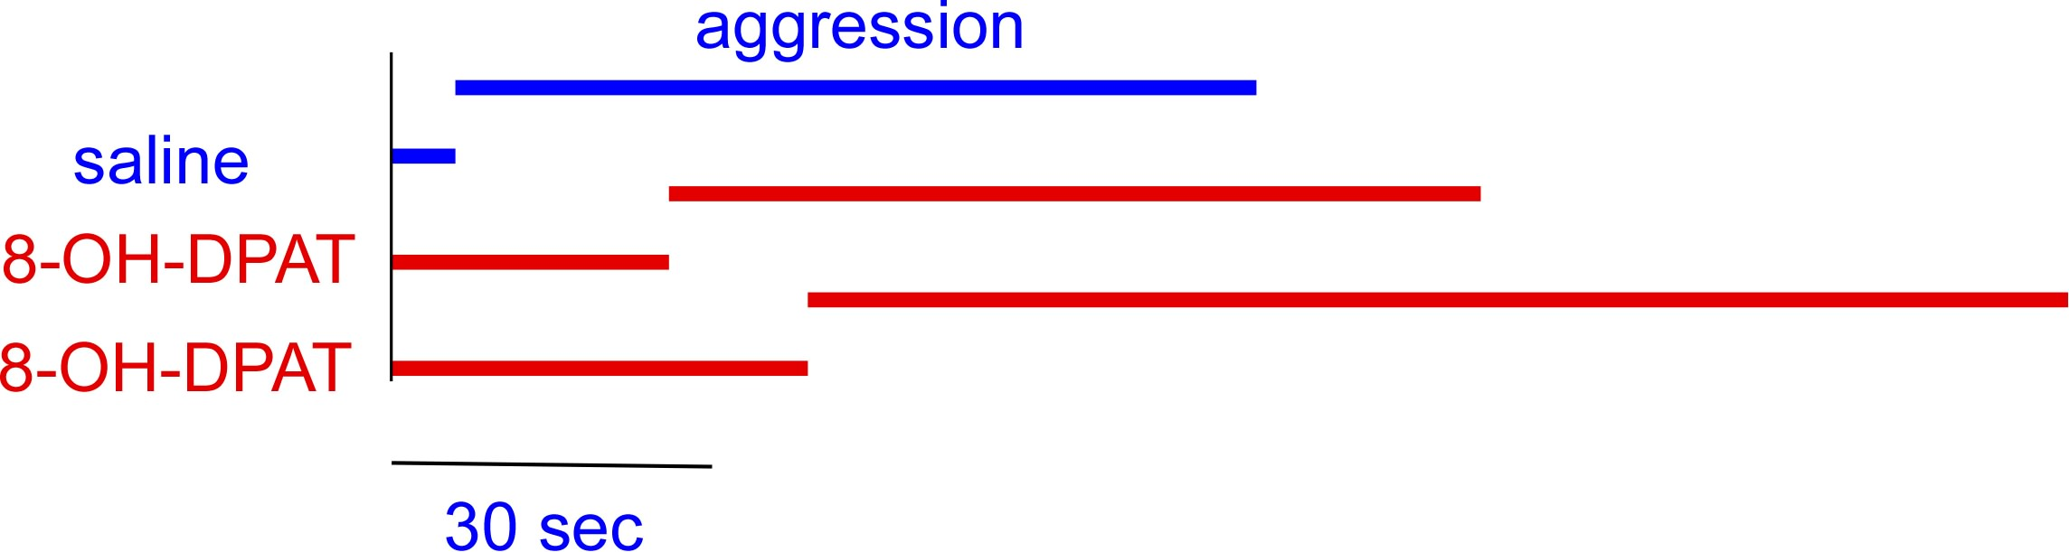
Hormones & neuromodulators facilitate but do not cause aggression:
5-HT in Gymnotus omari dyads
activating 5HT_{1A}R raises aggression initiation threshold
but it acts on autoreceptors to suppress 5-HT neurons

Slide 49
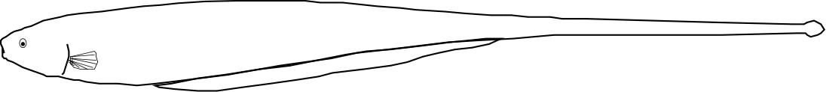

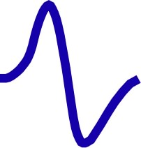
two postsynaptic serotonin receptors in B. gauderio change EOD waveform in opposite directions
excitation
more
5HT_{1A}R
constitutively active
5HT_{2A}R
5-HT
less
inhibition
Allee, Markham, Salazar, Stoddard 2008

Slide 50
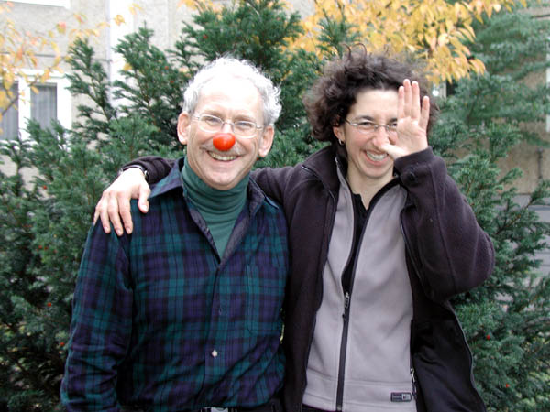
Serotonin treatment paradox
Effects of SSRIs include violence & suicide.
Ethologist Bob Reineke (1948-2007) with friend in 2006

Slide 51
Lessons from serotonin
A transmitter (e.g., 5-HT) does not encode behavior. Circuits & receptors encode the valence of behavior.

Slide 52
Conclusions about neuroendocrine regulation of behavioral strategies & tactics
Regarding model organisms of behavior:
a) principles transfer better than details.
b) life history is as important as phylogeny.

Slide 53
Conclusions about neuroendocrine regulation of behavioral strategies & tactics
Regarding model organisms of behavior:
a) principles transfer better than details.
b) life history is as important as phylogeny.
Evolution conserves ligands & circuits.
Receptor distributions are evolutionarily plastic.

Slide 54
Conclusions about neuroendocrine regulation of behavioral strategies & tactics
Regarding model organisms of behavior:
a) principles transfer better than details.
b) life history is as important as phylogeny.
Evolution conserves ligands & circuits.
Receptor distributions are evolutionarily plastic.
The same modulator produces opposite behaviors depending on the receptor type and its distribution.
Always watch the receptors.

