Slide 1
Ludwig Boltzmann and Atomic Theory
Principal Source:
Boltzmann’s Atom
David Lindley, The Free Press,
New York 2001

Slide 2
Atom
Greek ‘Uncutable’
Universe composed of indivisible objects

Slide 3
Philosophy and Atomic Theory
Titus Lucretius Carus (ca 95 to 55 BC)
Ancient Greece
“Clothes hung above a wind-swept shore grow damp; spread in the sun they dry again. Yet it is not apparent ot us how the moisture clings to the cloth, or flees the heat. Water, then, is dispersed in particles, atoms too small to be observable.”
De Rerum Natura (The Nature of Things)

Slide 4
Philosophy and Atomic Theory
Titus Lucretius Carus (ca 95 to 55 BC)
Ancient Greece
“For surely the atoms did not hold council, assigning order to each, flexing their keen minds with questions of place and motion and who goes where. But shuffled and jumbled in many ways, in the course of endless time they are buffeted, driven along, chancing upon all motions, combinations. At last they fall into such an arrangement as would create this universe…”
De Rerum Natura (The Nature of Things)

Slide 5
Daniel Bernoulli
Swiss
1738:
Relationship between pressure and atom vibration energy

Slide 6
John Herapath
1820:
Heat equals the motion of atoms
Paper rejected by Royal Society

Slide 7
John James Waterson (1811-1883)
Scottsman working in India
1845:
Temperature corresponds to energy of motion of ‘molecules’
Pressure due to impacts on container walls
All molecules have same energy, therefore heavier move more slowly
Paper rejected by Royal Society
Rediscovered by Lord Raleigh in 1891 and published in 1892

Slide 8
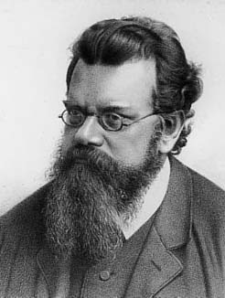
Ludwig Eduard Boltzmann
Born in Vienna 1844
Wels and Linz
University of Vienna 1863
Ph.D. at 22
University of Graz 1869
“Elegance is for the tailor and the shoemaker”
Died September 5, 1906

Slide 9
Students
Nernst
Arrhenius

Slide 10
1872: Further studies of the thermal equilibrium of gas molecules
Previously derived Maxwell-Boltzmann distribution of molecular velocities was the only possible solution at equilibrium

Slide 11
Maxwell-Boltzmann Distribution

Slide 12
Java Applets
http://comp.uark.edu/~jgeabana/mol_dyn/
http://www.uark.edu/misc/julio/kinth/avo.html

Slide 13
The H-theorem
Irreversible increase in entropy of an ideal gas.
“Appears to predict an irreversible increase in entropy, despite microscopically reversible dynamics. This has led to much discussion.” (Wikipedia)

Slide 14
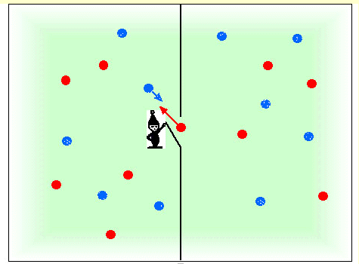
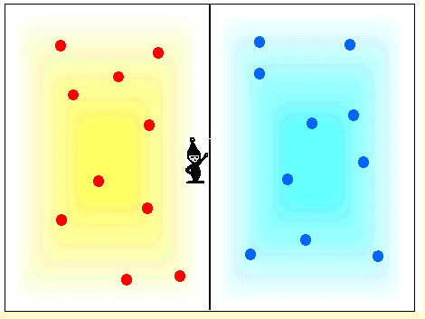
The H-theorem
Second Law of Thermodynamics: ΔS≥0
Maxwell’s demon
Koo-Chul Lee, School of Physics
Seoul National University
http://myhome.hanafos.com/~dcknsk/workshop/images/maxwell1.gif

