Slide 1
Final Exam Review
GLY-5835

Slide 2
Young-Laplace Eqn (1805)
∞
r

Slide 3
Young-Laplace (-Gauss)Eqn (1805, 1806, 1830)

Slide 4
Measuring Surface Tension

Slide 5
Surface Adhesion (Adsorption) in LBM

Slide 6
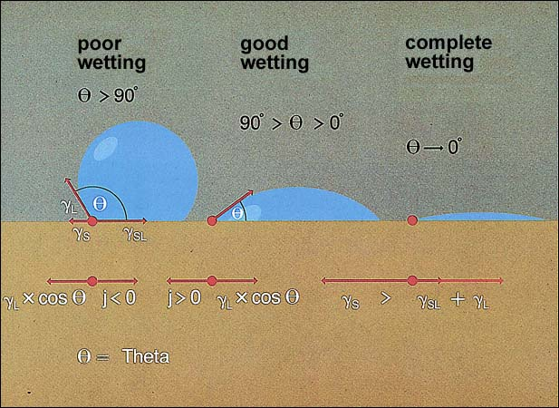
Wetting
http://www.hdm-stuttgart.de/projekte/printing-inks/b_sel42.jpg

Slide 7
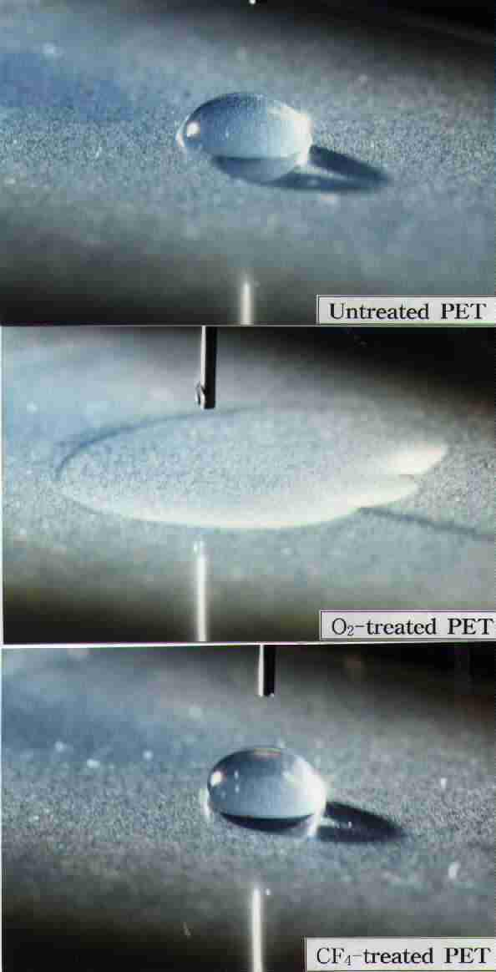
Wetting
http://psii.kist.re.kr/Teams/psii/research/Con_4.jpg

Slide 8
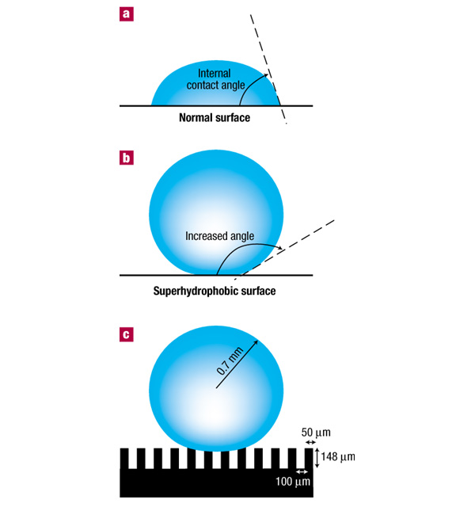
Geometrically-controlled Superhydrophobic surfaces
http://www.nature.com/nmat/journal/v1/n1/images/nmat715-f1.jpg

Slide 9
SCMP LBM Adhesive Force Formula
s is a ‘switch’ that takes on value 1 if the site at x + e_{a}Δt is a solid and is 0 otherwise
We seem to have flexibility in the choice of the pre-sum factor; the papers cited use ρ or Ψ

Slide 10
Computation of ψ
// Compute psi, Eq. (61).
for( j=0; j<LY; j++)
for( i=0; i<LX; i++)
if( !is_solid_node[j][i])
{
psi[j][i] = 4.*exp( -200. / ( rho[j][i]));
}

Slide 11
Sforce
// Compute interaction force, Eq. (66).
for( j=0; j<LY; j++)
{
jp = ( j<LY-1)?( j+1):( 0 );
jn = ( j>0 )?( j-1):( LY-1);
for( i=0; i<LX; i++)
{
ip = ( i<LX-1)?( i+1):( 0 );
in = ( i>0 )?( i-1):( LX-1);
if( !is_solid_node[j][i])
{
sum_x=0.;
sum_y=0.;
if( is_solid_node[j ][ip]) // neighbor 1
{ sum_x = sum_x + WM*ex[1];
sum_y = sum_y + WM*ey[1]; }
if( is_solid_node[jp][i ]) // neighbor 2
{ sum_x = sum_x + WM*ex[2];
sum_y = sum_y + WM*ey[2]; }
if( is_solid_node[j ][in]) // neighbor 3
{ sum_x = sum_x + WM*ex[3];
sum_y = sum_y + WM*ey[3]; }

Slide 12
Sforce
if( is_solid_node[jn][i ]) // neighbor 4
{ sum_x = sum_x + WM*ex[4];
sum_y = sum_y + WM*ey[4]; }
if( is_solid_node[jp][ip]) // neighbor 5
{ sum_x = sum_x + WD*ex[5];
sum_y = sum_y + WD*ey[5]; }
if( is_solid_node[jp][in]) // neighbor 6
{ sum_x = sum_x + WD*ex[6];
sum_y = sum_y + WD*ey[6]; }
if( is_solid_node[jn][in]) // neighbor 7
{ sum_x = sum_x + WD*ex[7];
sum_y = sum_y + WD*ey[7]; }
if( is_solid_node[jn][ip]) // neighbor 8
{ sum_x = sum_x + WD*ex[8];
sum_y = sum_y + WD*ey[8]; }
sforce_x[j][i] = -Gads * psi[j][i] * sum_x;
sforce_y[j][i] = -Gads * psi[j][i] * sum_y;
}
}
}

Slide 13
Contact Angles in SCMP LBM
Cohesive force:
Adhesive force:
Interplay between these forces will determine wetting

Slide 14
Contact Angles in SCMP LBM
Assume uniform liquid or vapor surroundings:

Slide 15
Contact Angles in LBM
Assume uniform surroundings:
Liquid
Vapor

Slide 16
Contact Angles in LBM
Assume uniform surroundings:
Liquid surrounded by solid
Vapor surrounded by solid

Slide 17
Contact Angles in LBM
Zero degree contact angle:
  Adhesive force equal to cohesive force for liquid
Liquid
Liquid surrounded by solid

Slide 18
Contact Angles in LBM
180 degree contact angle:
  Adhesive force on vapor equal to cohesive force for vapor
Vapor
Vapor surrounded by solid

Slide 19
Contact Angles in LBM
90 degree contact angle:
  Adhesive force on vapor equal to cohesive force for ‘interface’ ψ (= [ψ_{l +} ψ_{v}]/2)
Interface
Interface surrounded by solid

Slide 20
Multicomponent Multiphase
LB Models
Single Component Multiphase
Single Phase
(No Interaction)
Interaction Strength
Attractive
Number of Components
Nature of Interaction
Multi- Component Multiphase
Repulsive
Miscible Fluids/Diffusion (No Interaction)
Inherent Parallelism
Immiscible Fluids
High
Low

Slide 21
Adding a component/substance
Often just need another loop:
for( subs=0; subs<NUM_FLUID_COMPONENTS; subs++)
for( j=0; j<LY; j++)
for( i=0; i<LX; i++)
{
    …
}

Slide 22
One composite u for f_{eq} calculation
(Eqn. 95 in Sukop and Thorne; note error in 2006 printing)
// Compute density, Eq. (97), and the sums used (below)
// in the velocities.
for( subs=0; subs<NUM_FLUID_COMPONENTS; subs++)
for( j=0; j<LY; j++)
for( i=0; i<LX; i++)
{
rhoij[subs] = 0.;
u_xij[subs] = 0.;
u_yij[subs] = 0.;
if( !is_solid_node[j][i]) {
for( a=0; a<9; a++) {
rhoij[subs] += ftemp_ij[a];
u_xij[subs] += ex[a]*ftemp_ij[a];
u_yij[subs] += ey[a]*ftemp_ij[a]; } }
}

Slide 23
One composite u for f_{eq} calculation
// Compute the composite velocity and individual velocities.
for( j=0; j<LY; j++)
{
for( i=0; i<LX; i++)
{
if( !is_solid_node[j][i])
{
ux_sum = u_xij[0]/tau0 + u_xij[1]/tau1;
uy_sum = u_yij[0]/tau0 + u_yij[1]/tau1;
if( rhoij[0] + rhoij[1] != 0)
{
// Composite velocity, Eq. (95).
uprime_x = ( ux_sum) / ( rhoij[0]/tau0 + rhoij[1]/tau1);
uprime_y = ( uy_sum) / ( rhoij[0]/tau0 + rhoij[1]/tau1);
}
else { uprime_x = 0.; uprime_y = 0.; }
// Individual velocities, Eq. (96), x-direction.
if( rhoij[0] != 0) { u_xij[0] = u_xij[0] / rhoij[0]; }
else { u_xij[0] = 0.; }
if( rhoij[1] != 0) { u_xij[1] = u_xij[1] / rhoij[1]; }
else { u_xij[1] = 0.; }
// Individual velocities, Eq. (96), y-direction.
if( rhoij[0] != 0) { u_yij[0] = u_yij[0] / rhoij[0]; }
else { u_yij[0] = 0.; }
if( rhoij[1] != 0) { u_yij[1] = u_yij[1] / rhoij[1]; }
else { u_yij[1] = 0.; }
}
}
}

Slide 24
Interparticle Forces
// Compute fluid-fluid interaction force, equation (98),
// (assuming periodic domain).
//
// We begin by computing psi even though in this implementation
// it is the same as rho. A different function of rho could
// be substituted here.
for( subs=0; subs<NUM_FLUID_COMPONENTS; subs++)
for( j=0; j<LY; j++)
for( i=0; i<LX; i++)
if( !is_solid_node[j][i])
{
psi[subs][j][i] = rho[subs][j][i];
}

Slide 25
Interparticle Forces
// Compute the summations in Eq. (98).
for( subs=0; subs<NUM_FLUID_COMPONENTS; subs++)
{
for( j=0; j<LY; j++)
{
jp = ( j<LY-1)?( j+1):( 0 );
jn = ( j>0 )?( j-1):( LY-1);
for( i=0; i<LX; i++)
{
ip = ( i<LX-1)?( i+1):( 0 );
in = ( i>0 )?( i-1):( LX-1);
Fxtemp = 0.;
Fytemp = 0.;

Slide 26
Interparticle Forces
if( !is_solid_node[j][i])
{
if( !is_solid_node[j ][ip]) // neighbor 1
{ Fxtemp = Fxtemp + WM*ex[1]*psi[subs][j ][ip];
Fytemp = Fytemp + WM*ey[1]*psi[subs][j ][ip]; }
if( !is_solid_node[jp][i ]) // neighbor 2
{ Fxtemp = Fxtemp + WM*ex[2]*psi[subs][jp][i ];
Fytemp = Fytemp + WM*ey[2]*psi[subs][jp][i ]; }
if( !is_solid_node[j ][in]) // neighbor 3
{ Fxtemp = Fxtemp + WM*ex[3]*psi[subs][j ][in];
Fytemp = Fytemp + WM*ey[3]*psi[subs][j ][in]; }
if( !is_solid_node[jn][i ]) // neighbor 4
{ Fxtemp = Fxtemp + WM*ex[4]*psi[subs][jn][i ];
Fytemp = Fytemp + WM*ey[4]*psi[subs][jn][i ]; }
if( !is_solid_node[jp][ip]) // neighbor 5
{ Fxtemp = Fxtemp + WD*ex[5]*psi[subs][jp][ip];
Fytemp = Fytemp + WD*ey[5]*psi[subs][jp][ip]; }
if( !is_solid_node[jp][in]) // neighbor 6
{ Fxtemp = Fxtemp + WD*ex[6]*psi[subs][jp][in];
Fytemp = Fytemp + WD*ey[6]*psi[subs][jp][in]; }
if( !is_solid_node[jn][in]) // neighbor 7
{ Fxtemp = Fxtemp + WD*ex[7]*psi[subs][jn][in];
Fytemp = Fytemp + WD*ey[7]*psi[subs][jn][in]; }
if( !is_solid_node[jn][ip]) // neighbor 8
{ Fxtemp = Fxtemp + WD*ex[8]*psi[subs][jn][ip];
Fytemp = Fytemp + WD*ey[8]*psi[subs][jn][ip]; }
} /* if( !is_solid_node[j][i]) */

Slide 27
Interparticle Forces
Fx[subs][j][i] = Fxtemp;
Fy[subs][j][i] = Fytemp;
} /* for( i=0; i<LX; i++) */
} /* for( j=0; j<LY; j++) */
} /* for( subs=0; subs<NUM_FLUID_COMPONENTS; subs++) */
// Compute the final interaction forces of Eq. (98) using
// the summations computed above.
for( j=0; j<LY; j++)
{
for( i=0; i<LX; i++)
{
if( !is_solid_node[j][i])
{
Fxtemp = Fx[1][j][i];
Fx[1][j][i] = -G*psi[1][j][i]*Fx[0][j][i];
Fx[0][j][i] = -G*psi[0][j][i]*Fxtemp;
Fytemp = Fy[1][j][i];
Fy[1][j][i] = -G*psi[1][j][i]*Fy[0][j][i];
Fy[0][j][i] = -G*psi[0][j][i]*Fytemp;
}
}
}

Slide 28
Complementary Densities
6,000 ts
Domain 5X100
Periodic boundary

Slide 29

Complementary Densities
2,500 ts
Domain 100X100
Periodic boundary

Slide 30

Computing big U (aka ueq)
#define BIG_U_X( u_, rho_) \
(u_) \
+ lattice->param.tau[subs] \
* lattice->force[subs][n].force[0]/(rho_) \
+ lattice->param.tau[subs] \
* lattice->force[subs][n].sforce[0]/(rho_) \
+ lattice->param.tau[subs] \
* lattice->param.gforce[subs][0]
#define BIG_U_Y( u_, rho_) \
(u_) \
+ lattice->param.tau[subs] \
* lattice->force[subs][n].force[1]/(rho_) \
+ lattice->param.tau[subs] \
* lattice->force[subs][n].sforce[1]/(rho_) \
+ lattice->param.tau[subs] \
* lattice->param.gforce[subs][1]

Slide 31

Multicomponent Multiphase LBM
Separate distributions
Repulsive interaction

Slide 32
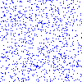
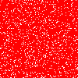
Phase (fluid-fluid) separation

Slide 33
Laplace Law
Interfacial tension (as opposed to surface tension between a liquid and its own vapor)

Slide 34
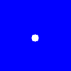
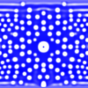
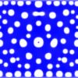
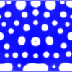




Metastability

Slide 35
MCMP LBM with Surfaces
Like SCMP except each fluid phase can interact with surface
Two surface interaction parameters, one fluid/fluid
Young’s Equation:

Slide 36
MCMP SForce
for( j=0; j<LY; j++)
{
jp = ( j<LY-1)?( j+1):( 0 );
jn = ( j>0 )?( j-1):( LY-1);
for( i=0; i<LX; i++)
{
ip = ( i<LX-1)?( i+1):( 0 );
in = ( i>0 )?( i-1):( LX-1);
if( !is_solid_node[j][i])
{
sum_x=0.;
sum_y=0.;
if( is_solid_node[j ][ip]) // neighbor 1
{ sum_x = sum_x + WM*ex[1];
sum_y = sum_y + WM*ey[1];}
if( is_solid_node[jp][i ]) // neighbor 2
{ sum_x = sum_x + WM*ex[2];
sum_y = sum_y + WM*ey[2];}
if( is_solid_node[j ][in]) // neighbor 3
{ sum_x = sum_x + WM*ex[3];
sum_y = sum_y + WM*ey[3];}
if( is_solid_node[jn][i ]) // neighbor 4
{ sum_x = sum_x + WM*ex[4];
sum_y = sum_y + WM*ey[4];}
if( is_solid_node[jp][ip]) // neighbor 5
{ sum_x = sum_x + WD*ex[5];
sum_y = sum_y + WD*ey[5];}
if( is_solid_node[jp][in]) // neighbor 6
{ sum_x = sum_x + WD*ex[6];
sum_y = sum_y + WD*ey[6];}
if( is_solid_node[jn][in]) // neighbor 7
{ sum_x = sum_x + WD*ex[7];
sum_y = sum_y + WD*ey[7];}
if( is_solid_node[jn][ip]) // neighbor 8
{ sum_x = sum_x + WD*ex[8];
sum_y = sum_y + WD*ey[8];}
for( subs=0; subs<NUM_FLUID_COMPONENTS; subs++)
{
sforce_x[subs][j][i] = -Gads[subs]*sum_x;
sforce_y[subs][j][i] = -Gads[subs]*sum_y;
}
}
}
}

Slide 37
MCMP surface forces
A surrounded by itself:
  F_{A} = G ρ_{A}ρ_{B}
A surrounded by solid:
  F_{ads}^{A} = G_{ads}^{A}ρ_{A}
F_{ads}^{A} = F_{A} leads to:
Since complimentary density is low, G_{ads} should be small relative to G

Slide 38
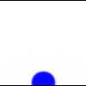
90-degree contact angle
Multicomponent fluids interacting with a surface when G = 0.1 and G_{ads}¹ = G_{ads}² = -0.01.

Slide 40

45° Contact Angle
Wetting fluid must have lowest G_{ads}
Multicomponent fluids interacting with a surface when G = 0.1, G_{ads}¹ = -0.02, and G_{ads}² = 0.0507.

Slide 41
2 Phase Flow Analytical Solution
q₁
H-h
u₂
q₂
u₁
Y
h
β
Z
g

Slide 42
Co- and Counter-current flows

Slide 43
Countercurrent air and water
Pressure gradient in air phase
Pressure gradient in water phase

Slide 44
Density and Viscosity Contrasts
Large density and viscosity contrasts are a major challenge of LBM research.
McCracken and Abraham (2005): pressure in standard multicomponent LB models is p = (ρ₁ + ρ₂)c_{s}², where c_{s} is the speed of sound
Significance is that for total pressure to be constant, the sum of the densities of the 2 species must be constant
Not the case in real gasses, where differing molecular weights lead to constant pressures despite different densities

Slide 45
Multicomponent Miscible
LB Models
Single Component Multiphase
Single Phase
(No Interaction)
Interaction Strength
Attractive
Number of Components
Nature of Interaction
Multi- Component Multiphase
Repulsive
Miscible Fluids/Diffusion (No Interaction)
Inherent Parallelism
Immiscible Fluids
High
Low

Slide 46
Solute/Heat Transport
Two approaches:
  Multicomponent with 0 or small interaction parameter
  ‘Passive’ second component (Inamuro)

Slide 47
Diffusion Modeling with LB
Flekøy [PRE 1993]/Yoshino and Inamuro [Int. J. Num. Meth. 2003]
  Multicomponent LB
  Separate ‘passive’ distribution
Shan and Doolen [PRE 1996]
  Multicomponent, multiphase LB (Phase separation possible)
  Separate ‘active’ distribution
  ‘Complementary’ densities
Diffusion coefficient:
Relaxation time

Slide 48
1-D Tests
Crank, J. 1975. The Mathematics of Diffusion, 2nd ed. Clarendon Press, Oxford. 414 pp.
Fick’s 2nd Law:
Unbounded domain
  Plane instantaneous source
  Extended source
Initial Mass
Initial Concentration
Half-width of source

Slide 49
1-D Test with a wall
Finite system:
Standard ‘Bounce-back’ from solids boundary works for diffusion
Superposition of original
process and reflections
Bounceback alone is a suitable no flux BC

Slide 50

2-D Test
Instantaneous point source:

Slide 51
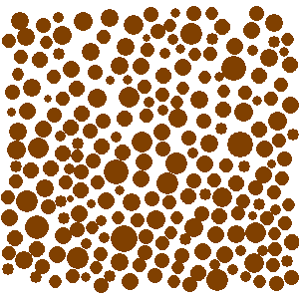
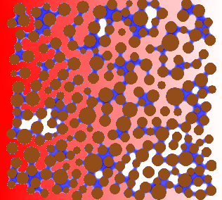
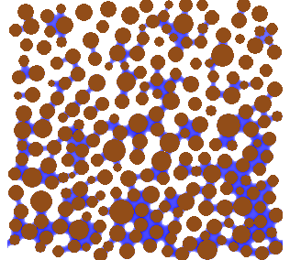
Effective Diffusion
Tortuosity (T = Lpath/L) and percolation (2D)

Slide 52
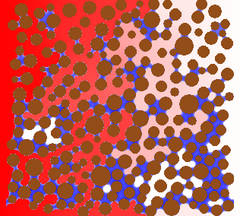
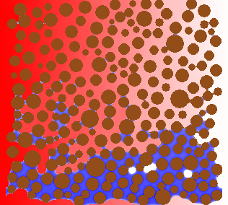
Gravity and Bond Number
No Gravity
Gravity
2x Gravity
Gravitational/capillary forces
  g gravitational acceleration
  r characteristic pore radius
  Δρ difference in fluid densities
  γ interfacial tension between fluids
Surface tension

Slide 53

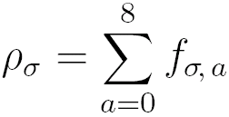
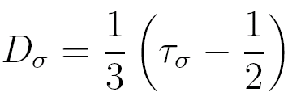
Solute Transport (Inamuro method)
Solute is simulated by a second distribution f_{σ} called the “solute component” or σ-component.
f_{σ} corresponds to the fluid distribution function except with a simpler equilibrium distribution
Concentration: // Analogous to fluid density.
Diffusion coefficient: // Analogous to viscosity.
Yoshino, M. and T. Inamuro (2003) Int. J. Numer. Meth. Fluids 43, 183.

Slide 54
LBM Constant Concentration
Yoshino, M. and T. Inamuro, 2003. Int. J. Numer. Meth. Fluids 43, 183.

Slide 55
Constant Concentration BC Code
// Constant concentration on north side.
for( i=0; i<LX; i++)
{
fi = ftemp[LY-1][i];
rho_sigma_prime = 6.*( rho_sigma_bar
- ( fi[0] + fi[1] + fi[3]
+ fi[2] + fi[5] + fi[6]));
fi[4] = (1./ 9.)*rho_sigma_prime;
fi[7] = (1./36.)*rho_sigma_prime;
fi[8] = (1./36.)*rho_sigma_prime;
}
// Constant concentration on south side.
for( i=0; i<LX; i++)
{
fi = ftemp[0][i];
rho_sigma_prime = 6.*( rho_sigma_bar
- ( fi[0] + fi[1] + fi[3]
+ fi[7] + fi[4] + fi[8]));
fi[2] = (1./ 9.)*rho_sigma_prime;
fi[5] = (1./36.)*rho_sigma_prime;
fi[6] = (1./36.)*rho_sigma_prime;
}
// Constant concentration on east side.
for( j=0; j<LY; j++)
{
fj = ftemp[j][LX-1];
rho_sigma_prime = 6.*( rho_sigma_bar
- ( fj[0] + fj[2] + fj[4]
+ fj[1] + fj[5] + fj[8]));
fj[3] = (1./ 9.)*rho_sigma_prime;
fj[7] = (1./36.)*rho_sigma_prime;
fj[6] = (1./36.)*rho_sigma_prime;
}
// Constant concentration on west side.
for( j=0; j<LY; j++)
{
fj = ftemp[j][0];
rho_sigma_prime = 6.*( rho_sigma_bar
- ( fj[0] + fj[2] + fj[4]
+ fj[3] + fj[6] + fj[7]));
fj[1] = (1./ 9.)*rho_sigma_prime;
fj[5] = (1./36.)*rho_sigma_prime;
fj[8] = (1./36.)*rho_sigma_prime;
}

Slide 56
LBM Constant Flux Boundaries
Maintaining true constant concentration difficult
Constant flux more common
Finite difference approximation

Slide 57
LBM Fixed/Zero Diffusive Flux
n

Slide 58
Constant Diffusive Flux Code
// Constant diffusive flux boundary on north side.
for( i=0; i<LX; i++)
{
fi = ftemp[LY-1][i];
rho_prime = 6.*( J0 + fi[2] + fi[5] + fi[6]);
fi[4] = (1./ 9.)*rho_prime;
fi[7] = (1./36.)*rho_prime;
fi[8] = (1./36.)*rho_prime;
}
// Constant diffusive flux boundary on south side.
for( i=0; i<LX; i++)
{
fi = ftemp[0][i];
rho_prime = 6.*( J0 + fi[7] + fi[4] + fi[8]);
fi[2] = (1./ 9.)*rho_prime;
fi[5] = (1./36.)*rho_prime;
fi[6] = (1./36.)*rho_prime;
}
// Constant diffusive flux boundary on east side.
for( j=0; j<LY; j++)
{
fj = ftemp[j][LX-1];
rho_prime = 6.*( J0 + fi[1] + fi[5] + fi[8]);
fj[3] = (1./ 9.)*rho_prime;
fj[7] = (1./36.)*rho_prime;
fj[6] = (1./36.)*rho_prime;
}
// Constant diffusive flux boundary on west side.
for( j=0; j<LY; j++)
{
fj = ftemp[j][0];
rho_prime = 6.*( J0 + fi[3] + fi[6] + fi[7]);
fj[1] = (1./ 9.)*rho_prime;
fj[5] = (1./36.)*rho_prime;
fj[8] = (1./36.)*rho_prime;
}

Slide 59
Macroscopic Governing Equations
Diffusion or heat equation
Convection-Diffusion/Dispersion Equation (CDE)

Slide 60
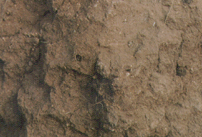
Breakthrough Curves
Influent Solution: Concentration C₀
‘Piston’ Flow – no dispersion
Dispersed Flow
Retarded/ Dispersed Flow
Effluent Solution: Concentration C

Slide 61
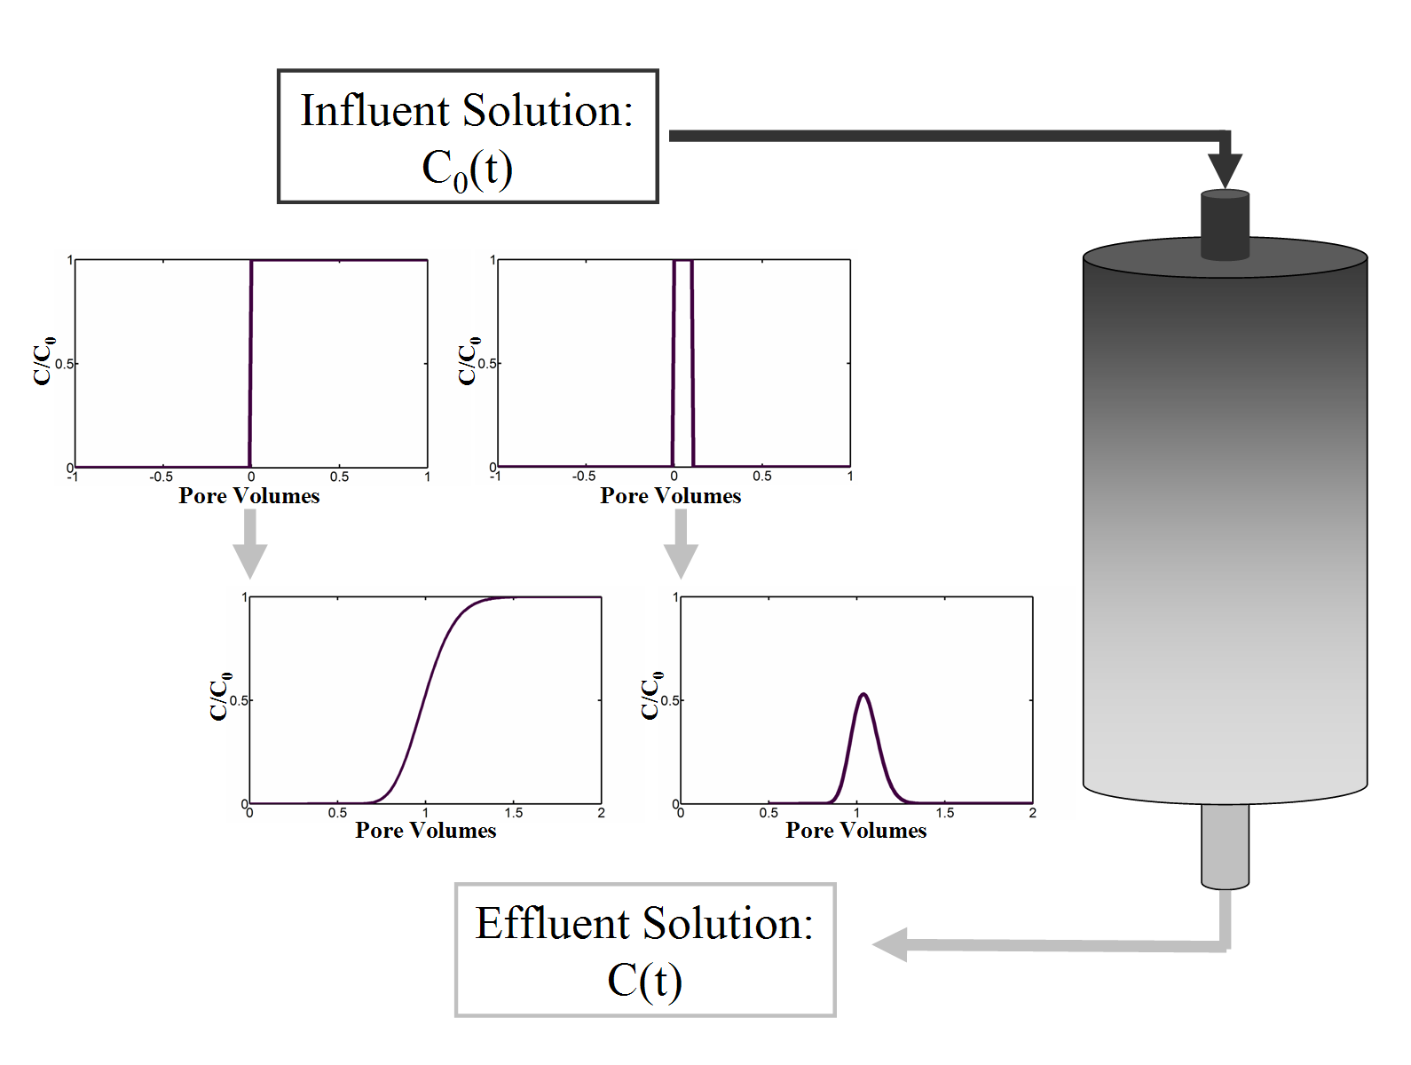

Slide 62


Breakthrough Curve
q = 1 m/y
10 m

Slide 63
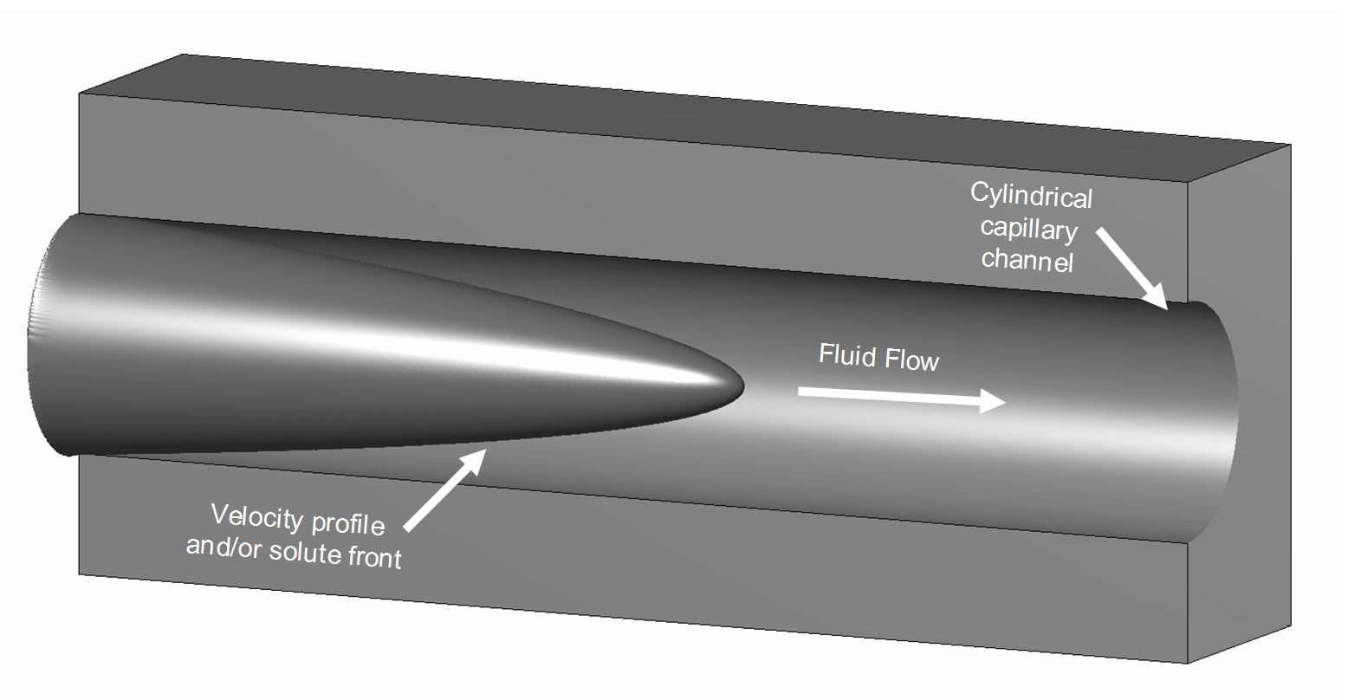
Taylor Dispersion

Slide 64
Taylor Dispersion

Slide 65
Taylor/Aris Dispersion
See also Stockman, H.W., A lattice-gas study of retardation and dispersion in fractures: assessment of errors from desorption kinetics and buoyancy, Wat. Resour. Res. 33, 1823 - 1831, 1997.

Slide 66
Pore Volume

Slide 67
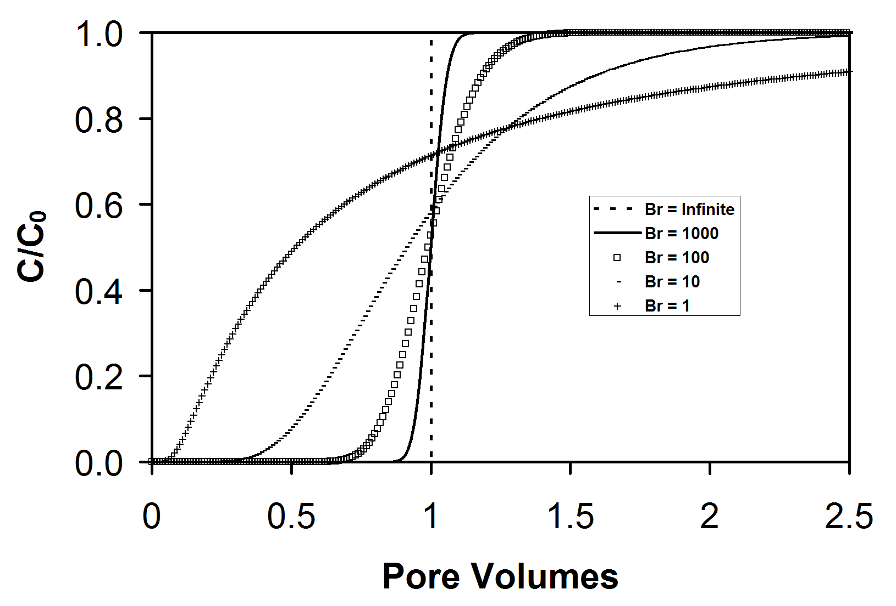
Continuous Source

Slide 68
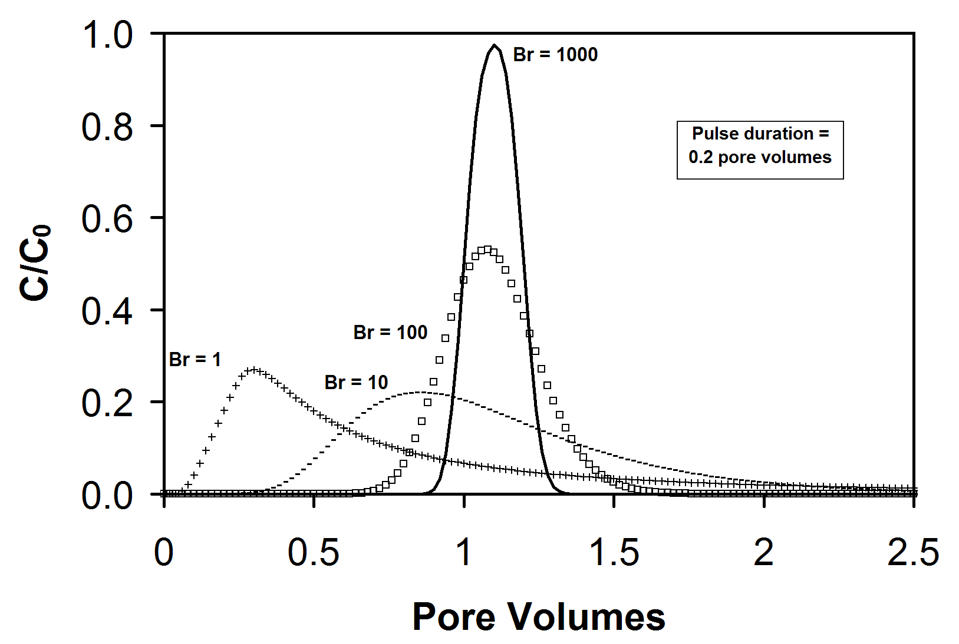
Pulse Source

Slide 69
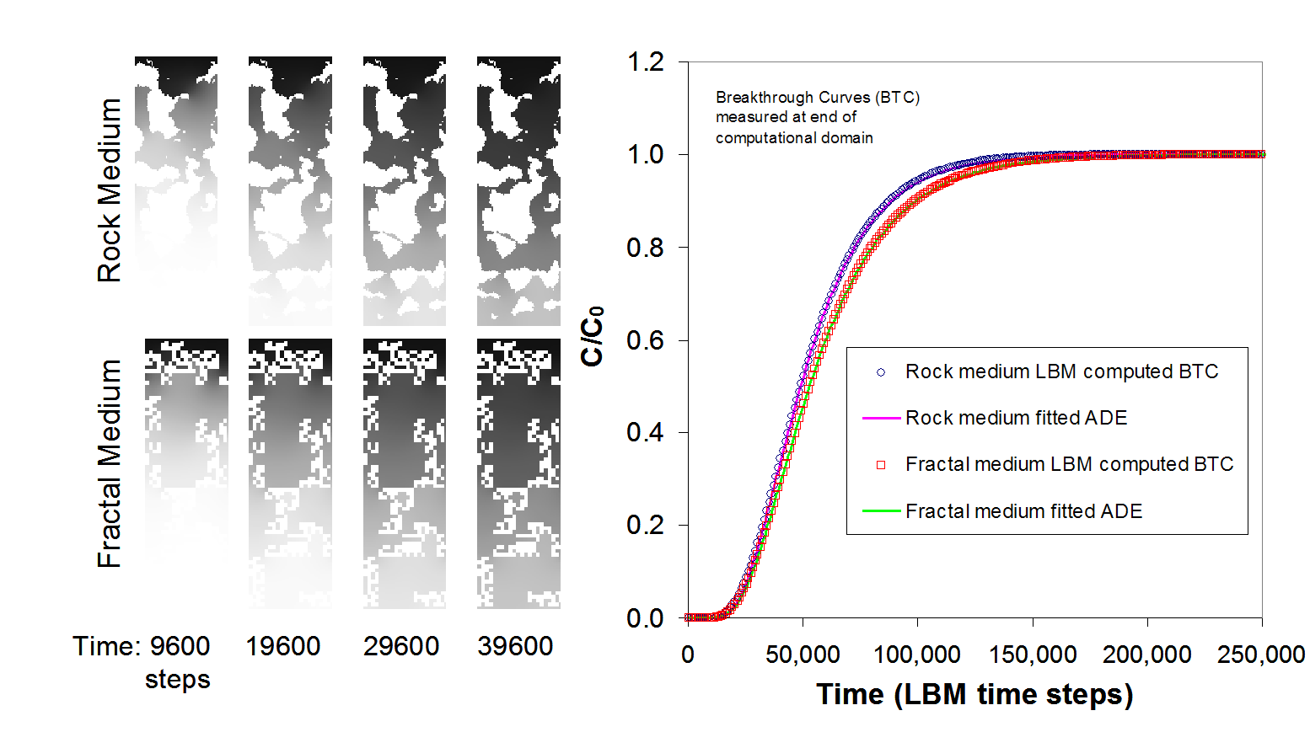
Solute Transport in Porous Media

Slide 70

Analytical Solutions
A-1
A-2
A-3
A-4
van Genuchten, M.Th. and P.J. Wierenga (1986) Solute dispersion coefficients and retardation factors. In: Klute A (ed.) Methods of Soil Analysis, 2nd edn, Part 1, pp 1025-1054. American Society of Agronomy, Madison, Wisconsin.

Slide 71
Analytical Solutions
van Genuchten M Th and Wierenga PJ (1986) Solute dispersion coefficients and retardation factors. In: Klute A (ed.) Methods of Soil Analysis, 2nd edn, Part 1, pp 1025-1054. American Society of Agronomy, Madison, Wisconsin.

Slide 72
Convection-Diffusion (1D Open)
D_{m} = 0.00033 lu ts⁻¹
Br = 760
A-1
A-3

Slide 73
Taylor-Aris Dispersion
LB Strategy:
  Periodic, gravity driven flow
Choose Br
Choose maximum velocity
a
Poiseuille slit: u = 2/3 u_{max}
u_{max}
Molecular diffusion coefficient
Kinematic viscosity
L
g
Choose slit width
Dispersion coefficient
Gravity

Slide 74
Taylor-Aris Dispersion
A-1, D_{m} = 0.1667 lu²ts⁻¹, D = 0.167
A-1, D_{m} = 0.003333 lu²ts⁻¹, D = 0.029
A-1, D_{m} = 0.0003333 lu²ts⁻¹, D = 0.25
A-3, D_{m} = 0.003333 lu²ts⁻¹

Slide 75
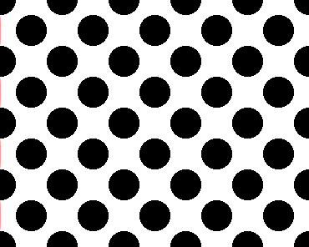
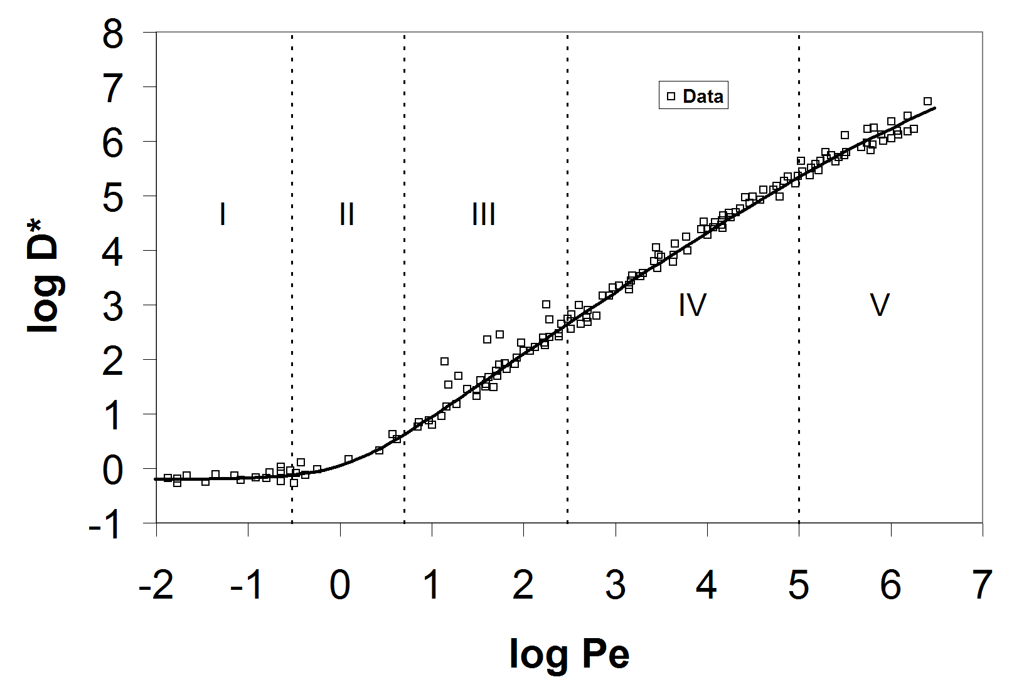
Peclet Number Correlations
Pfannkuch, H.O. 1963. Contribution a l’etude des deplacements de fluides miscibles dans un milieu poreux, Revue de l'Institut Francais du Petrole
Fried, J.J. and M.A. Combarnous, 1971. Adv. Hydroscience 7, 169-282.
Pe ≈ 25
D = D* D_{m} ≈ 0.1
D_{model} ≈ 0.004
Grubert, D. 1997. Int. J. Mod. Phys. B, 8(4) 817

Slide 76
Peclet Number Correlations

Slide 77
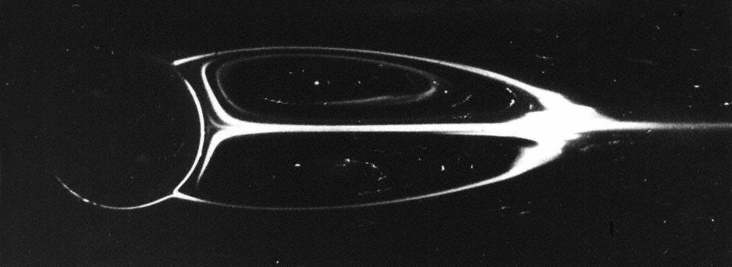
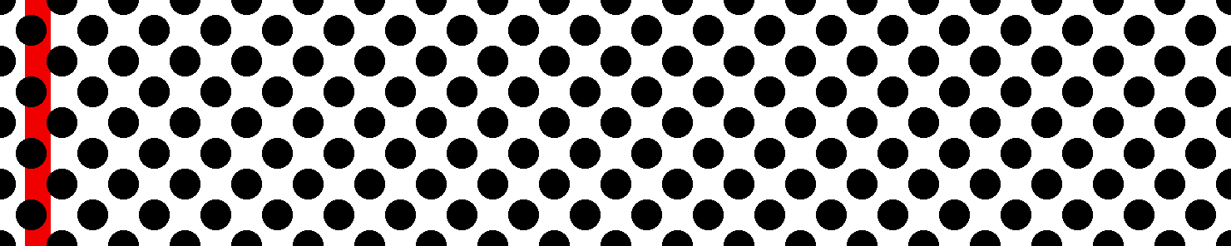
High Reynolds Number
Single cylinder, Re ≈ 41
Taneda, J. Fluid Mech. 1956. (Also Katachi Society web pages)

Slide 78

High Reynolds Number
Lattice gas version: Perea-Reeves, S.J. and H.W. Stockman, 1997. Chem. Eng. Sci. 52(19):3277-3286.

Slide 79
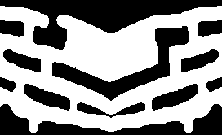
Diffusion, Dead End Pores, and Tailing

Slide 80
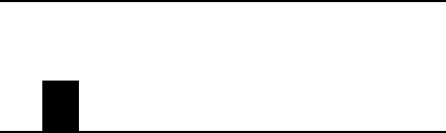
Re ~ 900

Slide 81
Buoyancy
Equation of State
Incorporation of buoyancy as a velocity perturbation

Slide 82

Buoyancy

Slide 83


Porous Media Flow Modeling with Lattice Boltzmann Methods
…
Earth Sciences
Florida International University
Notes:
1

Slide 84
Outline
Motivation
Lattice Boltzmann Method (LBM)
Macroscopic porous media
Anisotropic dispersion
  Analytical solution verification
Conduit/porous media domains

Slide 85
Motivation
Lattice Boltzmann models can simulate Navier-Stokes fluid motion and associated solute/heat diffusion: Good for fractures/conduits
Pore-scale LBM a LONG way from being applied to outcrop or larger scale problems, but:
  ‘Macroscopic’ porous media approach creates a Darcy’s Law solver that works at all scales
  Incorporation of anisotropic dispersion gives a standard CDE solver

Slide 86
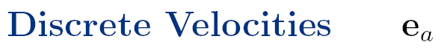
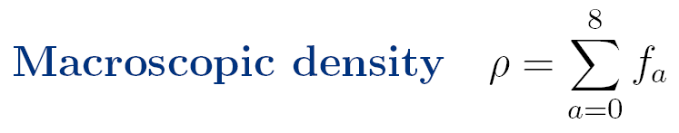
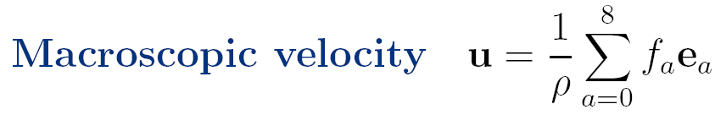
LBM Basics
6
2
5
e₆
e₂
e₅
3
e₃
0
e₁
1
e₄
e₇
e₈
Histogram view of the distribution function, f.
7
4
8
Lattice Unit, lu
f₂
f₆
f₅
f₃
f₀
f₁
f₇
f₈
f₄
Unfold
f
f
f₀
f₄
f₁
f₂
f₃
f₄
f₁
f₂
f₃
f₅
f₆
f₅
f₇
f₆
f₈
f₇
f₈
1
0
2
1
3
2
4
3
5
4
6
5
7
6
8
7
8
a
a
Notes:
Slide e and f with the pictures…

Slide 87
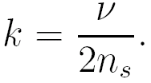
Porous Media
Balasubramanian, K., et al. (1987) Phys. Rev. A 36, 2248-2253
Dardis, O. and J. McCloskey (1998) Phys. Rev. E 57, 4834-4837
Dardis, O. and J. McCloskey (1998) Geophys. Res. Let. 25, 1471-1474
Freed, D.M. (1998) Int. J. Modern Phys C 9, 1491-1503
Consider the traditional collision step as a second intermediate step after streaming, denoted by f **:
Then the porous medium step has the form
where a´ is the index of the direction opposite e_{a}.
Permeability:
n_{s}=0, free-fluid
n_{s}=1, no-flow (but solute diffusion?)
a´
a
x+e_{a}Δt
x
Notes:
Porous media method is radical – allows arbitrary porosity without excessive resolution, allows transcending pore-scale.

Slide 88
Porous Media
Dardis, O. and J. McCloskey (1998) Phys. Rev. E 57, 4834-4837
Dardis, O. and J. McCloskey (1998) Geophys. Res. Let. 25, 1471-1474
Permeability:
Darcy’s Law:
u = -G*/(2n_{s}ρ)
Damping factor related to scatterer density n_{s}
Notes:
Porous media method is radical – allows arbitrary porosity without excessive resolution, allows transcending pore-scale.

Slide 89
Porous Media
Dardis, O. and J. McCloskey (1998) Phys. Rev. E 57, 4834-4837
Dardis, O. and J. McCloskey (1998) Geophys. Res. Let. 25, 1471-1474
Notes:
Porous media method is radical – allows arbitrary porosity without excessive resolution, allows transcending pore-scale.

Slide 90

Anisotropic Dispersion
When solute transport is simulated with this standard porous medium method, ‘dispersion’ is isotropic, which is incorrect:

Slide 91
Anisotropic Dispersion
δ_{αβ} is the Kronecker Delta and Γ_{L} and Γ_{T} are the longitudinal and transverse dispersivities respectively (δ_{αβ} = 1 for α = β)
Use results to determine dispersion tensor:

Slide 92
Anisotropic Dispersion
Zhang X, Bengough AG, Crawford JW, Young IM, 2002, A lattice BGK model for advection and anisotropic dispersion equation. Adv Wat Resour 25:1-8
Zhang X, Crawford JW, Bengough AG, Young IM, 2002, On boundary conditions in the lattice Boltzmann model for advection and anisotropic dispersion equation. Adv Wat Resour 25:601-609
Dispersion tensor:
Mass conservation:
Invert to solve for τs

Slide 93

Verification against analytical solution
Γ_{L}=0.5, Γ_{T}=0.1 lu
Periodic boundaries
Gravity forcing (v_{x}=0.01lu ts⁻¹,
v_{y}=0.005 lu ts⁻¹)
StAnMod 3DADE Analytical Solution
T = 15,000 ts
LBM Solution

Slide 94



Random K Field

Slide 95


Conduit with porous background
Re ≈ 1300

Slide 96
Conduit with porous background
Re ≈ 1300

Slide 97
Conduit with porous background
Re ≈ 1300

