Slide 1
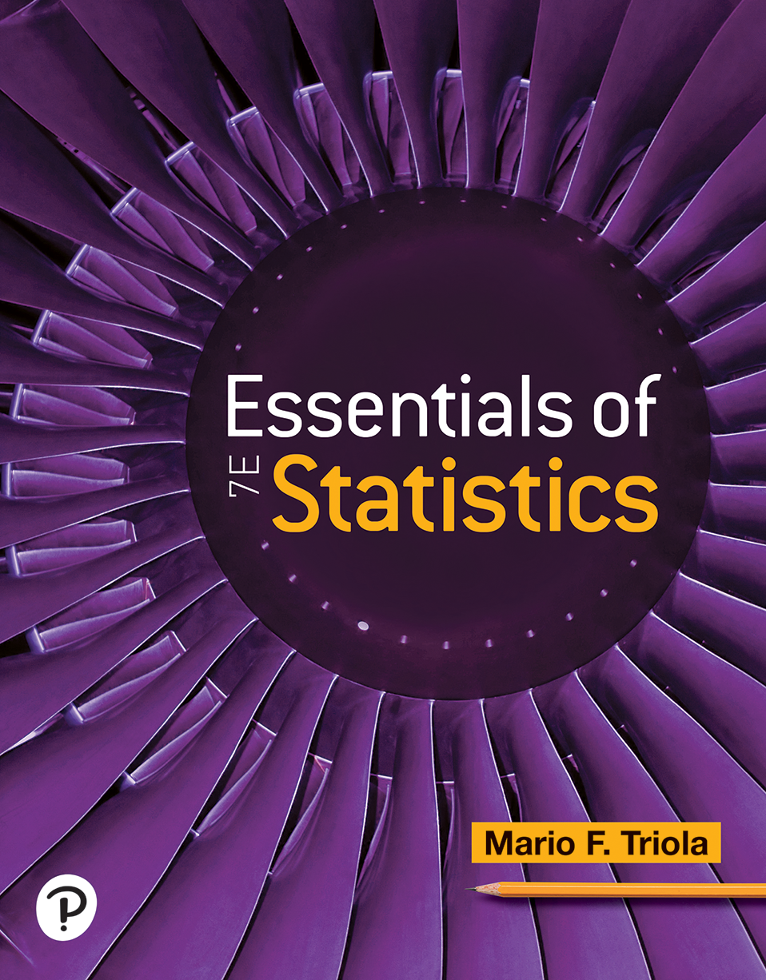

Essentials of Statistics
Seventh Edition
Chapter 10
Correlation and Regression
Copyright © 2023, 2019, 2015 Pearson Education, Inc. All Rights Reserved
Notes:
If this PowerPoint presentation contains mathematical equations, you may need to check that your computer has the following installed:
1) MathType Plugin
2) Math Player (free versions available)
3) NVDA Reader (free versions available)

Slide 2
Correlation and Regression
10-1 Correlation
10-2 Regression
10-3 Rank Correlation

Slide 3
Key Concept
We introduce the linear correlation coefficient r, which is a number that measures how well paired sample data fit a straight-line pattern when graphed. We use the sample of paired data (sometimes called bivariate data) to find the value of r, and then we use r to decide whether there is a linear correlation between the two variables.
We consider only linear relationships, which means that when graphed in a scatterplot, the points approximate a straight-line pattern. Then, we discuss methods for conducting a formal hypothesis test that can be used to decide whether there is a linear correlation between all population values for the two variables. Finally, we discuss a method of randomization whereby we resample many times to test the null hypothesis of no correlation.

Slide 4
Correlation
  Definition
  A correlation exists between two variables when the values of one variable are somehow associated with the values of the other variable.

Slide 5
Linear Correlation
  Definition
  A linear correlation exists between two variables when there is a correlation and the plotted points of paired data result in a pattern that can be approximated by a straight line.

Slide 6
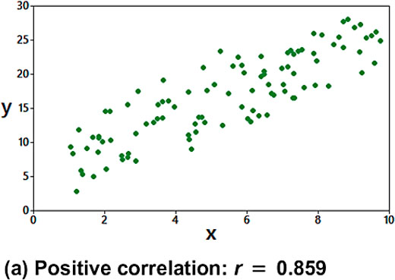
Interpreting Scatterplots (1 of 4)
Distinct straight-line, or linear, pattern. We say that there is a positive linear correlation between x and y, since as the x values increase, the corresponding y values also increase.
Notes:
The vertical axis ranges from 10 to 25, in increments of 5. The horizontal axis ranges from 0 to 10, in increments of 2. The points are scattered in a weak linear positive manner from (1, 2) to (10, 25). All values are estimated.

Slide 7
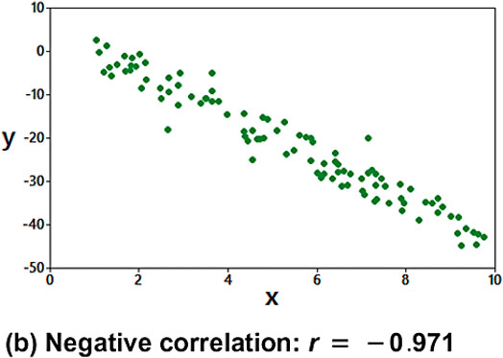
Interpreting Scatterplots (2 of 4)
Distinct straight-line, or linear pattern. We say that there is a negative linear correlation between x and y, since as the x values increase, the corresponding y values decrease.
Notes:
The vertical axis ranges from negative 50 to 10, in increments of 10. The horizontal axis ranges from 0 to 10, in increments of 2. The points are scattered in a strong linear negative manner from (1, 0) to (10, negative 48). All values are estimated.

Slide 8
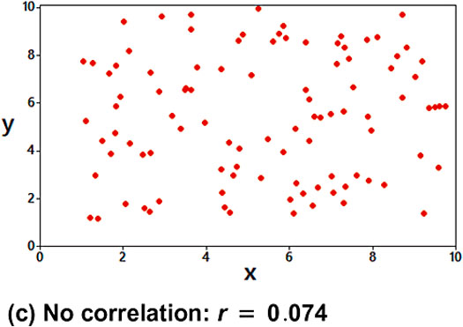
Interpreting Scatterplots (3 of 4)
No distinct pattern, which suggests that there is no correlation between x and y.
Notes:
The vertical axis ranges from 0 to 10, in increments of 2. The horizontal axis ranges from 0 to 10, in increments of 2. The points are scarcely scattered between (0, 1) and (1, 10) to (9, 1) and (9, 10). All values are estimated.

Slide 9
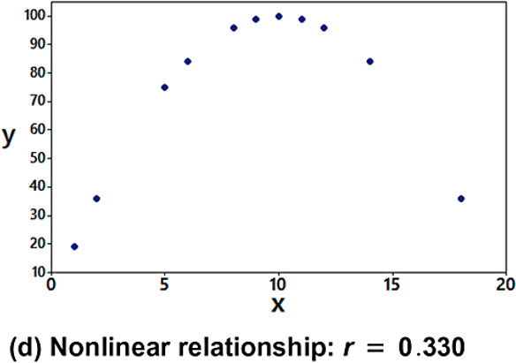
Interpreting Scatterplots (4 of 4)
Distinct pattern suggesting a correlation between x and y, but the pattern is not that of a straight line.
Notes:
The vertical axis ranges from 10 to 100, in increments of 10. The horizontal axis ranges from 0 to 20, in increments of 5. The points are scattered in a downward opening parabolic manner from (19, 1) to its peak at (10, 98), and ends at (18, 38). All values are estimated.

Slide 10
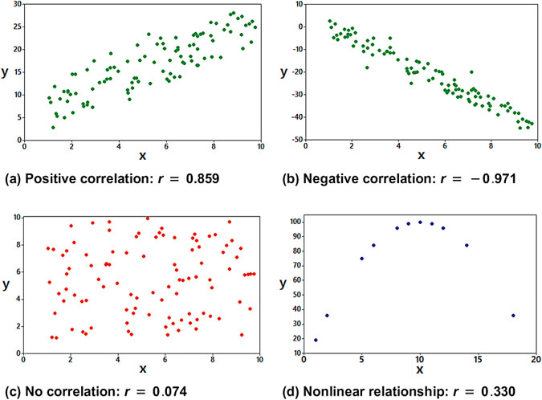
Measure the Strength of the Linear Correlation With r
We use the linear correlation coefficient r, which is a number that measures the strength of the linear association between the two variables.
Notes:
The mini tab window for a, positive correlation, r = 0.859, displays a scatterplot in the x y plane. The vertical axis ranges from 10 to 25, in increments of 5. The horizontal axis ranges from 0 to 10, in increments of 2. The points are scattered in a weak linear positive manner from (1, 2) to (10, 25). The mini tab window for b, negative correlation, r = negative 0. 971 displays a scatterplot in the x y plane. The vertical axis ranges from negative 50 to 10, in increments of 10. The horizontal axis ranges from 0 to 10, in increments of 2. The points are scattered in a strong linear negative manner from (1, 0) to (10, negative 48). The mini tab window for c, no correlation, r = 0.074, displays a scatterplot in the x y plane. The vertical axis ranges from 0 to 10, in increments of 2. The horizontal axis ranges from 0 to 10, in increments of 2. The points are scarcely scattered between (0, 1) and (1, 10) to (9, 1) and (9, 10). The mini tab window for d, non linear relationship, r = negative 0. 330 displays a scatterplot in the x y plane. The vertical axis ranges from 10 to 100, in increments of 10. The horizontal axis ranges from 0 to 20, in increments of 5. The points are scattered in a downward opening parabolic manner from (19, 1) to its peak at (10, 98), and ends at (18, 38). All values are estimated.

Slide 11
Linear Correlation Coefficient r
  Definition
  The linear correlation coefficient r measures the strength of the linear correlation between the paired quantitative x values and y values in a sample.
  The linear correlation coefficient r is computed by using Formula 10-1 or Formula 10-2, included in the following Key Elements box. [The linear correlation coefficient is sometimes referred to as the Pearson product moment correlation coefficient in honor of Karl Pearson (1857–1936), who originally developed it.]

Slide 12
Calculating and Interpreting the Linear Correlation Coefficient r (1 of 10)
Objective
Determine whether there is a linear correlation between two variables.

Slide 13
Calculating and Interpreting the Linear Correlation Coefficient r (2 of 10)
Notation for the Linear Correlation Coefficient
n number of pairs of sample data.
denotes addition of the items indicated.
sum of all x values.
indicates that each x value should be squared and then
those squares added.
indicates that the x values should be added and the total
then squared. Avoid confusing

Slide 14
Calculating and Interpreting the Linear Correlation Coefficient r (3 of 10)
Notation for the Linear Correlation Coefficient
indicates that each x value should first be multiplied
by its corresponding y value. After obtaining all such products, find their sum.
r linear correlation coefficient for sample data
linear correlation coefficient for a population of paired
data

Slide 15
Calculating and Interpreting the Linear Correlation Coefficient r (4 of 10)
Requirements
Given any collection of sample paired quantitative data, the linear correlation coefficient r can always be computed, but the following requirements should be satisfied when using the sample paired data to make a conclusion about linear correlation in the corresponding population of paired data.
The sample of paired (x, y) data is a simple random sample of quantitative data.
Visual examination of the scatterplot must confirm that the points approximate a straight-line pattern.

Slide 16
Calculating and Interpreting the Linear Correlation Coefficient r (5 of 10)
Requirements
Because results can be strongly affected by the presence of outliers, any outliers must be removed if they are known to be errors. The effects of any other outliers should be considered by calculating r with and without the outliers included*.
*Requirements 2 and 3 above are simplified attempts at checking this formal requirement: The pairs of (x, y) data must have a bivariate normal distribution.

Slide 17
Calculating and Interpreting the Linear Correlation Coefficient r (6 of 10)
Formulas for Calculating r
Formula 10-1
(Good format for calculations)
Notes:
r =start fraction n left parenthesis sum of x y right parenthesis minus left parenthesis sum of x right parenthesis left parenthesis sum of y right parenthesis over square root of start expression n left parenthesis sum of x squared right parenthesis minus left parenthesis sum of x right parenthesis squared end expression square root of start expression n left parenthesis sum of y squared right parenthesis minus left parenthesis sum of y right parenthesis squared end expression end fraction

Slide 18
Calculating and Interpreting the Linear Correlation Coefficient r (7 of 10)
Formulas for Calculating r
Formula 10-2
(Good format for understanding)
where
denotes the z score for an individual sample
value x and
is the z score for the corresponding
sample value y.

Slide 19
Calculating and Interpreting the Linear Correlation Coefficient r (8 of 10)
Rounding the Linear Correlation Coefficient r
Round the linear correlation coefficient r to three decimal places so that its value can be directly compared to critical values.

Slide 20
Calculating and Interpreting the Linear Correlation Coefficient r (9 of 10)
Interpreting the Linear Correlation Coefficient r
Using P-Value from Technology to Interpret r: Use
the P-value and significance level
as follows:
P-value
Supports the claim of a linear correlation.
P-value
Does not support the claim of a linear correlation.

Slide 21
Calculating and Interpreting the Linear Correlation Coefficient r (10 of 10)
Interpreting the Linear Correlation Coefficient r
Using Table A-6 to Interpret r: Consider critical values from Table A-6 or technology as being both positive and negative:
Correlation If
critical value, conclude that there is
sufficient evidence to support the claim of a linear correlation.
No Correlation If
critical value, conclude that there is
not sufficient evidence to support the claim of a linear correlation.

Slide 22
Properties of the Linear Correlation Coefficient r (1 of 2)
The value of r is always between
and 1 inclusive.
That is,
If all values of either variable are converted to a different scale, the value of r does not change.
The value of r is not affected by the choice of x or y. Interchange all x values and y values, and the value of r will not change.

Slide 23
Properties of the Linear Correlation Coefficient r (2 of 2)
​​r measures the strength of a linear relationship. It is not designed to measure the strength of a relationship that is not linear.
​r is very sensitive to outliers in the sense that a single outlier could dramatically affect its value.

Slide 24
Example: Finding r Using Technology (1 of 2)
Use technology to find the linear correlation coefficient r for the Powerball jackpot amounts and numbers of tickets listed in the table.
Jackpot | 334 | 127 | 300 | 227 | 202 | 180 | 164 | 145 | 255
Tickets | 54 | 16 | 41 | 27 | 23 | 18 | 18 | 16 | 26

Slide 25
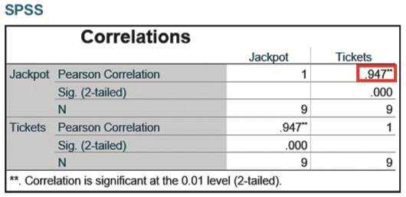
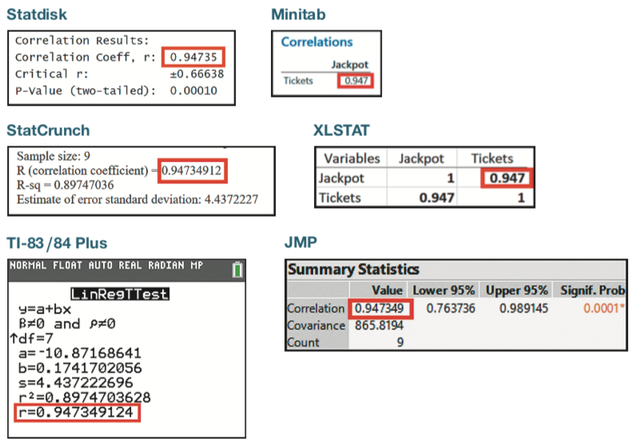
Example: Finding r Using Technology (2 of 2)
Solution
The value of r will be automatically calculated with software or a calculator. r = 0.947 (rounded).
Notes:
A stat disk output titled, Correlation results lists three lines. The lines are as follows. Line 1. Correlation coefficient, r, 0.94735. Line 2. Critical, r, + or minus 0.66638. Line 3. P value, two tailed, 0.00010. The value, 0.94735, is highlighted. A mini tab output titled, Correlations lists the jackpot value 0.947 for the entry, ticket. The value, 0.947, is highlighted. A stat crunch output, lists four lines. The lines are as follows. Line 1. Sample size, 9. Line 2. R, Correlation coefficient = 0.94734912, which is highlighted. Line 3. R squared = 0.89747036. Line 4. Estimate of error standard deviation, 4.43722227. An X L Stat window depicts a table. The table is as follows. The table has 2 Rows and 3 columns. The columns have the following headings from left to right. Variables, Jackpot, Tickets. The Row entries are as follows. Row 1. Jackpot, 1, 0.947. Row 2. Tickets, 0.947, 1. The second row first entry, 0.947, is highlighted. A graphing calculator screen titled, Lin Reg T Test, displays 8 lines. The lines are as follows. Line 1. Y = a + b x. Line 2. Beta does not equal 0 and roe does not equal 0. Line 3. Up arrow d f = 7. Line 4. a = negative 10.87168641. Line 5. b = 0.1741702056. Line 6. s = 4.437222696. Line 7. r squared = 0.8974703628. Line 8. r = 0.947349124. Line 8 is highlighted. A J M P output displays a table titled, Summary Statistics. The table is as follows. A Table has 3 Rows and 5 columns. The columns have the following headings from left to right. Parameter, Value, Lower 95%, Upper 95%, Significant Probability. The Row entries are as follows. Row 1. Correlation, 0.947349, 0.763736, 0.989145, 0.0001 asterisk. Row 2. Covariance, 865.8194, blank, blank, blank. Row 3. Count, 9, blank, blank, blank. The value 0.947349 is highlighted.
The table is as follows. The table has 6 Rows and 3 columns. The columns have the following headings from left to right. Correlations, Jackpot, Tickets. The Row entries are as follows. Row 1. Jackpot, Pearson Correlation, 1, 0.947 double asterisk. Row 2. Jackpot, Significance, 2 tailed, Blank, 0. Row 3. Jackpot, N, 9, 9. Row 4. Tickets, Pearson Correlation, 0.947 double asterisk, 1. Row 5. Tickets, Significance, 2 tailed, 0, Blank. Row 6. Tickets, N, 9, 9. Double asterisk, correlation is significant at the 0.01 level, 2 tailed. The row 1 column 3 entry, 0.947 double asterisk is highlighted.

Slide 26
Example: Finding r Using Formula 10-1 (1 of 3)
Use Formula 10-1 to find the linear correlation coefficient r for the Powerball jackpot amounts and numbers of tickets listed in the table.
Jackpot | 334 | 127 | 300 | 227 | 202 | 180 | 164 | 145 | 255
Tickets | 54 | 16 | 41 | 27 | 23 | 18 | 18 | 16 | 26

Slide 27
Example: Finding r Using Formula 10-1 (2 of 3)
Solution
The variable x is used for the jackpot amount, the variable y is used for the numbers of lottery tickets, there are 9 pairs of data, n = 9, and the other required values are computed in the table.
x Jackpot | y Tickets | ^{x squared} | y squared | x y
5334 | 54 | 111,556 | 2916 | 18,036
127 | 16 | 16,129 | 256 | 2032
300 | 41 | 90,000 | 1681 | 12,300
227 | 27 | 51,529 | 729 | 6129
202 | 23 | 40,804 | 529 | 4646
180 | 18 | 32,400 | 324 | 3240
164 | 18 | 26,896 | 324 | 2952
145 | 16 | 21,025 | 256 | 2320
255 | 26 | 65,025 | 676 | 6630
the sum of x = 1934 | the sum of y = 230 | the sum of x squared = 455,364 | the sum of y squared = 7691 | the sum of x y = 58,285

Slide 28
Example: Finding r Using Formula 10-1 (3 of 3)
Solution
Notes:
r =start fraction n left parenthesis sum of x y right parenthesis minus left parenthesis sum of x right parenthesis left parenthesis sum of y right parenthesis over square root of start expression n left parenthesis sum of x squared right parenthesis minus left parenthesis sum of x right parenthesis squared end expression square root of start expression n left parenthesis sum of y squared right parenthesis minus left parenthesis sum of y right parenthesis squared end expression end fraction
= start fraction 9 left parenthesis 58,285 right parenthesis minus left parenthesis 1934 right parenthesis left parenthesis 239 right parenthesis over square root of start expression 9 left parenthesis 455,364 right parenthesis minus left parenthesis 1934 right parenthesis squared end expression square root of start expression 9 left parenthesis 7961 right parenthesis minus left parenthesis 239 right parenthesis squared end fraction

Slide 29
Example: Finding r Using Formula 10-2 (1 of 6)
Use Formula 10-2 to find the linear correlation coefficient r for the Powerball jackpot amounts and numbers of tickets listed in the table.
Jackpot | 334 | 127 | 300 | 227 | 202 | 180 | 164 | 145 | 255
Tickets | 54 | 16 | 41 | 27 | 23 | 18 | 18 | 16 | 26

Slide 30
Example: Finding r Using Formula 10-2 (2 of 6)
Solution
If manual calculations are absolutely necessary, Formula 10-1 is much easier than Formula 10-2, but Formula 10-2 has the advantage of making it easier to understand how r works. The variable x is used for the jackpot amount, and the variable y is used for the numbers of lottery tickets sold. In Formula 10-2, each sample value is replaced by its corresponding z score.

Slide 31
Example: Finding r Using Formula 10-2 (3 of 6)
Solution
For example, using unrounded numbers, the jackpots
have a mean of
and a standard deviation of
so the first x value of 334 is converted to a
z score of 1.6894:

Slide 32
Example: Finding r Using Formula 10-2 (4 of 6)
Solution
The table on the next slide lists the z scores for all of the jackpot amounts (third column) and the z scores for all of the numbers of tickets (fourth column). The last
column of the table lists the products

Slide 33
Example: Finding r Using Formula 10-2 (5 of 6)
x (Jackpot) | y (Tickets) | ^{z sub x} | z sub y | ^{z sub x times z sub y}
5334 | 54 | 1.6894 | 2.1172 | 3.57680
127 | 16 | negative 1.2465 | negative 0.8143 | 1.01502
300 | 41 | 1.2071 | 1.1143 | 1.34507
227 | 27 | 0.1718 | 0.0343 | 0.00589
202 | 23 | negative 0.1828 | negative 0.2743 | 0.05014
180 | 18 | negative 0.4948 | negative 0.6600 | 0.32657
164 | 18 | negative 0.7218 | negative 0.6600 | 0.47639
145 | 16 | negative 0.9912 | negative 0.8143 | 0.80713
255 | 26 | 0.5689 | negative 0.0429 | negative 0.02441
Blank | Blank | Blank | Blank | the sum of z sub x times z sub y = 7.57862

Slide 34
Example: Finding r Using Formula 10-2 (6 of 6)
Solution
Using
the value of r is calculated:

Slide 35
Example: Is There a Linear Correlation? (1 of 10)
Using the value of r = 0.947 for the nine pairs of data in the table, and using a significance level of 0.05, is there sufficient evidence to support a claim that there is a linear correlation between Powerball jackpots and numbers of tickets sold?
Jackpot | 334 | 127 | 300 | 227 | 202 | 180 | 164 | 145 | 255
Tickets | 54 | 16 | 41 | 27 | 23 | 18 | 18 | 16 | 26

Slide 36
Example: Is There a Linear Correlation? (2 of 10)
Solution
Requirement Check
The data are a simple random sample, so the first requirement is satisfied.

Slide 37
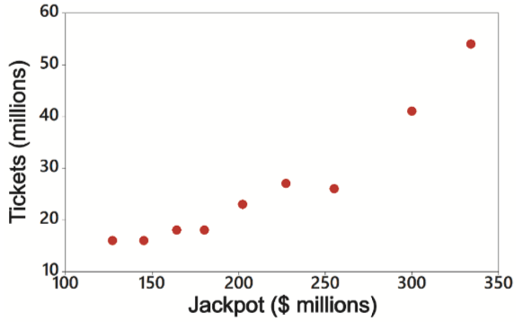
Example: Is There a Linear Correlation? (3 of 10)
Solution
Requirement Check
The second requirement of a scatterplot showing a straight-line pattern is satisfied.
Notes:
The vertical axis is labeled, Tickets, in millions and ranges from 10 to 60, in increments of 10. The horizontal axis is labeled, Jackpot, in million dollars and ranges from 100 to 350, in increments of 50. The data from the scatterplot is tabulated as follows. The table has 1 Rows and 10 columns. The columns have the following headings from left to right. Jackpot, 334, 127, 300, 227, 202, 180, 164, 145, 255. The Row entries are as follows. Row 1. Tickets, 54, 16, 41, 27, 23, 18, 18, 16, 26.

Slide 38
Example: Is There a Linear Correlation? (4 of 10)
Solution
Using P-Value from Technology to Interpret r: Use
the P-value and significance level
as follows:
P-value
Supports the claim of a linear correlation.
P-value
Does not support the claim of a linear
correlation.

Slide 39
Example: Is There a Linear Correlation? (5 of 10)
Solution
The Statdisk display shows that the P-value is 0.0001. Because the P-value is less than or equal to the significance level of 0.05, we conclude there is sufficient evidence to support the conclusion that for countries, there is a linear correlation between Powerball lottery jackpot amounts and numbers of tickets sold.
Statdisk
Correlation Results:
Correlation coeff, r: 0.94735
Critical r:
P-Value (two-tailed): 0.00010

Slide 40
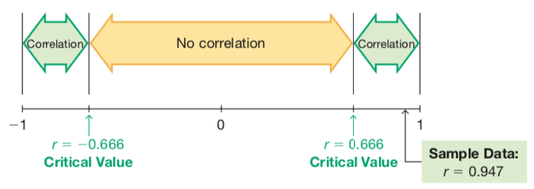
Example: Is There a Linear Correlation? (6 of 10)
Solution
Using Table A-6 to Interpret r: Consider critical values from Table A-6 as being both positive and negative, and draw a graph similar to the figure below.
Notes:
The distance between negative 1 and r = negative 0.666 and the distance between 1 and r = 0.666 are labeled, correlation. The distance between r = negative 0.666 and r = 0.666 is labeled, no correlation.

Slide 41
Example: Is There a Linear Correlation? (7 of 10)
Solution
For the 9 pairs of data, Table A-6 yields a critical value of
r = 0.666 and technology yields a critical value of r = 0.666. We can now compare the computed value of r = 0.947 to
the critical values of
Notes:
The distance between negative 1 and r = negative 0.666 and the distance between 1 and r = 0.666 are labeled, correlation. The distance between r = negative 0.666 and r = 0.666 is labeled, no correlation.

Slide 42
Example: Is There a Linear Correlation? (8 of 10)
Solution
Correlation If the computed linear correlation coefficient r lies in the left or right tail region beyond the critical value for that tail, conclude that there is sufficient evidence to support the claim of a linear correlation.
No Correlation If the computed linear correlation coefficient lies between the two critical values, conclude that there is not sufficient evidence to support the claim of a linear correlation.

Slide 43
Example: Is There a Linear Correlation? (9 of 10)
Solution
Because the figure shows that the computed value of r = 0.947 lies beyond the upper critical value, we conclude that there is sufficient evidence to support the claim of a linear correlation between Powerball jackpot amounts and numbers of tickets sold.
Notes:
The distance between negative 1 and r = negative 0.666 and the distance between 1 and r = 0.666 are labeled, correlation. The distance between r = negative 0.666 and r = 0.666 is labeled, no correlation.

Slide 44
Example: Is There a Linear Correlation? (10 of 10)
Interpretation
It appears that there is a linear correlation between lottery jackpot amounts and numbers of tickets sold. It appears that higher jackpots correspond to more tickets sold. In addition to the numbers, common sense and critical thinking also support this finding.
Although we have found a linear correlation, we should not conclude that one of the variables is a cause of the other. It is reasonable to believe that larger jackpots cause higher ticket sales, but that belief is not justified by the statistical analysis. Correlation does not imply causation.

Slide 45
Spurious Correlation
Definition
A spurious correlation is a correlation that doesn’t have an actual association.
Spurious correlations will become more common with the increased use of big data, and they are more likely to occur with time-series data that have similar trends.

Slide 46
Interpreting r: Explained Variation
The value of
is the proportion of the variation in y that
is explained by the linear relationship between x and y.

Slide 47
Example: Explained Variation (1 of 2)
Using the 9 pairs of data in the table, we get a linear correlation coefficient of r = 0.947. What proportion of the variation in numbers of tickets sold can be explained by the variation in jackpot amounts?
Jackpot | 334 | 127 | 300 | 227 | 202 | 180 | 164 | 145 | 255
Tickets | 54 | 16 | 41 | 27 | 23 | 18 | 18 | 16 | 26

Slide 48
Example: Explained Variation (2 of 2)
Solution
With r = 0.947 we get
Interpretation
We conclude that 0.897 (or about 90%) of the variation in numbers of tickets can be explained by the linear relationship between jackpot amounts and numbers of tickets sold. This implies that about 10% of the variation in the numbers of tickets sold cannot be explained by the linear correlation between the two variables.

Slide 49
Interpreting r With Causation: Don’t Go There!
Correlation does not imply causality!
We noted previously that there is sufficient evidence to support the claim of a linear correlation between lottery jackpot amounts and numbers of tickets sold. We should not make any conclusion that includes a statement about a cause-effect relationship between the two variables. We should not conclude that an increase in the jackpot amount will cause ticket sales to increase.

Slide 50
Common Errors Involving Correlation
Assuming that correlation implies causality
Using data based on averages
Ignoring the possibility of a nonlinear relationship

Slide 51
Formal Hypothesis Test (1 of 2)
Hypotheses If conducting a formal hypothesis test to determine whether there is a significant linear correlation between two variables, use the following
null and alternative hypotheses that use
to represent the linear correlation coefficient of the population:
Null Hypothesis
Alternative Hypothesis

Slide 52
Formal Hypothesis Test (2 of 2)
Test Statistic The same methods of Part 1 can be used with the test statistic r, or the t test statistic can be found using the following:
(with
degrees of freedom)
P-values and critical values can be found using technology or Table A-3 as described in earlier chapters.

Slide 53
Example: Hypothesis Test Using the P-Value from the t Test (1 of 5)
Use the paired data in the table to conduct a formal hypothesis test of the claim that there is a linear correlation between the two variables. Use a 0.05 significance level with the P-value method of testing hypotheses.
Jackpot | 334 | 127 | 300 | 227 | 202 | 180 | 164 | 145 | 255
Tickets | 54 | 16 | 41 | 27 | 23 | 18 | 18 | 16 | 26

Slide 54
Example: Hypothesis Test Using the P-Value from the t Test (2 of 5)
Solution
Requirement Check In a previous example, we noted that the requirements appear to be satisfied. To claim that there is a linear correlation is to claim that the
population linear correlation coefficient
is different from 0. We therefore have the following hypotheses:

Slide 55
Example: Hypothesis Test Using the P-Value from the t Test (3 of 5)
Solution
The linear correlation coefficient is r = 0.947 (from technology) and n = 23 (because there are 23 pairs of sample data), so the test statistic is
Notes:
t = start fraction start expression r over the square root of start expression start fraction 1 minus r squared over n minus 2 end fraction end expression end expression end fraction = start fraction start expression 0.947 over the square root of start expression start fraction 1 minus 0.947 squared over 9 minus 2 end fraction end expression end expression end fraction = 7.800

Slide 56
Example: Hypothesis Test Using the P-Value from the t Test (4 of 5)
Solution
With
degrees of freedom, Table A-3 shows
that the test statistic of t = 7.800 yields a P-value that is less than 0.01. Technologies show that the P-value is 0.000 when rounded. Because the P-value of 0.000 is less than the significance level of 0.05, we reject
(“If the P is low, the null must go.” Yup, the
P-value of 0.000 is low.)

Slide 57
Example: Hypothesis Test Using the P-Value from the t Test (5 of 5)
Interpretation
This formal hypothesis test results in the same conclusion as Example 4. It appears that there is a linear correlation between lottery jackpots amounts and numbers of tickets sold. It appears that higher jackpots correspond to more tickets sold.

Slide 58
One-Tailed Tests
The examples and exercises in this section generally involve two-tailed tests, but one-tailed tests can occur with a claim of a positive linear correlation or a claim of a negative linear correlation. In such cases, the hypotheses will be as shown here.
Claim of Negative Correlation (Left-Tailed Test) | Claim of Positive Correlation (Right-Tailed Test)
H sub 0 colon rho = 0 | H sub 0 colon rho = 0
H sub 1 colon rho is less than 0 | H sub 1 colon rho is greater than 0

Slide 59

Copyright
This work is protected by United States copyright laws and is provided solely for the use of instructors in teaching their courses and assessing student learning. Dissemination or sale of any part of this work (including on the World Wide Web) will destroy the integrity of the work and is not permitted. The work and materials from it should never be made available to students except by instructors using the accompanying text in their classes. All recipients of this work are expected to abide by these restrictions and to honor the intended pedagogical purposes and the needs of other instructors who rely on these materials.

