Slide 1
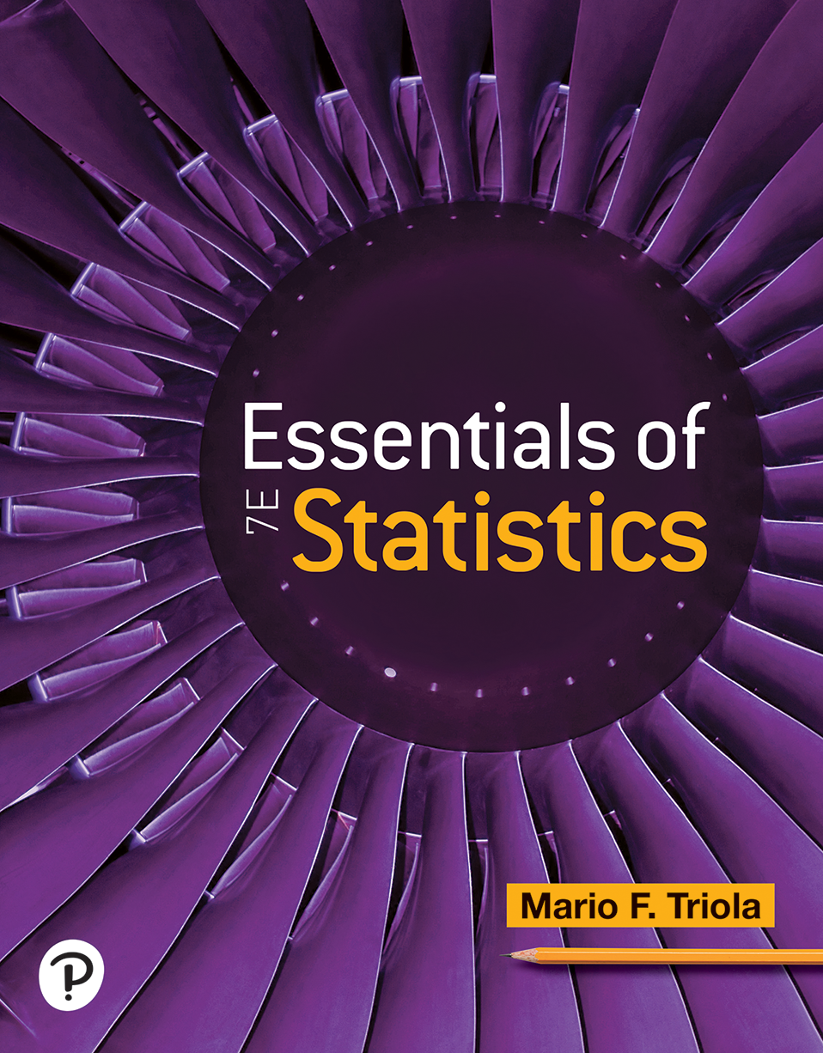

Essentials of Statistics
Seventh Edition
Chapter 10
Correlation and Regression
Copyright © 2023, 2019, 2015 Pearson Education, Inc. All Rights Reserved
Notes:
If this PowerPoint presentation contains mathematical equations, you may need to check that your computer has the following installed:
1) MathType Plugin
2) Math Player (free versions available)
3) NVDA Reader (free versions available)

Slide 2
Correlation and Regression
10-1 Correlation
10-2 Regression
10-3 Rank Correlation

Slide 3
Key Concepts
This section presents methods for finding the equation of the straight line that best fits the points in a scatterplot of paired sample data. That best-fitting straight line is called the regression line, and its equation is called the regression equation. Then we discuss marginal change, influential points, and residual plots as tools for analyzing correlation and regression results.

Slide 4
Regression Line
Definition
  Given a collection of paired sample data, the regression line (or line of best fit, or least-squares line) is the straight line that “best” fits the scatterplot of the data.

Slide 5
Regression Equation
Definition
  The regression equation
algebraically describes the regression line. The regression equation expresses a relationship between x (called the explanatory variable, or predictor variable,
or independent variable) and
(called the response
variable or dependent variable).

Slide 6
Finding the Equation of the Regression Line (1 of 6)
Objective
Find the equation of a regression line.
Notation for the Equation of a Regression Line
 | Sample Statistic | Population Parameter
y-intercept of regression line
Slope of regression line
Equation of the regression line

Slide 7
Finding the Equation of the Regression Line (2 of 6)
Requirements
The sample of paired (x, y) data is a random sample of quantitative data.
Visual examination of the scatterplot shows that the points approximate a straight-line pattern.*
Outliers can have a strong effect on the regression equation, so remove any outliers if they are known to be errors. Consider the effects of any outliers that are not known errors.*

Slide 8
Finding the Equation of the Regression Line (3 of 6)
Requirements
*Note: Requirements 2 and 3 are simplified attempts at checking these formal requirement for regression analysis:
For each fixed value of x, the corresponding values of y have a normal distribution.

Slide 9
Finding the Equation of the Regression Line (4 of 6)
Requirements
For the different fixed values of x, the distributions of the corresponding y-values all have the same standard deviation. (This is violated if part of the scatterplot shows points very close to the regression line while another portion of the scatterplot shows points that are much farther away from the regression line.)
For the different fixed values of x, the distributions of the corresponding y values have means that lie along the same straight line.

Slide 10
Finding the Equation of the Regression Line (5 of 6)
Formulas for Finding the Slope
and y-Intercept
in the Regression Equation
Slope:
y-intercept:

Slide 11
Finding the Equation of the Regression Line (6 of 6)
Rounding the Slope
and the y-Intercept
Round
to three significant digits. It’s difficult to
provide a simple universal rule for rounding values of
but this rule will work for most situations.

Slide 12
Example: Using Technology to Find the Regression Equation (1 of 9)
Use technology to find the equation of the regression line in which the explanatory variable (or x variable) is the amount of the lottery jackpot and the response variable (or y variable) is the corresponding number of lottery tickets sold. (Jackpot amounts are in millions of dollars and numbers of tickets sold are in millions.)
Jackpot | 334 | 127 | 300 | 227 | 202 | 180 | 164 | 145 | 255
Tickets | 54 | 16 | 41 | 27 | 23 | 18 | 18 | 16 | 26

Slide 13
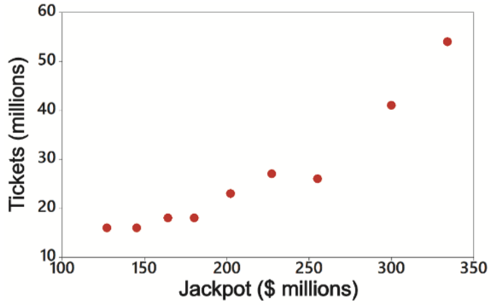
Example: Using Technology to Find the Regression Equation (2 of 9)
Solution
Requirement Check
(1) The data are a simple random sample.
(2) The scatterplot indicates that the pattern of points is reasonably close to a straight-line pattern.
(3) There are no outliers. The requirements are satisfied.
Notes:
The vertical axis is labeled, Tickets, in millions and ranges from 10 to 60, in increments of 10. The horizontal axis is labeled, Jackpot, in million dollars and ranges from 100 to 350, in increments of 50. The data from the scatterplot is tabulated as follows. The table has 1 Rows and 10 columns. The columns have the following headings from left to right. Jackpot, 334, 127, 300, 227, 202, 180, 164, 145, 255. The Row entries are as follows. Row 1. Tickets, 54, 16, 41, 27, 23, 18, 18, 16, 26.

Slide 14
Example: Using Technology to Find the Regression Equation (3 of 9)
Solution
Technology The use of technology is recommended for finding the equation of a regression line. Shown below are the results from different technologies. Minitab and X L S T A T provide the actual equation; the other technologies list the values of the y-intercept and the slope. All of these technologies show that the regression equation can be
expressed as
where
is the predicted number of tickets sold and x is the amount of the jackpot.

Slide 15
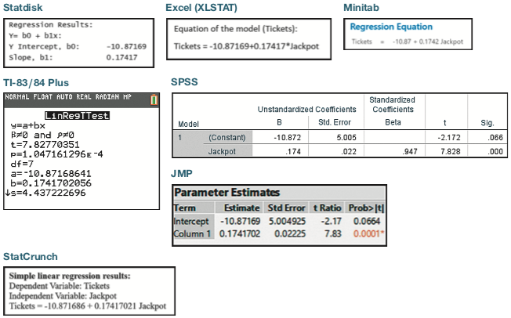
Example: Using Technology to Find the Regression Equation (4 of 9)
Notes:
A stat disk output titled, regression results lists three lines. The lines are as follows. Line 1. Y = b 0 + b 1 x. Line 2. Y intercept, b 0, negative 10.87169. Line 3. Slope, b 1, 0.17417. A excel, X L stat window titled, equation of the model, tickets, displays a line. Tickets = negative 10.87169 + 0.17417 asterisk Jackpot. A mini tab window titled, regression equation, displays a line. Tickets = negative 10.87 + 0.1742 Jackpot. A graphing calculator screen titled, L i n R e g T Test, displays 8 lines. The lines are as follows. Line 1. Y = a + b x. Line 2. Beta does not equal 0 and roe does not equal 0. Line 3. t = 7.82770351. Line 4. p = 1.047161296 E to the power of negative 4. Line 5. d f = 7. Line 6. a = negative 10.87168641. Line 7. b = 0.1741702056. Line 8. Down arrow s = 4.437222696. A stat crunch window titled, simple linear regression results displays three lines. The lines are as follows. Line 1. Dependent variable, tickets. Line 2. Independent variable, Jackpot. Line 3. Tickets = negative 10.871686 + 0.17417021 Jackpot. A S P S S window displays a table. The table is as follows. A Table has 2 Rows and 6 columns. The columns have the following headings from left to right. Model, Unstandardized coefficients, B, Unstandardized coefficients, Standard error, Standardized coefficients, Beta, T, significance. The Row entries are as follows. Row 1. 1, constant, Negative 10.872, 5.005, Blank, Negative 2.172, 0.066. Row 2. 1, Jackpot, 0.174, 0.022, 0.947, 7.828, 0. A J M P window lists a table titled, Parameter estimates. The table is as follows. The table has 2 Rows and 5 columns. The columns have the following headings from left to right. Term, Estimate, Standard error, T ratio, Probability greater than absolute value of t, . The Row entries are as follows. Row 1. Intercept, Negative 10.87169, 5.004925, Negative 2.17, 0.0664. Row 2. Column 1, 0.1741702, 0.02225, 7.83, 0.0001 asterisk.

Slide 16
Example: Using Technology to Find the Regression Equation (5 of 9)
Solution
We should know that the regression equation is an estimate of the true regression equation for the population of paired data. This estimate is based on one particular set of sample data, but another sample drawn from the same population would probably lead to a slightly different equation.

Slide 17
Example: Using Technology to Find the Regression Equation (6 of 9)
Use the first formulas for
to find the equation
of the regression line in which the explanatory variable (or x variable) is the jackpot amount and the response variable (or y variable) is the corresponding number of tickets sold.
Jackpot | 334 | 127 | 300 | 227 | 202 | 180 | 164 | 145 | 255
Tickets | 54 | 16 | 41 | 27 | 23 | 18 | 18 | 16 | 26

Slide 18
Example: Using Technology to Find the Regression Equation (7 of 9)
Solution
Requirement Check The requirements are previously verified.
We begin by finding the slope
as follows. Remember, r
is the linear correlation coefficient,
is the standard
deviation of the sample y values, and
is the standard
deviation of the sample x values.

Slide 19
Example: Using Technology to Find the Regression Equation (8 of 9)
Solution
After finding the slope
we can now find the y-intercept
as follows:

Slide 20
Example: Using Technology to Find the Regression Equation (9 of 9)
Solution
After rounding, the slope is
and the y-intercept
We can now express the regression equation
as
where
is the predicted number
of tickets sold and x is the amount of the jackpot.

Slide 21
Example: Graphing the Regression Line (1 of 2)
Graph the regression equation
on the scatterplot of the jackpot/tickets data from the previous examples and examine the graph to subjectively determine how well the regression line fits the data.

Slide 22
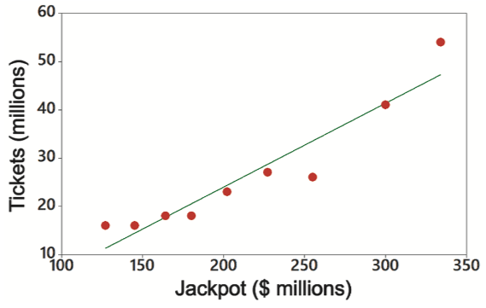
Example: Graphing the Regression Line (2 of 2)
Solution
Shown below is the Minitab display of the scatterplot with
the graph of the regression line included. The regression line appears to fit the points well, but the points are not very close to the line.
Notes:
The vertical axis is labeled, Tickets, in millions and ranges from 10 to 60, in increments of 10. The horizontal axis is labeled, Jackpot, in million dollars and ranges from 100 to 350, in increments of 50. The data from the scatterplot is tabulated as follows. The table has 1 Row and 10 columns. The columns have the following headings from left to right. Jackpot, 334, 127, 300, 227, 202, 180, 164, 145, 255. The Row entries are as follows. Row 1. Tickets, 54, 16, 41, 27, 23, 18, 18, 16, 26. A regression line starts at (127, 10), passes through (180, 18), (300, 41), and ends at (334, 48). All values are estimated.

Slide 23
Making Predictions (1 of 2)
Regression equations are often useful for predicting the value of one variable, given some specific value of the other variable. When making predictions, we should consider the following:
Bad Model: If the regression equation does not appear to be useful for making predictions, don’t use the regression equation for making predictions. For bad models, the best predicted value of a variable is simply its sample mean.
Good Model: Use the regression equation for predictions only if the graph of the regression line on the scatterplot confirms that the regression line fits the points reasonably well.

Slide 24
Making Predictions (2 of 2)
Correlation: Use the regression equation for predictions only if the linear correlation coefficient r indicates that there is a linear correlation between the two variables.
Scope: Use the regression line for predictions only if the data do not go much beyond the scope of the available sample data.
The figure on the next slide summarizes a strategy for predicting values of a variable y when given some value of x.

Slide 25
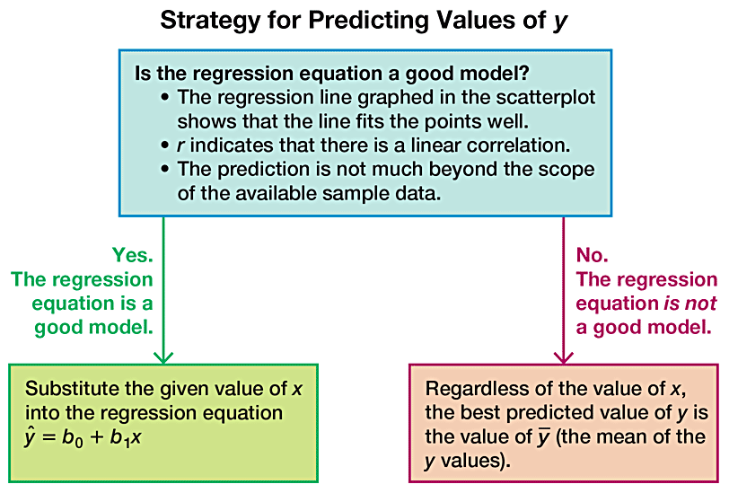
Strategy for Prediction Values of y
Notes:
The steps are as follows. Step 1. Is the regression equation a good model. The regression line graphed in the scatterplot shows that the line fits the points well. r indicates that there is a linear correlation. The prediction is not much beyond the scope of the available sample data. Step 2. If yes, The regression equation is a good model. Substitute the given value of x into the regression equation y hat = b sub 0 + b sub 1 x. If no, The regression equation is not a good model. Regardless of the value of x, the best predicted value of y is the value of y, the mean of the y values.

Slide 26
Example: Making Predictions (1 of 4)
a. Use the jackpot/tickets data to predict the number of lottery tickets sold when the jackpot is $625 million. How close is the predicted value to the actual value of 90 million tickets that were actually sold when the Powerball lottery had a jackpot of $625 million?
b. Predict the I Q score of an adult who is exactly 175 cm tall.

Slide 27
Example: Making Predictions (2 of 4)
Solution
a. ​Good Model: Use the Regression Equation for Predictions. The regression line fits the points well. Also, there is a linear correlation between Powerball jackpot amounts and numbers of tickets sold. Because the
regression equation
is a good model,
substitute x = 625 into the regression equation to get a predicted value of 97.9 million tickets sold. The actual number of tickets sold was 90 million, so the predicted value of 97.9 million tickets is pretty good.

Slide 28
Example: Making Predictions (3 of 4)
Solution
b. ​Bad Model: Use
for predictions. Knowing that
there is no correlation between height and I Q score, we know that a regression equation is not a good model, so the best predicted value of I Q score is the mean, which is 100.

Slide 29
Example: Making Predictions (4 of 4)
Interpretation
In part (a), the paired data result in a good regression model, so the predicted number of tickets sold is found by substituting the value of x = 625 into the regression equation. However, in part (b) there is no correlation between height and I Q, so the best predicted I Q score is
the mean I Q score of
Key point: Use the regression equation for predictions only if it is a good model. If the regression equation is not a
good model, use
for the predicted value of y.

Slide 30
Marginal Change (1 of 2)
Definition
  In working with two variables related by a regression equation, the marginal change in a variable is the amount that it changes when the other variable changes by exactly
  one unit. The slope
in the regression equation represents
  the marginal change in y that occurs when x changes by one unit.

Slide 31
Marginal Change (2 of 2)
Let’s consider the nine pairs of jackpot/ticket data. Those
nine pairs of data result in this regression equation:
The slope of 0.174 tells us that if we
increase the jackpot x by 1 (million dollars), the predicted number of tickets sold will increase by 0.174 million (or 174,000 tickets). That is, for every additional 1 million dollars added to the jackpot amount, we expect the ticket sales to increase by 174,000 tickets. This realization has led lottery officials to adjust their rules to make winning more difficult so that jackpots will grow considerably larger and drive greater lottery ticket sales.

Slide 32
Outlier
Definition
  In a scatterplot, an outlier is a point lying far away from the other data points.

Slide 33
Influential Points
Definition
  Paired sample data may include one or more influential points, which are points that strongly affect the graph of the regression line.

Slide 34
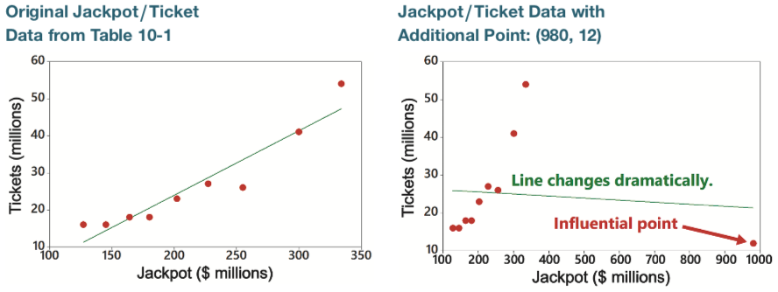
Example: Influential Points (1 of 2)
Consider the nine pairs of jackpot/tickets data. The scatterplot located to the left below shows the regression line. If we include an additional pair of data, x = 980 and y = 12, we get the regression line shown to the right below.
Notes:
First scatterplot plots tickets in millions versus Jackpot in millions of dollars. The horizontal axis ranges from 100 to 350 in increments of 50. The vertical axis ranges from 10 to 60 in increments of 10. The data points are populated sparsely between (130, 15) and (300, 43). A best fit line passes through (160, 16) and (300, 40). A text reads, Original Jackpot or Ticket Data from Table 10.1. Second scatterplot plots tickets in millions versus Jackpot in millions of dollars. The horizontal axis ranges from 100 to 1000 in increments of 100. The vertical axis ranges from 10 to 60 in increments of 10. The data points are populated densely between (130, 15) and (260, 28), and sparsely plotted between (300, 40) and (320, 55). An outlier labeled, influential point, is plotted at (980, 12). A regression line passes through (120, 28) and (1000, 22). A text reads, Jackpot or Ticket Data with Additional Point, (980, 12).

Slide 35
Example: Influential Points (2 of 2)
The additional point (980,12) is an influential point because the graph of the regression line did change considerably in the right graph. Compare the two graphs to see clearly that the addition of this one pair of values has a very dramatic effect on the regression line, so that additional point is an influential point. The additional point is also an outlier because it is far from the other points.

Slide 36
Residual
Definition
  For a pair of sample x and y values, the residual is the difference between the observed sample value of y and the y value that is predicted by using the regression equation. That is,

Slide 37
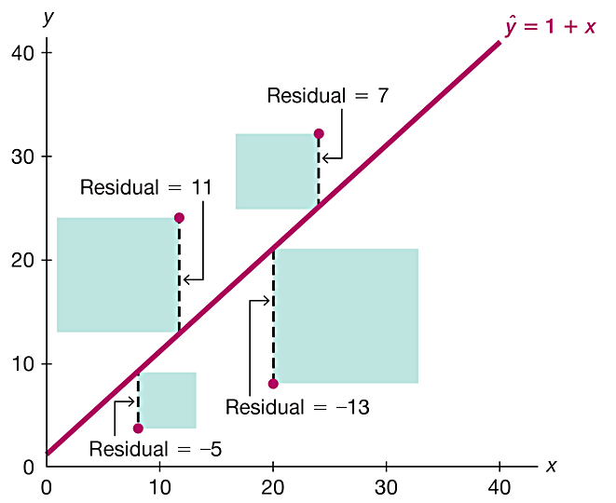
Residuals
Consider the sample point with coordinates of (8, 4).
Observed value: For x = 8, the corresponding observed value is y = 4.
Predicted value: If we substitute x = 8 into the regression equation of
x | 8 | 12 | 20 | 24
y | 4 | 24 | 8 | 32
we get the predicted value
Residual: The difference between the observed value and predicted value is the residual, so the residual
is
Notes:
The horizontal axis ranges from 0 to 40 in increments of 10. The vertical axis ranges from 0 to 40 in increments of 10. A line, y hat = 1 + x, rises through (0, 1), (10, 11), (20, 21), (30, 31), and (40, 41). Four points are plotted at (8, 2), (11, 23), (20, 6), and (14, 32). The line and the points are connected with dashed lines, and the vertical distance between the line and the points are shaded. The residuals between the points and the line are labeled as follows. The distance between the point (8, 2) and the line, residuals = negative 5. The distance between the point (11, 23) and the line, residuals = 11. The distance between the point (20, 6) and the line, residuals = negative 13. The distance between the point (14, 32) and the line, residuals = 7.

Slide 38
Least-Squares Property
Definition
  A straight line satisfies the least-squares property if the sum of the squares of the residuals is the smallest sum possible.

Slide 39
Residual Plots (1 of 2)
Definition
A residual plot is a scatterplot of the (x, y) values after each of the y-coordinate values has been replaced by the residual
value
(where
denotes the predicted value of y).
That is, a residual plot is a graph of the points

Slide 40
Residual Plots (2 of 2)
To construct a residual plot, draw a horizontal reference line through the residual value of 0, then plot the paired values of
Criteria for Residual Plot
  The residual plot should not have any obvious pattern.
  The residual plot should not become much wider (or thinner) when viewed from left to right.

Slide 41
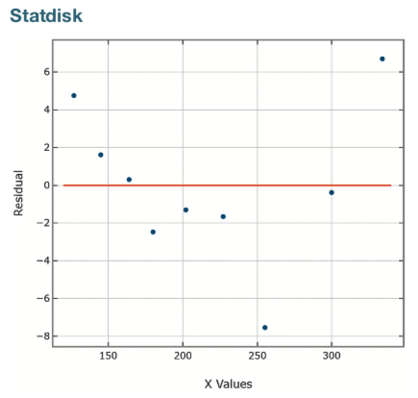
Example: Residual Plots
The jackpot/tickets data are used to obtain the accompanying Statdisk-generated residual plot, which is a plot of the
values.
See that this residual plot satisfies the preceding two general criteria for residual plots.
Notes:
The graph plots residuals versus x values. The horizontal axis ranges from 150 to 300 in increments of 50. The vertical axis ranges from negative 8 to 6 in increments of 2. The data points are plotted sparsely between (120, 4.3) and (255, negative 7.8). A line passes through residual = 0. All values are estimated.

Slide 42
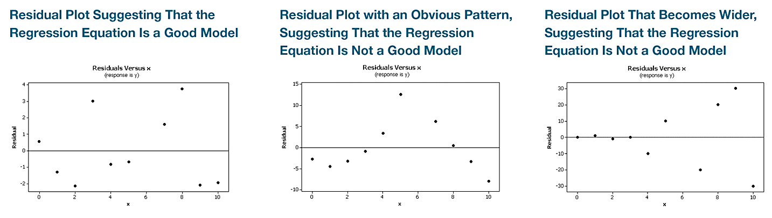
Residual Plots
See the three residual plots below. The leftmost residual plot suggests that the regression equation is a good model. The middle residual plot shows a distinct pattern, suggesting that the sample data do not follow a straight-line pattern as required. The rightmost residual plot becomes thicker, which suggests that the requirement of equal standard deviations is violated.
Notes:
The first residual plots residual versus x, response is y. The horizontal axis ranges from 0 to 10 in increments of 2. The vertical axis ranges from negative 2 to 4 in increments of 1. The data points are populated randomly across the plot, with no specific pattern. A text reads, residual plot suggesting that the regression equation is a good model. The second residual plots residual versus x, response is y. The horizontal axis ranges from 0 to 10 in increments of 2. The vertical axis ranges from negative 10 to 15 in increments of 5. The data points are populated as a concave up increasing curve between (0, negative 2) and (5, 13), and then the data points fall from (5, 13) to (10, negative 8). A text reads, residual plot with an obvious pattern, suggesting that the regression equation is not a good model. The third residual plots residual versus x, response is y. The horizontal axis ranges from 0 to 10 in increments of 2. The vertical axis ranges from negative 30 to 30 in increments of 10. The data points are populated horizontally between (0, 0) and (3, 0), and then a group of data points fall from (4, negative 10) to (10, negative 30). Another group of data points rise from (5, 10) to (9, 30). A text reads, residual plot that becomes wider, suggesting that the regression equation is not a good model. All values are estimated.

Slide 43

Copyright
This work is protected by United States copyright laws and is provided solely for the use of instructors in teaching their courses and assessing student learning. Dissemination or sale of any part of this work (including on the World Wide Web) will destroy the integrity of the work and is not permitted. The work and materials from it should never be made available to students except by instructors using the accompanying text in their classes. All recipients of this work are expected to abide by these restrictions and to honor the intended pedagogical purposes and the needs of other instructors who rely on these materials.

